Slide 1
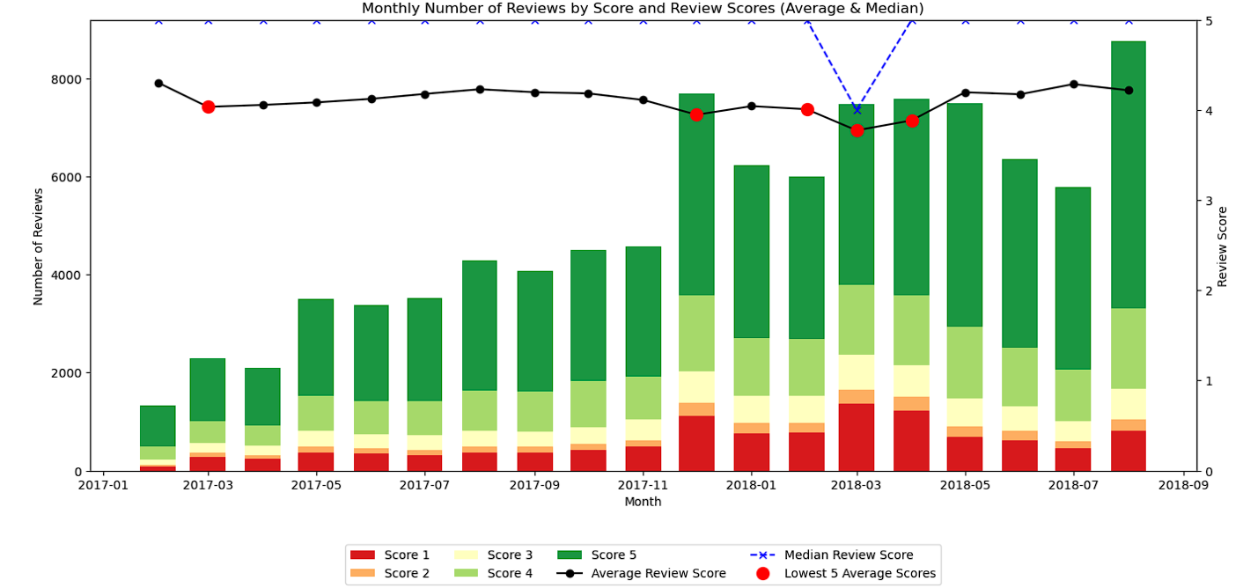
Long DELIVERY TIME and later-than-expected Deliveries significantly impact customer satisfaction
Review Score | Days Taken To Deliver Order (Median) | Days Taken To Deliver Order (75th Percentile) | Number of Later-Than-Expected Deliveries
1 | 16 | 30 | 3,412
5 | 9 | 13 | 1,045
Actionable:
Set KPI with delivery timings benchmarked to those seen in high review scores
2) Add in a bit more buffer when calculating estimated delivery time

Slide 2
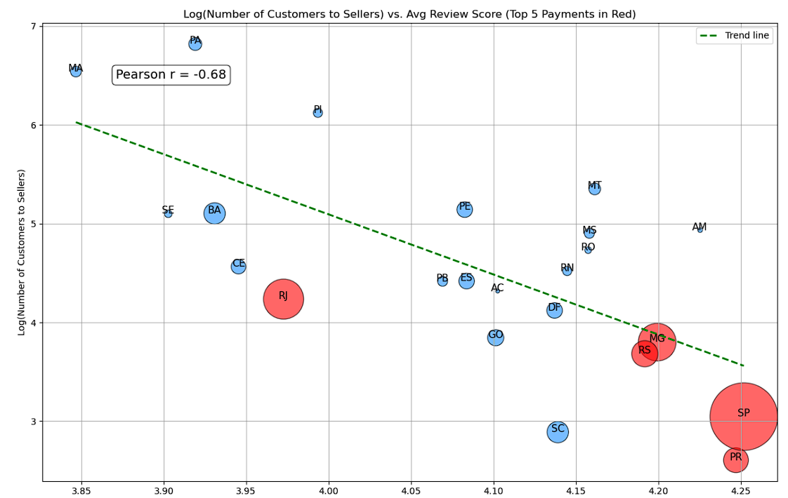
CUSTOMER-SELLER PROXIMITY correlated with customer satisfaction due to possible influence on delivery times
Actionable:
Prioritise onboarding of sellers in major cites in the state of Rio Janeiro.
Review Score | Days Taken To Deliver Order (Median) | Days Taken To Deliver Order (75th Percentile) | Number of Later-Than-Expected Deliveries
1 | 16 | 30 | 3,412
5 | 9 | 13 | 1,045
MG Average Delivery Time: 11.5 days
RJ Average Delivery Time: 14.8 days
RS Average Delivery Time: 14.8 days
SP Average Delivery Time: 8.3 days
PR Average Delivery Time: 11.5 days
Notes:
SP (São Paulo)
RJ (Rio de Janeiro)
MG (Minas Gerais)
RS (Rio Grande do Sul)
PR (Parana)

