Slide 1
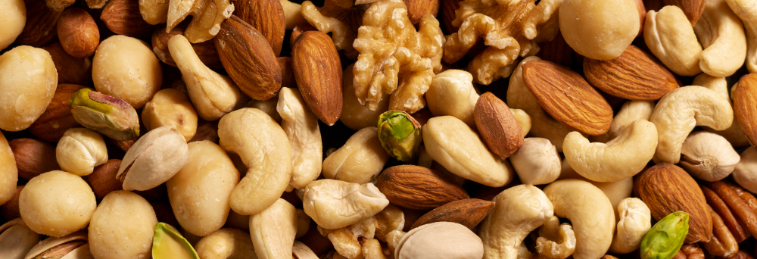

driving growth and efficiency in fmcg
@freepik
Through AI-powered insights

Slide 2
About the company
Lay of the land
Leading FMCG brand
99% offline sales (supermarket-led)
Export footprint across 20+ countries

Slide 3
Current Growth Impediments
House-brand competition: Price pressure and reduced shelf visibility limit offline growth
2. Manual inventory check and control: Slow, reactive process → lost sales and unnecessary waste
COMPANY FACING STAGNANT
GROWTH
Strategies To Accelerate Growth
IMPEDIMENTS & COUNTER STRATEGIES
Diversify revenue stream: Grow online sales and reach 50 export markets
Intelligent Inventory Management: Use forecasting and monitoring to optimize stock

Slide 4
Current siloed systems HINDER strategy implementation
PROBLEM STATEMENT
Target User | Strategies | Why Current System Hinders Implementation
C-suite | Diversify revenue stream | • No unified metrics platform → fragmented view • Slow, manual insight generation → hard to prioritise markets/channels • Result: Delayed decisions and slowed growth
Operations | Intelligent Inventory Management | • No sales data access → no demand forecasting • No unified view of outlet needs or routing • Result: Reactive inventory, stockouts/overstocks, higher costs, limited growth

Slide 5
USING 3Is TO PROPEL GROWTH
INTELLIGENCE, INTERACTIVITY, INNOVATION
Data Source
Key Features:
Unified platform integrating data to deliver user-specific metrics
Smart forecasting & route optimization
AI-driven insights for fast decision
24/7 conversational chatbot for instant, personalized answers
Internal Data (e.g. sales data, product info, inventory etc.)
LLMs: (e.g. OpenAI)
External Data (e.g. Route Information)
AI Layer
AI Analytics
Demand Forecasting
Unified Presentation / Application Layer
Executive Dashboards with Personalized Predictive Insights
(Intelligence)
AI Chatbot
(Interactivity)
AI Demand Forecast , Stock Monitoring, Delivery Route Optimization (Innovation)

Slide 6
IMPACT ANALYSIS FOR KEY FEATURES
IMPACT VERSUS EFFORT
High Impact
Unified platform
Conversational Chatbot
Story Mode Analytics
AI-powered insights on Platform
Smart Demand Forecasting & Route Optimization
High Effort
Low Effort
Restock Alert Notification
Personalised Customer Recommendation
Low Impact

Slide 7

3I-POWERED
DASHBOARD DEMO
@freepik

Slide 8
DESIRED OUTCOMES
HOW THE SOLUTION SUPPORTS STRATEGY IMPLEMENATION
Make quick, informed decisions on how to diversify revenue stream
Proactive inventory management optimised to reduce loss in revenue and costs
Accelerate growth
Notes:
© Copyright PresentationGo.com – The free PowerPoint template library

