Slide 1
Python for Dummies
Miquel Estévez Gay
IQCC
24 de juliol de 2017

Slide 2
Python for data science
Which is better for data analysis: R or Python? http://www.quora.com/Which-is-better-for-data-analysis-R-or-Python
SAS vs. R (vs. Python) – which tool should I learn? http://www.analyticsvidhya.com/blog/2014/03/sas-vs-vs-python-tool-learn/
Python Vs R Machine learninghttp://datascience.stackexchange.com/questions/326/python-vs-r-machine-learning
How to Choose Between Learning Python or R First http://blog.udacity.com/2015/01/python-vs-r-learn-first.html
Python, Machine Learning, and Language Wars http://sebastianraschka.com/blog/2015/why-python.html

Slide 3
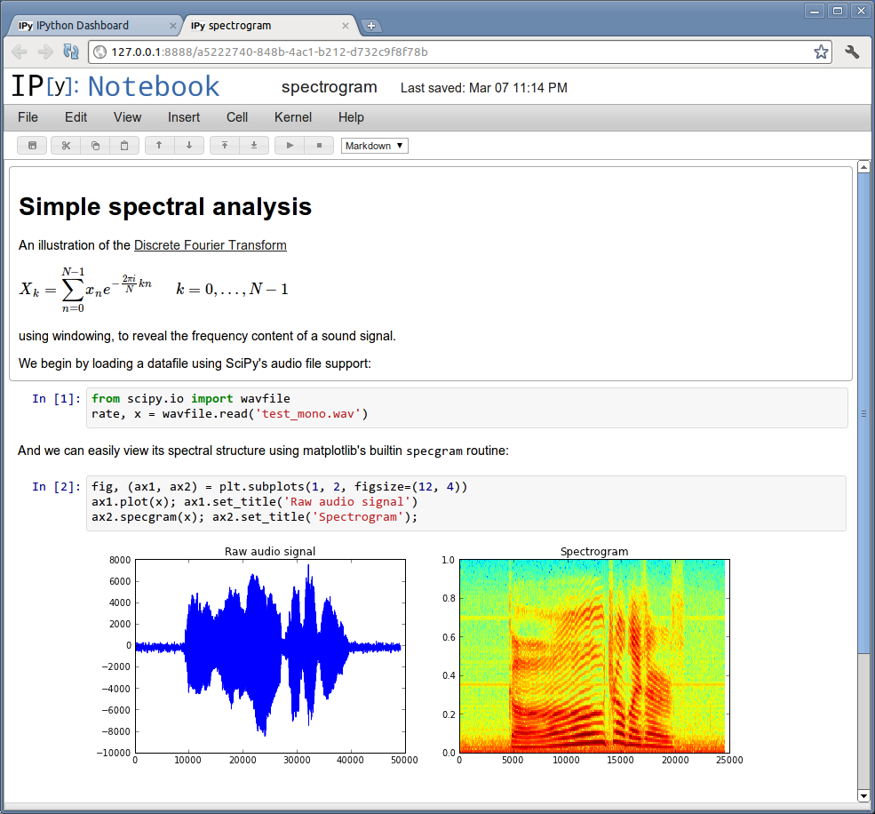
Interactive shells
python
IDLE
Jupyter (previously called ipython)
  shell
  notebook
spyder
eric
PIDA
Sage

Slide 4
Python distributions
Anaconda
  https://www.continuum.io/downloads
Enthought Canopy
  https://www.enthought.com/products/canopy/

Slide 5
Which python version?
Language is fast evolving
2 versions now coexist: 3.x and 2.x
These versions are not completely compatible
3.x is better and continued
2.x has some software still not ported
Both can safely coexisit
  Packages and shells are for a specific version
2to3 -w hello.py

Slide 6
Hello World program
print(“Hello World!”)
print(“Hello World!”)
$ python3 hello.py

Slide 7
Language elements
Integers
Floats
Numbers
Strings
Booleans
Lists
Tuples
Sets
Dictionaries

Slide 8
Numbers
Integers:
>>> i = 5
Floating point:
>>> x = 5.
>>> x = 5.0
Lesson 1. Exercise 1!
Swap the type of the number:
>>> x = 5 # x is a integer
>>> y = float(x) # y is a float

Slide 9
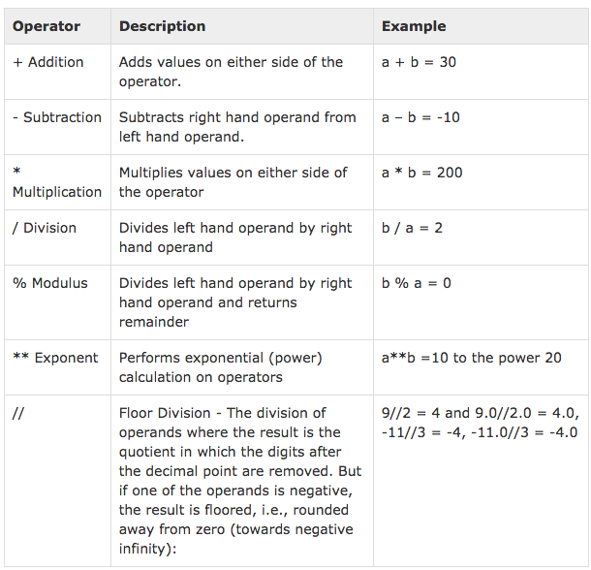
Basic Operators

Slide 10
Memory limitations
> i = 5
> j = i**i**i
Limited by amount of memory:
>>> i.bit_length()
3
>>> j = i**i**i
>>> j.bit_length()
7257

Slide 11
Equality and assignments
Equality (==):
> i = 43
> i == 42
False (Boolean)
Lesson 1. Exercise 2!
Assignments (=):
> i = 42
> print(i)
42
Explicit notation:
> i = i+1
> j = j / 10.
Short notation:
> i += 1
> j /= 10.

Slide 12
strings
Strings:
> str(6.7)
> c ='Hola'
Operations:
> s='numeric ' +'python'
> len(s)
> s[5]
'i'
> s.split()
['numeric', 'python']
> print('Result: %5.3f' % (11./3.))
3.667
Non mutable:
> s[6]
> s[6]='7' #Error!
Regular expressions
import re

Slide 13
Lists, sets and tuples
Heterogeneous containers:
> l=[6, 'a', [5,[9,8,7,6]], -6.5, (True, True)]
> [1,2]+[3,4]
> l.append(6)
sets:
s=set([4,3,2,3])
> 4 in s
True
> s
set([2, 3, 4])
Tuples are unmutable lists
t=(1,2,3)

Slide 14
Lists, sets and tuples
List indexing and methods:
> l = list(range(10))
> l[4] = 20
> l[4:]
> l[-4]
> l[:]
> l[::-1] #reverse
> l.reverse()
> l.pop()
> l.extend([3,4,5])
> l.sort()
Set methods:
> s1=set([1,2,3,4])
> s2=set([3,4,5,6,7])
> s1.union(s2)
> s1.intersection(s2)
> s1.difference(s2)
> s2.difference(s1)
> s1.intersection(s2) == s2 & s1
True
> s1 - s2 == s2 - s1
False
First index is 0

Slide 15
Uses of lists, sets and tuples
Calculate and keep all the primes < 1000
Given a coordinate file, calculate for each atom a list of all the atoms that are at less than 0.2nm.
Get the solutions of a quadratic equation (0,1,2) or (real vs. complex).
http://docs.python.org/3/tutorial/datastructures.html

Slide 16
Copying and looping over lists
lists are treated as pointers:
copying lists, makes a copy of the pointer.
> l=[1,2,3,4]
> l2=l
> l[2]=1000
l1
[1, 2 , 1000, 4]
Looping over lists: (I’ll focus an loops later)
Fortran/C style:
num=[2,3,2,3,4,5,5]
for i in range(len(num)):
print(num[i])
Pythonic style:
for item in num:
print(item)
This can be used for sets, dictionaries, and tuples.

Slide 17
Dictionaries
Setting elements:
> phone={}
> phone['Ramon']='1242'
> phone['Joan']='1323'
> phone['Quique']='1242'
> phone.keys()
['Quique', 'Joan', 'Ramon']
> d2 = dict(Ramon=1242, Joan=1323, Quique=1242)
Dictionaries are not ordered
Getting elements:
> for key in phone:
... print(key, phone[key])
Quique 1242
Joan 1323
Ramon 1242
Removing elements:
> del(phone['Ramon'])

Slide 18
The beauty of Python blocks
We are usually told to indent blocks for clarity.
Python makes this the syntax rule to identify blocks.
The code has to be nice!
Convention:
Use 4 spaces
Use spaces, not tabs.
while iter < maxIter:
x = f(x)
iter = iter + 1
if i>0:
print("i is positive")
elif i==0:
print("i is zero")
else:
print("i is negative")

Slide 19
Execution control: if
if... elif... else
if <condition>:
<block>
elif <condition>:
<block>
else:
<block>
4==4 #True
5!=4 #True
4>=5 #False
4 in [4,5] #True
result=True
if result: print('yes')

Slide 20
Execution control
Conditions can be combined with:
and or not ( )
Object identity:
> a=[1,2,3]
> b=a
> b is a
True
Any non-zero number or non-empty string is True:
> if []: print ('yes')
else: print('no')
no
> if 5 and 'result':
print('yes')
else:
print('no')
yes
> if 5 or 1/0: print('yes')
yes

Slide 21
for and while loops
For loops
> dict={4:'a',3:'b', 2:'c', 1:'d'}
> for i in dict:
print(i, dict[i])
While
while <condition>:
<block>
Break continue pass
> pass # does nothing
break: Exit loop
if x>0:
pass
else:
break
cycle: Continue with the next iteration

Slide 22
Mutable and immutable
>>> a = 4
>>> id(a)
9157088
>>> a += 2
>>> id(a)
9157152
>>> s = 'Hola'
>>> id(s)
140165884365656
>>> s = s+ ' que tal?'
>>> id(s)
140165884365712
>>> ll = [3,4,5]
>>> id(ll)
140165884674416
>>> ll.append(6)
>>> id(ll)
140165884674416
Mutable objects can be mutated.
  Their identity remains the same
Immutable objects are “mutated” by creating a new object

Slide 23
Identity and equality
>>> a = 4
>>> b = a
>>> a is b
True
>>> id(a)
9157088
>>> id(b)
9157088
>>> l1 = [1,2,3,]
>>> l2 = l1
>>> l2 = l1[:]
>>> l2 is l1
False
>>> l2 == l1
True
>>> 1.0 is 1.0
True
>>> 1.0 == 1.0
True
>>> 1 == 1.0
True
>>> 1 is 1.0
False

Slide 24
Objects: everything
>>> a = 5
>>> isinstance(a, int)
True
>>> object
<class 'object'>
>>> int
<class 'int'>
>>> isinstance(a, object)
True
>>> issubclass(int, object)
True
Objects have variables:
> c = 4+5j
> c.real
Objects have methods:
> c.conjugate #the method
> c.conjugate() #its call
And we can apply functions to objects:
> abs(c)

Slide 25
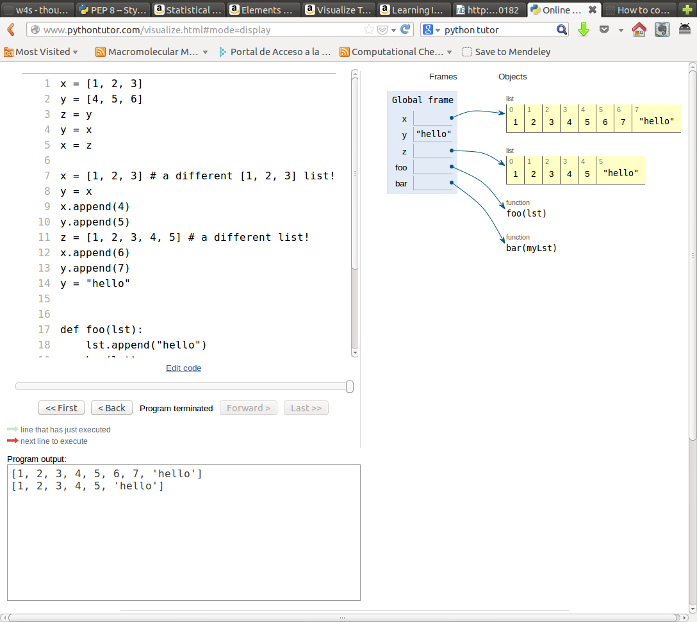
Python flow with pythontutor

Slide 26
try... except
“Look before you leap”:
def safe_divide_1(x, y):
if y==0:
print("Divide-by-0 attempt detected")
return None
else:
return x/y
“It's easier to ask forgiveness than permission”:
def safe_divide_2(x, y):
try:
return x/y
except ZeroDivisionError: print("Divide-by-0 attempt detected")
return None

