Slide 1


Slide 2
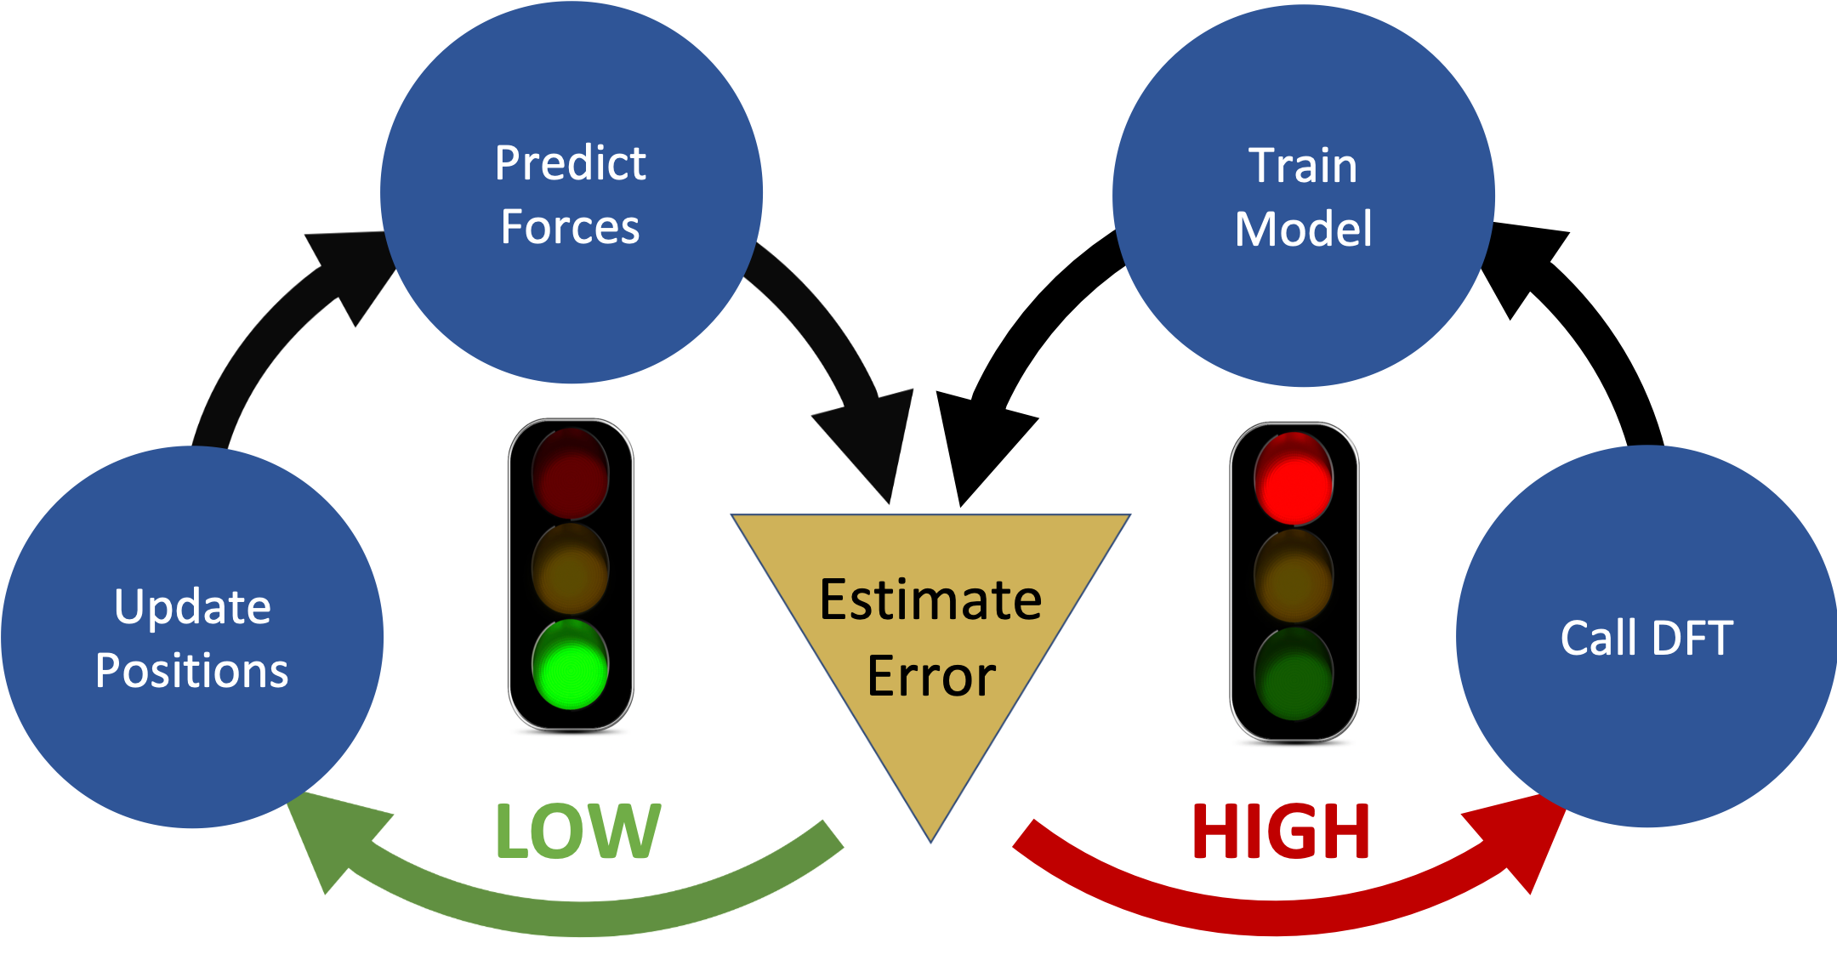

Slide 3
Structure
Atomic Environment
Kernels
Gaussian Process
On-the-fly Trainer

