Slide 1

Design and Implementation of
Library AI Assistant:
A RAG-Based Chatbot Using
Large Language Models (LLMs)
Mir Owahed Ali, Project Engineer (Content Curation), NDLI, IIT Kharagpur
Dr. B. Sutradhar, Librarian & Joint-PI, NDLI, Central Library, IIT Kharagpur

Slide 2
Problem Statement
Users struggle with keyword-based search limitations
Manual browsing across multiple web-pages and documents
LLMs alone produce hallucinations without domain-specific data
Static FAQs don't provide natural language queries

Slide 3
System Objectives
Semantic Search
Concise Responses
Provides relevant responses by understanding user's query, rather than keywords matching.
Summarized and brief answers from multiple documents without browsing.
Time Savings
Enhanced Discovery
Reduce staff workload and user search time significantly.
Quick access to library information through natural language queries.

Slide 4
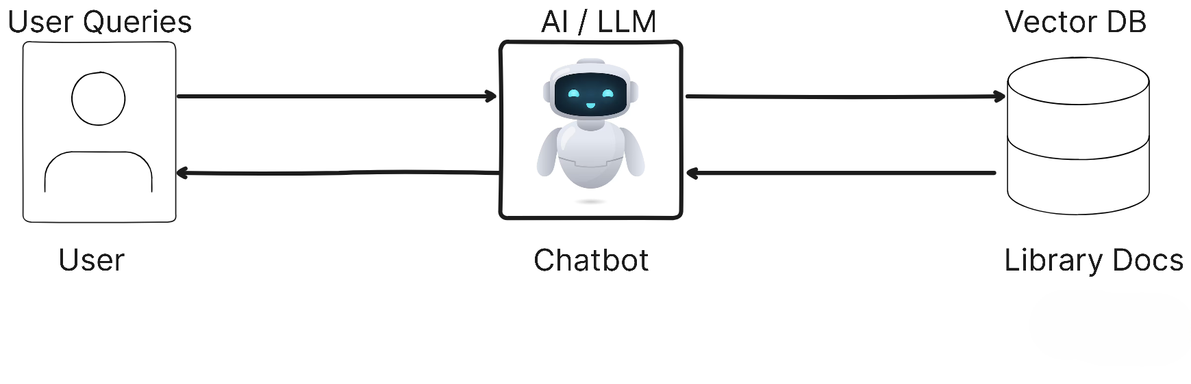
Retrieval Augmented Generation
(RAG)

Slide 5
RAG Pipeline Architecture
I. Data Ingestion Process
1. Data Collection
2. Parsing & Chunking
Website pages are crawled or scraped.
Lib docs in PDFs, PPTs etc. are collected.
Converted into Markdown/JSON.
Split into chunks (1k-2k) ch.
LLMs has a context window limit.
3. Embedding
Each text chunk is transformed vectors using OpenAI's text-embedding-3-small. Embedding dimensions like 1536 is used to capture the semantic relation.
4.Vector Storage
Store in FAISS, ChromaDB, or
Supabase. Cosine similarity is
used.
Each step is critical for building a robust RAG system

Slide 6
II. Query Retrieval & Response
01
02
03
User Query Input
Query Embedding
Similarity Search
Natural language question submitted via chat interface.
Convert query to vector using same embedding model.
Cosine similarity retrieves
top k=3-5 relevant chunks
from vector DB.
04
05
Context + System Prompt
Response Generation
Retrieved chunks sent to LLM with system prompt for guidance.
LLM (Mistral/LLaMA) generates
semantic, concise answer.

Slide 7
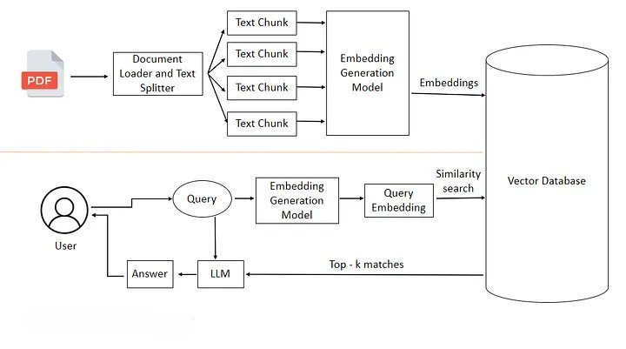
Retrieval Augmented Generation (RAG) Flow
Image source: Medium

Slide 8
Technical Implementation
Core Components
Deployment Options
LLMs: Meta Llama, Mistral, IBM Granite
Local: Ollama, Docker Model Runner (GPU/CPU)
Cloud: OpenRouter, Groq, HuggingFace APIs
Hybrid: Backend cloud-hosted,
Frontend integrated into library website
Embedding Models: nomic-embed-text,
OpenAI text-embedding-3-small
Vector DBs: FAISS, Supabase, ChromaDB
Framework: Python + LangChain, Flowise, Langflow
System Prompt Example
Analyzer: LangSmith
"Answer based only on retrieved documents. If information is unavailable, guide users to contact library support at library-support@example.com"
Memory: Buffer Window or PostgreSQL for chat session.

Slide 9
Results & Performance
Sample Query Demonstrations
Query: "how to check my written paper originality"
Query: "late fine charge of book"
Query: "how to get sem question paper"
Response: "Use Turnitin plagiarism check. Upload document and send request to Digital Library with Class ID, Author Name, Title, Submission ID. Contact: console@library.iitkgp.ac.in"
Response: "One rupee (Rs. 1/-) per day per book as overdue charge."
Response: "Access via http://10.18.24.75/peqp/. For unlisted papers, email console@library.iitkgp.ac.in"
System demonstrates semantic responses—user terms not in source docs still retrieve
accurate responses. Monitoring via LangSmith shows 0.70s–3.50s latency.

Slide 10
Future work & Improvement
Metadata Integration
Connect DB of library catalogue and Institutional Digital Repository for semantic resource discovery.
Multilingual Support
Enable Hindi, Bengali, and regional language queries for broader accessibility.
Service Insights
Analyze query patterns to identify gaps and introduce new library services.

Slide 11
Conclusion
This RAG-powered AI chatbot successfully demonstrates
Intelligent, accurate library support systems.
Flexible deployment (local/cloud), chat memory, and
monitoring tool.
Next-generation smart libraries.
Questions if any

