Slide 1
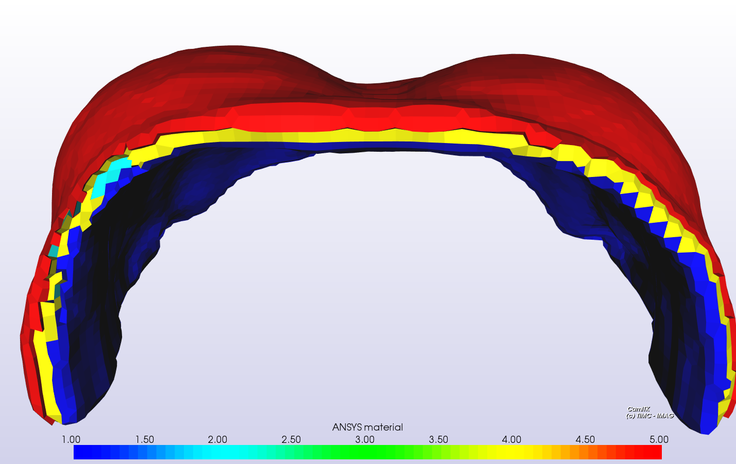
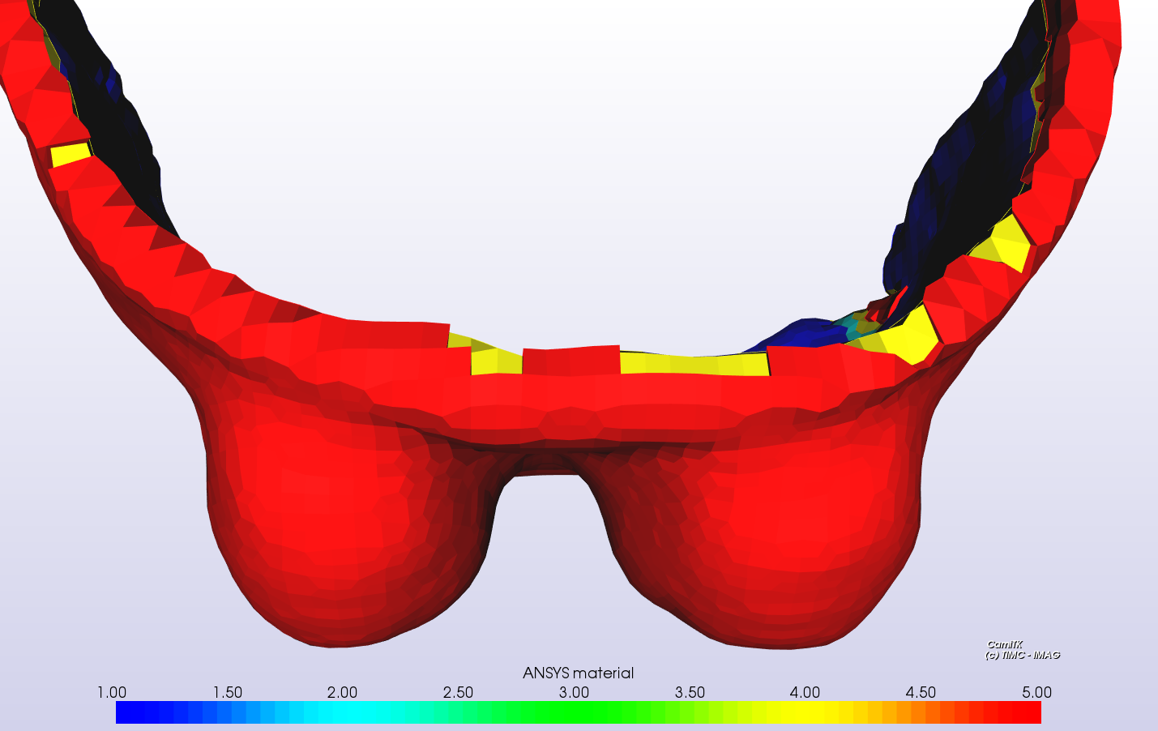
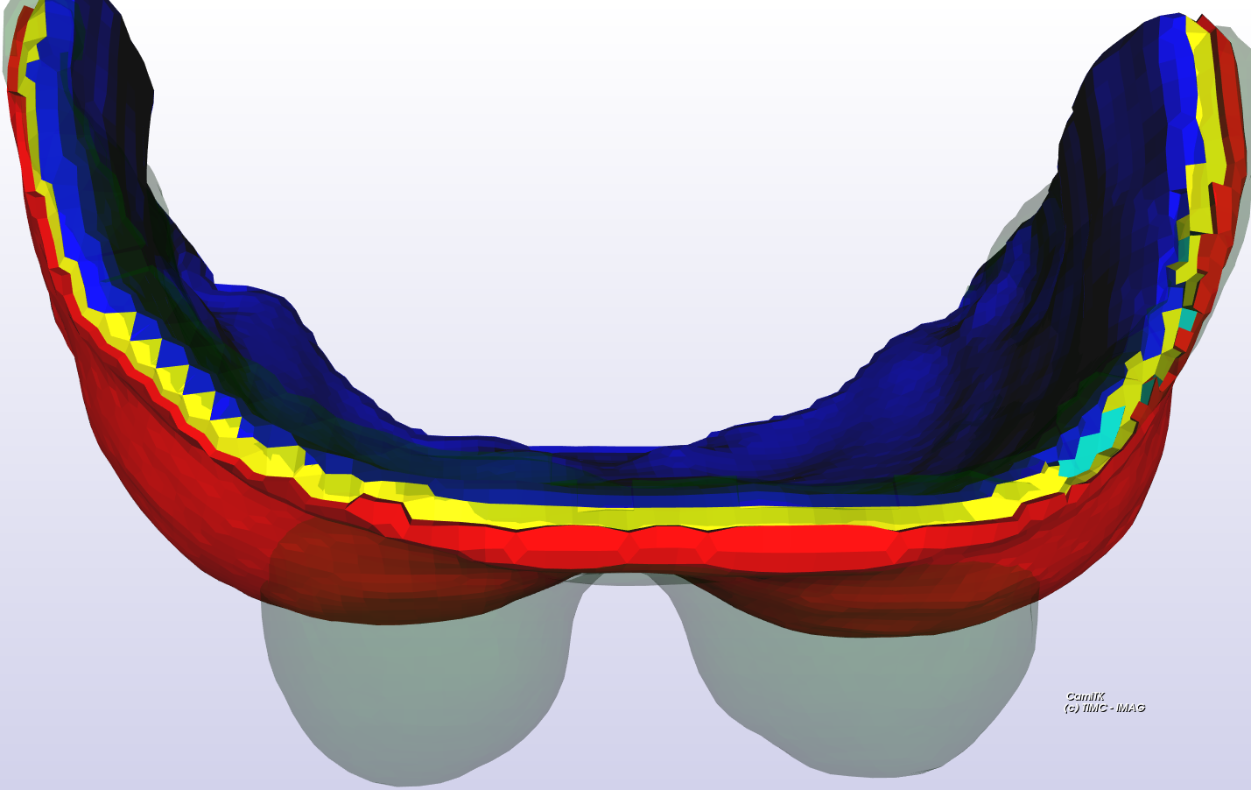
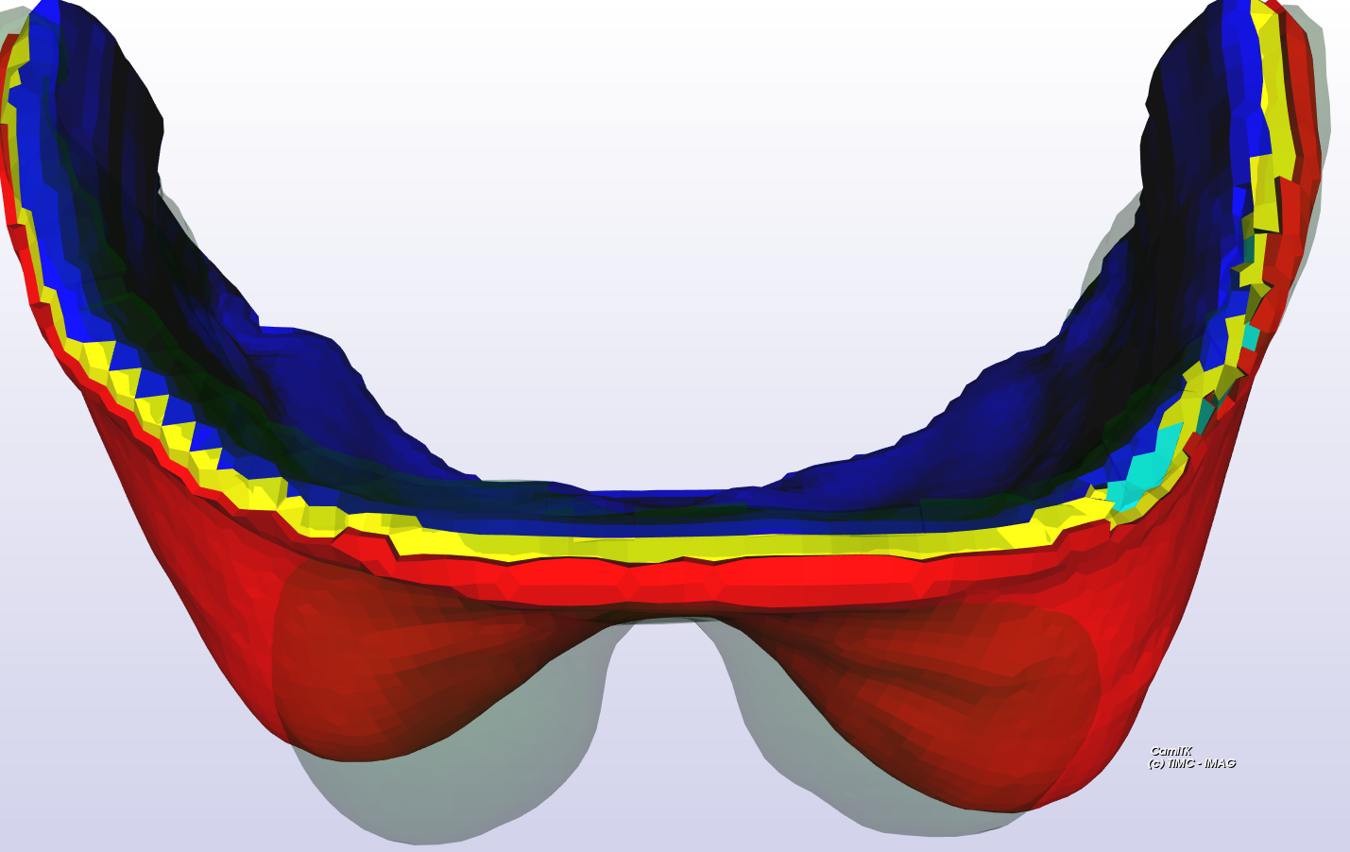
Ansys simulations with homogeneous material
Experimental
supine configuration
d) Experimental
prone configuration
b) Estimated prone vs prone
E=10kPa
c) Estimated prone vs prone
E=0.5kPa

Slide 2
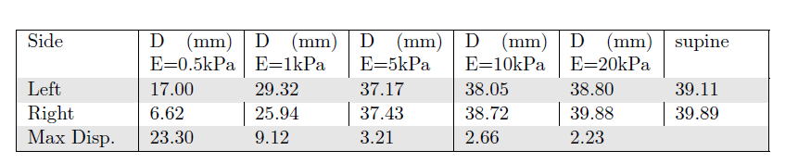
Ansys simulations with homogeneous material
Euclidian distance from nipple position from MR images in prone configuration to the nipple position in estimates prone configuration for different values of breast elastic modulus.

Slide 3
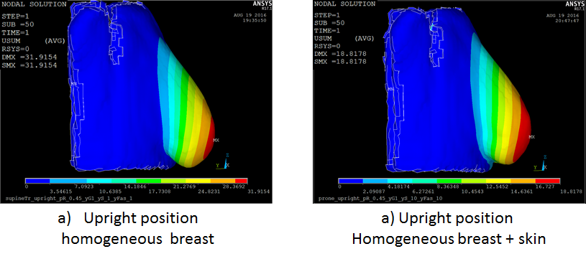
Skin impact in breast mechanics
In fig a) homogeneous breast with elastic modulus equal to 1kPa; in fig b) homogeneous breast with elastic modulus equal to 1kPa + a skin layer with elastic modulus equal to 10 kPa.

Slide 4
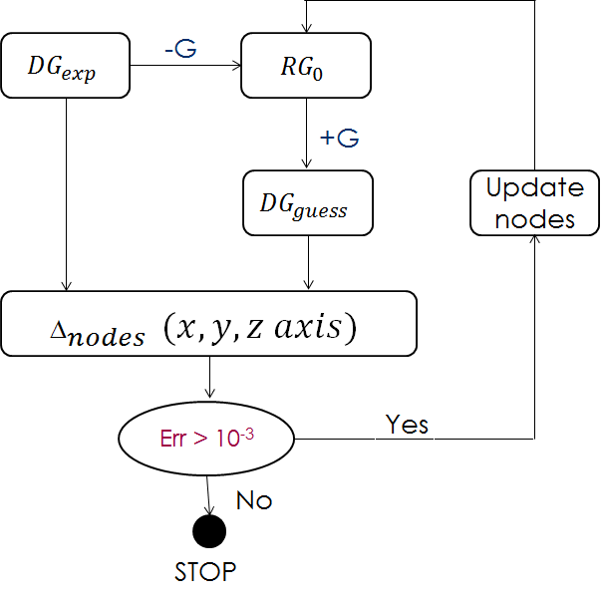
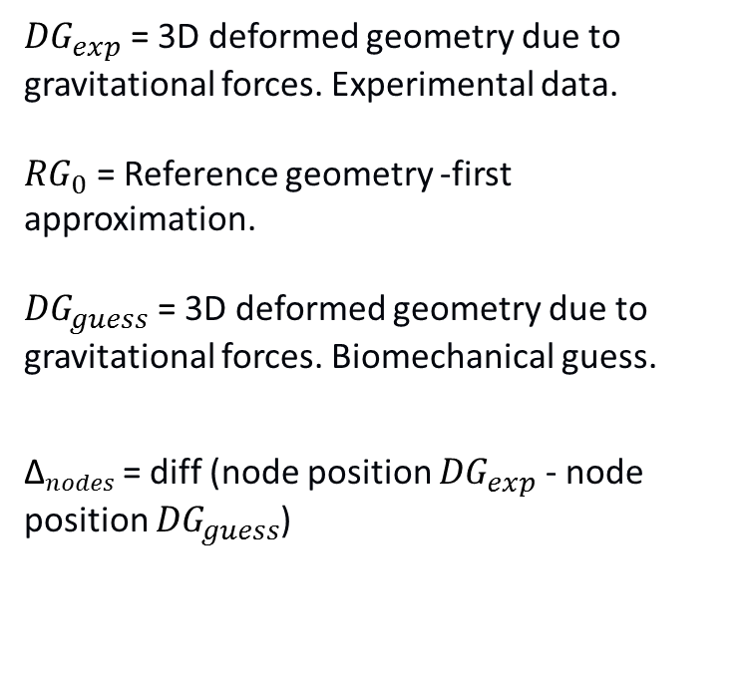
Iterative algorithm for stress-free geometry estimation .
${DG}_{exp}$ = 3D deformed geometry due to gravitational forces. Experimental data.
${RG}_{0}$ = Reference geometry -first approximation.
${DG}_{guess}$ = 3D deformed geometry due to gravitational forces. Biomechanical guess.
${\text{∆}}_{nodes }$= diff (node position ${DG}_{exp}$ - node position ${DG}_{guess}$)

Slide 5
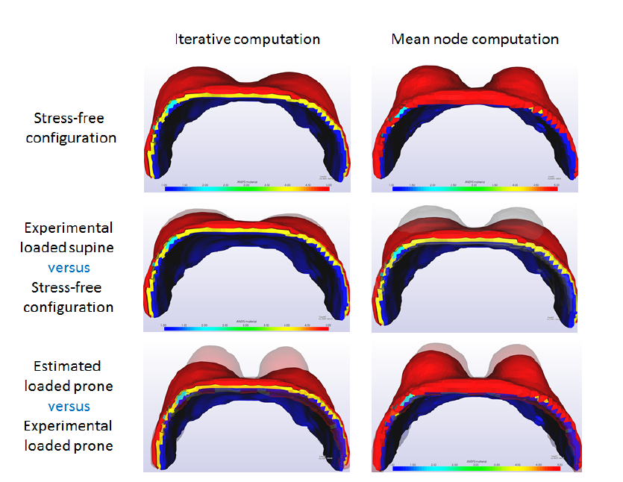
Stress-free geometry estimation.
Ansys simulation with: poisson ratio equal to 0.45, and elastic modulus of muscle equal to 30 kPa, Skin to 10 kPa and breast to 0.5 kPa.

Slide 6
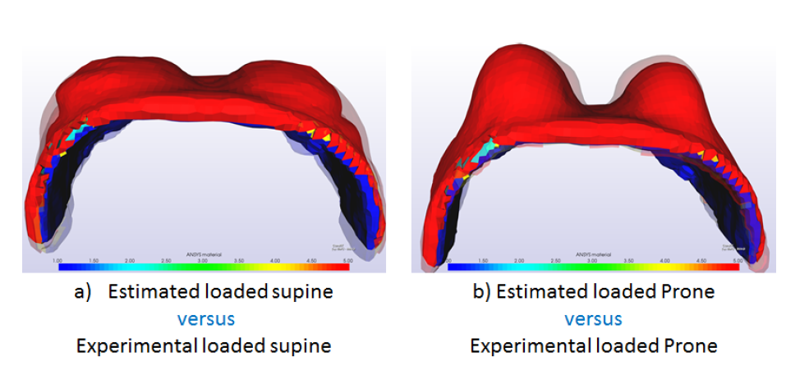
Prone and Supine estimation
Prone and supine estimation from “stress-free” geometry computed with mean node position. Three types of tissues: muscle breast and skin. Poisson ratio equal to 0.45 for all tissues types. Elastic modulus equal to 30 kPa for muscle, 10 kPa fosr skin ans 0.3kPa for breast.

