Slide 1
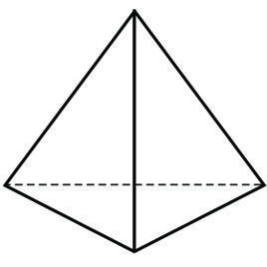
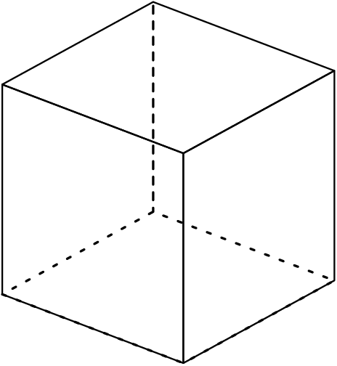
Strong form of GMB
Weak form of GMB
(principle of virtual work)
Numerical system of equations
Partial integration
Galerkin’s approximation method
1
Linear element type
Quadratic element type
2D
3
2
3D
a)
b)

Slide 2
a)
Reference configuration
Current configuration
b)

Slide 3





$$Γ_{B}$$
$$Γ_{A}$$
$$Γ$$
$$Ω_{A}$$
$$Ω_{B}$$

Slide 4
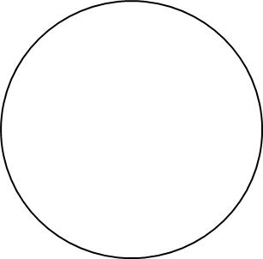
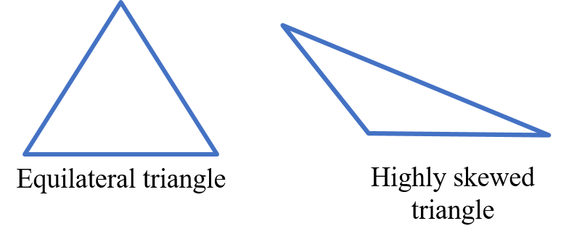

Slide 5








$$Ω_{A}$$
$$Γ_{A}$$
$$𝓍_{A}$$
$$\vec{n_{B}}$$
$$d_{1}({\text{𝓍}}_{B}, Γ_{A})$$
$$𝓍_{B}$$
$$Ω_{B}$$
$$Γ_{B}$$

Slide 6


$$Ω_{A}$$
$$Γ_{A}$$
$$𝓍_{B}$$
$$Ω_{B}$$
$$Γ_{B}$$

Slide 7






$$Ω_{A}$$
$$𝓍_{B}$$
$$Γ_{A}$$
$$\vec{n_{B}}$$
$$d_{1}({\text{𝓍}}_{B}, Γ_{A})$$
$$𝓍_{A}$$
$$Ω_{B}$$
$$Γ_{B}$$

Slide 8
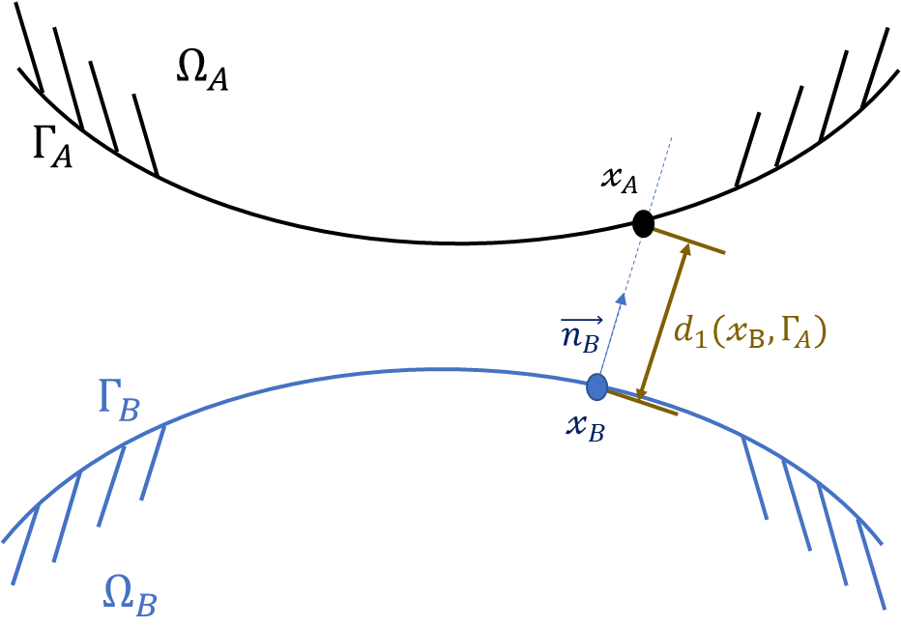
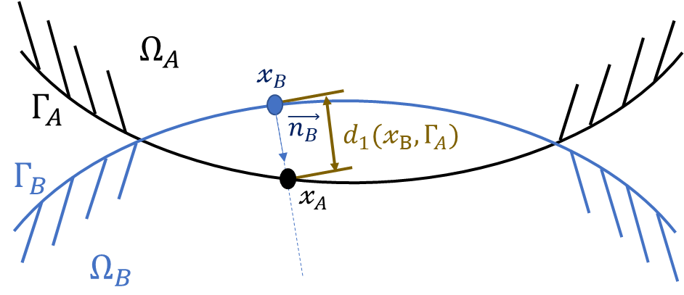
a)
b)

