Slide 1
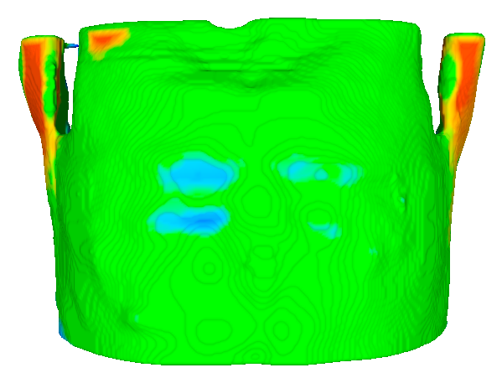
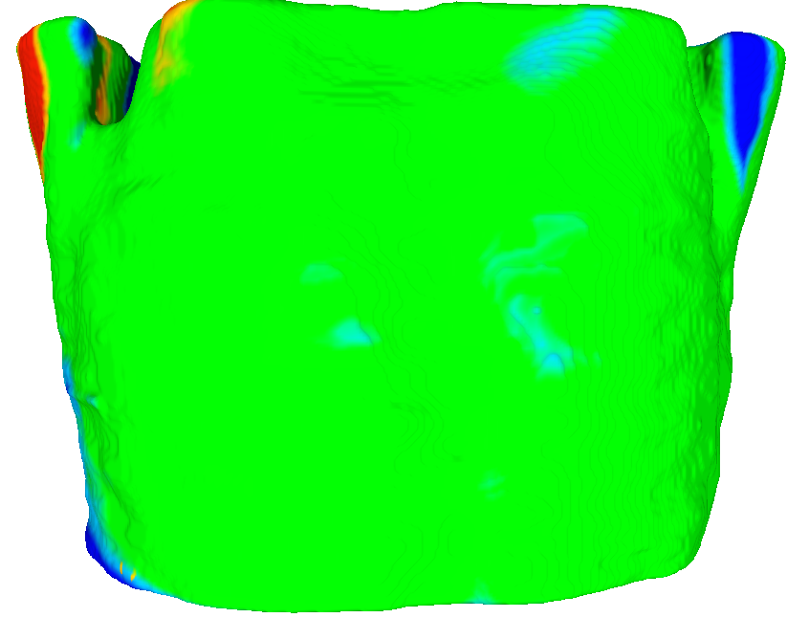
Outside distance
Outside distance
Inside distance
Inside distance
Distance within tolerance
Distance within tolerance
Tolerance ± 5mm
Maximum distance:
outside: 8.2 mm
inside: -16.25 mm
Tolerance ± 5mm
Maximum distance:
outside: 14.6 mm
inside: -14.9
Muscle geometry in prone configuration
Muscle geometry in supine tilted configuration

