Slide 1
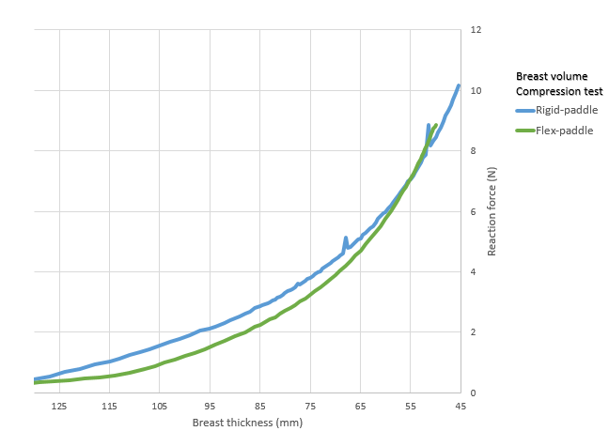
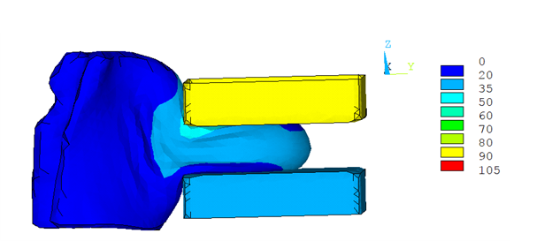
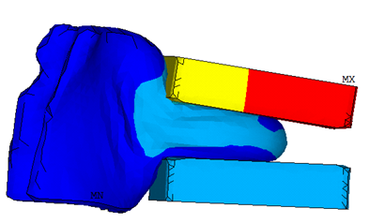
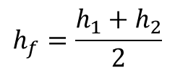



Rigid paddle
SRP
SFP
$$h_{r}$$
Flex paddle
Breast thickness (mm)
125
115
105
95
85
75
65
55
45
$$h_{1}$$
$$h_{2}$$
$$h_{f}=\frac{h_{1}+h_{2}}{2}$$
0
2
4
6
8
10
12
Compression force (N)

