Slide 1



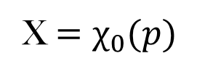



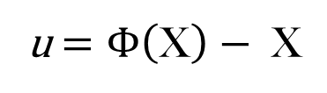




$x$ $=Φ(\text{X}){=χ}_{1}(χ_{0}^{−1} (\text{X}))$
u $=Φ\left(\text{X}\right)− \text{X}$
$$\text{X}$$
u
$$x$$
Current
configuration
Reference
configuration
$$\text{d}\text{X}$$
$$dx$$
$$Ω_{0}$$
$$Ω_{1}$$
X $=χ_{0}(p)$
$x=χ_{1}(p)$
$p$ $=χ_{0}^{−1} (\text{X})$
$p$ $=χ_{1}^{−1} (x)$
p
B

Slide 2













$$Ω_{1}^{′}$$
$$Ω_{1}$$
$$Ω_{0}$$
U
R
N
F
n
$$df$$
d $\tilde{f}$
$$T_{n}^{n}(x)$$
$$Ω_{1}$$
n
$$T^{n}(x)$$
$$T_{t}^{n}(x)$$
$$Ω_{0}$$
$$β$$
da
t
$$Ω_{1}$$
$$Ω_{1}^{′}$$

Slide 3

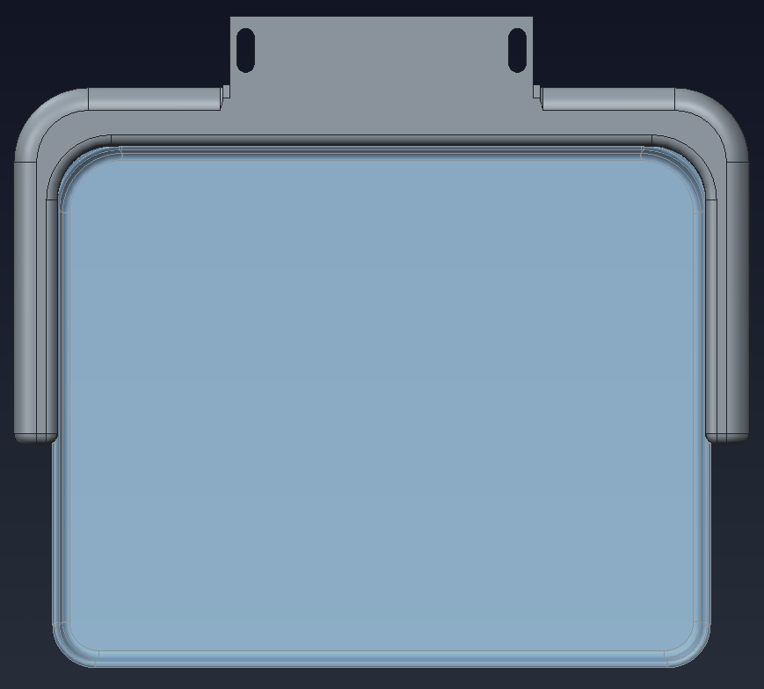
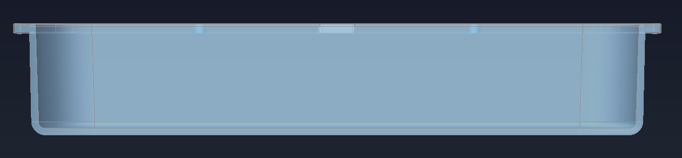
D
B
B*
A
A*
C
A*
A
 |  | Dimension in mm
 |  | A | A* | B | B* | C | D
5508072 | Sliding 19x23 paddle | 234 | 239 | 184 | 189 | 45 | 243
5508097 | 24x29 Standard paddle | 273.5 | 281.5 | 227.5 | 237.5 | 45 | 286
5508087 | Sliding 19x23 flexible paddle | 234 | 239 | 184 | 189 | 45 | 241.9
5508090 | 24x29 Flexible paddle | 273.5 | 281.5 | 227.5 | 237.5 | 45 | 285.8
5508099 | Sliding square spot paddle | 91.8 | 99 | 91.8 | 99 | 39.5 | 107.1
5508107 | Sliding round spot paddle |  |  |  |  | 25.5
5508102 | Sliding small breast or implant 10x23 paddle | 230.7 | 236.8 | 94.3 | 101.7 | 55 | 243
5508103 | 2D Loc 19x23 paddle | 234 | 239 | 184 | 189 | 45 | 243
5508104 | 2D Loc Sliding Swiss cheese paddle | 234 | 239 | 184 | 189 | 45 | 243

Slide 4
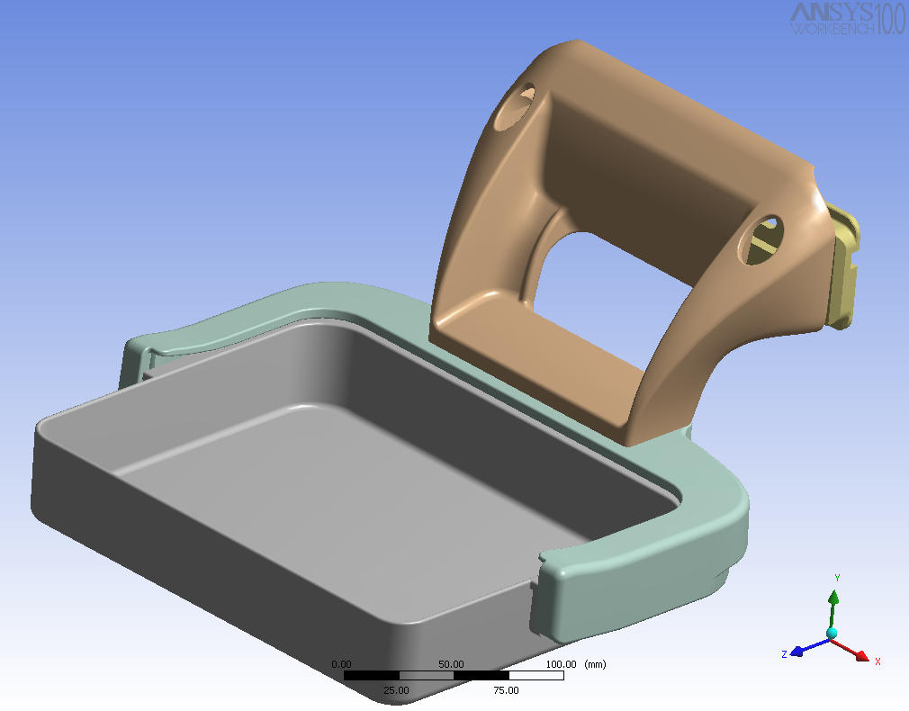
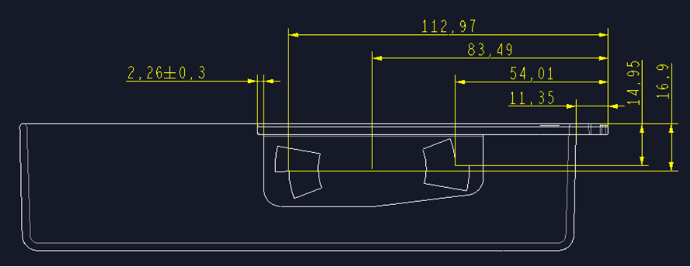
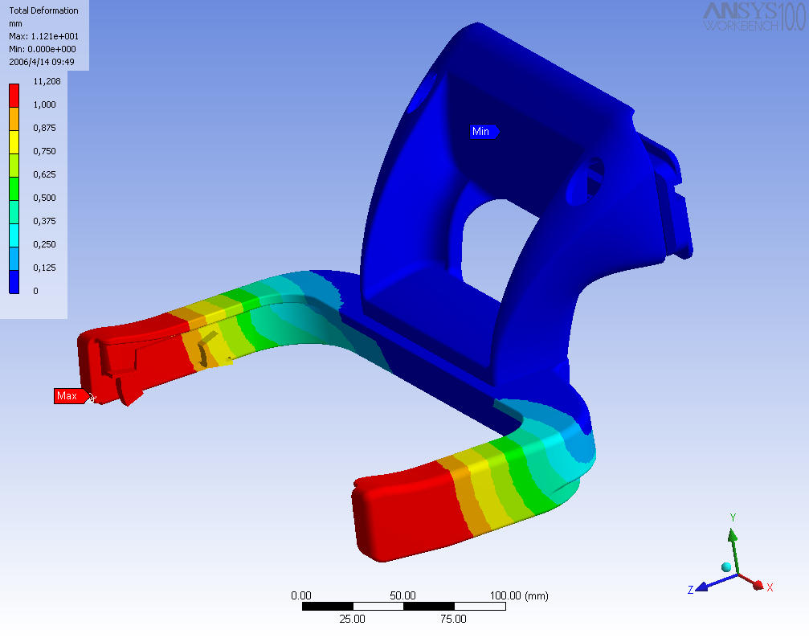
Flex paddle dimensions

