Slide 1

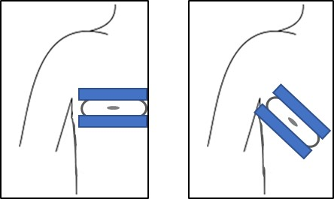
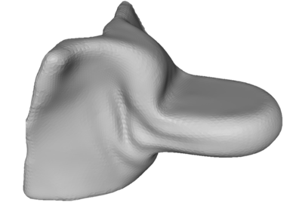


Source
SID
Source-Isocenter Distance
SDD
Source-Detector Distance
Isocenter
y
x
Detector
z
$$l_{x}$$
$$l_{z}$$

Slide 2
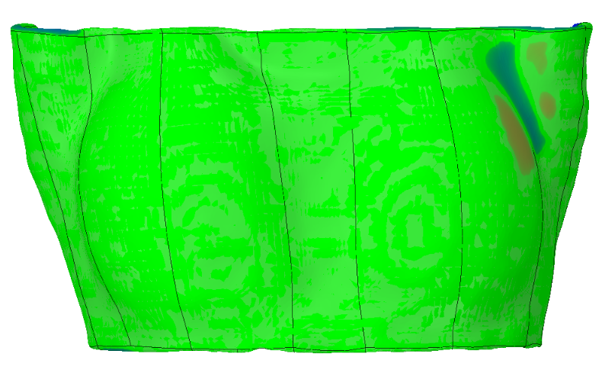

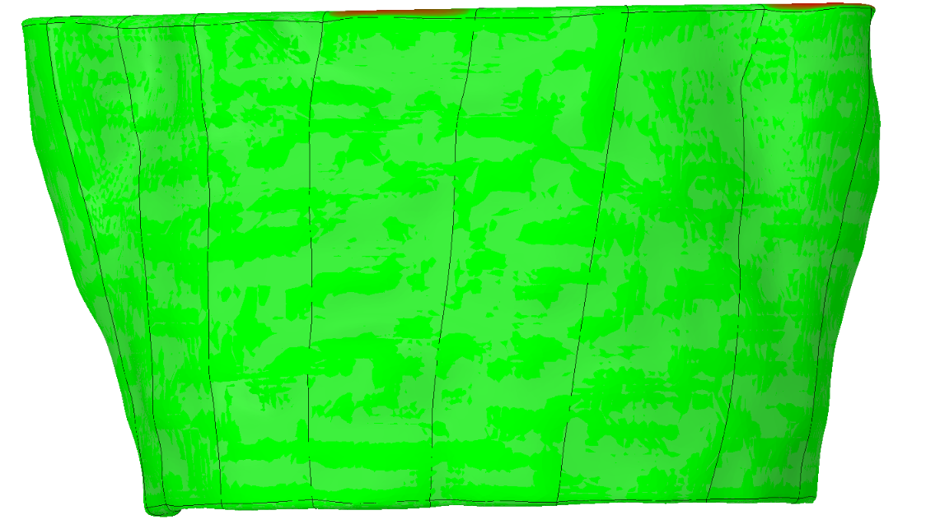
Inside distance
Outside distance
Distance within tolerance
Tolerance ± 0.5 mm
Maximum distance:
outside : 1.25 mm
inside : 1.6 mm
Inside distance
Outside distance
Distance within tolerance
Tolerance ± 0.5 mm
Maximum distance:
outside : 3.06 mm
inside : 1.57 mm

Slide 3
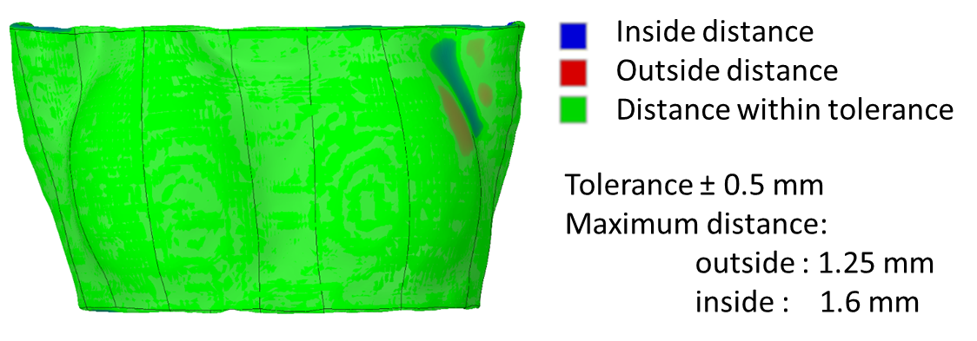
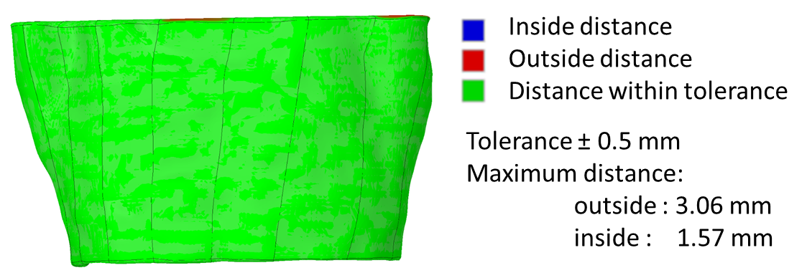
a)
b)

