Slide 1

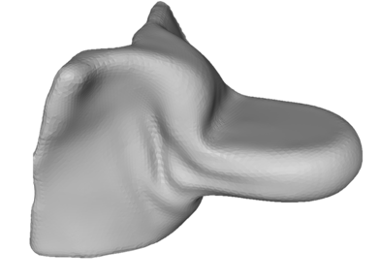


Source
SID
Source-Isocenter Distance
SDD
Source-Detector Distance
Isocenter
y
x
Detector
z
$$l_{x}$$
$$l_{z}$$

