Slide 1
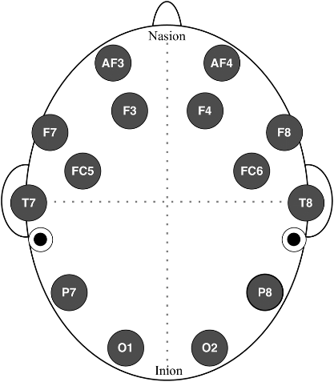
DEAP Dataset
DREAMER Dataset
 |  | AF3 | Fp1 |  | Fp2 | AF4
F7 |  | F3 |  | Fz |  | F4 |  | F8
 | FC5 |  | FC1 |  | FC2 |  | FC6
T3 |  | C3 |  | Cz |  | C4 |  | T4
 | CP5 |  | CP1 |  | CP2 |  | CP6
P7 |  | P3 |  | Pz |  | P4 |  | P8
 |  |  | PO3 |  | PO4
 |  |  | O1 | Oz | O2
 |  | AF3 | Fp1 |  | Fp2 | AF4
F7 |  | F3 |  | Fz |  | F4 |  | F8
 | FC5 |  | FC1 |  | FC2 |  | FC6
T7 |  | C3 |  | Cz |  | C4 |  | T8
 | CP5 |  | CP1 |  | CP2 |  | CP6
P7 |  | P3 |  | Pz |  | P4 |  | P8
 |  |  | PO3 |  | PO4
 |  |  | O1 | Oz | O2

Slide 2
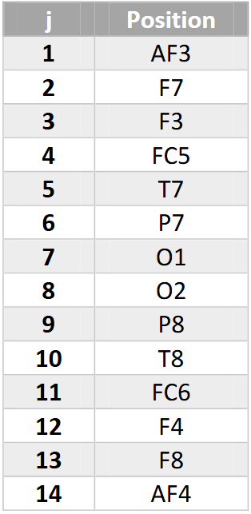
 |  | AF3 | Fp1 |  | Fp2 | AF4
F7 |  | F3 |  | Fz |  | F4 |  | F8
 | FC5 |  | FC1 |  | FC2 |  | FC6
T7 |  | C3 |  | Cz |  | C4 |  | T8
 | CP5 |  | CP1 |  | CP2 |  | CP6
P7 |  | P3 |  | Pz |  | P4 |  | P8
 |  |  | PO3 |  | PO4
 |  |  | O1 | Oz | O2

