Slide 2

Research Overview
\textcolor{cwAlert{Problem}}: Static cyber defenses fail against adaptive adversaries
\textcolor{cwDecoy{Solution}}: PPO-based agent learning optimal honeypot placement

Slide 3
Ancient War Strategy Quotes
``All warfare is based on deception.''
``The greatest victory is that which requires no battle.'' --- Sun Tzu, The Art of War.

Slide 4
Key Terms \& Concepts

Slide 5

The Cybersecurity Challenge
Alert Fatigue: 4,000+ daily alerts, 67\% ignored
Static Defenses: Predictable patterns exploited

Slide 6
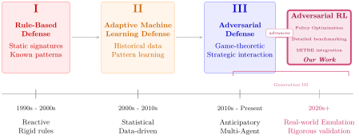
Evolution of Cyber Defense

Slide 7
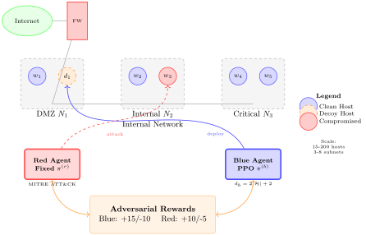
Network and Agent Environment Overview

Slide 8
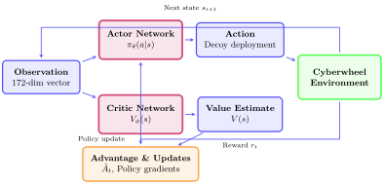
PPO Training Architecture
172-dimensional observation space: Alert history + network state + metadata
Strategic reward feedback: Learn optimal deception placement through experience

Slide 9
RL Foundations (PPO — concise)

Slide 10
Key Results: 89\% Performance Improvement
\textcolor{cwAlert{89\% improvement}} over static baseline
82.4\% asset protection rate (vs 61.7\% static)
92.3\% correlation with MITRE ATT\&CK patterns

Slide 11
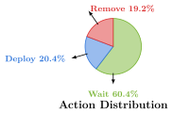
Learned Strategic Behaviors
Balanced Strategy: 20.4\% deploy, 19.2\% remove, 60.4\% wait
Superior Consistency: $\sigma = 37.37$ vs baseline variance

Slide 12
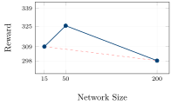
Scalability Analysis
Consistent Performance: 298-325 reward range
Linear memory usage: Practical for enterprise

Slide 13
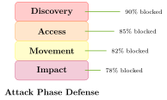
Real-World Validation
295 attack techniques implemented
Complete kill chain coverage (4 phases)

Slide 14
Research Methodology
Multi-Agent Setup: Learning blue vs fixed red (295 techniques)
Training: 10M timesteps, 5 random seeds

Slide 15
Future Directions \& Impact
Real-world deployment in operational environments
Multi-defender coordination across distributed networks
Explainable AI for analyst understanding and trust

Slide 16
Conclusions

