Slide 1
OpenCL Fast Fourier Transform
Ruobing Li

Slide 2
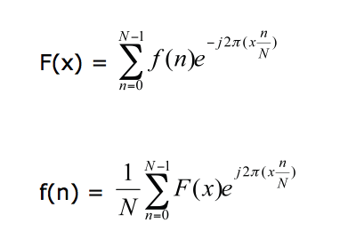

Discrete Fourier Transform
Takes $O(n^{2})$ with this naïve implementation.

Slide 3
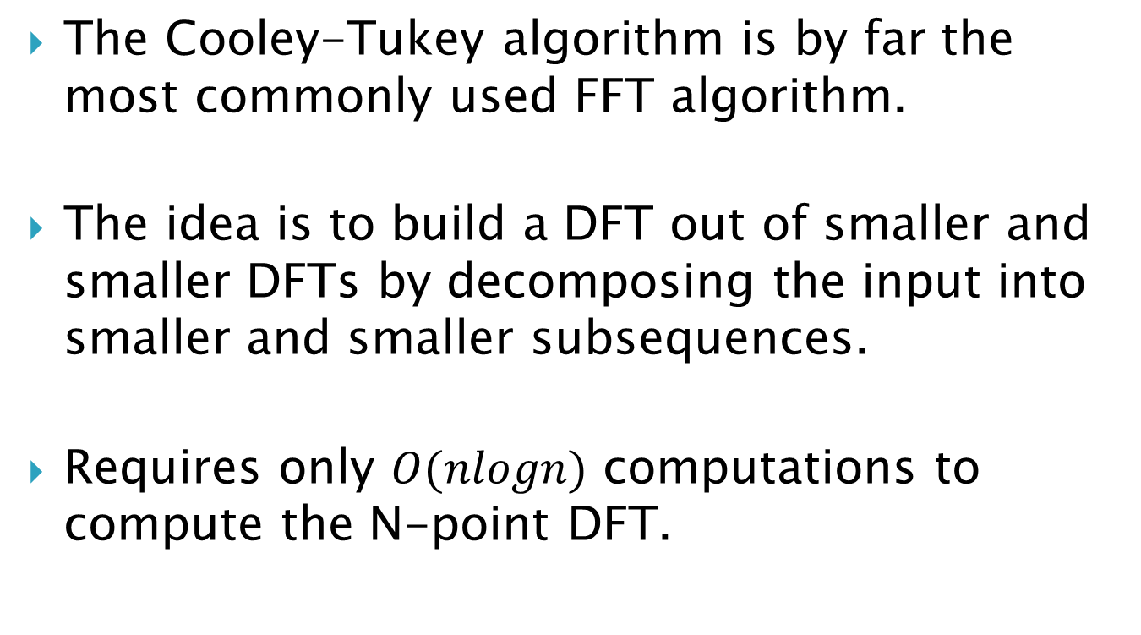
Fast Fourier Transform
The Cooley-Tukey algorithm is by far the most commonly used FFT algorithm.
The idea is to build a DFT out of smaller and smaller DFTs by decomposing the input into smaller and smaller subsequences.
Requires only $O(nlogn)$ computations to compute the N-point DFT.

Slide 4
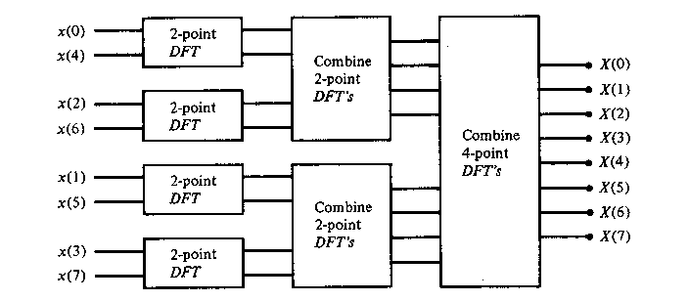
Fast Fourier Transform

Slide 5
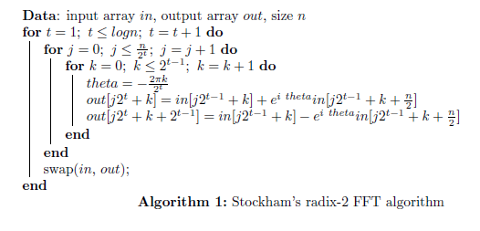
Stockham’s FFT Algorithm

Slide 6
Implementation
We have implemented three different kinds of kernels: radix-2, 4 and 8.
Higher radix makes better use of private memory to processes several iterations per kernel
Reduce the need of global communication.

Slide 7
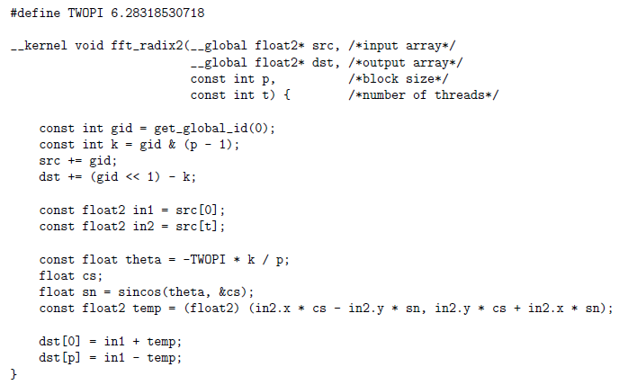
Implementation

Slide 8
Results
 | Xeon X5650 | Tesla M2070
radix-2 | 3.38 Gflop/s | 25.66 Gflop/s
radix-4 | 9.42 Gflop/s | 39.15 Gflop/s
radix-8 | 11.12 Gflop/s | 47.28 Gflop/s
Performance (in Gflop/s) of different kernels on size N = 2^24
Total number of real add+mul operations ius 5Nlog(N).

Slide 9
Results
 | Xeon X5650 | Tesla M2070
logN = 15 | 1.22 Gflop/s | 18.76 Gflop/s
18 | 5.21 Gflop/s | 39.19 Gflop/s
21 | 7.75 Gflop/s | 56.53 Gflop/s
24 | 11.12 Gflop/s | 47.28 Gflop/s
27 | 10.86 Gflop/s | 50.05 Gflop/s
Performance (in Gflop/s) of radix-8 kernels on different sizes (logN)

