Slide 1
LastCopy
Bring every
record home
Check that field forms, answers and photos reached the server.
Recover supported gaps. Verify the result.
OPEN AGENT 2026 · TRACK 02
Notes:
LastCopy, Open Agent Hackathon 2026, Track 02: The Agent That Can Explain Why. Working product at https://lastcopy-five.vercel.app. No sponsor endorsement claimed.

Slide 2
Record totals do not tell
the whole story
2
stranded submissions in an authored control.
Other records still exist on the server.
A spreadsheet can omit repeats while the original XML retains every answer.
Equal file bytes do not establish that every referenced filename is accessible.
Notes:
Authored fixture: fixtures/stage2/stranded and public /demo stranded case. Actual comparator finds two MISSING_SUBMISSION items while other records exist on the server. No field-user or adoption statistic is claimed.

Slide 3
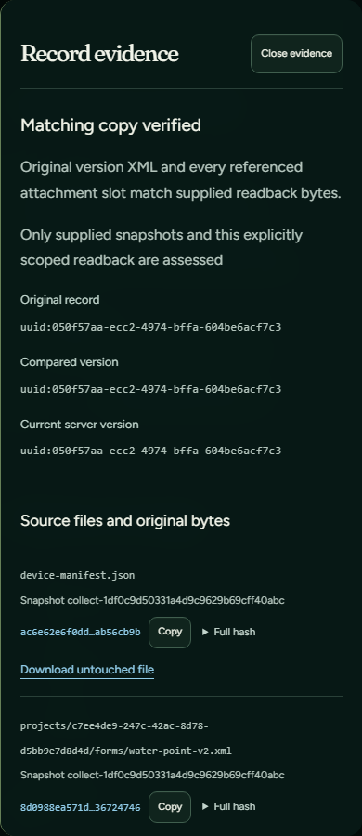
A finding you can open
See the original file, precise XML occurrence
and attachment reference.
Add exports
Check copies
Review gaps
Verify recovery
Notes:
Actual product capture: docs/verification/release-final/hosted-owner/evidence-390.png, 26 October 2026. Synthetic record. Source files, namespace-aware XML occurrence paths, values, media slot and evidence receipt are inspectable; raw inputs remain unchanged.

Slide 4
The missing-answer hypothesis
was rejected
Missing answers?
→
Read raw XML
→
Guide the export
The reviewer requested the original XML. Repeated answers were present, so the plan changed to export guidance.
Captured Connected run · 4 actual Zetaris queries · 3 Nightshift calls
2 critique rounds · World Model reads changed the next action
Notes:
Fresh actual connected capture, 26 October 2026: private/release-connected-export-retry; independently verified in docs/verification/release-final/connected-export-independent.json. Public receipts at web/public/verification/sponsor-export-review.json. Replay on the website; no live calls while viewing. Actual model: nvidia/nemotron-3.5-lightning-30b-a3b, reported by Nightshift.

Slide 5
Evidence directs the next step
Zetaris
World Model
Nightshift
→
→
Scoped evidence queries
Private source-object hashes
Provenance and revisions
Reads select unresolved work
Bounded investigator
and reviewer inference
The deterministic verifier decides preservation.
Python / FastAPI · Next.js / React · SQLite · ODK Central
Models request evidence; they cannot alter verdicts or write field records.
Notes:
Architecture: docs/ARCHITECTURE.md; lastcopy/connected.py; lastcopy/investigation.py; bridge/investigation-world.ts. Small bounded CSV manifests are materialized in Zetaris NDP; no claim of heterogeneous in-place federation or cheap full-file scans from LIMIT. The pinned unchanged Apache-2.0 Meterless World Model reference is credited in THIRD_PARTY_NOTICES.md. Development used Codex desktop on Windows; Cursor was not used.

Slide 6
Recovery is verified by readback
A missing submission was restored
with its original identifier.
1
matching instance
MISSING_SUBMISSION → PRESERVED
The upload completed before acknowledgement. After a restart,
readback established preservation before another write was considered.
Upload captured 25 October · fresh XML/media checked 26 October
Repeat Apply: no upload · originals unchanged
Notes:
Real dedicated synthetic Central project 2. Original recovery and lost-acknowledgement/restart acceptance: docs/verification/cloud/restart-control-receipt.json and restart-control-events.jsonl. Fresh original XML/version/media readback on 26 October: docs/verification/release-final/recovery-summary.json (approved metadata summary; full readback retained privately on AWS). Repeated Apply was tested with transport writes forbidden; one matching instance remained. No new upload is claimed for 26 October. Source hashes retained unchanged.

Slide 7
Checked paths and remaining limits
Verified
Still to finish
Offline comparisons without external network
Actual sponsor investigations and reviewer revision
Fresh Central readback; no duplicate on repeat
Signup and password reset confirmed
Physical-phone automatic backup
Unattended off-host and full-system recovery
Independent security review and retention policy
Remaining mobile performance goals
The hosted core works while the PC is off. The local sponsor runtime and emulator still require it.
Notes:
Verification receipts: docs/verification/release-final. Actual network-disabled production container compared all five fixtures with zero provider calls and unchanged source files. Both fresh sponsor cases were independently recomputed. Human confirmed signup and password-reset email/sign-in. npm full/production audits: zero known advisories; 25 Python version entries checked against PyPI: none reported. Debian base-image advisories remain open; this is not independent security certification. Lighthouse goals remain goals, not field Core Web Vitals claims.

Slide 8
LastCopy
Keep the originals.
Keep the evidence.
Try without an account
lastcopy-five.vercel.app/demo
Next: independent device backup and stronger operational controls
Notes:
Review draft, not an event submission. Demo: https://lastcopy-five.vercel.app/demo. Captured sponsor receipts: https://lastcopy-five.vercel.app/technical. Repository: https://github.com/miracle352/lastcopy remains private until the owner chooses judge access/publication. Official requirements verified 26 October at https://hackathon.genai.works/event/open-agent-hackathon-2026#rules. Deadline 27 October 23:45 UTC (28 October 00:45 Africa/Lagos). Current authenticated submission form fields remain for owner review.

