Slide 2

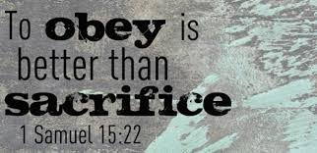
Devotion:

Slide 3
IT Customer Relationship Management
IT CRM– Module 4
Cesar D. Galingana, MIT, LPT

Slide 4
MODULE 4:
Topic: Sales Process Automation

Slide 5
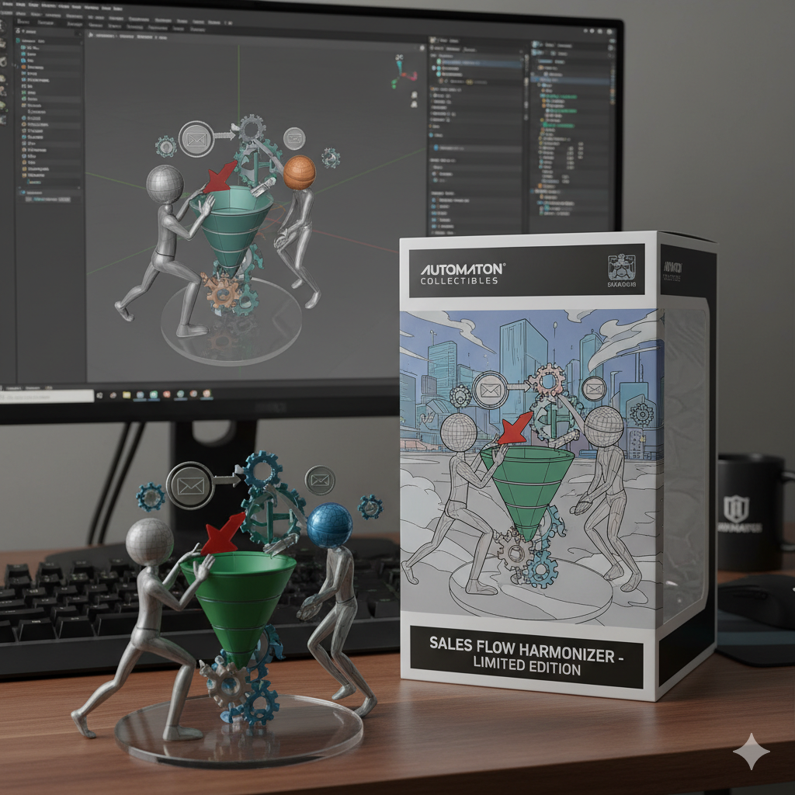
Sales Process Automation (SPA) - Customers expect quick responses, personalized interactions, and seamless experiences.
- leveraging technology, primarily CRM systems, to streamline, standardize, and automate repetitive tasks within the sales cycle.

Slide 6
Sales Process Automation (SPA) - Customers expect quick responses, personalized interactions, and seamless experiences.
- leveraging technology, primarily CRM systems, to streamline, standardize, and automate repetitive tasks within the sales cycle.

Slide 7
Why is this crucial for you?
✓ If you're going into sales, SPA will be your daily toolkit.
✓ If you're in marketing, you'll need to understand how your leads flow into the sales process.
✓ If you're in management, SPA helps you gain visibility, forecast accurately, and optimize your sales engine.

Slide 8
1. Mapping the Sales Pipeline Stages: The Customer's Journey Through Sales
The sales pipeline is a visual representation of where all your potential deals are in the sales process. It's a structured, step-by-step journey that a lead takes from initial contact to becoming a customer.

Slide 9
1. Mapping the Sales Pipeline Stages: The Customer's Journey Through Sales
a. Why Map the Pipeline?
• Clarity: Provides a clear, shared understanding of the sales process for everyone in the organization.
• Consistency: Ensures all sales reps follow a standardized approach.
• Visibility: Allows sales managers to see the health of their sales efforts at a glance.
• Forecasting: Enables more accurate predictions of future revenue.
• Optimization: Helps identify bottlenecks and areas for improvement in the sales process.

Slide 10
1. Mapping the Sales Pipeline Stages: The Customer's Journey Through Sales
b. Typical Sales Pipeline Stages (Example):
1. Prospecting/Lead Generation:
• Description: Identifying potential customers (leads) who might be interested in your product or service.
• Activities: Research, cold outreach (calls, emails), content downloads, event attendance.
• Goal: Generate initial interest and contact.
• Transition: Lead becomes "Qualified Lead" or "Opportunity."

Slide 11
1. Mapping the Sales Pipeline Stages: The Customer's Journey Through Sales
b. Typical Sales Pipeline Stages (Example):
2. Qualification:
• Description: Assessing whether a lead is a good fit for your product/service and has the potential to become a customer (e.g., BANT criteria: Budget, Authority, Need, Timeline).
• Activities: Discovery calls, needs analysis, asking probing questions.
• Goal: Determine if the lead is worth pursuing further.
• Transition: Qualified lead becomes a "Prospect" or "Opportunity."

Slide 12
1. Mapping the Sales Pipeline Stages: The Customer's Journey Through Sales
b. Typical Sales Pipeline Stages (Example):
3. Needs Analysis/Discovery:
• Description: Deeply understanding the prospect's specific challenges, pain points, and goals.
• Activities: Detailed conversations, solution mapping, understanding current processes.
• Goal: Uncover specific problems your product can solve.
• Transition: Clear understanding of prospect's needs.

Slide 13
1. Mapping the Sales Pipeline Stages: The Customer's Journey Through Sales
b. Typical Sales Pipeline Stages (Example):
4. Solution Presentation/Demonstration:
• Description: Presenting how your product/service specifically addresses the prospect's identified needs and pain points.
• Activities: Product demos, customized presentations, case studies.
• Goal: Show the value and benefits of your solution.
• Transition: Prospect understands the solution's value.

Slide 14
1. Mapping the Sales Pipeline Stages: The Customer's Journey Through Sales
b. Typical Sales Pipeline Stages (Example):
5. Proposal/Quote:
• Description: Providing a formal offer, outlining the proposed solution, pricing, terms, and conditions.
• Activities: Drafting proposals, sending quotes, clarifying details.
• Goal: Present a clear path to purchase.
• Transition: Prospect reviews the offer.

Slide 15
1. Mapping the Sales Pipeline Stages: The Customer's Journey Through Sales
b. Typical Sales Pipeline Stages (Example):
6. Negotiation/Objection Handling:
• Description: Addressing any concerns, objections, or requests for adjustments from the prospect.
• Activities: Price negotiations, contract reviews, addressing competitor comparisons.
• Goal: Overcome obstacles to closing the deal.
• Transition: Agreement reached on terms.

Slide 16
1. Mapping the Sales Pipeline Stages: The Customer's Journey Through Sales
b. Typical Sales Pipeline Stages (Example):
7. Closed-Won / Closed-Lost:
• Description: The final outcome of the sales process.
• Activities: Signing contracts, onboarding new customers, or analyzing reasons for loss.
• Goal: Secure the customer or learn from the loss.

Slide 17
1. Mapping the Sales Pipeline Stages: The Customer's Journey Through Sales
c. Customizing the Pipeline:
• Every business has a unique sales process. The number and names of stages can vary.
• The key is that each stage represents a distinct step, with clear entry and exit criteria.
• CRM systems allow you to customize these pipeline stages to match your specific sales methodology.

Slide 18
2. Automating Sales Tasks: Freeing Up Sales Reps
By automating repetitive, time-consuming administrative tasks, sales reps can dedicate more time to high-value activities like engaging with prospects and closing deals.

Slide 19
2. Automating Sales Tasks: Freeing Up Sales Reps
a. Key Sales Tasks That Can Be Automated:
• Email Sequences (Sales Cadences/Drip Campaigns):
• Automation: Automatically send a series of personalized emails to
prospects based on triggers (e.g., after a demo, after a form
submission, if no response).
• Benefit: Ensures consistent follow-up, saves reps time, keeps
leads warm.
• Example: A 3-email sequence sent over a week to prospects who
downloaded a product brochure.

Slide 20
2. Automating Sales Tasks: Freeing Up Sales Reps
a. Key Sales Tasks That Can Be Automated:
Task Creation & Reminders:
• Automation: Automatically create follow-up tasks for sales reps
(e.g., "Call prospect X in 2 days," "Send proposal to Y," "Schedule
demo with Z") based on deal stage changes or specific actions.
• Benefit: Ensures no lead falls through the cracks, improves
organization, boosts productivity.
• Example: When a deal moves to "Proposal Sent" stage, a task is
automatically created to "Follow up on proposal in 3 days."

Slide 21
2. Automating Sales Tasks: Freeing Up Sales Reps
a. Key Sales Tasks That Can Be Automated:
Data Entry & Updates:
• Automation: Automatically log emails, calls, and meetings to the
CRM. Update contact/deal records based on integrations (e.g.,
website activity, form submissions).
• Benefit: Reduces manual data entry errors, ensures CRM data is
always up-to-date, saves reps significant time.
• Example: An email sent from a rep's Outlook is automatically logged
to the associated contact record in CRM.

Slide 22
2. Automating Sales Tasks: Freeing Up Sales Reps
a. Key Sales Tasks That Can Be Automated:
Lead Routing & Assignment:
• Automation: Automatically assign new leads to the appropriate sales rep based on predefined rules (e.g., geography, industry, company size, round-robin).
• Benefit: Ensures quick follow-up, prevents leads from being missed, balances workload.

Slide 23
2. Automating Sales Tasks: Freeing Up Sales Reps
a. Key Sales Tasks That Can Be Automated:
Meeting Scheduling:
• Automation: Use scheduling tools (often integrated with CRM) that
allow prospects to book meetings directly on a rep's calendar,
eliminating back-and-forth emails.
• Benefit: Streamlines scheduling, improves prospect experience.

Slide 24
2. Automating Sales Tasks: Freeing Up Sales Reps
a. Key Sales Tasks That Can Be Automated:
Quote Generation & Contract Management:
• Automation: Generate professional quotes and proposals directly from CRM data. Integrate with e-signature tools for faster contract signing.
• Benefit: Reduces errors, speeds up the sales cycle, improves professionalism.

Slide 25
2. Automating Sales Tasks: Freeing Up Sales Reps
b. Tools for Automation:
• CRM Systems (e.g., HubSpot Sales Hub,
Salesforce Sales Cloud): These platforms are built with extensive
automation capabilities.
• Marketing Automation Platforms: Often integrate with CRM to
automate lead nurturing.
• Third-Party Integrations: Tools for scheduling, e-signatures, data
enrichment that connect to the CRM. By automating these tasks,
sales teams become more efficient, more consistent, and
ultimately, more effective.

Slide 26
3. Deal Management and Forecasting: Predicting Future Revenue
Effective Deal Management is about systematically tracking and moving opportunities through the sales pipeline. Sales Forecasting is the process of predicting future sales revenue based on current deals in the pipeline
and historical data. Both are
critical for business planning.

Slide 27
3. Deal Management and Forecasting: Predicting Future Revenue
a. Deal Management:
• Centralized View: CRM provides a single, centralized place to manage all active deals. Each deal typically has:
• Deal Name: (e.g., "Innovate Solutions - CRM Implementation")
• Associated Contact(s) & Company: Who is involved.
• Deal Stage: Where it is in the pipeline (e.g., "Proposal Sent").
• Amount: Estimated revenue.
• Close Date: Estimated date of closing.
• Probability: Likelihood of closing (often tied to deal stage).
• Activities: Logged calls, emails, meetings related to the deal.
• Notes: Important details and next steps.

Slide 28
3. Deal Management and Forecasting: Predicting Future Revenue
a. Deal Management:
• Visibility: Sales managers can see every deal, its status, and the activities associated with it.
• Standardization: Ensures all reps follow the same process for managing deals.
• Collaboration: Allows sales teams to collaborate on complex deals.

Slide 29
3. Deal Management and Forecasting: Predicting Future Revenue
b. Sales Forecasting:
• How it Works: CRM systems use the data from your sales pipeline to generate forecasts.
• Pipeline Value: Sum of all deals in the pipeline.
• Weighted Pipeline: Sum of (Deal Amount x Probability) for all deals. This gives a more realistic estimate.
• Deal Velocity: How long deals typically stay in each stage, or the total time from creation to close.
• Conversion Rates: Percentage of deals that move from one stage to the next, or from qualified lead to closed-won.

Slide 30
3. Deal Management and Forecasting: Predicting Future Revenue
• Forecasting Methods (often supported by CRM):
• Opportunity Stage Forecasting: Based on the stage of each deal in the pipeline.
• Historical Data Forecasting: Using past sales trends to predict future performance.
• Lead-Based Forecasting: Predicting sales based on the number and quality of new leads generated.
• AI-Powered Forecasting: Advanced CRM systems use AI/ML to analyze vast amounts of data (historical, behavioral, external factors) to provide highly accurate predictions.

Slide 31
3. Deal Management and Forecasting: Predicting Future Revenue
c. Benefits of Effective Deal Management & Forecasting:
• Improved Planning: Businesses can better plan resources, production, and marketing efforts.
• Resource Allocation: Managers can identify where sales reps need help or where to focus efforts.
• Performance Management: Provides a baseline for evaluating sales team performance.
• Early Warning System: Helps identify potential shortfalls in revenue early enough to take corrective action.
• Investor Confidence: Accurate forecasts are crucial for attracting andretaining investors. CRM systems are indispensable for robust deal
management and accurate sales forecasting, transforming
guesswork into data-driven predictions.

Slide 32
Lecture Activity: "Sales Automation Architect" Challenge
Goal: Understand how sales automation works and build essential sales tools (email templates & sequences) in HubSpot!
Part 1: Lecture Component - Automating the Sales Journey (Individual Work) Explain & Strategize (15-20 mins)
• Review: Think back to our lecture on "Sales Process Automation."
• Your Task: In your OWN words (3-5 sentences each), answer the following:

Slide 33
Lecture Activity: "Sales Automation Architect" Challenge
Goal: Understand how sales automation works and build essential sales tools (email templates & sequences) in HubSpot!
Part 1: Lecture Component - Automating the Sales Journey (Individual Work) Explain & Strategize (15-20 mins)
1. Sales Pipeline Stages: Why is it important to map out clear sales pipeline stages?
2. Automating Tasks: Give two examples of sales tasks that can be automated, and explain how automation benefits the sales rep.

Slide 34
Part 2: Laboratory Component - Build Your Sales Tools (Hands-on HubSpot)
Create Sales Email Templates & a Sequence (45-60 mins in Lab)
• Access: Log in to your HubSpot Free CRM account.
• Scenario: Imagine you are a sales development representative (SDR) for
a B2B SaaS company selling project management software. You’ve
just had a great demo with a prospect, and now you need to follow up.
• Your Task:
1. Create 2 Sales Email Templates:
• Template 1: Post-Demo Follow-Up: Design an email template to
send immediately after a demo.
• Content: Thank them for their time, recap key points discussed, offer to
answer questions.

Slide 35
Personalization: Use at least 2 HubSpot personalization tokens (e.g., {{contact.firstname}}, {{deal.dealname}}).
•Template 2: Value Proposition Reminder: Design an email template to send 2-3 days after the first, if no response.
• Content: Briefly reiterate a key benefit of your software, share a relevant case study link (fictional or real), and suggest a next step.
• Personalization: Use at least 1 HubSpot personalization token.

Slide 36
2. Create a Simple Sequence:
• Sequence Name: Give it a clear name (e.g., "Post-Demo Nurture Sequence").
• Add Steps: Add your two created email templates as steps in the sequence.
• Set Delays: Set a delay of 2-3 days between Email 1 and Email 2.
• Enrollment: Show how you would enroll a contact into this sequence.
3. Screenshot Proof: Take screenshots of:
• Your Post-Demo Follow-Up Email Template (showing content and personalization tokens).
• Your Value Proposition Reminder Email Template (showing content and personalization tokens).
• Your Sequence Overview (showing both emails and delays).
• A screenshot showing how you would enroll a contact into this sequence.

Slide 37


END ….

Slide 38


