Slide 2
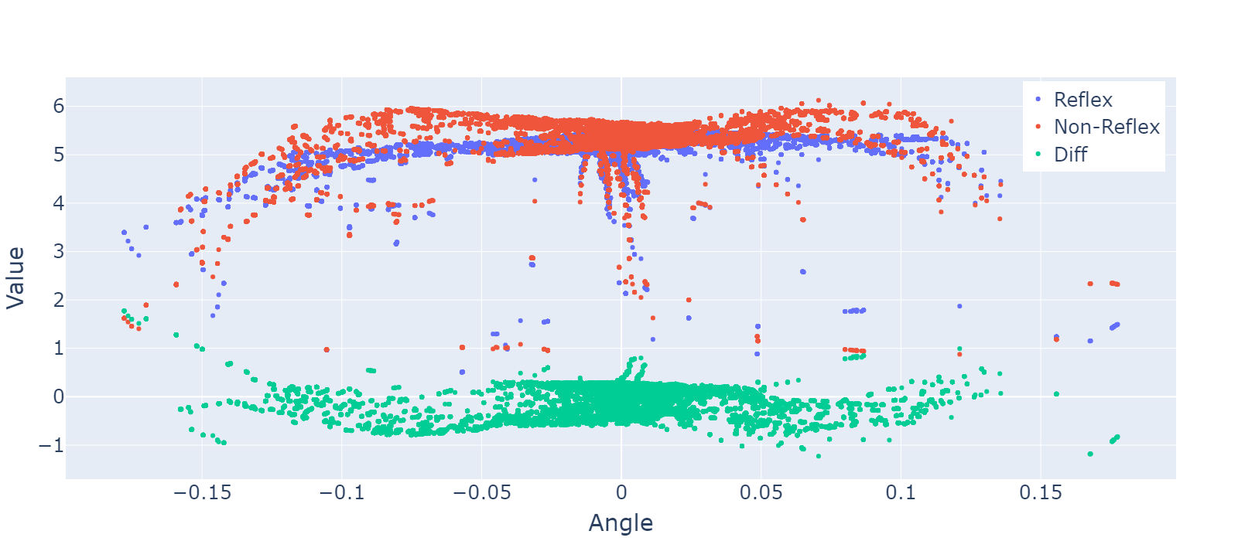
Designing reflexes automatically
Train a policy
Gather all states that lead to the death / end of the episode
Cluster them using SVC
Train / build the network such that the MSE loss for the action picked is low.

Slide 3
Alternatively:
a
reflex
a
action
Train a policy
Collect states that have high magnitude negative TD error
(these are states that cannot be anticipated and learned)
Train a faster neural network on these states. (reflex)
a
a
a
a
a
a
a
a
a
a
a
time

Slide 4
Reflexes demonstrate sequence of actions perform better
Without reflex
a
a
With reflex
a
a

Slide 5
Extending to sequence of actions
a₀
Sequence action (picked at same response time)
Can be predicted
a₂
reflex action (picked at faster response time)
Cannot be predicted
a₀
a₀
a₀
a₁
a₁
a₁
a₁
a₁
a₁
a₁
a₂
a₂
a₂
time

