Slide 1

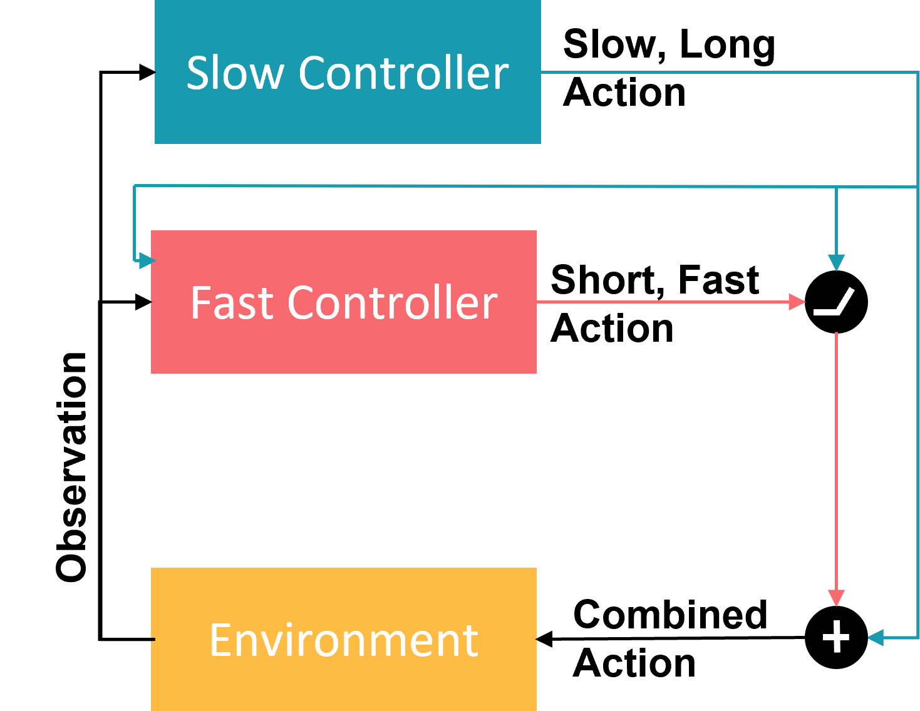
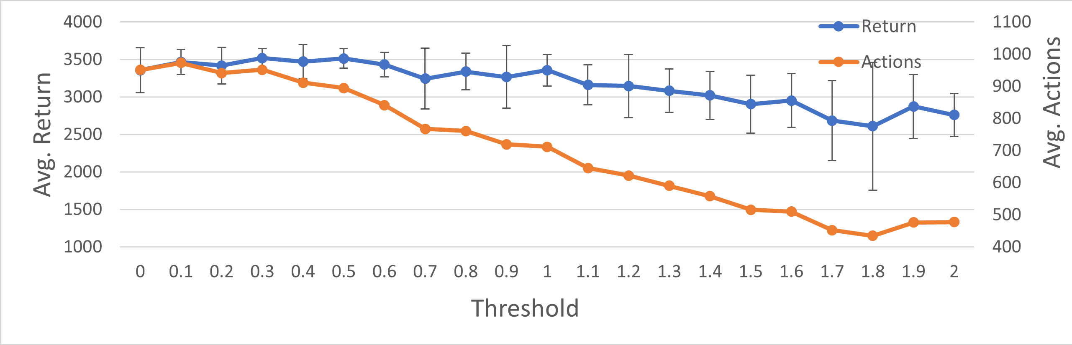
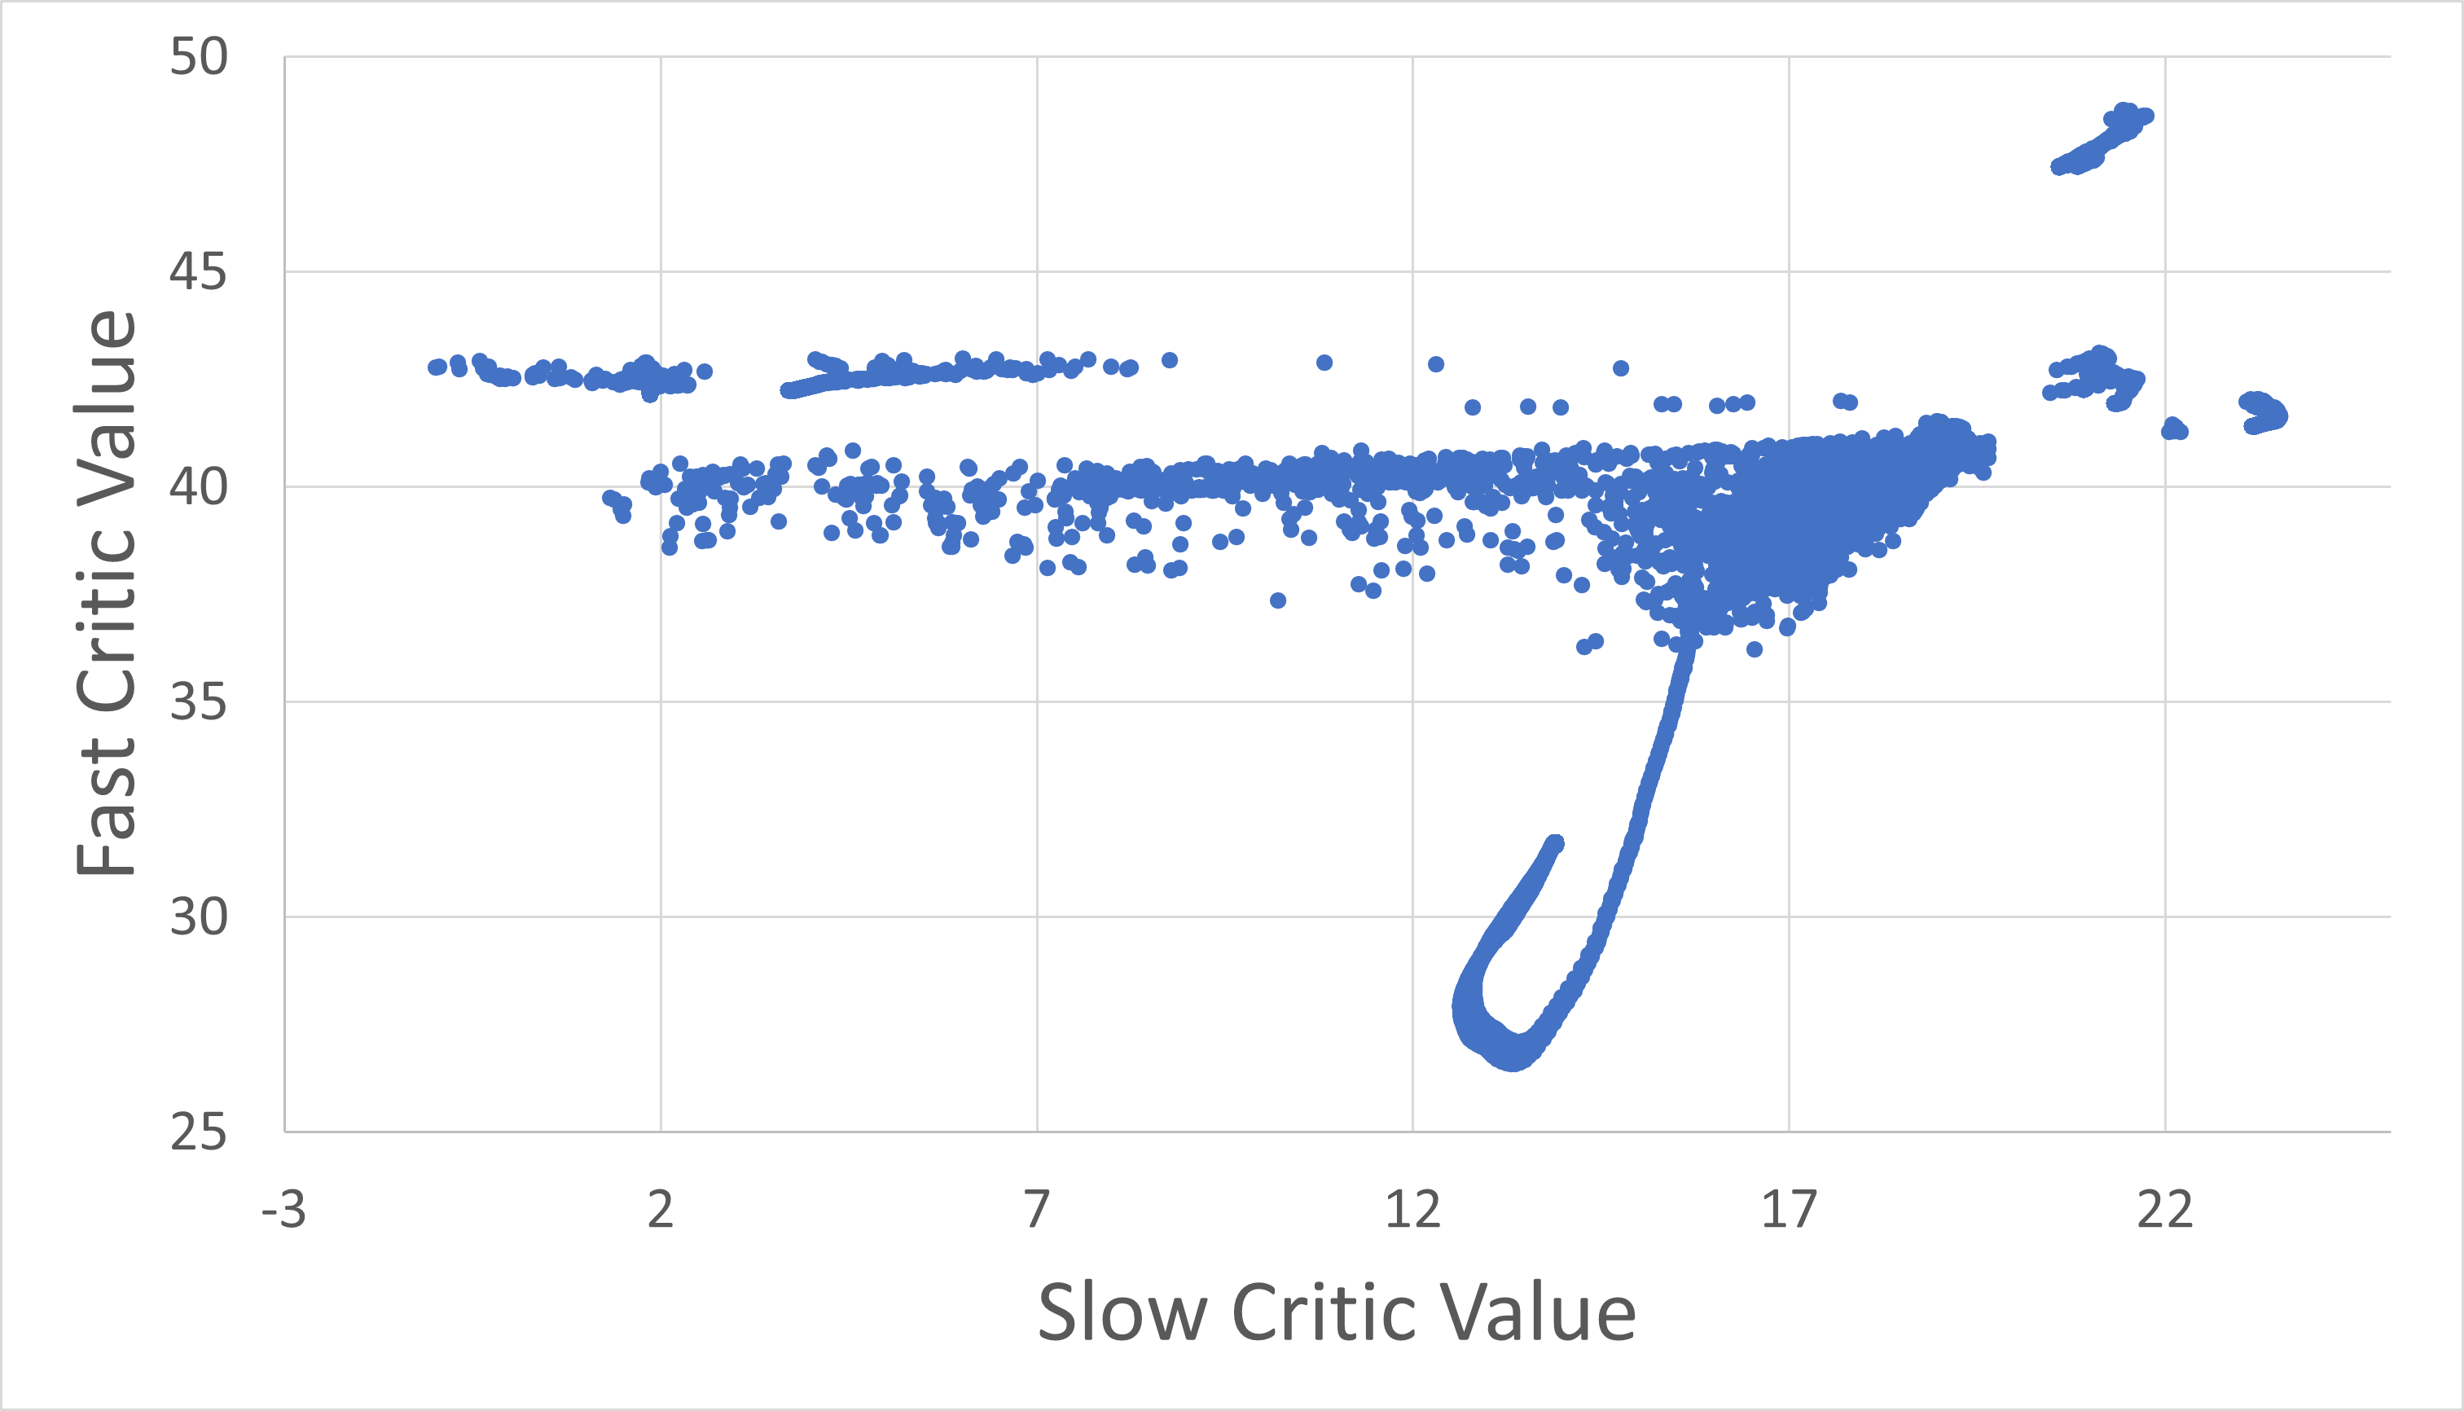
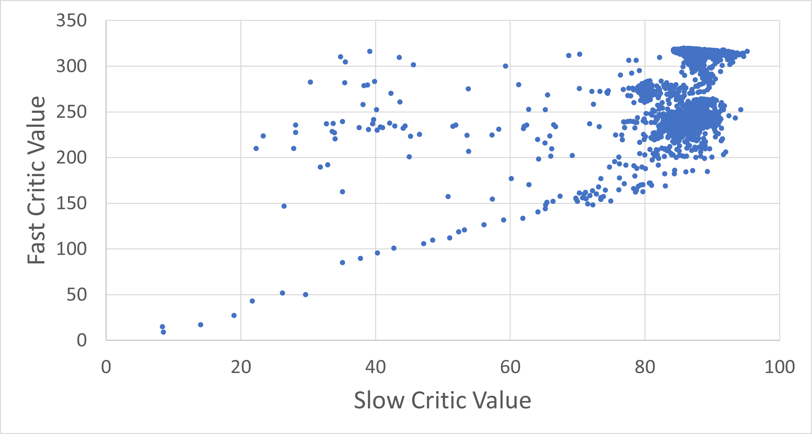
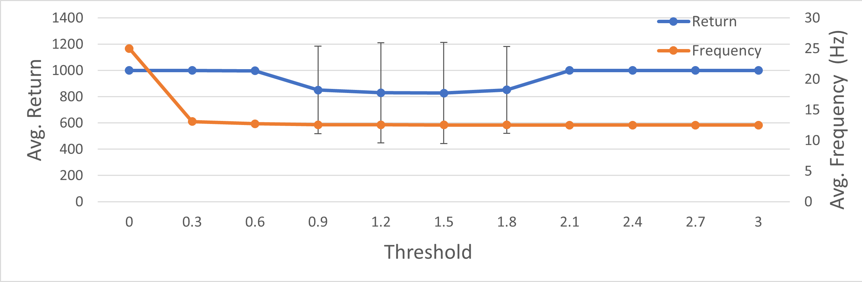
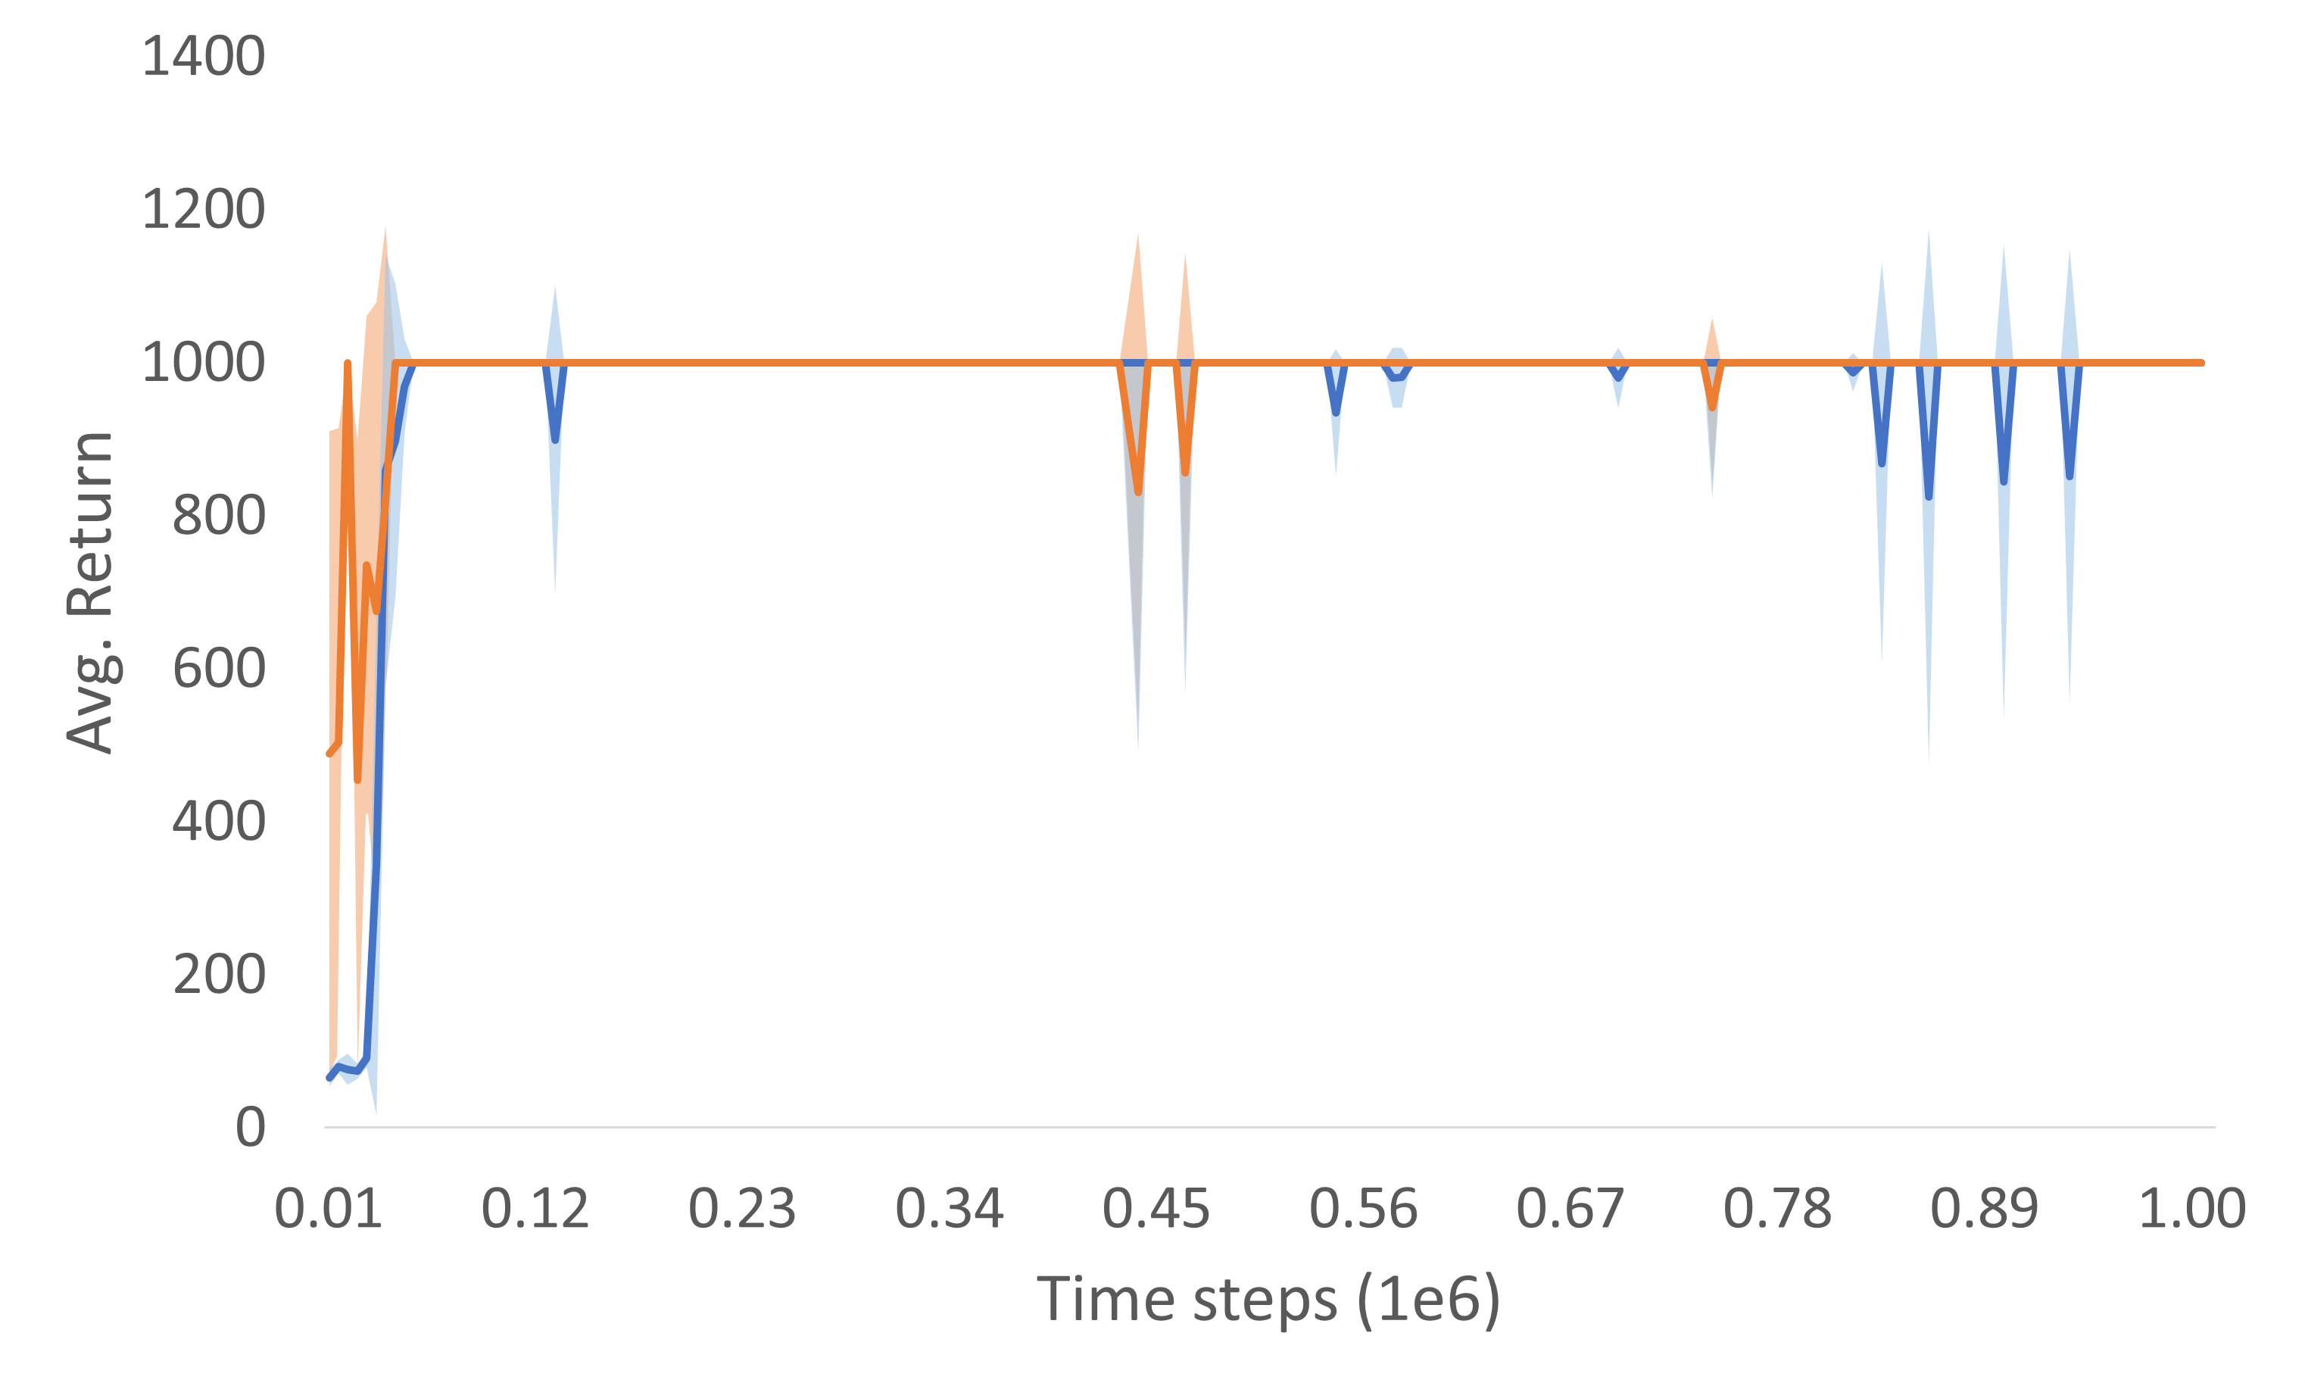
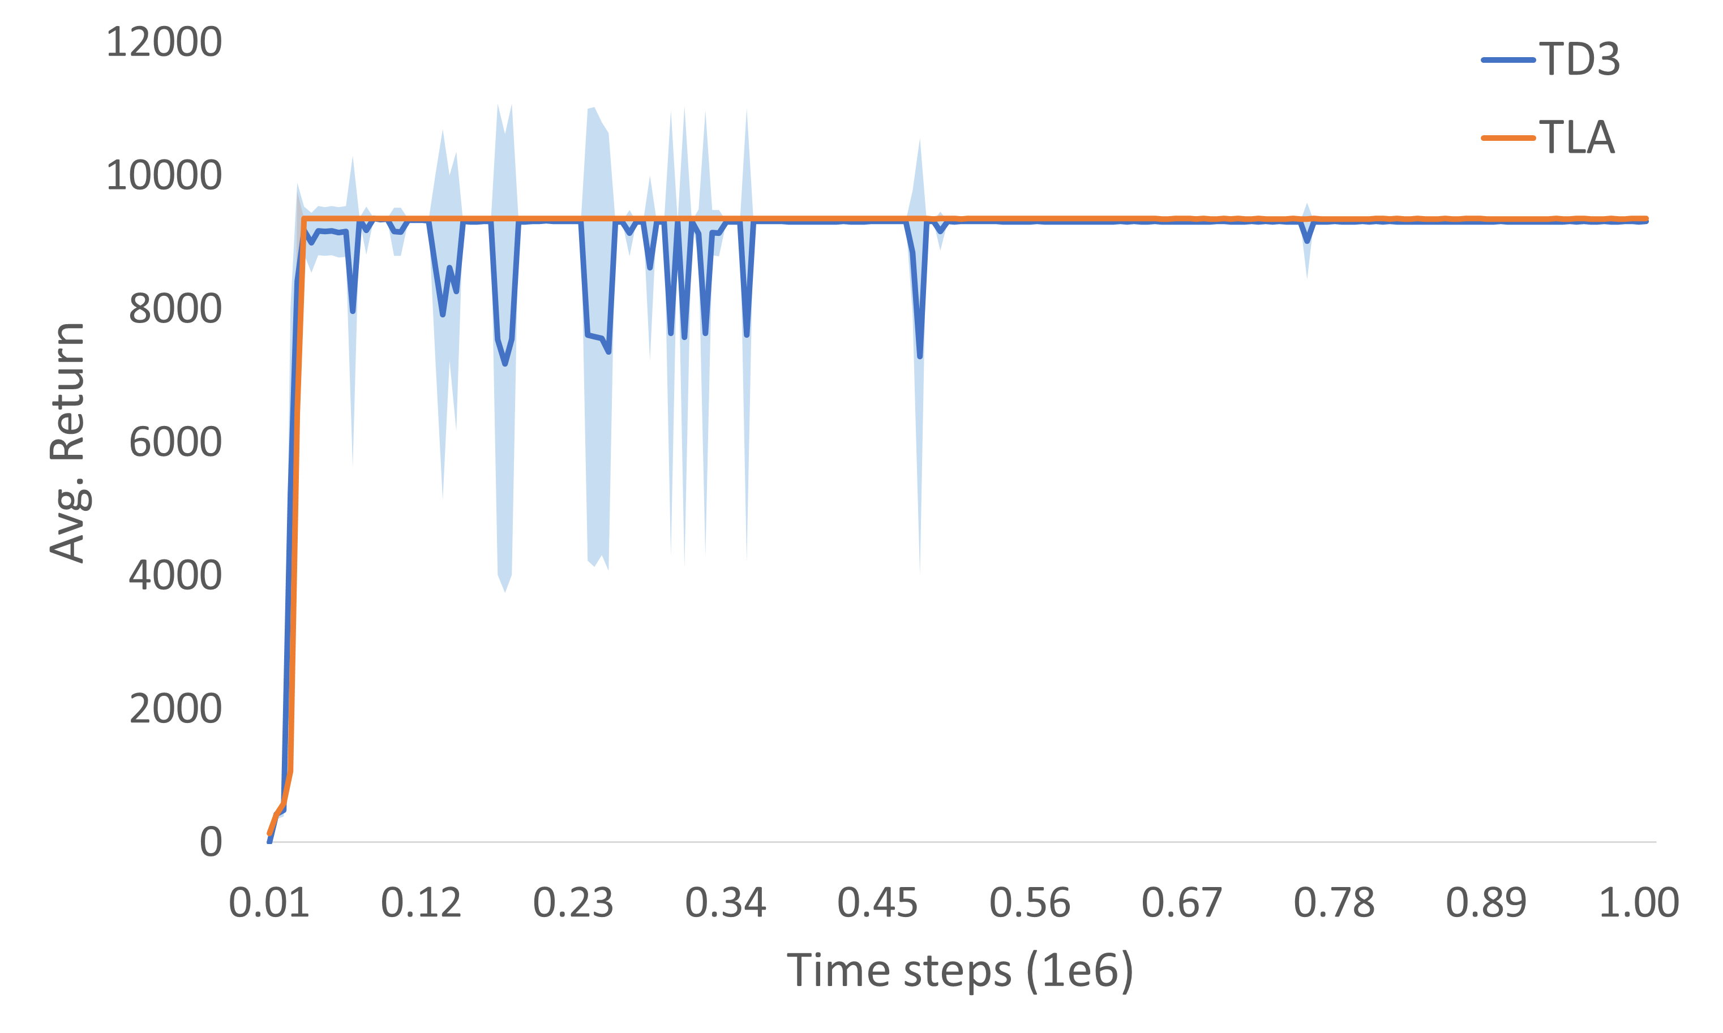


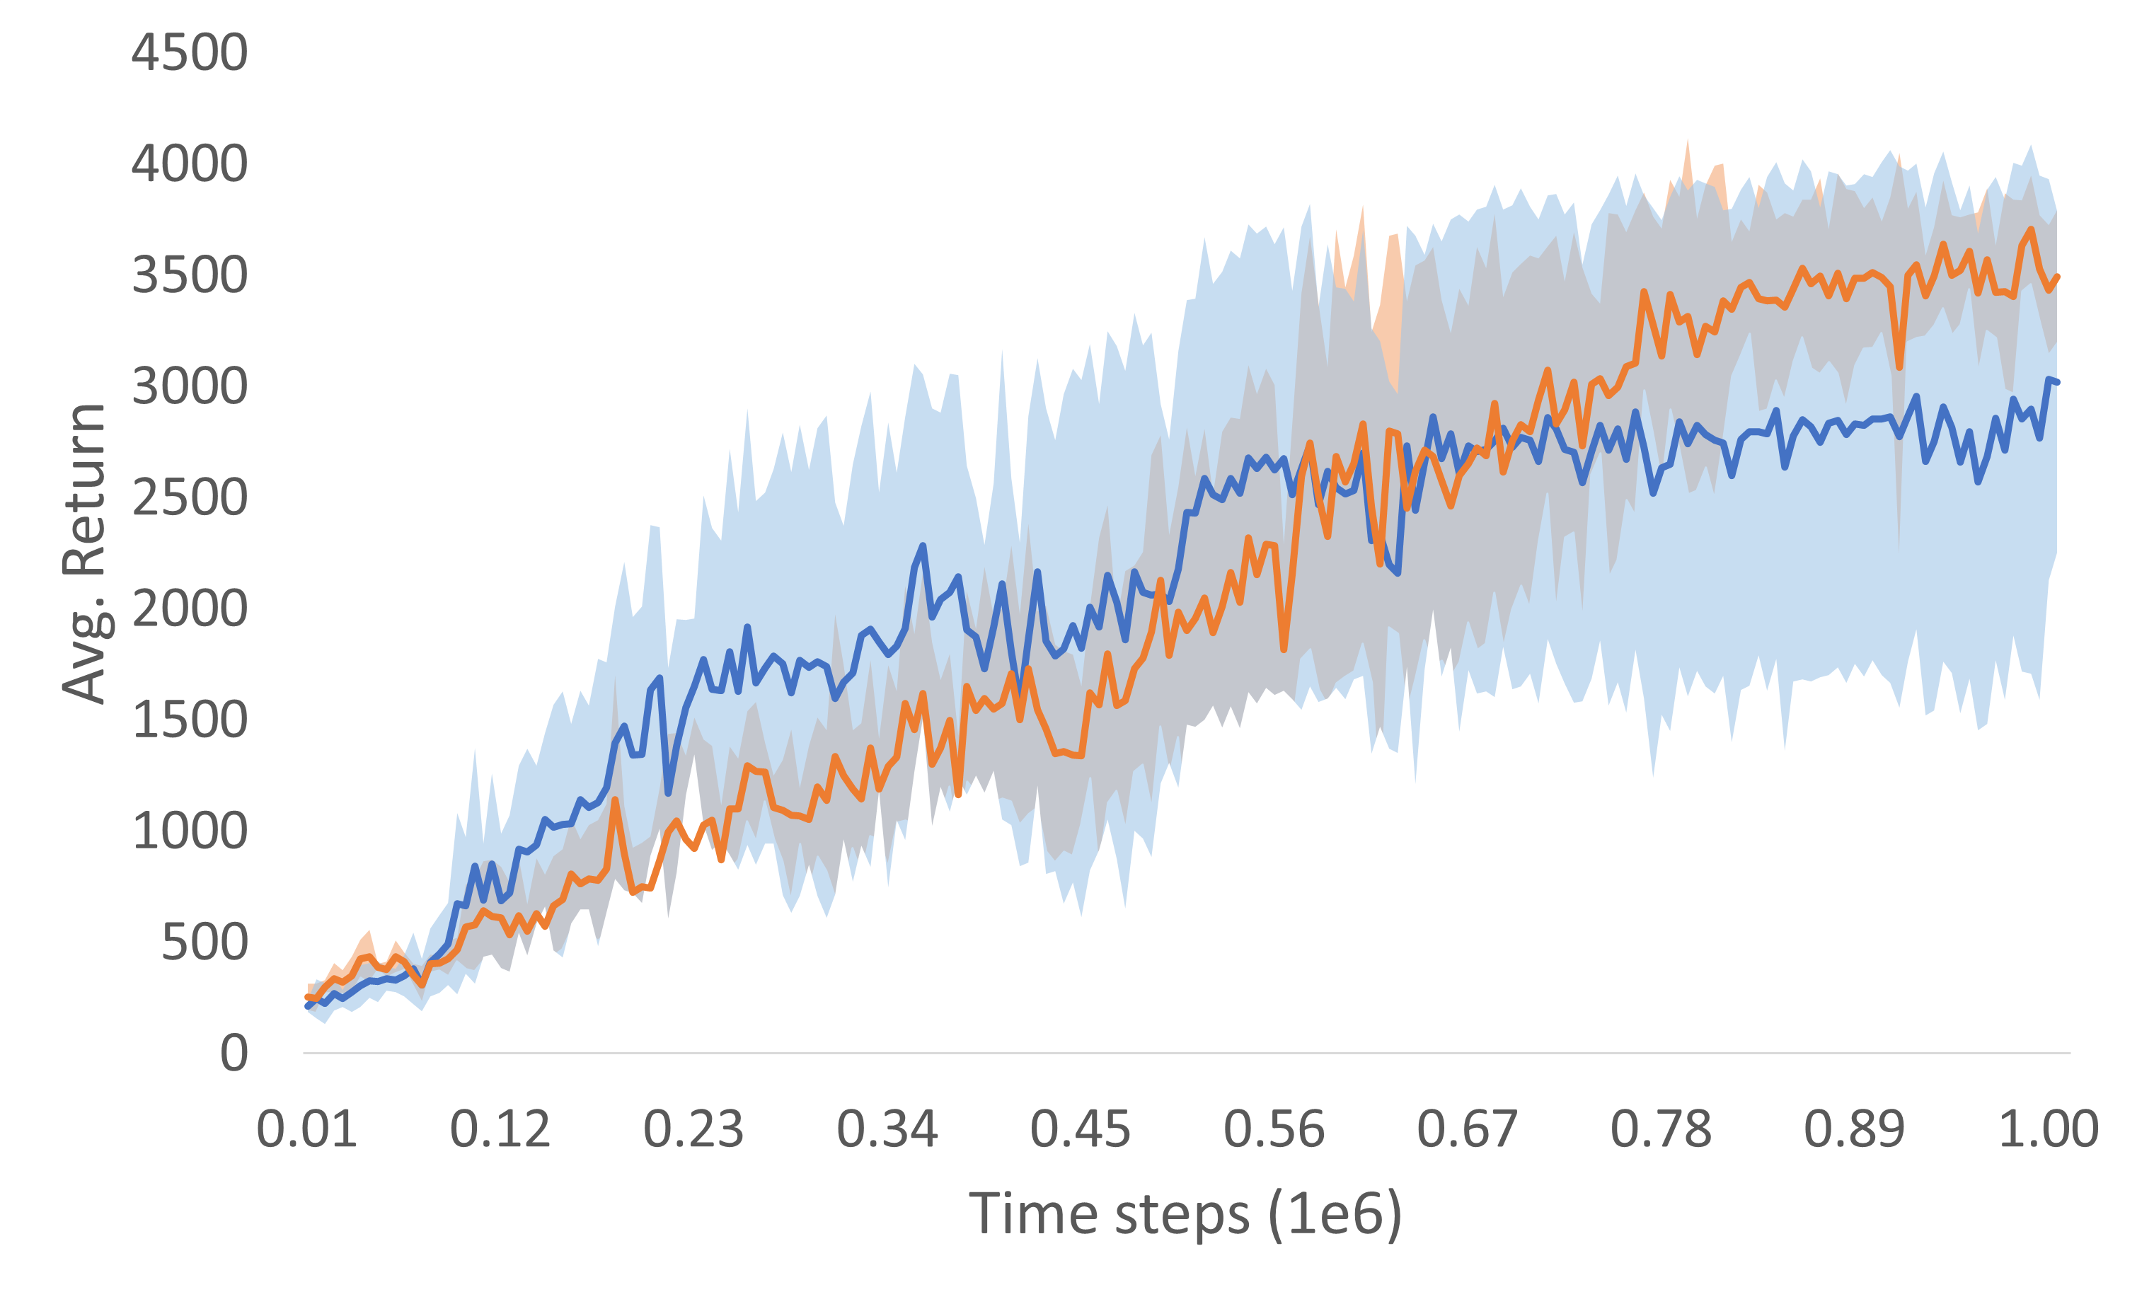
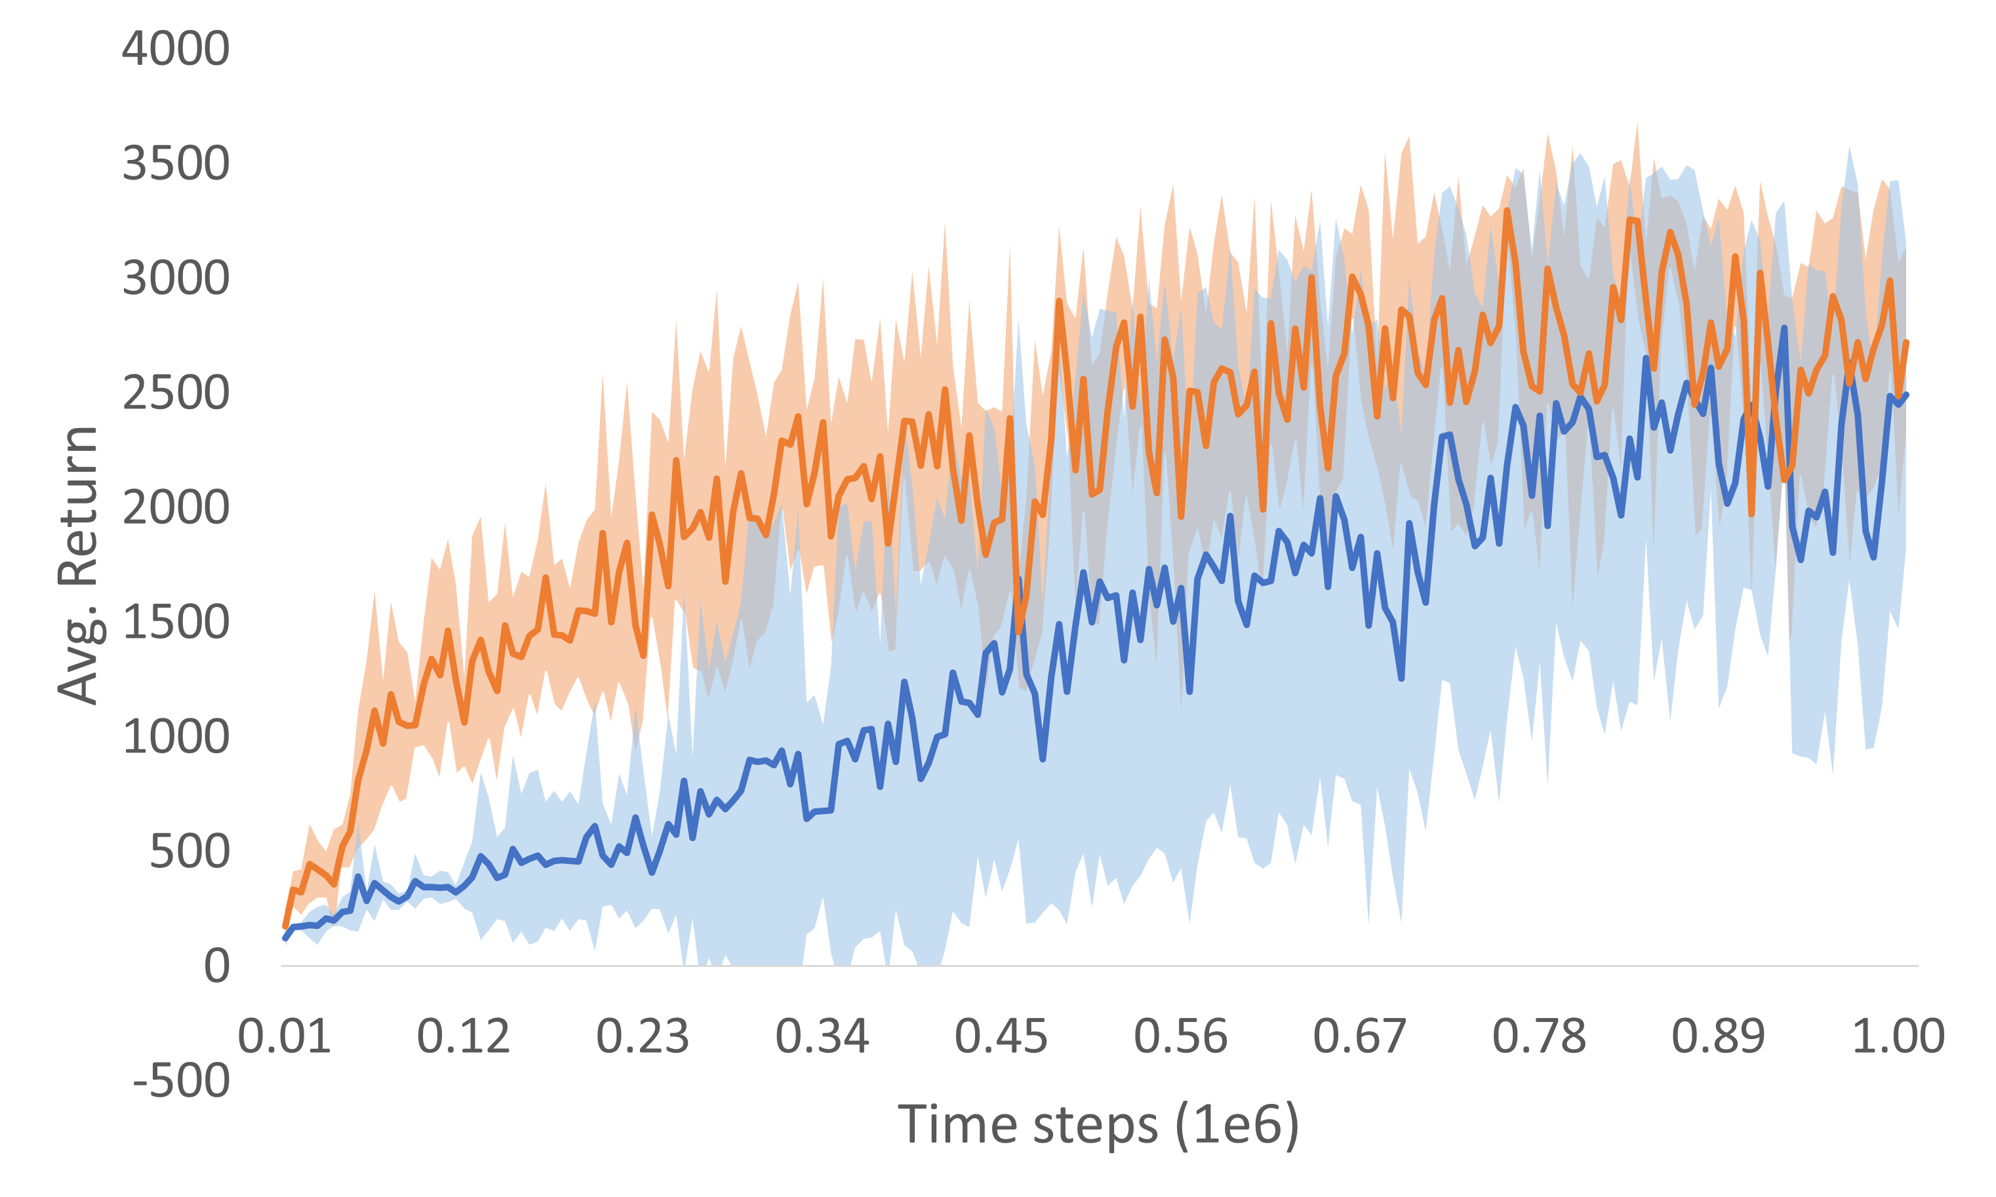
Efficient Control in Real Time Reinforcement Learning Using Temporally Layered Architecture
Devdhar Patel¹, Francesca Walsh¹, Joshua Russell¹, Zhongyang Zhang¹, Tauhidur Rahman¹, Terrence Sejnowski², Hava Siegelmann¹
¹University of Massachusetts Amherst, Amherst MA
² Salk Institute for Biological Studies, La Jolla, CA
Introduction
A fast constant response time for an RL agent is energy intensive and makes the learning difficult.
We developed a temporally layered architecture where each layer has a different response time allowing the RL agent to adapt its response time.
The fast action is gated based on its effect on the final action, reducing the action frequency and improving efficiency.
The fast layer is trained after the slow layer.
To measure efficiency, we introduce a new metric: Return Per Action (RPA).
We demonstrate performance on the MuJoCo continuous control environments.
Environment | TLA |  |  | TD3
 | Response Time | Avg. Return | RPA | Response Time | Avg. Return | RPA
InvertedPendulum-v2 | 0.04s, 0.08s | 1000 ± 0 | 1.9 | 0.04s | 1000 ± 0 | 1.00
InvertedDoublePendulum-v2 | 0.05s, 0.1s | 9358.94 ± 0.82 | 18.49 | 0.05s | 9358.48 ± 2.5 | 9.36
Hopper-v2 | 0.008s, 0.016s | 3443.21 ± 131.6 | 3.74 | 0.008s | 3032.25 ± 262.8 | 3.20
Walker2d-v2 | 0.008s, 0.016s | 3694.04 ± 128.58 | 3.96 | 0.008s | 3233.77 ± 895.3 | 3.23
Temporally Layered Architecture (TLA)
Critic Value Analysis
Results Overview
TLA outperforms the constant frequency networks on all environments tested while demonstrating efficient performance.
Learning curves suggest more stable learning with a lower standard deviation.
Gating the fast actions improves the efficiency and performance.
State-action values suggest that the fast controller discriminates between states that seem similar to the slow controller.
Hopper-v2
InvertedPendulum-v2
InvertedDoublePendulum-v2
InvertedPendulum-v2
Environment simulation
Environment paused
Manually designed Reflexes
Agent Processing
Environment simulating
Traditional RL
InvertedPendulum-v2
InvertedDoublePendulum-v2
s₀
a₀
s₁
a₁
s₂
a₂
s₀
a₀
s₁
a₁
s₂
a₂
Real-time RL
s₀
a₀
s₁
a₁
s₂
a₂
s₃
 | Seconds survived (Decisions made)
Res. speed | 0.16s | 0.08s | 0.04 | 0.02 | 0.01
w/o Reflex | 83.81 (534) | 109.21 (1366) | 127.8 (3195) | 152.68 (7634) | 138.4 (13840)
Reflex | 107.72 (674) | 129.14 (1618) | 132.23 (3306) | 159.63 (7982)
No action
a₀
a₁
a₂
Walker2d-v2
Hopper-v2
s₁
s₂
s₃

