Slide 1
MARL: Multi-agent Reinforcement learning

Slide 2
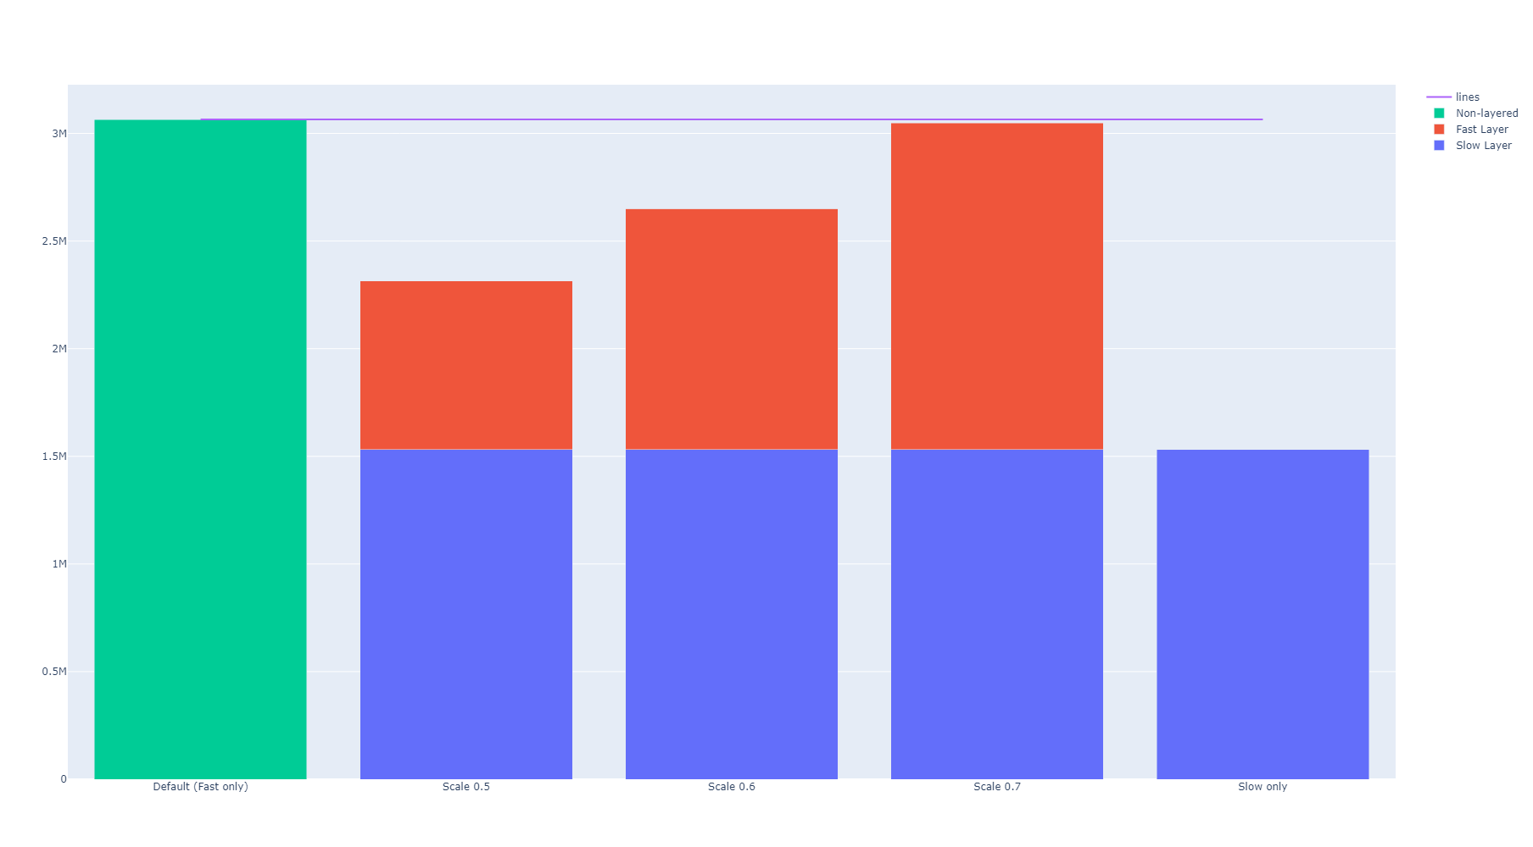
Scaling down the fast network makes the TLA compute efficient

Slide 3
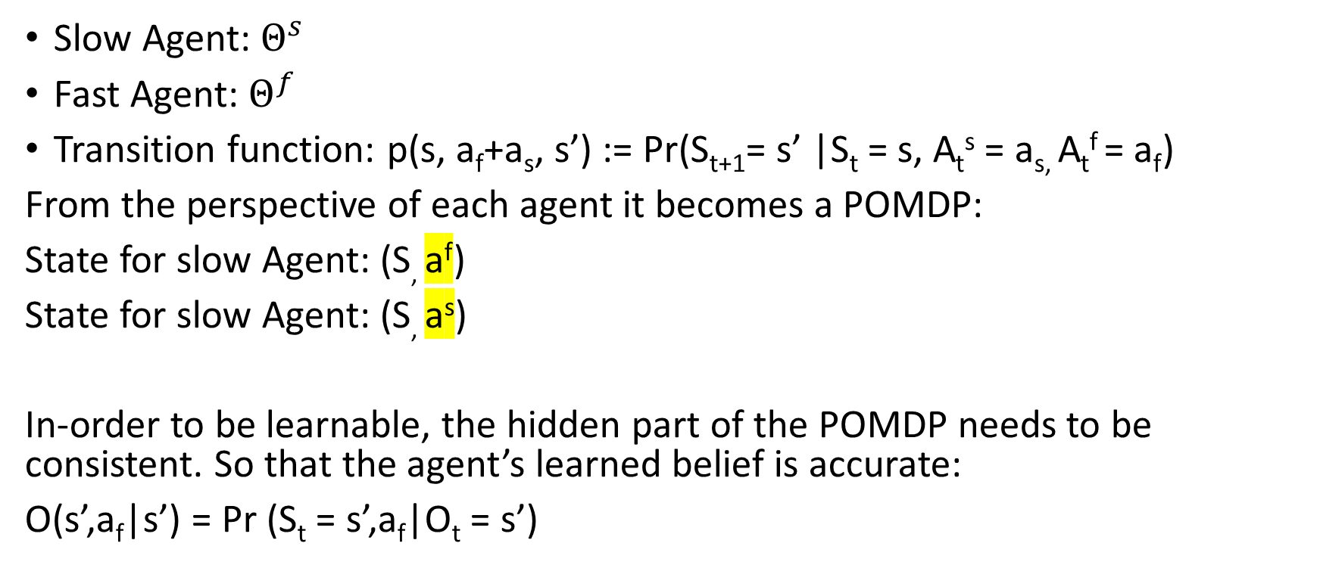
Temporally layered architecture as a Multi-agent system
Slow Agent: $Θ^{s}$
Fast Agent: $Θ^{f}$
Transition function: p(s, a_{f}+a_{s}, s’) := Pr(S_{t+1}= s’ |S_{t} = s, A_{t}^{s} = a_{s,} A_{t}^{f} = a_{f})
From the perspective of each agent it becomes a POMDP:
State for slow Agent: (S, a^{f})
State for slow Agent: (S, a^{s})
In-order to be learnable, the hidden part of the POMDP needs to be consistent. So that the agent’s learned belief is accurate:
O(s’,a_{f}|s’) = Pr (S_{t} = s’,a_{f}|O_{t} = s’)
Hidden

Slide 4
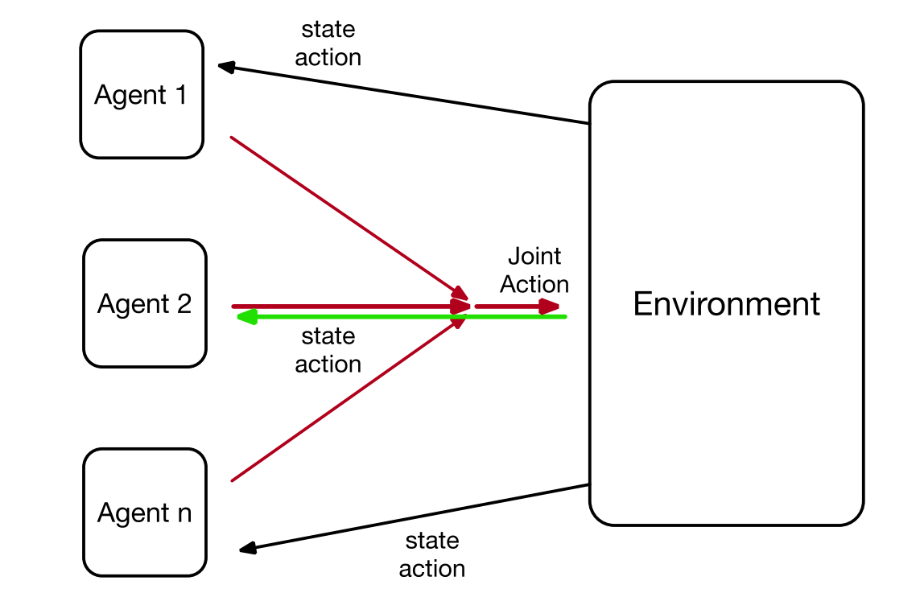
MARL
Types:
Fully cooperative (Same reward)
Fully competitive (Opposite reward)
Mixed games

Slide 5
Littman, Michael L.. “Value-function reinforcement learning in Markov games.” Cognitive Systems Research 2 (2001): 55-66.
THEROM 1:
In a single-agent environment, an agent following the Q-learning update rule will converge to the optimal Q-function with probability one. Furthermore, if the agent follows a (Greedy in the Limit with infinite exploration) GLIE policy and the optimal policy is unique, it will converge in behavior with probability one.+
THEORM 2:
In a multiagent environment, an agent following the Q-learning update rule will converge to the optimal response Q-function with probability one as long as all other agents converge in behavior with probability one. Furthermore, if the agent follows a GLIE policy and its best response policy is unique, it will also converge in behavior with probability one.
In an MDP, an optimal policy is one that maximizes the expected sum of discounted reward; it is undominated, meaning that there is no state from which any other policy can achieve a better expected sum of discounted reward. Every MDP has at least one optimal policy, and of the optimal policies for a given MDP, at least one is stationary and deterministic.
For many Markov games, there is no policy that is undominated because performance depends critically on the behavior of the other agents in the environment. How, then, can we define an optimal policy? An elegant idea from the game-theory literature is to define an agent’s optimal behavior as being its behavior at a Nash equilibrium. A set of policies π₁,…, π_{n} is in Nash equilibrium if each is a best response to the others.
At a Nash equilibrium, each agent is maximizing its reward given that all other agents remain fixed.

Slide 6
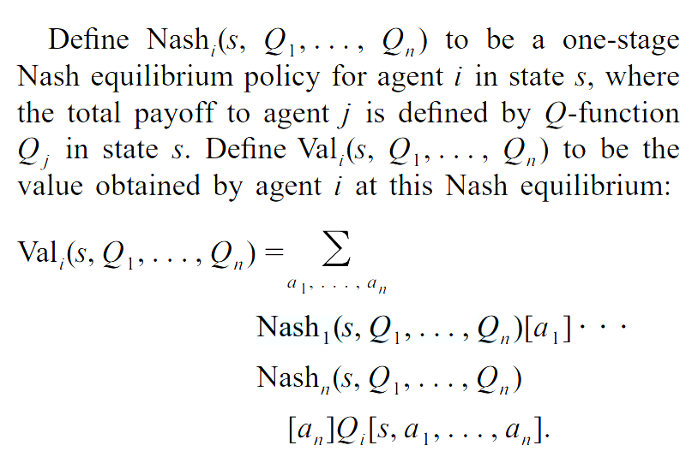
Nash Q-learning
The expected value is taken over all possible joint actions of the n agents, where we expect each agent to select actions according to the Nash equilibrium policy it chooses.
Note:
Note that Val_{i} need not be unique, in general, as games can have multiple Nash equilibria with different values.
Even if a game admits only one value of Val_{i}, it need not be the case that the policy Nash_{i} achieves this value, because other agents can choose other Nash equilibrium policies that don’t fit with Nash_{i}.
Finally, even if there is a unique Nash equilibrium, Nash_{i} need not achieve Val_{i} because other agents might not choose equilibrium strategies at all.

Slide 7
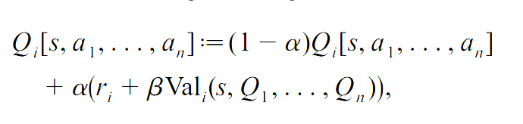
Nash Q-learning
Since the Nash and Val functions extend the notion of greedy action choice with argmax and max in MDPs to Markov games, a natural extension to the update rule from Q-learning is to use the Nash equilibrium value in place of the max to estimate each agent i’s Q-function:
given an experience tuple 〈s, a₁,…, a_{n}, r₁,…, r_{n}, s′〉. This learning algorithm is not known to converge in general, even if there is a unique value of the game. Some conditions to guarantee convergence are given in the next two sections. Note, however, that Hu (1999) and Hu and Wellman (2000) found that the rule sometimes converged in simulations even when the strict assumptions needed to guarantee convergence were not satisfied.

Slide 8
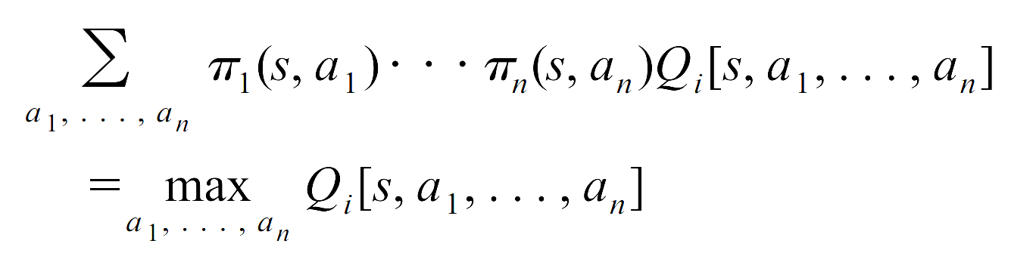
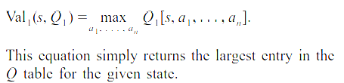
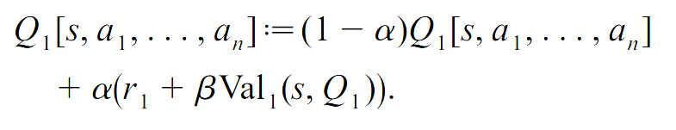
Coordination equilibria
Define a coordination equilibrium in an n-player game as one for which all agents achieve their maximum possible payoff.
Theorem 5
In a multiagent environment, an agent following the Nash Q-learning update rule will converge to the optimal Q-function with probability one as long as all Q-functions encountered have coordination equilibria and these are used in the update rule. Furthermore, if the agent follows a GLIE policy and the limit equilibrium is unique, it will converge in behavior with probability one.
Team Q-learning
In team games, all agents get the same reward, therefore, there is only a single Q-function that needs to be learned..
Update rule:

Slide 9
In a sense, team Markov games are harder. A set of team Q-learners will converge to optimal play if the limit Q-functions have a unique maximum for each state. If not, even though all agents will converge on an equilibrium, if they converge on different equilibria, they can score arbitrarily poorly. This is also true of a Q-learner among team Q-learners.
Claus and Boutilier (1998) examined simultaneous Q-learners in team games. They argue that two such learners converge to a Nash pair, although it need not be the optimal one. As far as I know, no formal proof has been presented. Nonetheless, Sen et al. (1994), Mundhe and Sen (2000) and others have successfully applied this technique to particular games, validating it as a reasonable approach.

Slide 10
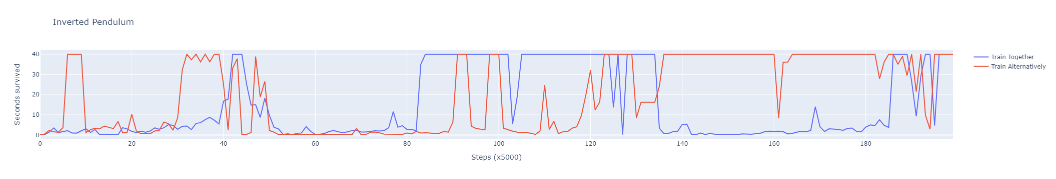
Simultaneous Q-learners

Slide 11
TLA as a team game
The limit Q-functions are not unique
If we penalize fast actions (or slow actions), they become unique
However, normally this would result in the fast or slow network always outputting zero.
If the slow network is sufficiently slowed so that a sufficiently complex unique non-zero fast policy is optimal, the energy consumption would be minimized.
Slow Controller
Slow, Long Action
Fast Controller
Short, Fast
Action
Observation
Common Critic
reward
Environment
Combined
Action

