Slide 1
Value Proposition
Customers automatically recognized by
RFID or NFC tags
Register sale in VendHQ automatically
No queuing to order – customer convenience and operational/staff efficiency

Slide 2

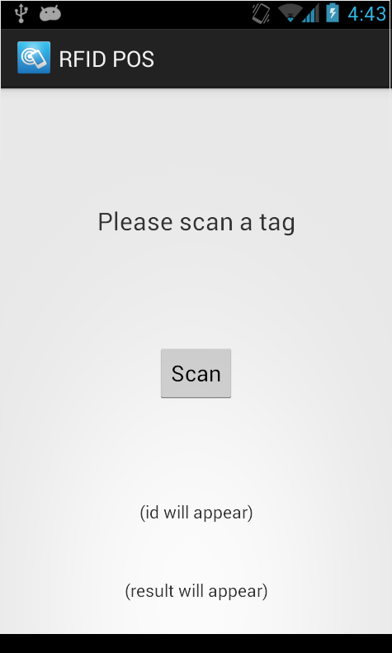
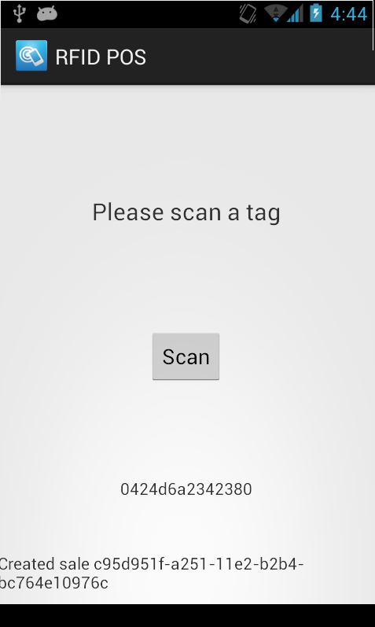
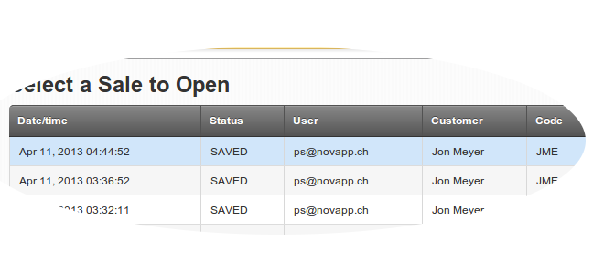
Proof of Concept
①
RFIDPOS app on
Android device
is started manually
(or automatically
on first scan)
②
App identifies the
card (UID) and
transmits it's ID
to the RFIDPOS
web service (using
WiFi or 2G/3G
internet connection)
Card ID
New Sale ID
Could show
More information
(product, price etc.)
③
The web service talks
to VENDHQ and creates
a new sale with a
pre-configured
product
④
Sale can be shown
and changed in
VendHQ
The whole process
takes 1-2 sec max.

Slide 3
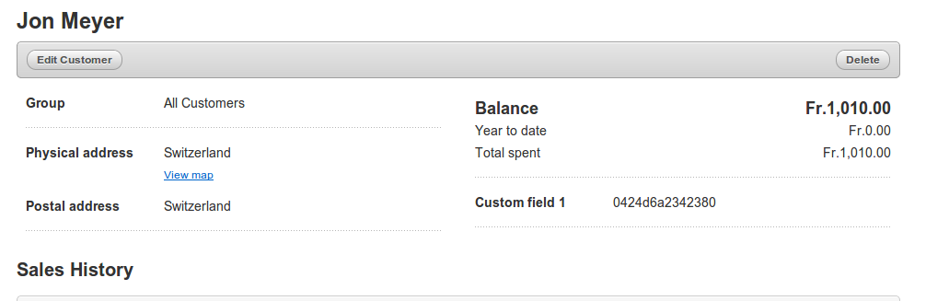
Card ID / Customer Link
Card ID
This must currently be done manually. In the future, RFIDPOS
will provide a „linkCustomer“ web service to allow this from the
Android device and/or using a web UI.

Slide 4
Architecture / Data Flow
NFC Tag
Tag is scanned
Customer &
Product Cache
RFIDPOS
Android
/cardtrx?cardid=<id>
RFIDPOS
web service
create sale
sync
VendHQ

Slide 5
Security/Privacy Concerns
Card Security
MiFare Classic (NFC) or ISO-18000 6C (RFID) provide security features (against card cloning and spoofing)
Loss of card not a problem since card does not store any information other than it's UID and security profile.
Any cards not known to RFIDPOS will not be accepted. Spoofed cards will not contain a valid security profile so no tempering is possible (to be verified).
RFIDPOS Security and Customer Privacy
RFIDPOS web service keeps only mapping between Customer ID, Card and Products in memory/cache (no names, addresses etc. stored in RFIDPOS *)
Card/Tag only stores UID and security profile. No customer data can be extracted using the data on the card.
VendHQ security (spoof sale with invalid or third party card?)
VendHQ stores Customer-2-Card mapping. Could be tampared by staff – if this is a concern, RFIDPOS would be used to store this mapping taking information out of reach of staff.
*) Disclaimer
Proof of concept used MiFare Ultralight NFC cards, and RFIDPOS caches all customer and product data for reasons of simplicity (security not a concern in PoC)

