Slide 1
DO-DOTASK

Slide 2
TABLE OF CONTENTS
01
02
03
ABOUT THE PROJECT
Project goals
Business model canvas

Slide 3

ABOUT THE PROJECT
Do-dotask is a web application that can help people manage their time using automated time managing functions.

Slide 4
PROJECT GOALS
To let the product be well known
To earn and improve

Slide 5
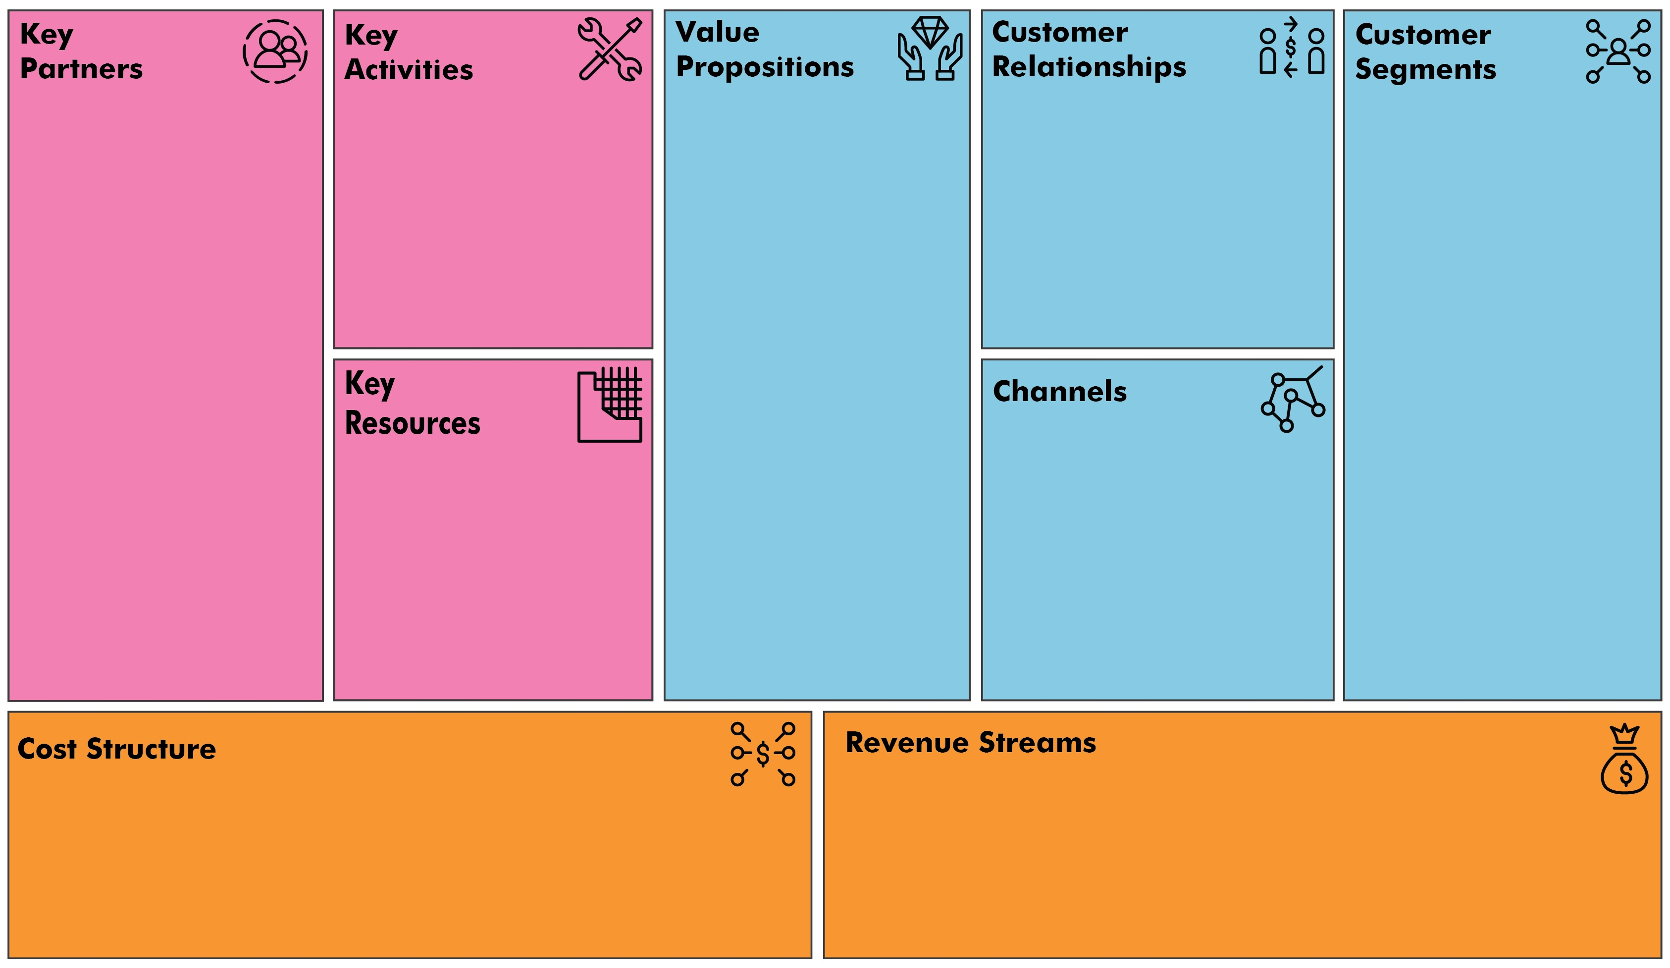
Business model canvas
☛ Web designing
☛ Web application development
☛ Improves time managing skills
☛Integrity and security of data for time managing
☛Self Service
☛ Demographic Segmentation
☛Technographic Segmentation
☛ Programmers
☛ Web Designer
☛ System Analyst
☛Web Developer
☛Computer(Desktop, Laptop)
☛ Online Service
☛Advertisements
☛ Marketing
☛ Business Development
☛ 3rd Party Licenses
☛ Service
☛ May bayad ba to?

Slide 6



OUR TEAM
Leevan jones s. olipane
Larry mirador
Angelo james h. aguirre

Slide 7
THANKS!
Please keep this slide for attribution

