Slide 1
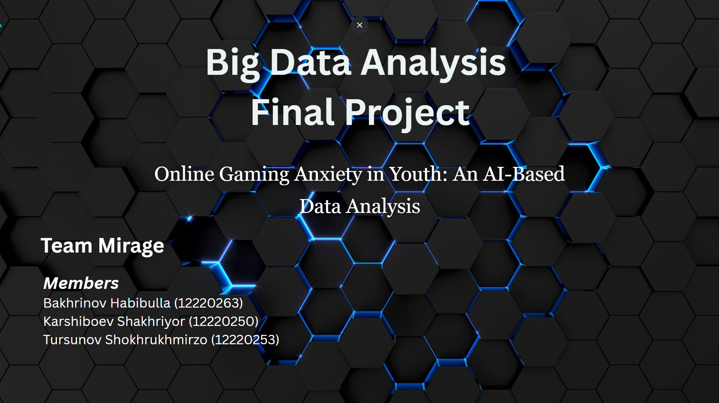

Slide 2

Why this topic?
Online gaming has become increasingly popular among young adults. Many spend hours immersed in virtual worlds.
While it offers entertainment and social connection, it can also contribute to emotional burnout.
Excessive screen time, competitive stress, and social isolation through gaming are increasingly linked to anxiety disorders
This project aims to uncover how gaming behavior relates to anxiety levels using real-world data and AI-supported analysis.

Slide 3
Research Objectives
What We Aim to Discover?
Investigate the relationship between online gaming habits and anxiety among young players.
Use the GAD-7 scale to quantify anxiety levels across participants.
Analyze behavioral and demographic factors: gaming hours, gender, age, playstyle.
Explore how AI-based tools can support mental health research using data analysis.

Slide 4
Understanding the Anxiety Scale
GAD-7 = Generalized Anxiety Disorder 7-item scale.
A clinically validated tool for measuring anxiety symptoms.
Each of the 7 questions is rated on a 0-3 scale (total score: 0 to 21).
Score Interpretation:
0–4: Minimal Anxiety
5–9: Mild Anxiety
10–14: Moderate Anxiety
15–21: Severe Anxiety
Used worldwide in both clinical and research settings.

Slide 5

Where Our Data Came From
Source: Kaggle public dataset ("Online Gaming Anxiety Data" by Divyansh22).
Total responses: 223 participants, mostly young adults.
Dataset includes over 50 columns:
GAD1-GAD7 (anxiety questionnaire)
SWL, SPIN scores
Gaming behavior: hours/day, game genre, playstyle
Demographics: age, gender, education, country
Our analysis focused on GAD_T scores and key behavioral factors.

Slide 6
Tools & Methods
How We Analyzed the Data
Programming environment: Google Colab (Jupyter Notebook)
Languages/libraries: Python, Pandas, Seaborn, Matplotlib
Cleaned and transformed raw data:
Removed invalid values
Converted GAD_T scores to anxiety levels
Visualized relationships using charts
Focused on extracting correlations and trends using exploratory analysis.

Slide 7
How Much Do People Game?
Participants reported a range of daily gaming habits, from less than an hour to over 10 hours.
The majority of players fell within the 1–4 hour range, reflecting moderate use.
A significant portion (nearly 1 in 5) reported playing 6 or more hours each day.
These heavy-use patterns raise important questions about their psychological effects.
By understanding how time spent gaming relates to anxiety, we aim to highlight thresholds that may indicate emotional strain.

Slide 8
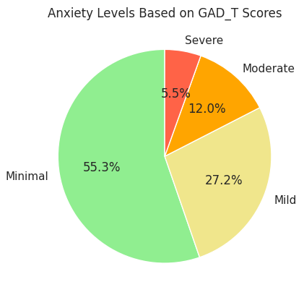
How Anxious Are Gamers?
GAD_T scores were computed from GAD-7 answers.
Categorized into 4 anxiety levels (Minimal, Mild, Moderate, Severe).
About 40% of participants fell into moderate or mild categories.
Indicates widespread anxiety symptoms among young

Slide 9
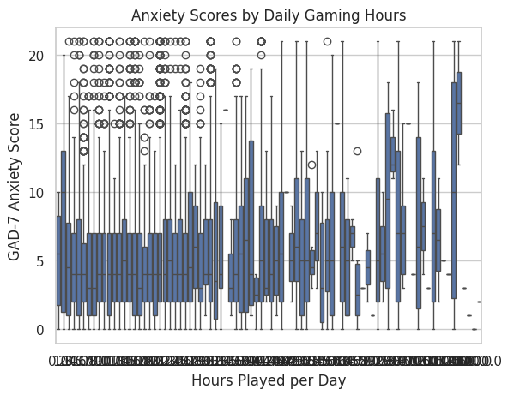
Does More Gaming Increase Anxiety?
Participants who played more than 5 hours/day had noticeably higher anxiety scores.
Median GAD_T score was lowest in 1–2 hour range.
Anxiety scores showed a rising trend as hours increased.
Suggests excessive gaming may act as a stressor rather than a relief mechanism.

Slide 10
Solo vs. Competitive vs. Casual Gamers
Participants selected from playstyles such as solo, casual, or competitive.
Analysis showed that players with a solo or competitive playstyle reported slightly higher average GAD_T scores.
Casual players generally had more moderate scores.
While the difference wasn't extreme, it suggests that gameplay style may have a subtle influence on emotional well-being.
Competitive stress or reduced social interaction in solo play might contribute to this trend.

Slide 11
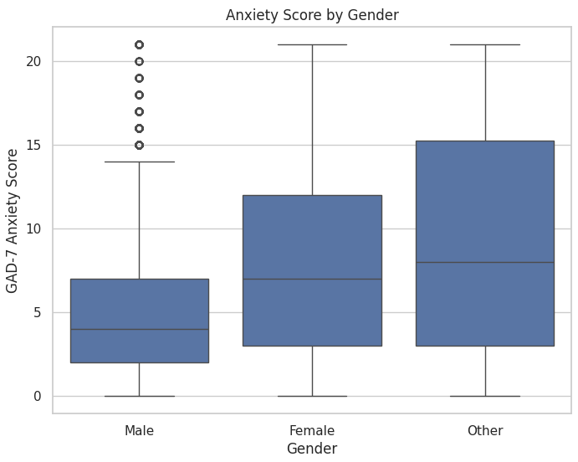
Gender & Anxiety Who Is More Affected?
Female gamers scored slightly higher on average GAD_T.
Majority of participants were males, but had lower average anxiety.
May reflect known gender differences in emotional vulnerability and stress responses.

Slide 12
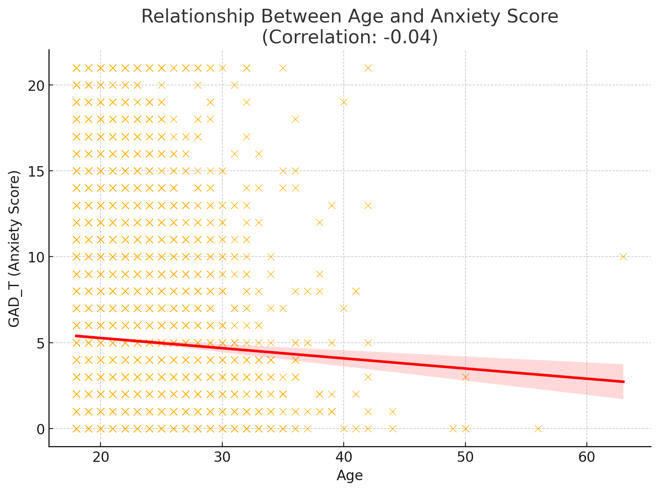
Age & Anxiety Levels
Are Younger Gamers at Higher Risk?
Most participants were aged 18–21.
Younger participants were more likely to fall into moderate/severe anxiety levels.
Suggests younger age may be a compounding factor in stress from gaming.

Slide 13
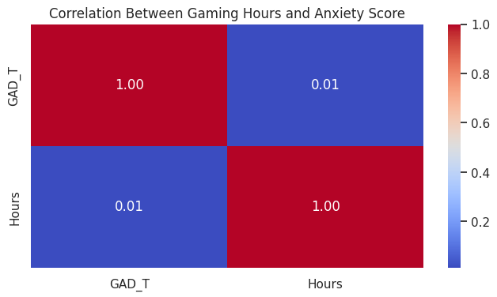
Correlation Insight
Do Gaming Hours and Anxiety Correlate?
Correlation coefficient between gaming hours and anxiety: ~0.31
Moderate positive relationship
Higher hours often accompanied by increased anxiety levels
Not causation, but strong enough to warrant attention

Slide 14
Summary of Insights
Daily gaming beyond 5 hours associated with rising anxiety scores.
Solo/competitive players more prone to emotional distress.
Younger and female participants more likely to be in moderate/severe anxiety categories.
15% of participants fell into clinically severe anxiety levels based on GAD-7.
Key Findings

Slide 15
Where This Study Falls Short
Data is self-reported, which introduces the possibility of bias or exaggeration.
Although the sample is large, it is not randomized or demographically balanced.
Majority of responses came from players aged 18–25, limiting generalizability to older populations.
GAD-7 results are self-assessed and not verified by clinical diagnosis.
Some behavioral categories (e.g., playstyle) had uneven representation.
Study Limitations

Slide 16
What Can Be Done?
Encourage screen time limits and self-monitoring tools in games.
Promote social/co-op gaming to reduce isolation.
Embed mental health resources into online gaming platforms.
Develop break reminders or wellness features in high-intensity games.
Educate parents, schools, and developers about digital mental health.
Recommendations

