Slide 1
Rust API
Growth Session 2

Slide 2
Summary
Rust
  pro and cons
  difference with NestJS
Project
  requirements
  management
  demo

Slide 3
Rust
Pros
Rapidity
Memory consumption
Embeddable
Integration
Time saving
Cons
Complexity
Learning
Compilation

Slide 4
Rust vs Node
Rocket REST API
  72 000 requests per second
  1MB memory used
Rocket REST API
  4 to 8ms response time
Nickel web framework
  100x faster
Restify REST API
  8 000 requests per second
  19MB memory used
Express REST API
  2 000 to 20 000 ms response time
Restana web framework
  100x slower

Slide 5
Project requirements
For this API it’s wanted that a user can be created with a name, no other field is required.
A user will be able to create a joke with a punch, this punch is not required.
Other users will then have the possibility to vote for a joke. This vote can be up or down. A user can not vote for his jokes.

Slide 6
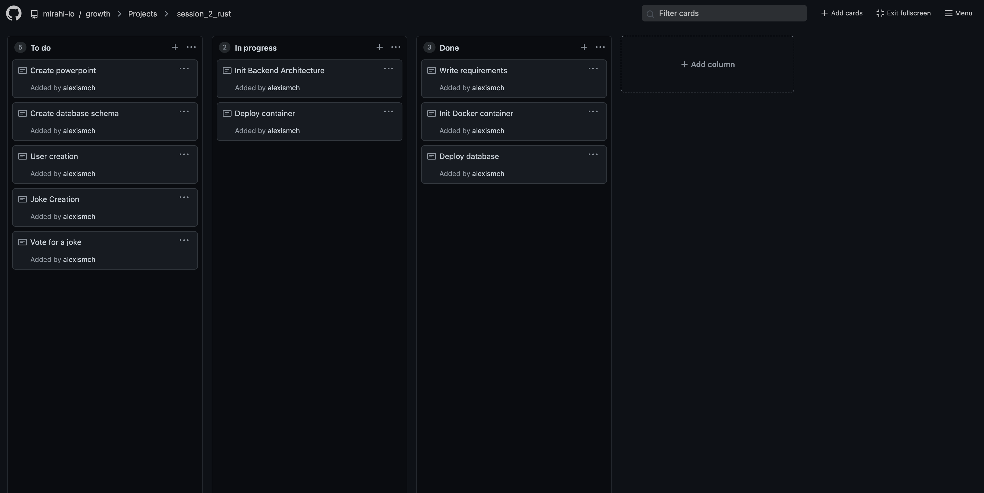
Project managment

Slide 7
Build & deployment

Slide 8
Demo

