Slide 1
SolidJS
Mirahi growth session APRIL 22th 2022​

Slide 2
Community & ecosystem
Open Source since 2018 => new in the competition
Not a lot third-party
11.5k weekly npm downloads

Slide 3
Similarities between SolidJs and React
JSX first class support
Declarative nature
Unidirectional data flow

Slide 4
Differences between SolidJS and React
Absence of a virtual DOM
Components don’t re-render
Fine-grained reactivity
=> SolidJS much faster

Slide 5
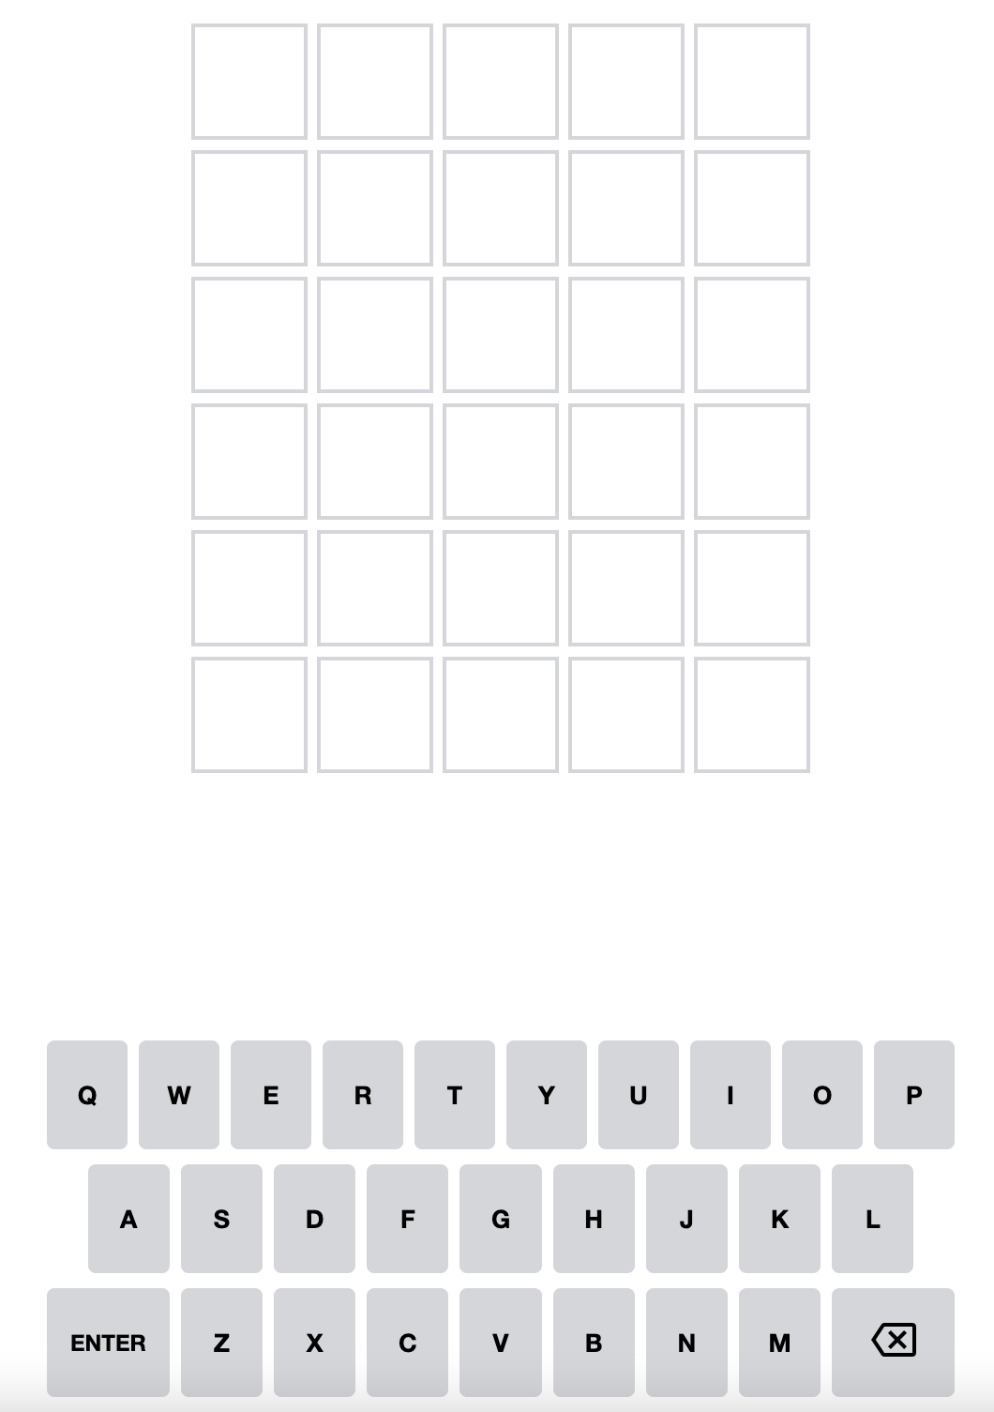
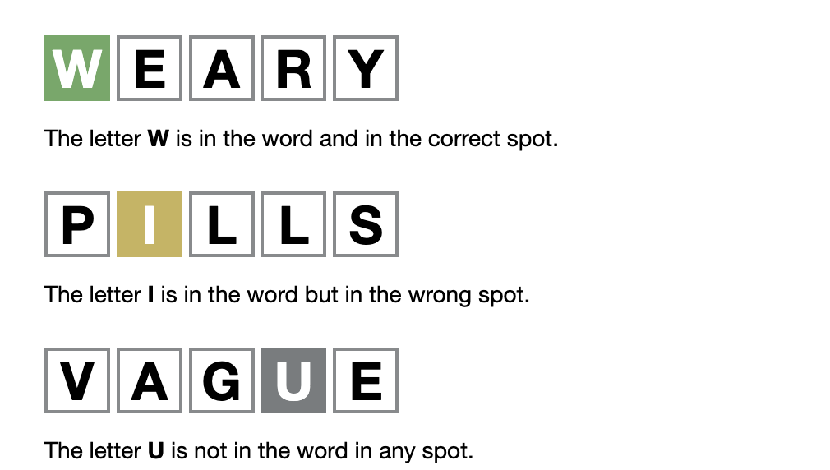
Today growth goal
Create a Wordle with SolidJS

Slide 6
Setup
Turborepo
3 wordle apps
Solidjs
Reactjs demo
Vuejs demo
Styles lib with vanilla extract
Automatic deploy to vercel with github action
Open source project

Slide 7
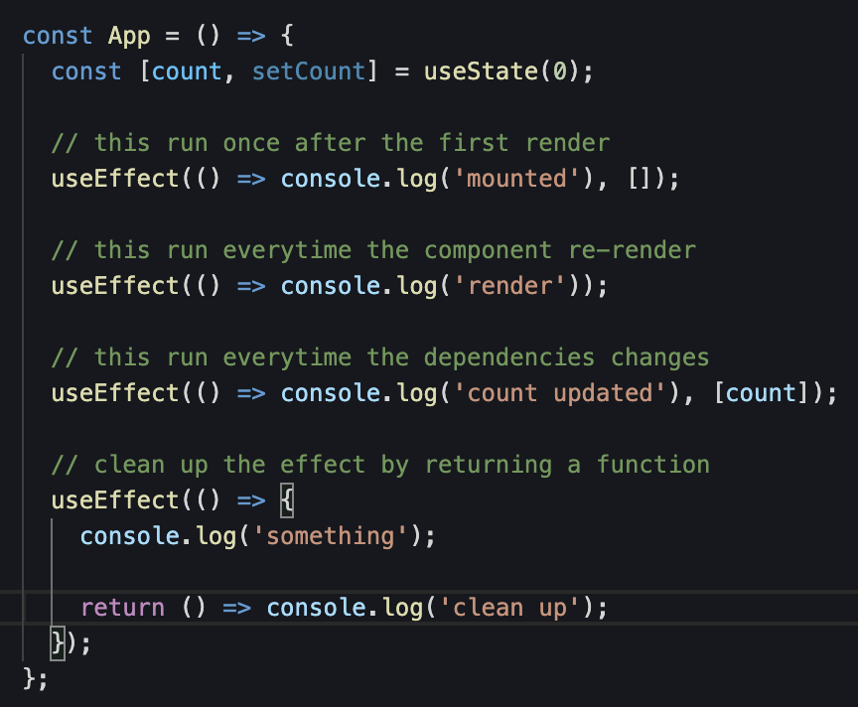
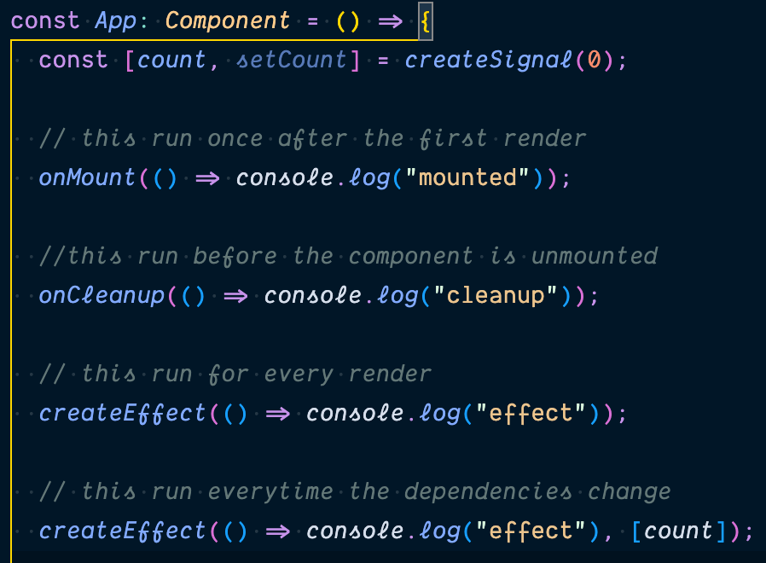
UseEffect VS SolidJS lifecycle hook

Slide 8
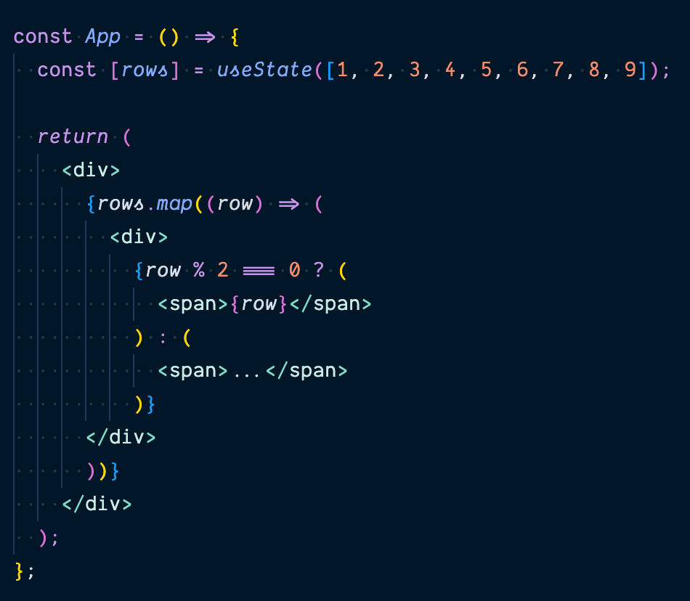
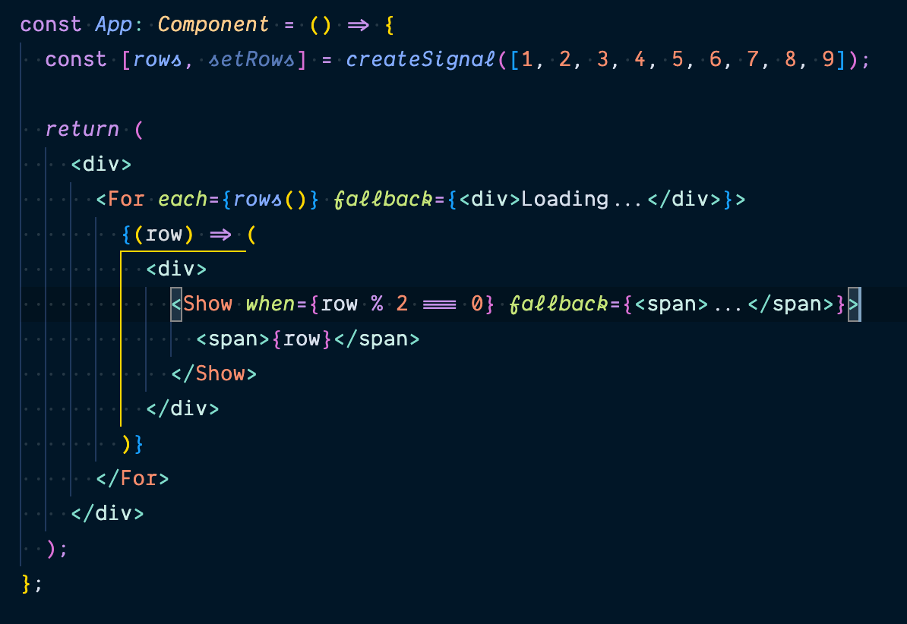
List render and the conditional display

Slide 9
Problematics
Component <For /> checking values reference
Don’t forget to execute signal accessor
Reactivity a bit strange when you come from react
Documentation not always clear

Slide 10
Let’s play
https://mirahi-solid-wordle.vercel.app

Slide 11
Questions?

Slide 12
Conclusion
SolidJS is a great framework
Maybe when you need more performances
VS svelte?

