Slide 1
Rebuild our website with Remix
Migrate our website from Next.js to Remix framework and rewrite UI library components to be compatible with Remix.

Slide 2
Summary
Introduction
Remix vs Next.js
Goals
Difficulties/process
Conclusion
What’s next?

Slide 3

Introduction
What is Remix?
“Remix is a full stack web framework that lets you focus on the user interface and work back through web fundamentals to deliver a fast, slick, and resilient user experience.”
It is a React framework built on top of React Router v6

Slide 4
Goals
Learn more about Remix and how it works compared to Next.js
Acquire knowledge with Remix to maybe use it with clients
Possibly improve performance on our website
Display the landing page completely

Slide 5
Remix vs Next.js
Remix is at least equally fast compared to Next.js at serving static content
Remix automatically handles errors, interruptions, and race conditions, Next.js doesn’t
Remix enables fast user experiences even on slow networks
…

Slide 6
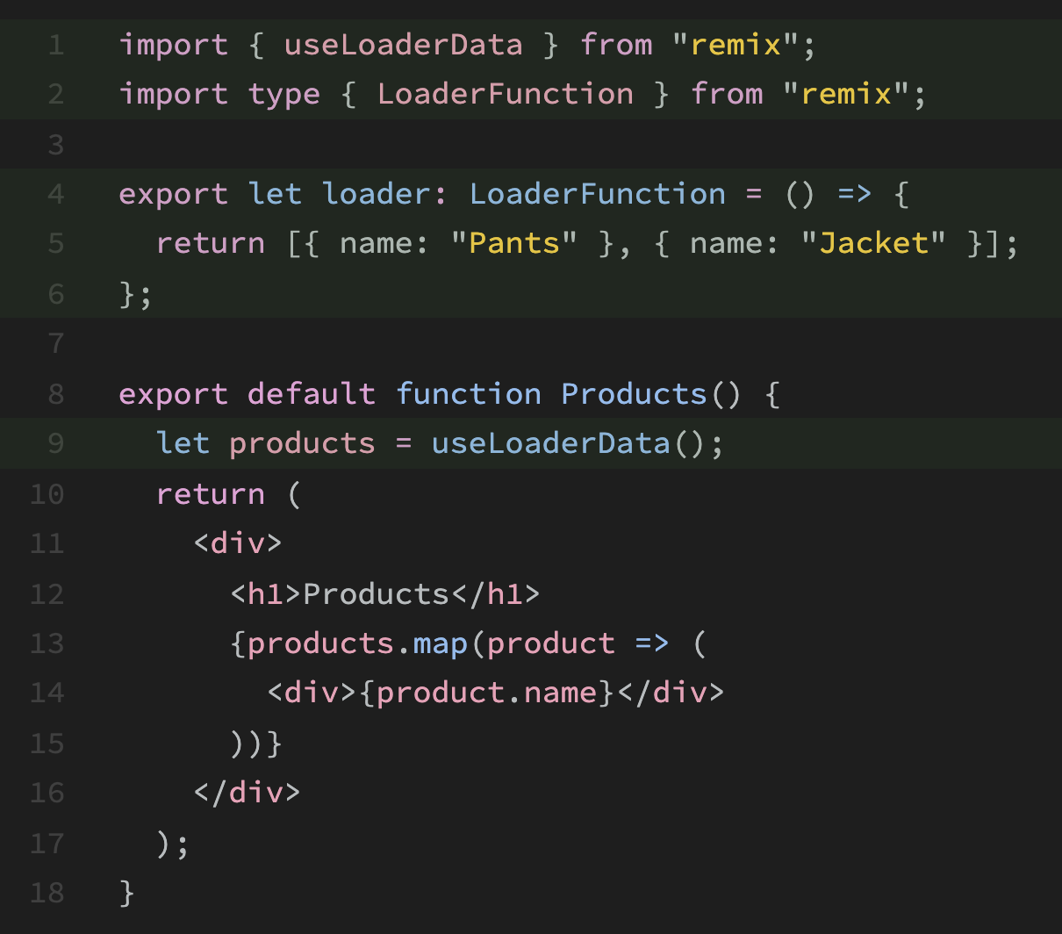
Remix vs Next.js
Data loading in Remix

Slide 7
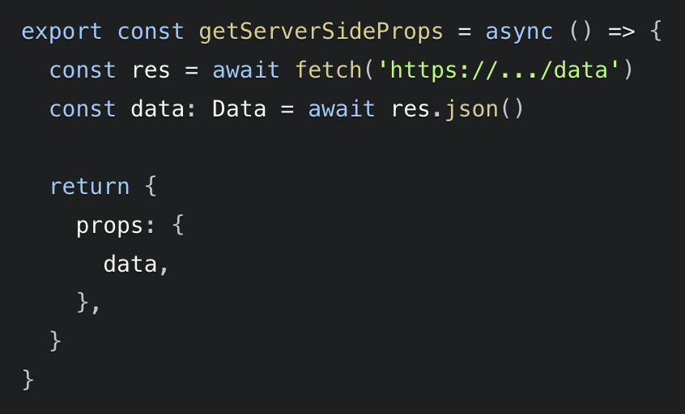
Remix vs Next.js
Data loading in Next.js using SSR

Slide 8
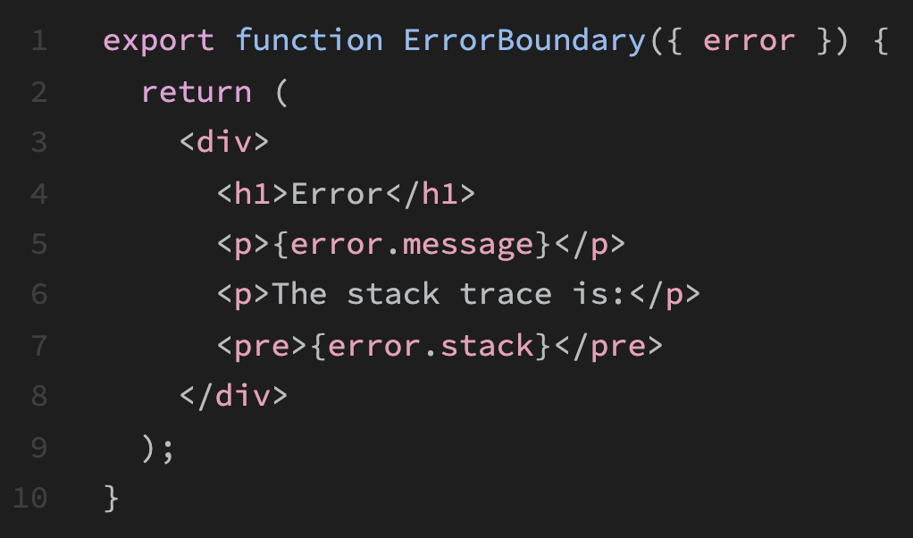
Remix vs Next.js
Catch errors in Remix routes
This component will render whenever there is an error on the route, either during rendering or data loading

Slide 9
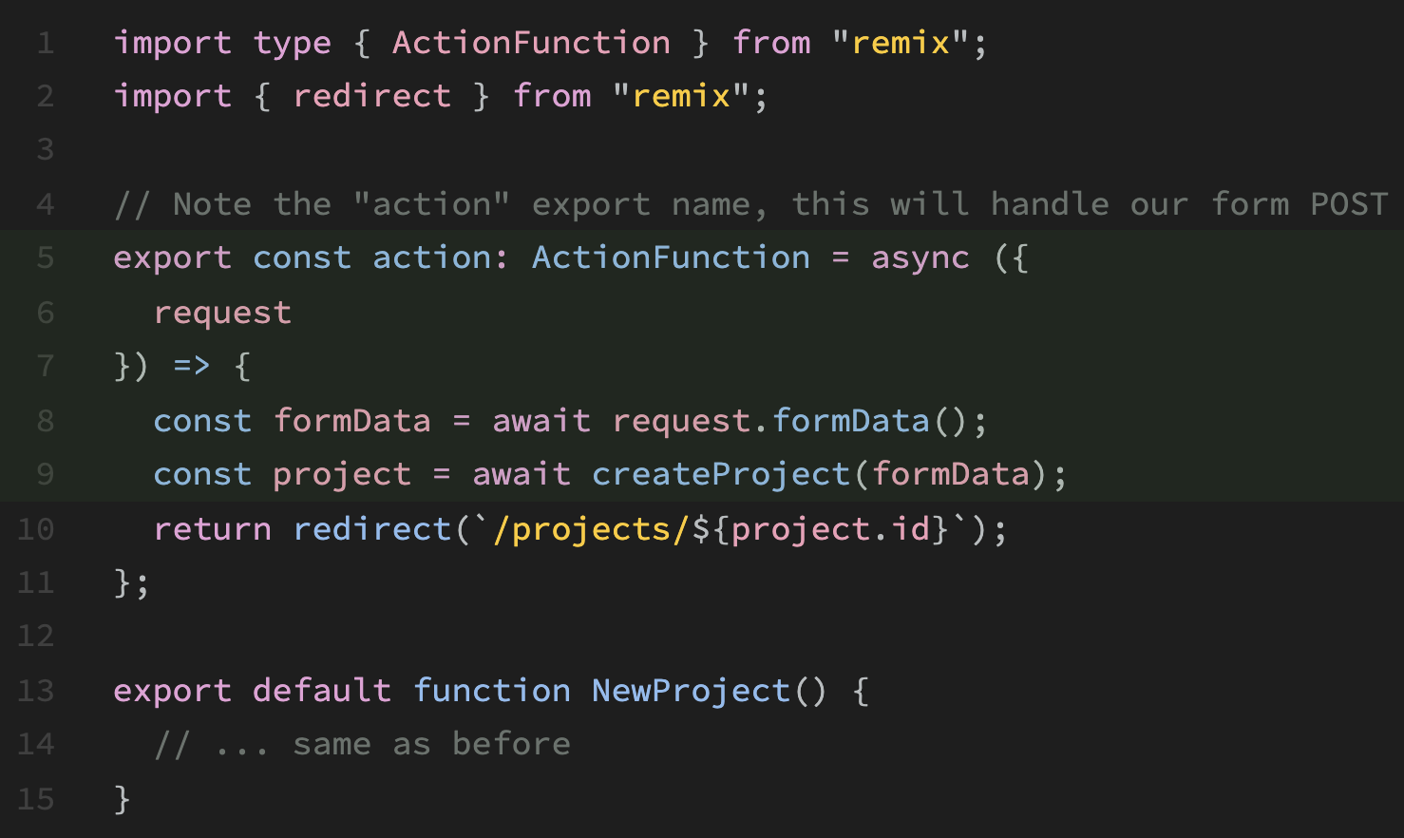
Remix vs Next.js
Data writes (mutations) in Remix

Slide 10
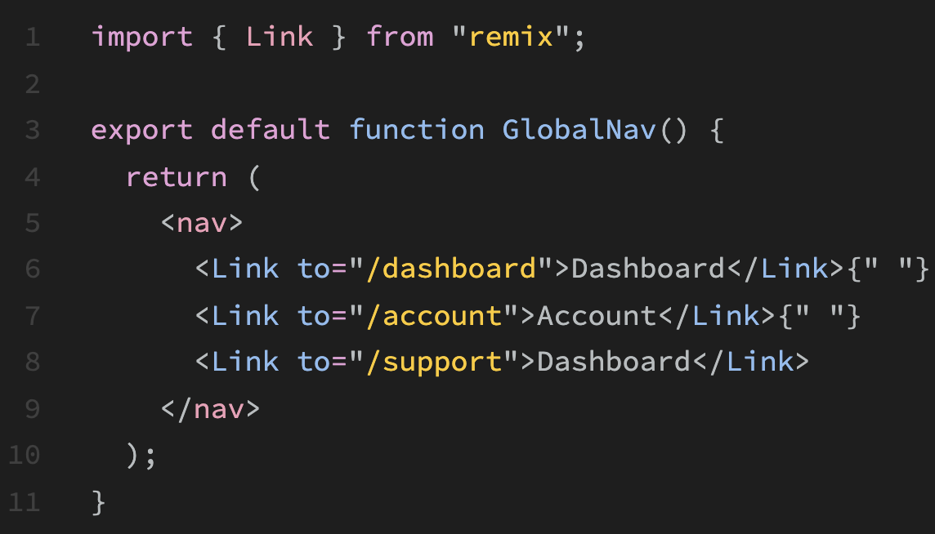
Remix vs Next.js
Routing in Remix

Slide 11
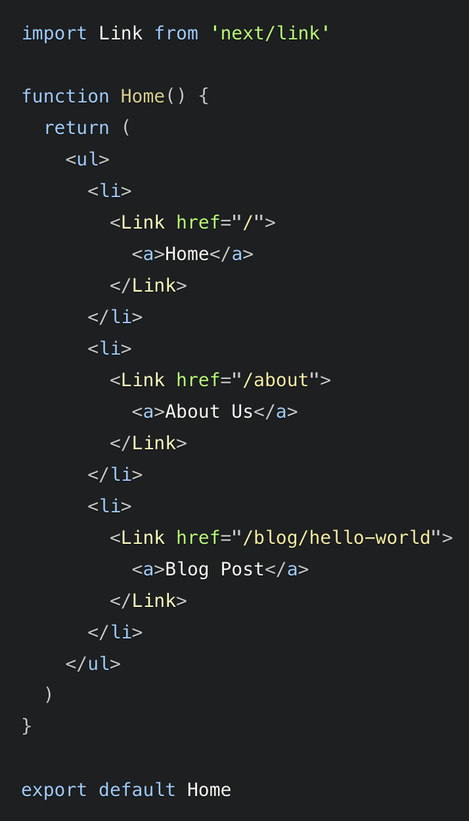
Remix vs Next.js
Routing in Next.js

Slide 12
Difficulties/process
Initiate the Remix app inside the Nx monorepo
Rewrite the UI library to be compatible with Remix
Use the new library from Prismic and replace the old one
Getting rid of React Query
Migrate components, endpoints, etc… from Next.js app to Remix app
Replace Next.js functionnalities with Remix ones
Because Remix is new, the official documentation is not completed yet and there is a lack of uses case

Slide 13
Demo time

Slide 14
Conclusion
Remix plugin for Nx is currently not stable nor “production ready”
It’s not simple to migrate from Next.js to Remix
It’s possible to migrate our website like we did, but it would be cleaner to start from scratch
Writing code with Remix is actually nice
Next.js comes with SSG out of the box, Remix doesn’t, it comes only with SSR

Slide 15
What’s next?
Shall we continue the migration or we start over from scratch?

