Slide 1
Food Deserts in New Jersey
A deep dive to find potential counties to open fresh food stores

Slide 2
Objective of the case study
Find a county (or counties) in New Jersey which has food desert and will be a good candidate for investment in fresh food/ retail grocery sector
Find meaningful correlations between existence of food deserts and other demographic data points
Explore linear predictive model(s) to identify impacted population size for existence of food desert in a county and logistic regression model to identify potential food deserts based on census tract datapoints

Slide 3
What is a food desert?
Food deserts are geographic areas where residents have few to no con­ve­nient options for secur­ing affordable and healthy foods — especially fresh fruits and vegetables. They are more common in areas with:
smaller populations.
higher rates of abandoned or vacant homes; and
residents who have lower levels of education, lower incomes, and higher rates of unemployment.

Slide 4
Possible Reasons for Existence of Food Deserts
Transportation challenges
Convenience food
Added risks
Income inequality
Reference:
The Annie E. Casey Foundation (2021). From Food Deserts in the United States. https://www.aecf.org/blog/exploring-americas-food-deserts

Slide 5
Outcome of this study
This analysis will help investors identify potential NJ counties in which to invest.
Both Federal and State Governments should also investigate these areas, implementing strategies, like:
Incentivizing grocery stores and supermarkets in underserved areas.
Funding city-wide programs to encourage healthier eating.
Extending support for small, corner-type stores and neighborhood-based farmers markets.

Slide 6
Methodology
Gathered, cleaned (‘NULL’ to ‘’) and filtered the dataset to just New Jersey records
Made sure the data type for ‘State’ and ‘County’ was set to “Geography”
Aggregated the data at county grain using pivot table
Used data bars & color scales to identify a list of potential candidates
Developed attributes specific charts to trim the list of potential candidates.

Slide 7
Dataset
This data is pulled from the Food Access Research Atlas site.
This data measures access by the Census-Tract, the lowest geographical grain for census op.
The source dataset was filtered on ‘State’ column to just keep rows for ‘New Jersey’. There were 2002 rows with 147 column.
Pivot table was created where the below listed attributes were aggregated at ‘County’ level using the attributes listed on the right:
Attribute Name | Description | Operation type
POP2010 | Population counts from 2010 census | Sum
OHU2010 | Occupied housing unit count from 2010 census | Sum
PovertyRate | Share of the tract population living with income at or below the Federal poverty thresholds for family size | Average
MedianFamilyIncome | Tract median family income | Average
LILATracts_1And10 | Flag for food desert when considering low accessibility at 1 and 10 miles | Sum
LILATracts_halfAnd10 | Flag for food desert when considering low accessibility at 1/2 and 10 miles | Sum
LILATracts_1And20 | Flag for food desert when considering low accessibility at 1 and 20 miles | Sum
TractLOWI | Total count of low-income population in tract | Sum
TractHUNV | Total count of housing units without a vehicle in tract | Sum
TractSNAP | Total count of housing units receiving SNAP benefits in tract | Sum
LAPOP05_10 | Population counts beyond 1/2 mile for urban areas or 10 miles for rural areas from supermarket | Sum
LAPOP1_10 | Population counts beyond 1 mile for urban areas or 10 miles for rural areas from supermarket | Sum
LAPOP1_20 | Population counts beyond 1 mile for urban areas or 20 miles for rural areas from supermarket | Sum
LALOWI05_10 | Low-income population count beyond 1/2 mile for urban areas or 10 miles for rural areas from supermarket | Sum
LALOWI1_10 | Low-income population count beyond 1 mile for urban areas or 10 miles for rural areas from supermarket | Sum
LALOWI1_20 | Low-income population count beyond 1 mile for urban areas or 20 miles for rural areas from supermarket | Sum

Slide 8
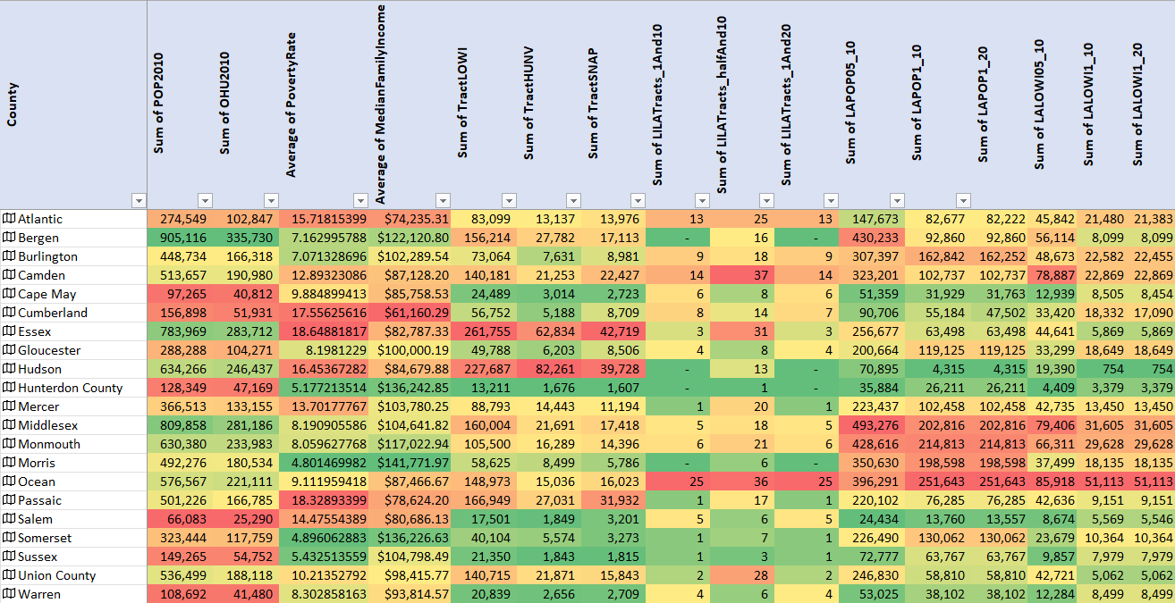
Data table with color scales
Candidates were selected based on the following constraints:
Counties with red-ish cells in right most 9 columns are preferred as it would have bigger impact
Counties with green-ish cells in the left most 7 columns are preferred as it would have less risk
Potential candidates:
Ocean
Monmouth
Morris
Burlington

Slide 9
Selection by Low Access Population
Potential candidates:
Bergen
Burlington
Camden
Middlesex
Monmouth
Morris
Ocean

Slide 10
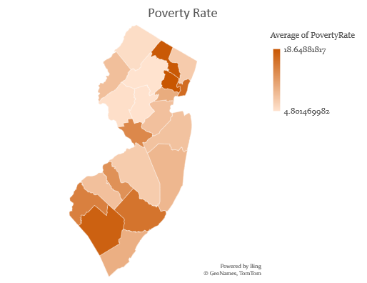
Selection by Poverty and Low-Income Pop.
Higher risks associated
Camden was eliminated

Slide 11
Selection by SNAP Receivers and Count of Housing Units without Vehicle
Higher risk associated
Higher impact associated

Slide 12
Selection by Counts of food desert tracts in 10- and 20-mile radiuses
Higher impact associated
Bergen, Morris were eliminated

Slide 13
Final selection
Ocean – Moderate risks due to moderate poverty rate and lower than average median household income, but highest impact in terms of population helped by investment.
Middlesex – Low risk due to lower-than-average poverty rate and higher than average median household income, great impact in terms of population helped by investment.
Monmouth - Low risk due to lower-than-average poverty rate and higher than average median household income, moderate impact in terms of population helped by investment as it has lower low-income population than Middlesex.
Burlington - Low risk due to lower-than-average poverty rate and higher than average median household income, least impact among these 4 in terms of population helped by investment.

Slide 14
EDA (Bonus)
Correlation Analysis and Race Distribution

Slide 15
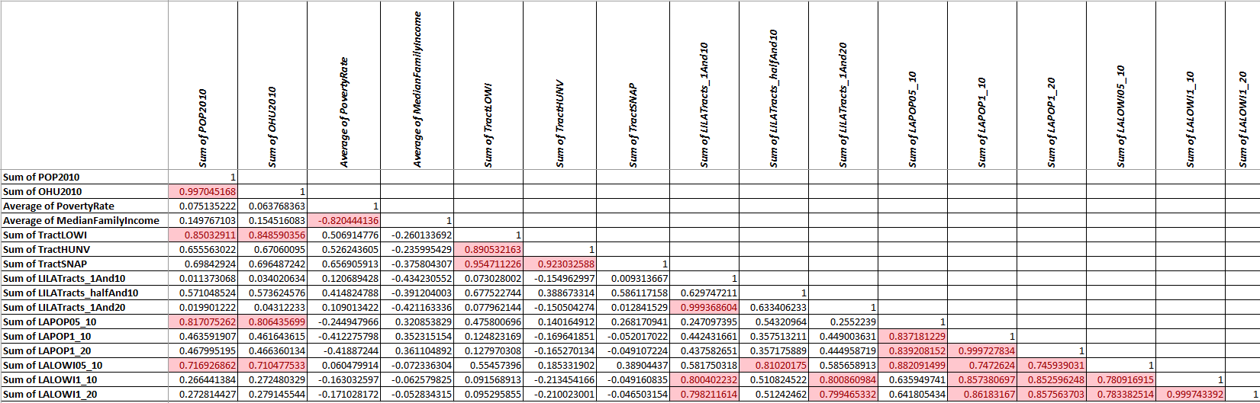
Food Desert Inhabitants by Race
None of these attributes have high correlations with either food desert tract counts or population living in those tracts.

Slide 16
Food Desert Inhabitants by Race
Most of the food deserts are inhabited by Caucasians. Other races tend avoid living in those areas.

Slide 17
Data Mining and Prediction (Bonus)
Linear and Logistic Regression

Slide 18
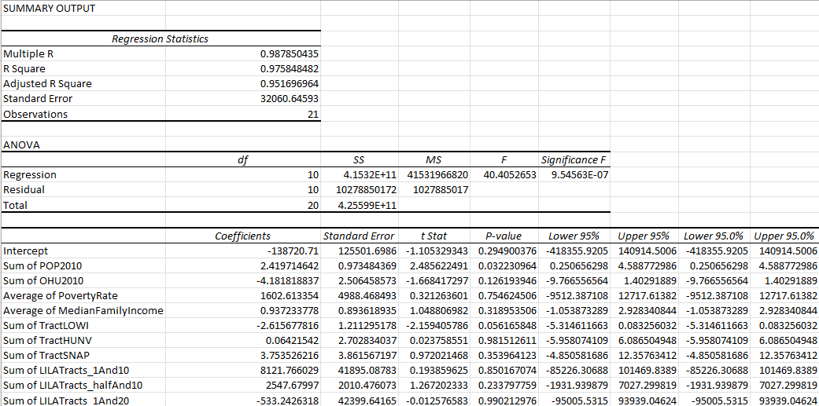
Linear Regression Model (best)
Response variable: LAPOP05_10
Accuracy: 97.58%
Equation:
Sum of LAPOP05_10 = -138720.709974656 + 2.41971464195797*Sum of POP2010 -4.18181883670726*Sum of OHU2010 + 1602.61335362862*Average of PovertyRate + 0.93723377754756*Average of MedianFamilyIncome -2.61567781571532*Sum of TractLOWI + 0.0642154197094879*Sum of TractHUNV + 3.75352621558695*Sum of TractSNAP + 8121.76602932826*Sum of LILATracts_1And10 + 2547.67996996631*Sum of LILATracts_halfAnd10 -533.242631823472*Sum of LILATracts_1And20

Slide 19
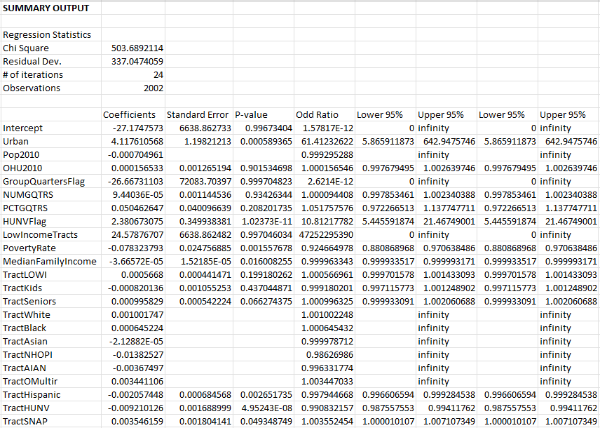
Logistic Regression Model
Response variable: LILATracts_1And10
Equation:
P(X) = e^( -27.1747573037723 + 4.11761056773327*Urban - 0.000704960539063267*Pop2010+ 0.00015653342909736*OHU2010 - 26.6673110310635*GroupQuartersFlag + 9.44036181288358E-05*NUMGQTRS + 0.0504626470640226*PCTGQTRS + 2.38067307466838*HUNVFlag + 24.5787670693794*LowIncomeTracts - 0.0783237931206215*PovertyRate - 3.66572000796622E-05*MedianFamilyIncome + 0.00056680033787382*TractLOWI - 0.0008201356482283*TractKids + 0.000995828551259705*TractSeniors + 0.0010017465834465*TractWhite + 0.000645223609282556*TractBlack -2.12881922468186E-05*TractAsian - 0.013825269710104*TractNHOPI -0.0036749704961802*TractAIAN + 0.00344110577041204*TractOMultir - 0.0020574475578762*TractHispanic - 0.00921012621165106*TractHUNV + 0.00354615880992393*TractSNAP)

Slide 20
Questions?

