Slide 1

Predicting House Prices and Identifying Ideal Locations in NJ
MIR AHMED
KAUSHIK RAJ DEVARASHETTY
MADHURI KOGANTI
LEONSTEEN STERLING

Slide 2
Introduction
Moving to a new state can be a challenging task, especially when trying to determine the ideal location to live. There are various factors to consider, such as the cost of living, crime rate, schools, and accessibility to amenities, which can be overwhelming to evaluate.
To tackle this challenge, we aim to develop a recommendation system that will assist people who are moving to NJ from other states in finding the appropriate county to rent or own a home using predictive modeling. The system also predict future average house prices which will help buyers identify risks.
This project will use publicly available datasets from various sources such as Zillow, Freddie Mac, NJ Department of Education, and the Census Bureau. This project's primary goal is to help real estate investors and buyers as well as new residents and potential movers make informed decisions based on the models’ predictions.

Slide 3
Problem statement
From a research project perspective, we would like our problem statement to be as follows:
What type of crime has the most impact on house prices for a specific county?

Slide 4
Methodology – Problem Statement
ETL and data cleansing
Exploratory Data Analysis (EDA)
Correlation Heatmap
Find the crime type that has the highest or lowest correlation value (Pearson's) with House price index

Slide 5
Methodology - Regression
ETL and EDA
Data Pre-Processing
Regression Models:
Linear Regression, Random Forest Regressor
Predict House prices using explanatory variables as parameters

Slide 6
Methodology - Classification
ETL and EDA
Data Pre-Processing
Classification Models:
Random Forest Classifier, Deep Learning Classifier
Predict suitable county using explanatory variables as parameters

Slide 7

Literature Review
New Jersey is the 47th biggest state in the country, which measures 22,608 square kilometers. In spite of the small area, the state is the most densely populated state in the USA. There are four cities in New Jersey, where Newark is the state’s largest city with 281k people, as estimated in 2019.
The state is surrounded by New York City, Philadelphia, And the eastern Jersey Shore and is located comfortably between Delaware, the Atlantic Ocean, New York, and Pennsylvania. The per capita income of this tiny state is $37,288 which makes it the most preferable country to live in.
The average size of each municipality varies from 15-18 square miles, despite being such a small state. We can say that new jersey is like a small packet with a big bang. According to Wallet Hub’s annual list, New Jersey has been officially announced as the best place in America to live in.
“Moving to New Jersey - A Complete Guide 2023.” Movingist, 2023, Retrieved March 10, 2023.
https://movingist.com/moving-to-new-jersey/

Slide 8
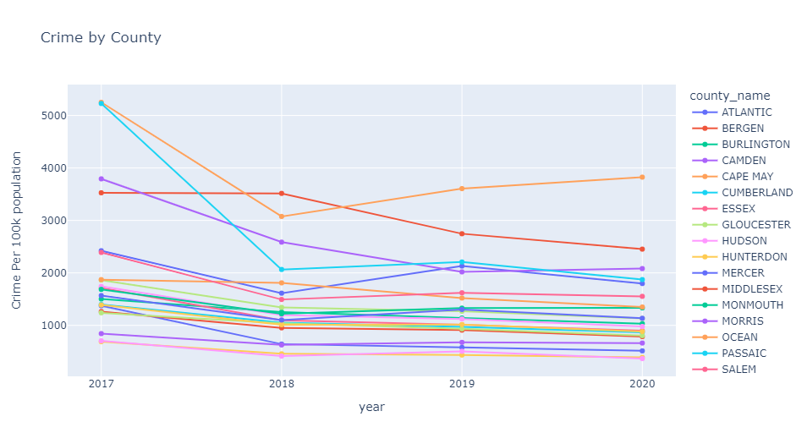
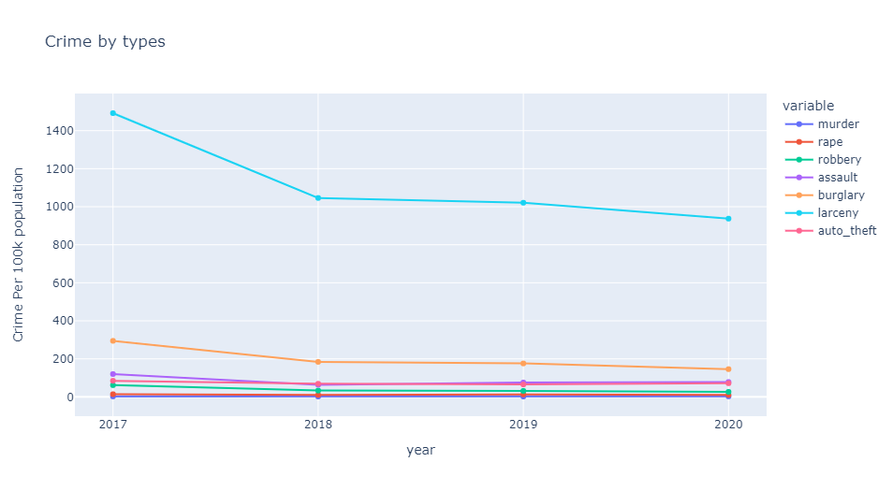
EDA: Crime
Most frequent violent crime in NJ is larceny which is also going down along with all other violent crimes over time.
Crime rates are going down in most of the counties across time, except Cape May.

Slide 9
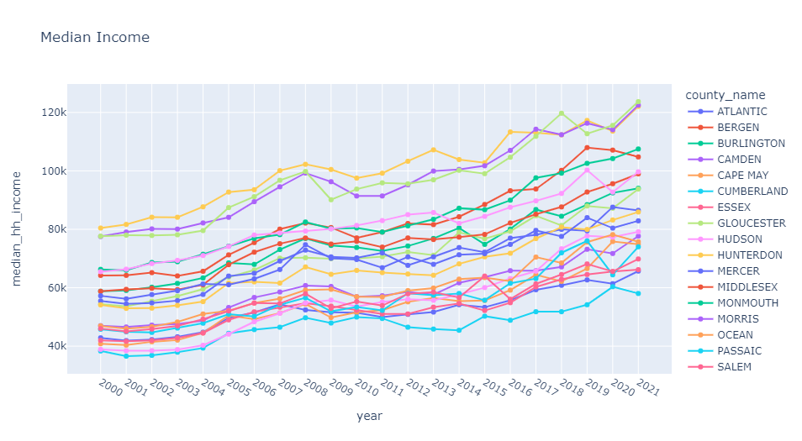
EDA: Income
Median income steadily increased over time.

Slide 10
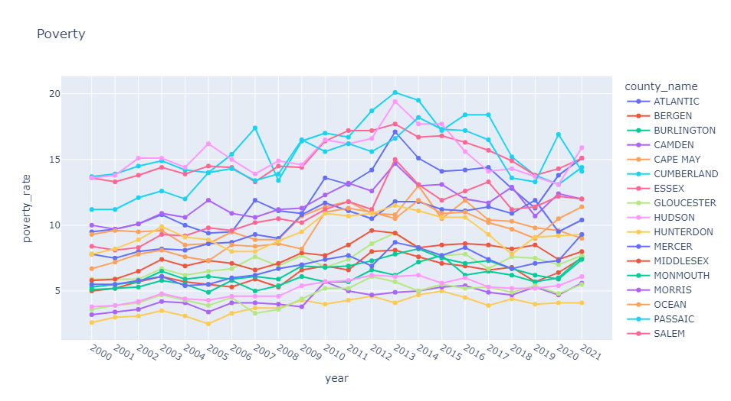
EDA: Poverty
• Poverty rates of counties are going up and down from 2000 through 2021. But ultimately, poverty rates in 2021 are more than what they were back in 2000.

Slide 11
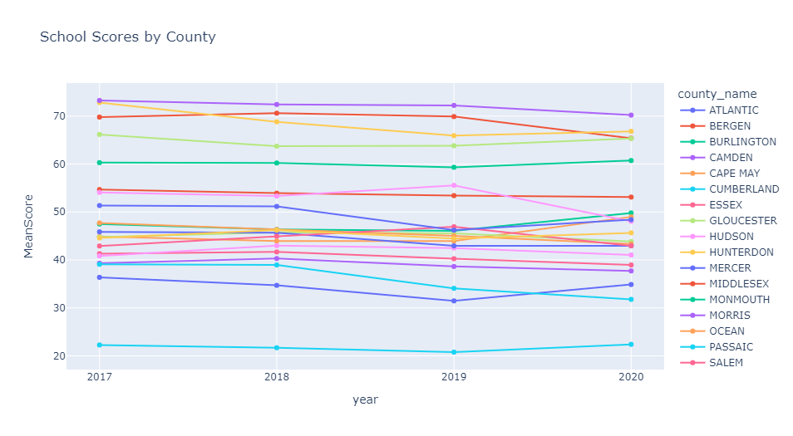
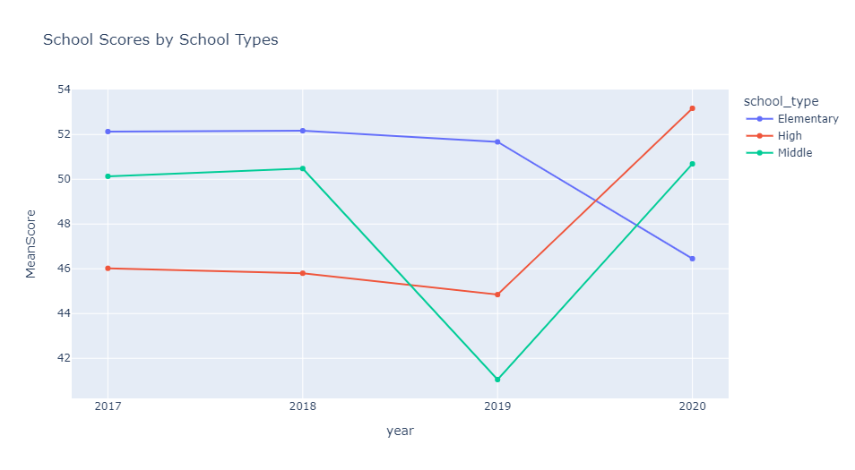
EDA: School performance
On average, NJ schools maintained their quality/ranking over time with a couple of exceptions like Passaic, Sussex, and Bergen.
Mean scores for elementary schools went down. Middle schools saw a steep decline from 2018-2019 then got back up in 2020. High school scores went up by a lot from 2019 onwards.

Slide 12
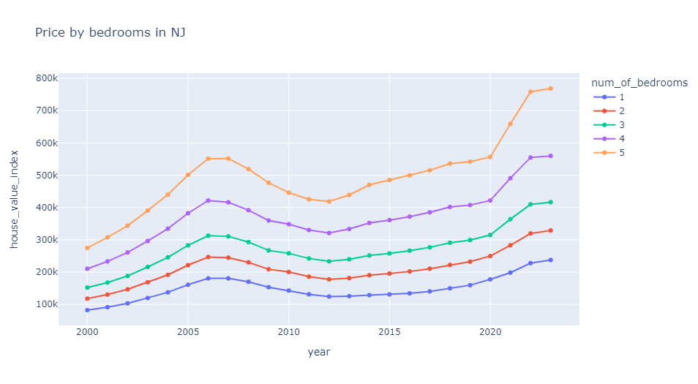
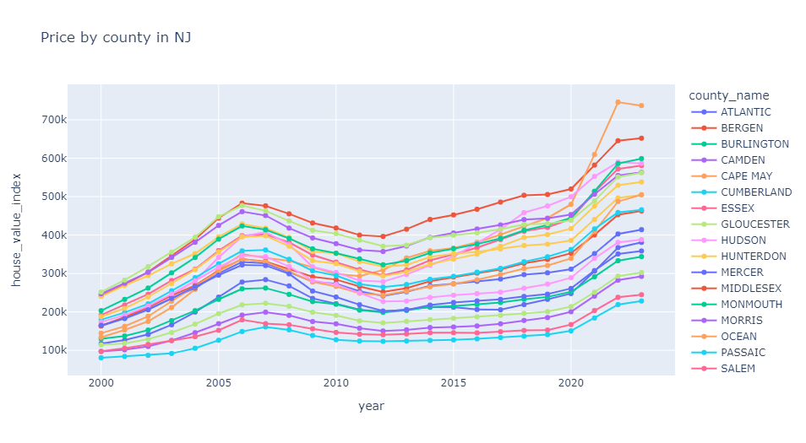
EDA: House prices
House prices for all bedrooms are going up over time except for a short decline from 2007 to 2012.
House prices for all counties are going up over time except for a short decline from 2007 to 2012.

Slide 13
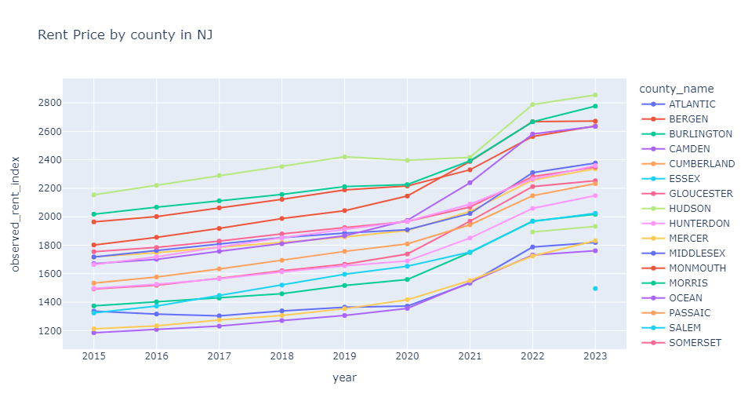
EDA: Rent Price
• Rental prices for all counties are going up over time.

Slide 14
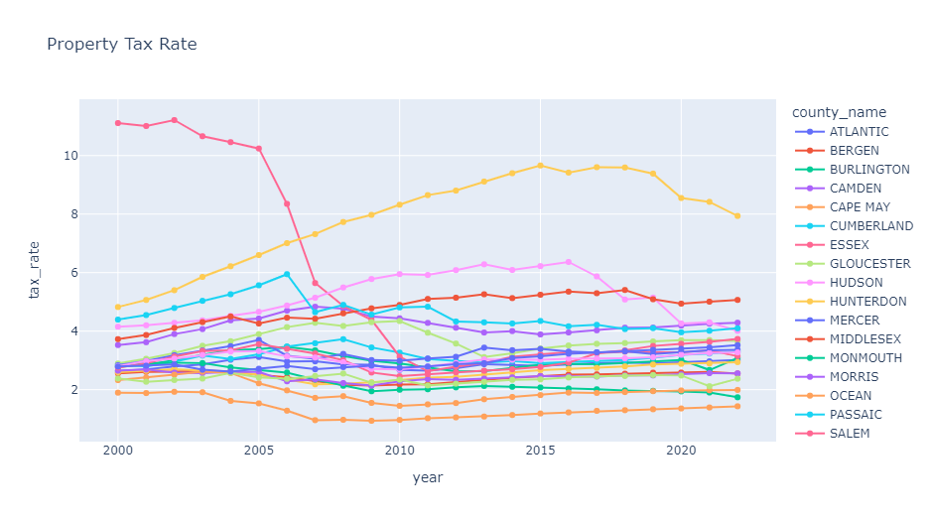
EDA: Property Tax
Essex property tax saw a considerable decline from 2005 through 2011.
Union property tax rose from 2000 till 2015, and then it declined.
Hudson also saw an increase in property tax until 2016, and then it decreased.
The rest of the counties maintained the exact property tax over time.

Slide 15
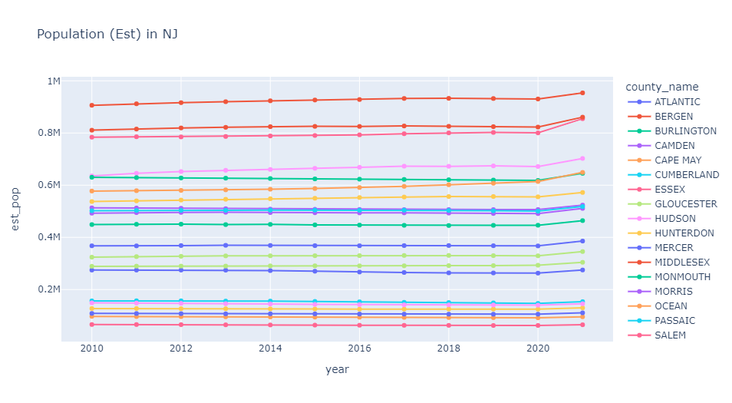
EDA: Population
Population counts are increasing very slightly over the years for all the counties.

Slide 16
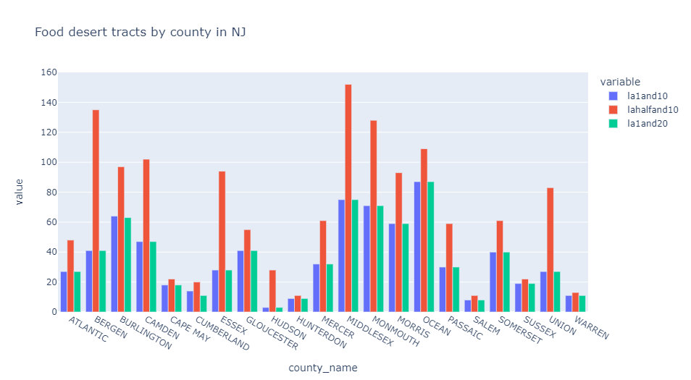
EDA: Food Desert
Food desert counts are mostly the same for both a 1-mile radius in urban areas and a 10-mile radius in rural areas and a 1-mile radius in urban areas and a 20-mile radius in rural areas.
Counts are high for a half-mile radius in urban areas and a 10-mile radius for rural areas for Middlesex, Bergen, and Monmouth.

Slide 17
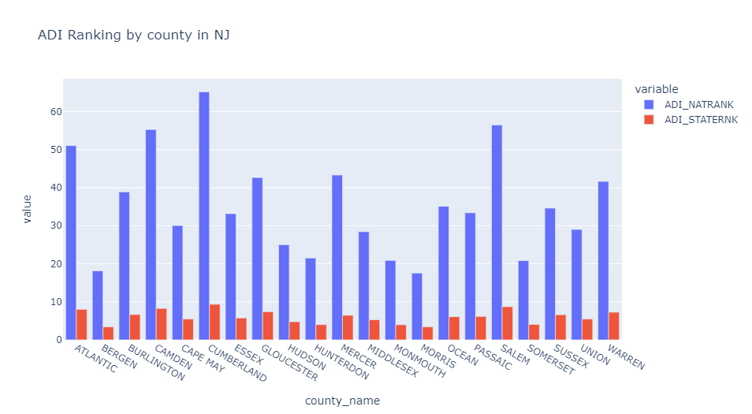
EDA: Area Deprivation Index
Counties like Cumberland, Salem, Camden, and Atlantic are ranked far down the list of counties nationwide regarding area deprivation index, which translates to low socioeconomic and educational opportunities.

Slide 18
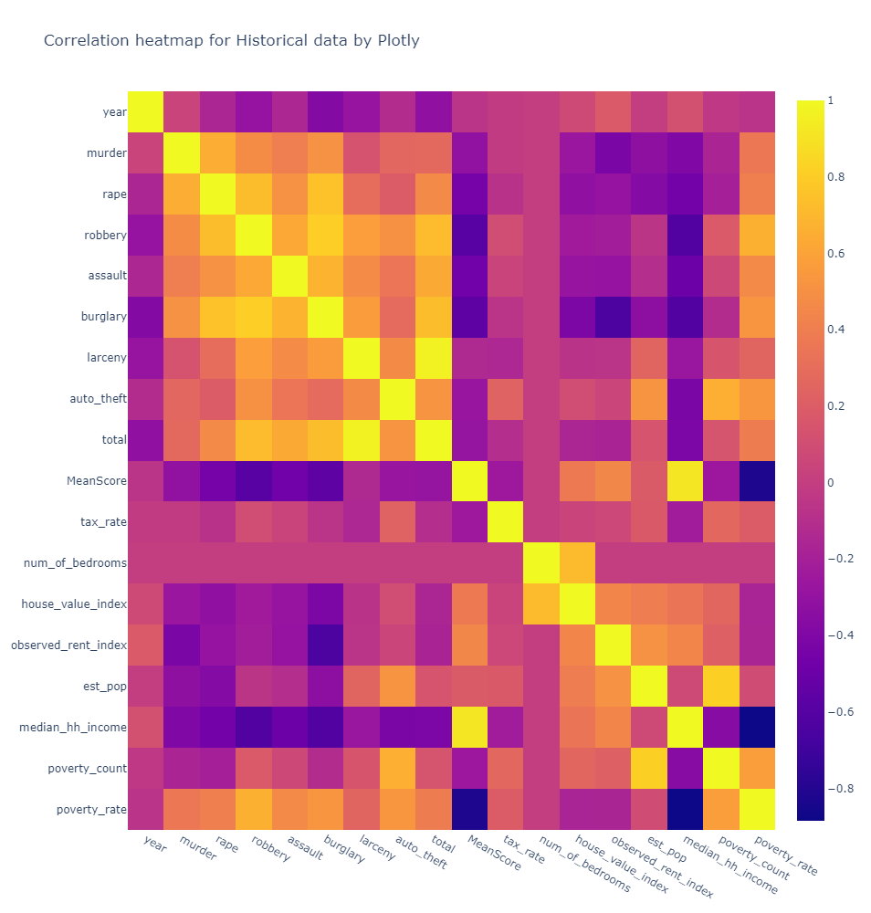
EDA: Correlation heatmap for historical data
The house value index has -
a strong positive correlation with number of bedrooms and
a weak positive correlation with school score, rent index, population, and median household income.
a weak negative correlation with the poverty rate but a weak positive correlation with the poverty count.

Slide 19
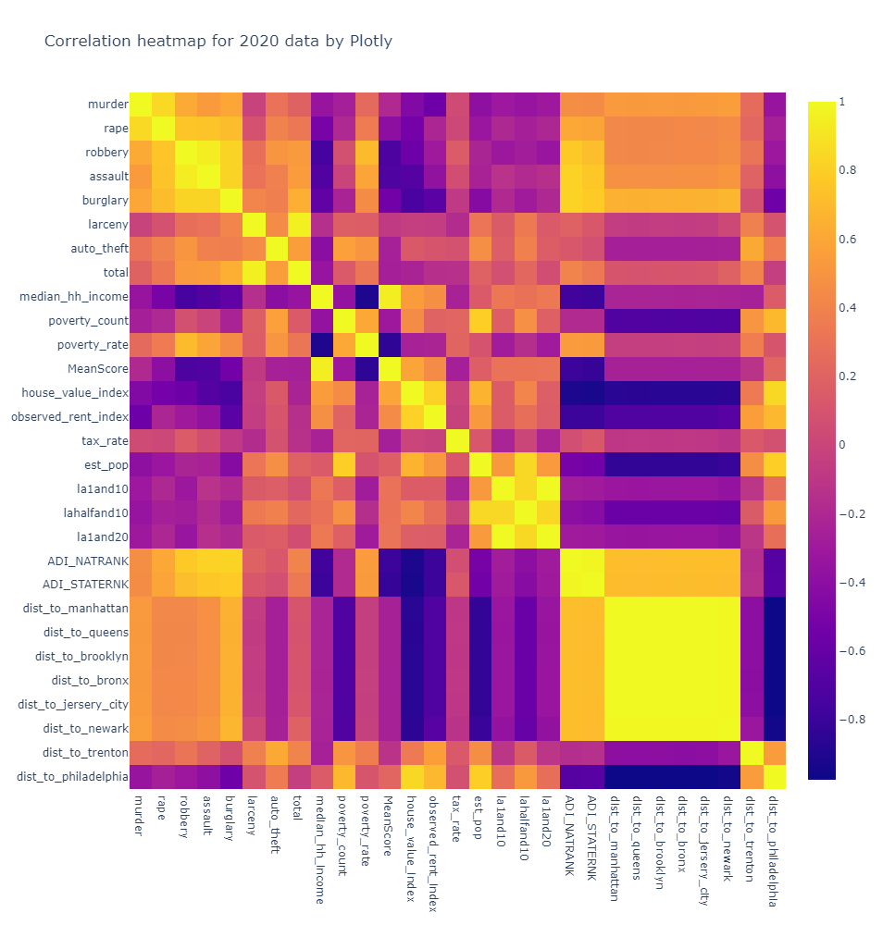
EDA: Correlation heatmap for 2020 data
The House Price Index has a strong negative correlation with distance to all major cities except Trenton and Philadelphia and Area Deprivation Index (ADI) - both national and state rankings and burglary.
The House Price Index has a strong positive correlation with the Observed Rent Index and a moderately strong positive correlation with population, median household income, and school scores.
The House Price Index also has a somewhat weak to moderate positive correlation to food desert count at a half-mile radius.
The poverty rate strongly correlates negatively with school score and median household income and a moderately strong positive correlation between different violent crimes. Of those violent crimes, burglary has the biggest correlation with the house price index.
Next, we have assault, which has a moderate negative correlation with house prices.

Slide 20
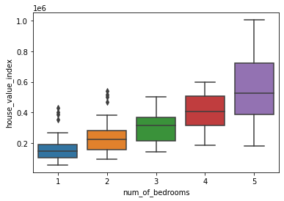
Linear Regression Model
Before we started with our modeling, we checked whether we have any outliers on our pre-processed dataset using boxplots in terms of house prices against number of bedrooms:
We do have a couple of outliers, but we did not exclude them from our modeling because:
They are not drastically variant from the population
They might be prices for condos in gentrified locations

Slide 21
Linear Regression Model
OLS Regression Results
==============================================================================
Dep. Variable: house_value_index R-squared: 0.856
Model: OLS Adj. R-squared: 0.848
Method: Least Squares F-statistic: 102.7
Date: Tue, 04 Apr 2023 Prob (F-statistic): 4.02e-151
Time: 15:53:55 Log-Likelihood: -5280.8
No. Observations: 420 AIC: 1.061e+04
Df Residuals: 396 BIC: 1.071e+04
Df Model: 23
Covariance Type: nonrobust
===============================================================================

Slide 22
Random Forest Regressor
Training Data Score: 0.9937723196024478
Testing Data Score: 0.9707401005841938
Mean Squared Error: 806404319.2723241
Root Mean Squared Error: 28397.25900984678
We also tried SVM regression and XGBoost for house price predictions but had to drop those due to low accuracy and high RMSE.

Slide 23
Random Forest Classifier
Below is the feature importance scores from random forest classification model:
[(0.3609237487342005, 'poverty_rate'),
(0.3103848368846969, 'median_hh_income'),
(0.15761129628656217, 'house_value_index'),
(0.12514809140252514, 'year'),
(0.04593202669201531, 'num_of_bedrooms')]
Below are the model scores:
Training Data Score: 1.0
Testing Data Score: 0.946031746031746

Slide 24
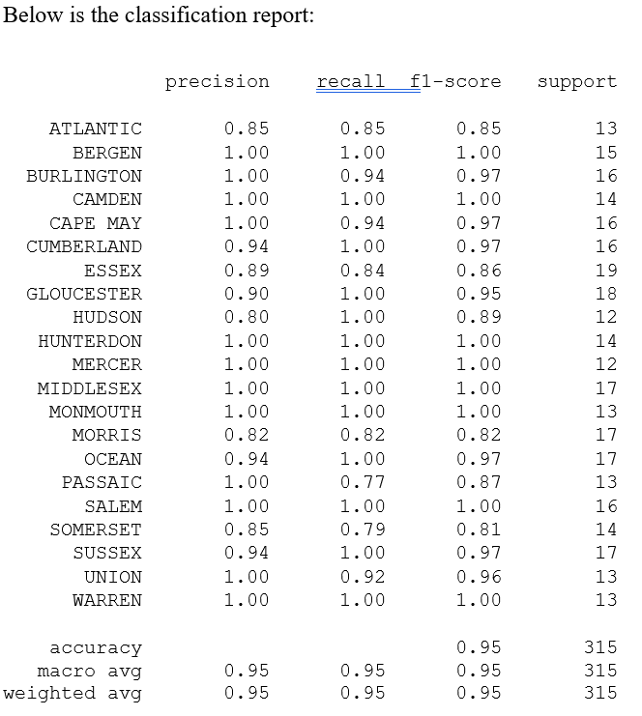
Random Forest Classifier

Slide 25
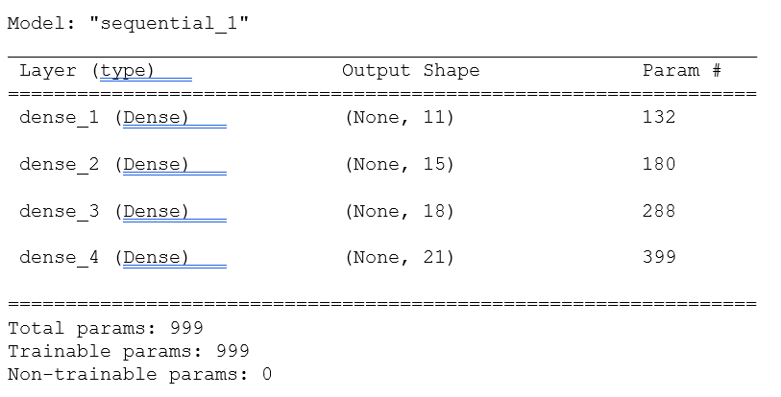
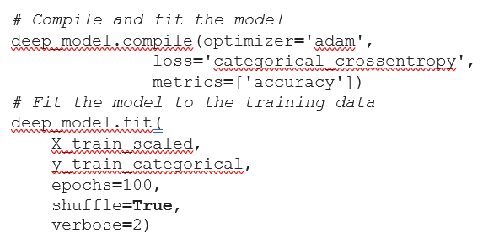
Deep Learning Classifier
We used label encoder to convert the county name column to encoded categorical column.
We wanted 4 layers to our model with 11 features and 21 unique outputs (21 unique county names).
Deep Neural Network - Loss: 0.04665800929069519, Accuracy: 0.9904761910438538

Slide 26
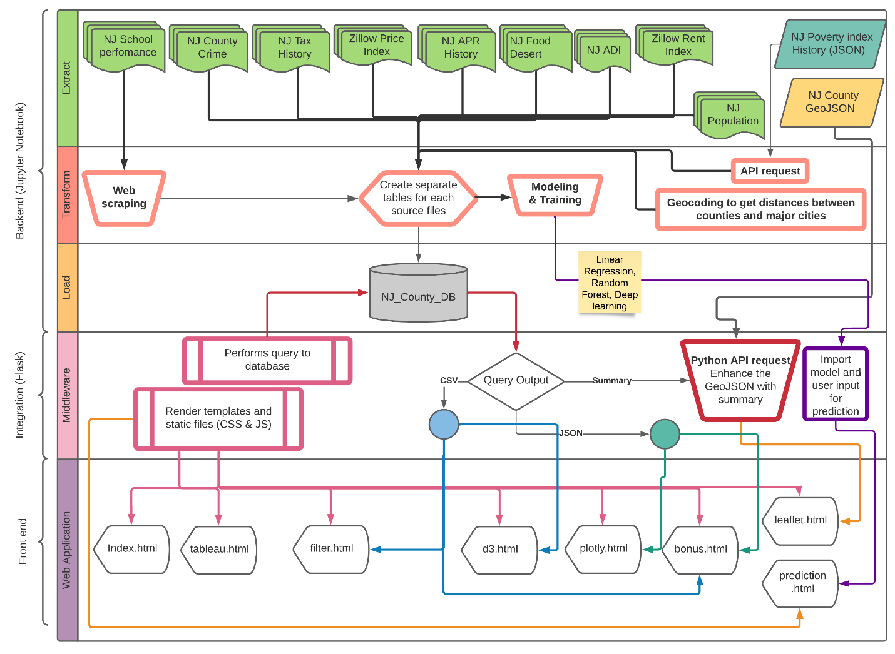
Flask Application Framework
Below is the blueprint of flask application built with python 3.8.8:

Slide 27
Challenges and Limitations
Free datasets available to import and utilize
Completeness of the data in terms of history
Free available tools for visualizations and web hosting
Known machine learning modeling techniques
Hardware for training machine learning models
Project timeframe

Slide 28
Conclusion
Based on our exploratory analysis, we came to the following conclusion:
The number of burglaries in a county has the most adverse effect on the Zillow house price index.
So, we should avoid counties for house purchases and rentals where the number of burglaries is high.

Slide 29
Data Sources
Zillow Home Value Index Data: https://www.zillow.com/research/data/
Mortgage Value Data: http://www.freddiemac.com/pmms/#
Tax Rate Data: https://www.state.nj.us/treasury/taxation/lpt/statdata.shtml
County Lines and Shape Data (GeoJSON): http://data.ci.newark.nj.us/dataset/new-jersey-counties-polygon/resource/95db8cad-3a8c-41a4-b8b1-4991990f07f3
NJ Department of Education Data for School Performance: https://www.schooldigger.com/go/NJ/schoolrank.aspx
Crime Data: For 2017: https://ucr.fbi.gov/crime-in-the-u.s
For 2018,2019,2020: https://www.njsp.org/ucr/current-crime-data.shtml
Poverty and Median Income Data: https://www.census.gov/programs-surveys/saipe/data/api.html
NJ Population History by County: https://www.nj.gov/labor/labormarketinformation/demographics/population-household-estimates/

Slide 30


