Slide 1

FIFA 22 Players
Mir Ahmed
DS-600 Data Mining Final Project

Slide 2
Overview
This project performed a deeper dive into the FIFA 22 players’s dataset that has also variables that attribute to a players preferred playing position, overall rating and values.
The dataset was downloaded from: https://www.kaggle.com/cashncarry/fifa-22-complete-player-dataset
The dataset has 89 attributes and 19260 rows (One row for each FIFA registered player). So, we can consider this dataset as the whole universe of data for this domain.
First, the following questions were answered through exploratory data analysis:
Does position have an impact on the wage and the valuation of a player?
Does growth have an impact on the wage and the valuation of a player?
Then, we moved on to preform feature selection using f_classif method and identify outliers using DBSCAN.
Finally, we created K-means clusters using our selected features.
As a bonus, we tried exploring prediction/ categorization models such as decision tree classifier and random forest classifier. The classification final model will help FIFA career mode users to identify the best positions for a player with ~72% accuracy.

Slide 3
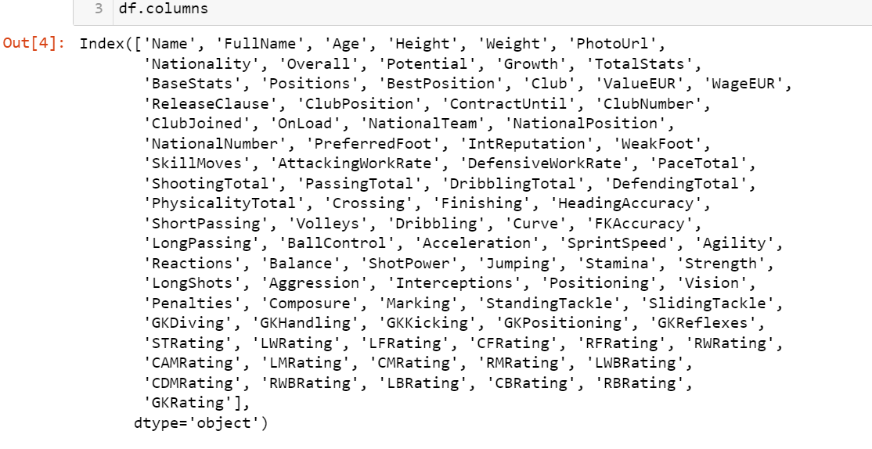
Dataset
We used pandas package to import the csv file.
The dataset contains attributes related to different soccer related abilities as well as some other features, i.e., value, wage, nationality, club name, playing position in club team, national team name, playing position in national team, jersey number in national team and club, release clause for clubs, contract info with clubs etc.
The scores to the soccer related abilities are given out by FIFA ratings division on a scale of 0 to 100. TotalStats is sum of scores from all soccer abilities related attributes and BaseStats is sum of scores from position related attributes.
We can see the columns in the screenshot to the right.

Slide 4
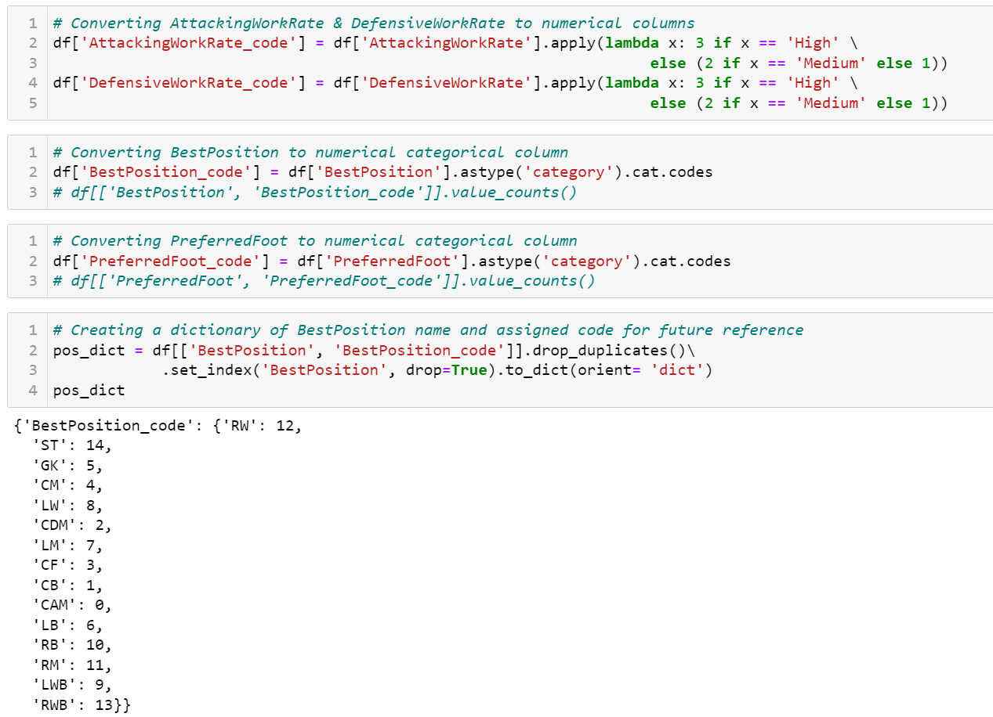
Transformation
In this step, we identified the object categorical variables and converted them to numerical (integer) categorical variables.
We can see on the screenshot to the left how each positions were converted to an integer value
Then we dropped the unnecessary columns, such as Name, FullName, PhotoUrl, Nationality, Positions, Club, ReleaseClause, ClubPosition, ContractUntil, ClubNumber, ClubJoined, OnLoad, NationalTeam, NationalPosition, NationalNumber, PreferredFoot, AttackingWorkRate, DefensiveWorkRate

Slide 5
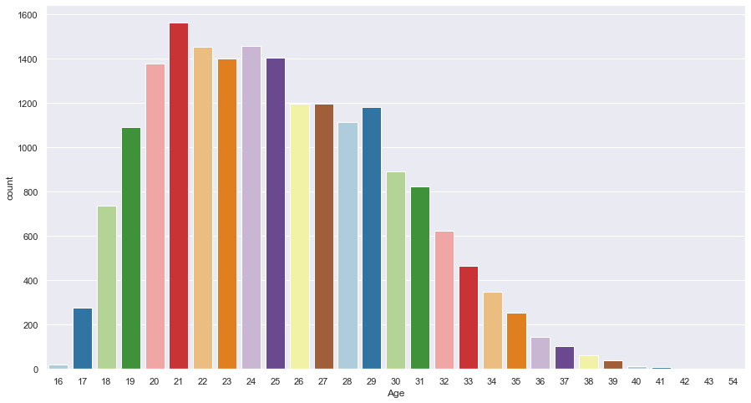
Exploratory Data Analysis
Players’ frequency by age:
Most of the players are from 20-29 of age bucket.
Age 21 has the highest frequency.

Slide 6
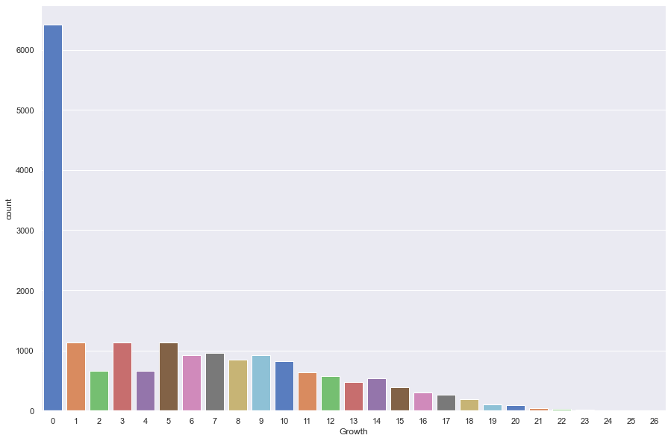
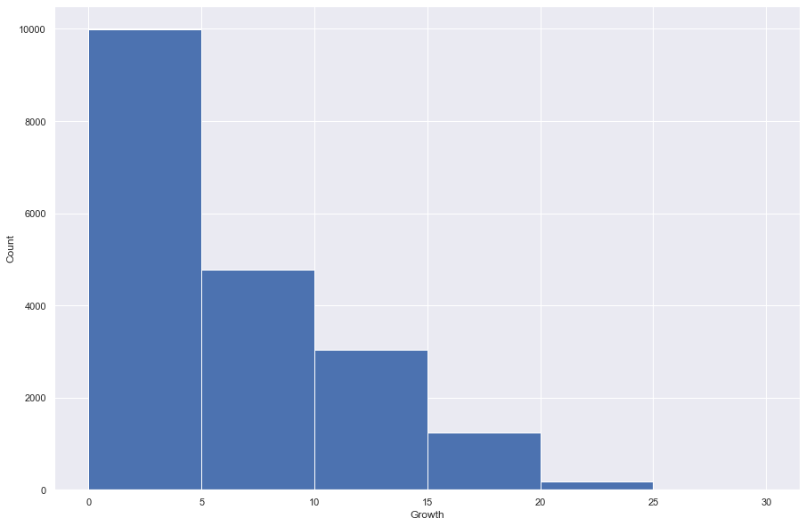
Exploratory Data Analysis – cont’d
Players’ frequency by growth:
Usually, growth is calculated by the difference in potential after 3 years and current rating.
Even though most amount have 0 growth, we do see a good amount players with exceptional growth (>10). The future of soccer looks good!

Slide 7
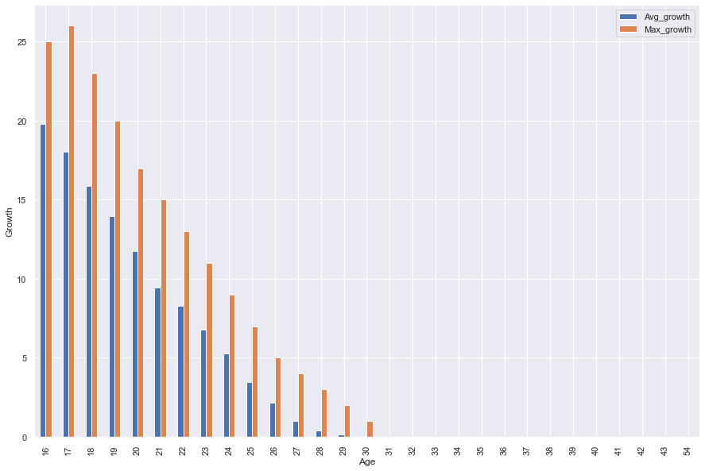
Exploratory Data Analysis – cont’d
Players’ growth by age:
Age and growth has a strong negative correlation (-0.86421).
That is why we see growth declining with increase in age.
A player has the most growth when he is young which is why buying young players or developing youths is very beneficial as a manager.

Slide 8
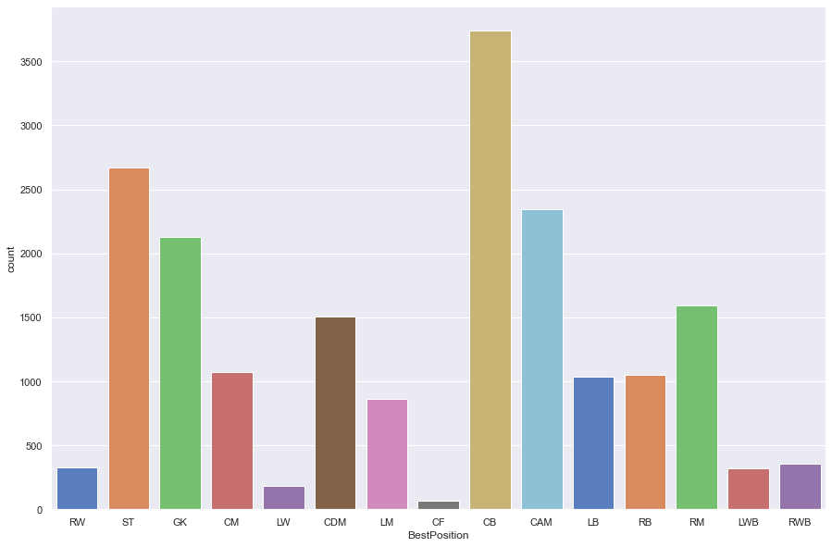
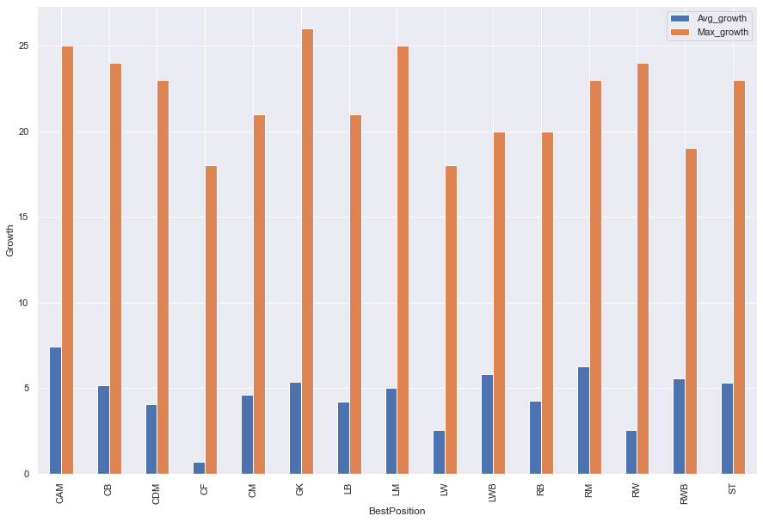
Exploratory Data Analysis – cont’d
Players’ growth and frequency by position:
We have a lot of CBs (Centre Back) in our dataset.
GK (Goalkeeper) has the highest growth, but CAM (Center attacking midfielder) has highest average growth.

Slide 9
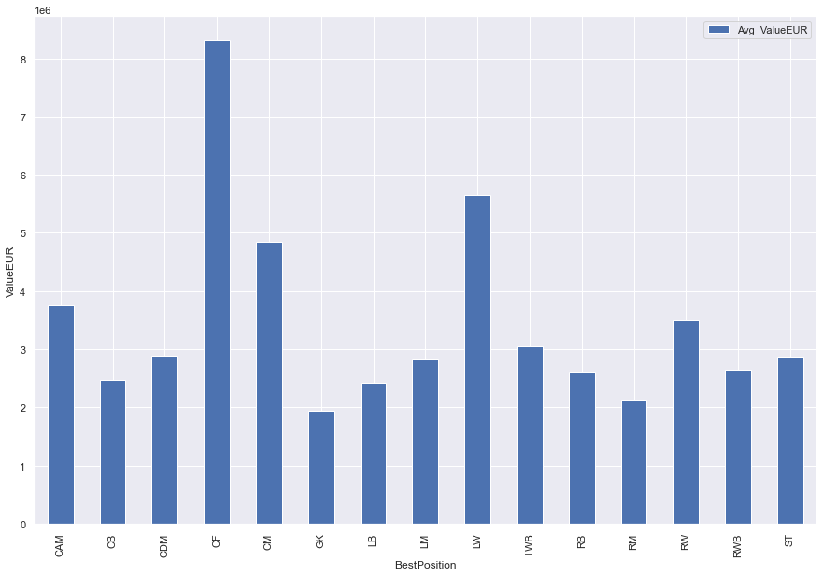
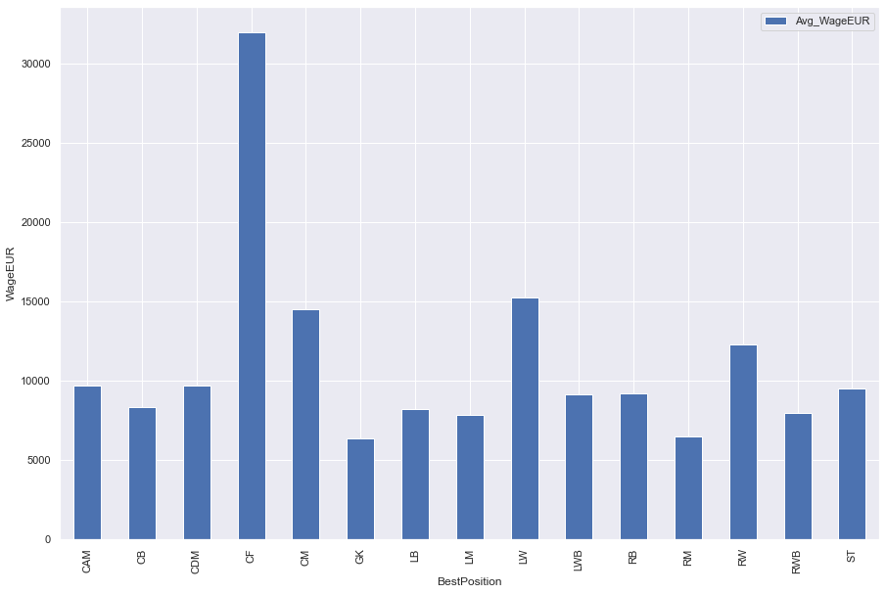
Exploratory Data Analysis – cont’d
Players’ wage and value by position:
CF (Center Forward) & LW (Left Winger) tend to have higher wages as well
CF (Center Forward) & LW (Left Winger) tend to have higher values (Euro in millions) in the transfer market.

Slide 10
Problem Statements
Does position have an impact on the wage and the valuation of a player?
Does growth have an impact on the wage and the valuation of a player?
Key1 | Key2 | correlation
BestPosition_code | ValueEUR | 0.018958
BestPosition_code | WageEUR | 0.008704
Key1 | Key2 | correlation
Growth | WageEUR | 0.194634
Growth | ValueEUR | 0.104524
So, Growth might have a very little impact on wage or valuation of a player. But it is strongly & negatively correlated with Age.
So, position has little to no impact on wage or valuation of a player.

Slide 11
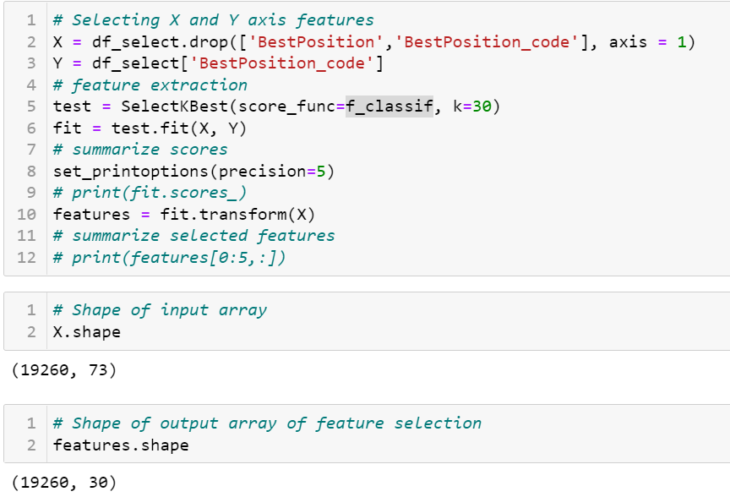
Feature Selection
After dropping the unnecessary columns, we were left with 73 attributes.
We used f_classif method which computes the ANOVA F-value for the provided sample and drop the variables those have very low variances or too similar.
Thus, we were able to get 30 attributes.
Still, we saw a couple of attributes which have nearly the same definitions as other attributes.
So, we dropped the following variables manually: 'GKDiving’, 'GKReflexes’, 'GKHandling’, 'GKKicking’, 'GKPositioning’
We added ‘BestPosition_code’ as it will be the response variable.
Finally, we got a dataset with 26 attributes.

Slide 12
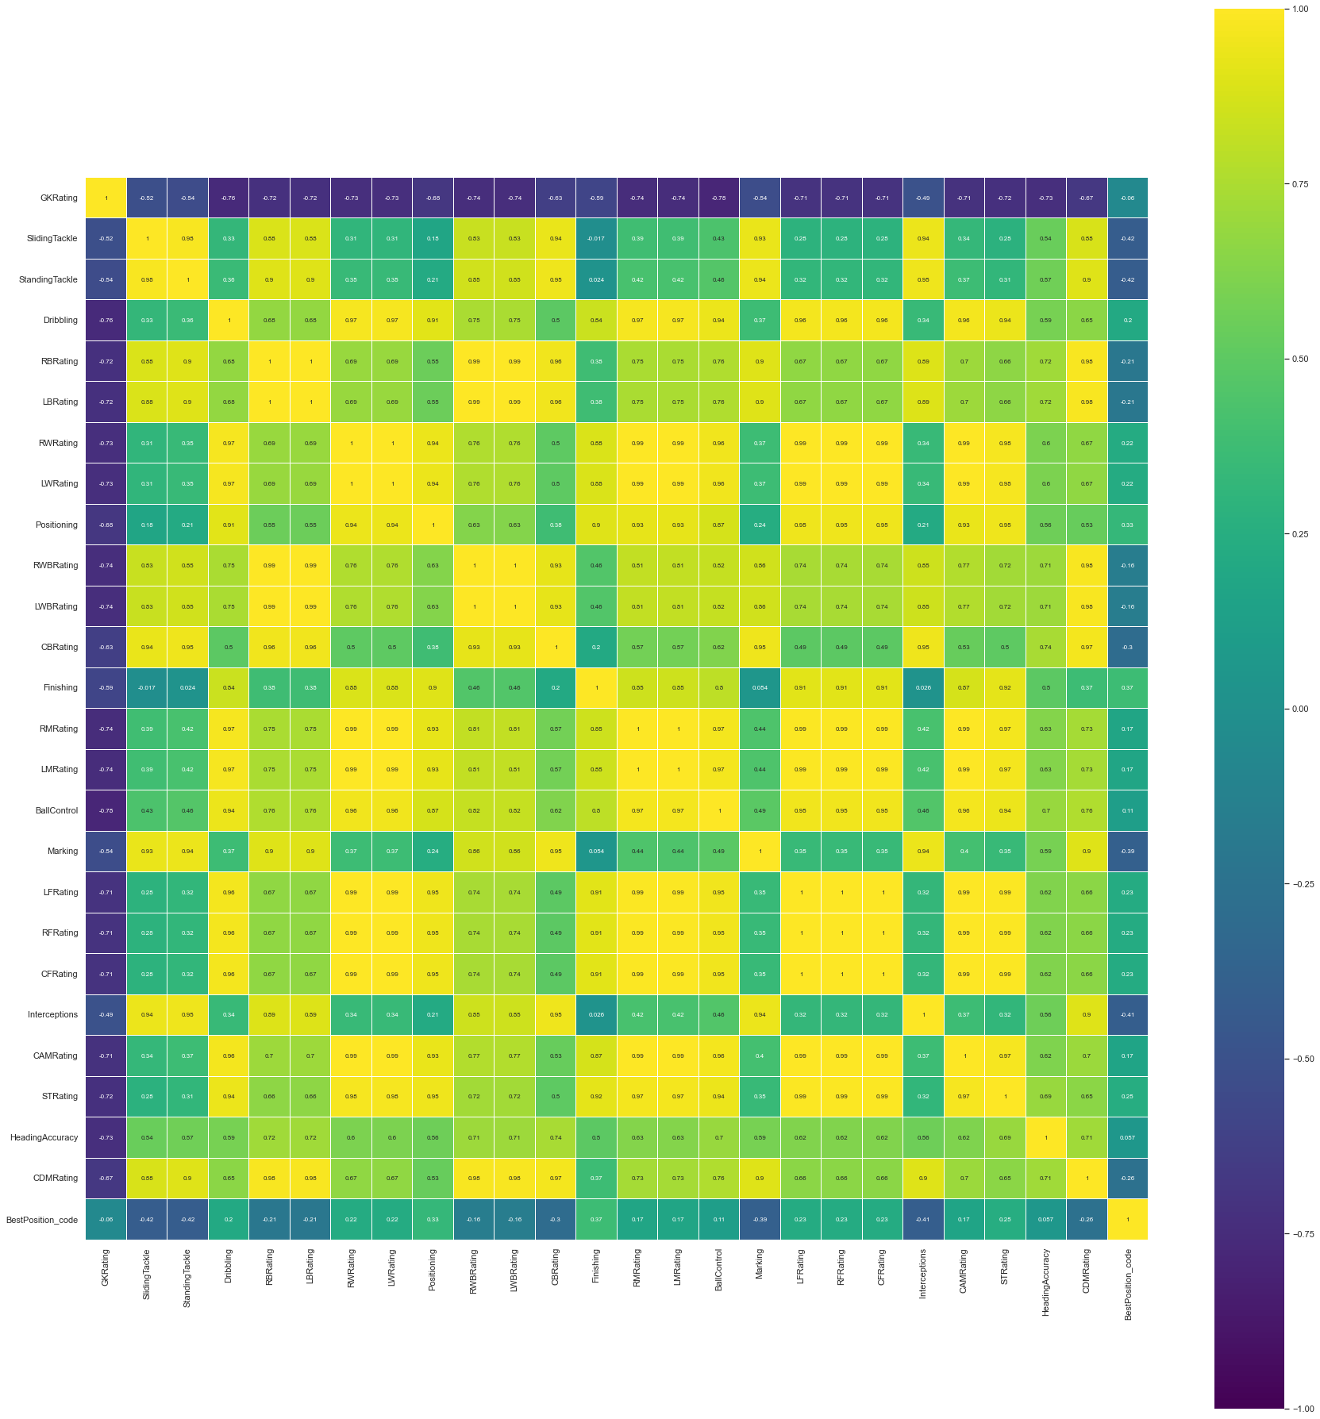
Correlation Heatmap
As 'BestPosition_code' is a categorical variable, we do not see any strong correlations with other ratio variables.

Slide 13
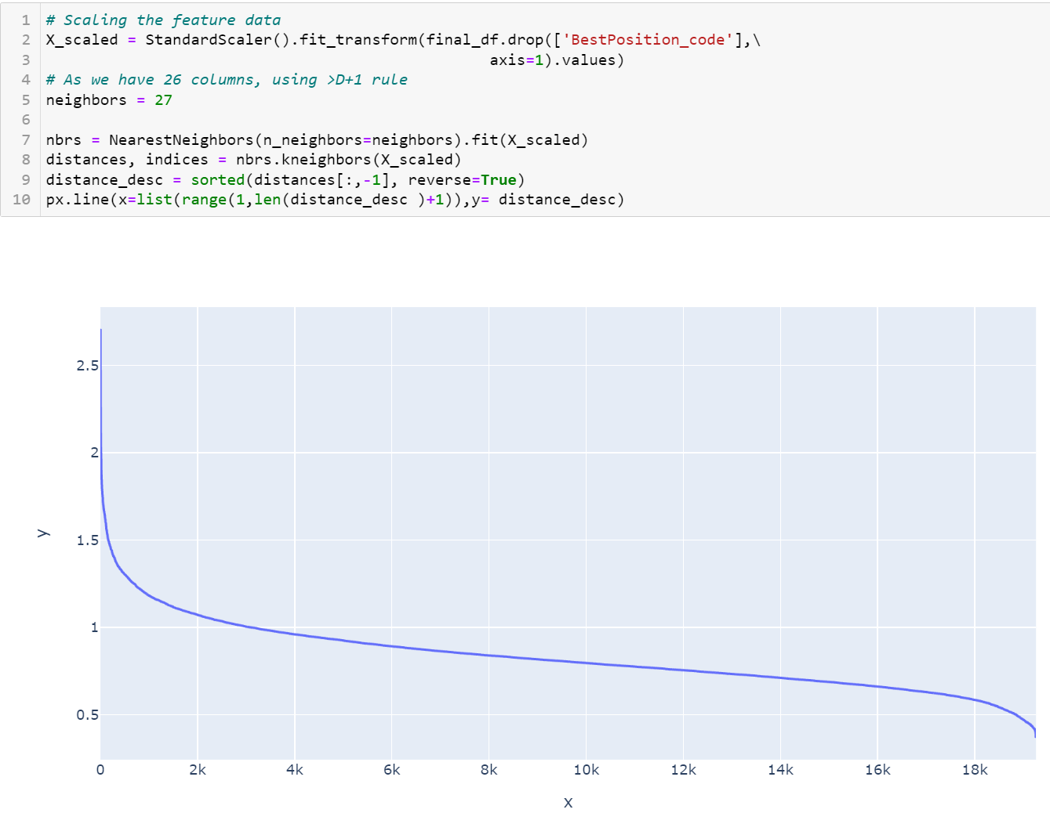
Outlier detection - DBSCAN
We must provide a value for epsilon, a parameter for DBSCAN, which defines the maximum distance between two points.
we find a suitable value for epsilon by calculating the distance to the nearest n points for each point, sorting and plotting the results. Then we look to see where the change is most pronounced and select that as epsilon.
We can calculate the distance from each point to its closest neighbor using the NearestNeighbors. The point itself is included in n_neighbors. The kneighbors method returns two arrays, one which contains the distance to the closest n_neighbors points and the other which contains the index for each of those points.
The optimal value for epsilon will be found at the point of maximum curvature.

Slide 14
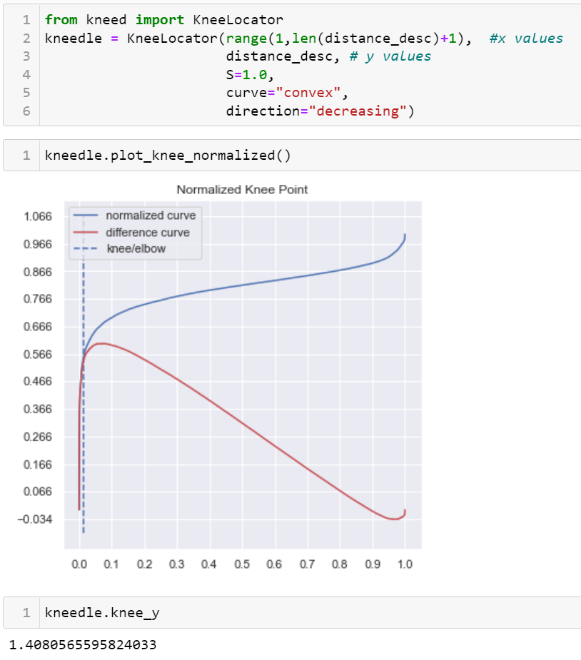
Outlier detection – DBSCAN – Cont’d
We have used the knee method to locate the optimum value of eps (maximum curvature for nearest neighbor method).
According to the graph above,value of eps should be 1.4080565595824033.

Slide 15
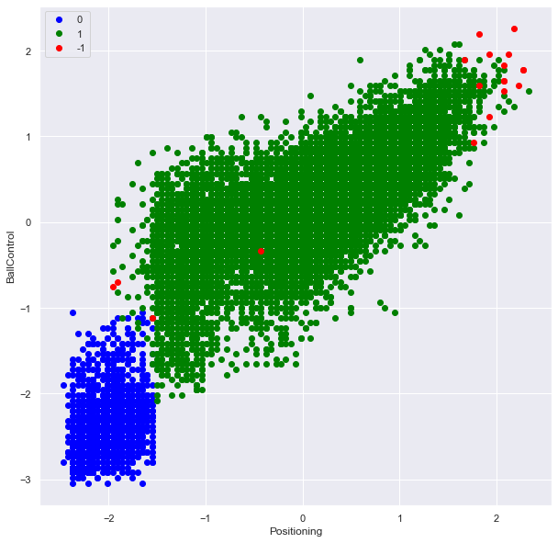
Outlier detection - DBSCAN – Cont’d
We have used the eps value created through the nearest neighbor method for DBSCAN.
We have used 27 as our minimum sample as the rule of thumb is to add 1 to the total number of columns for this parameter.
According to DBSCAN method, we have 19 outliers in the dataset. We will leave them for now as they are not that drastic.
So, DBSCAN basically identified the 16 best players at present, 1 youth player and 2 not so good players for their age as outliers.
DBSCAN output | Count
1 | 17118
0 | 2123
-1 | 19

Slide 16
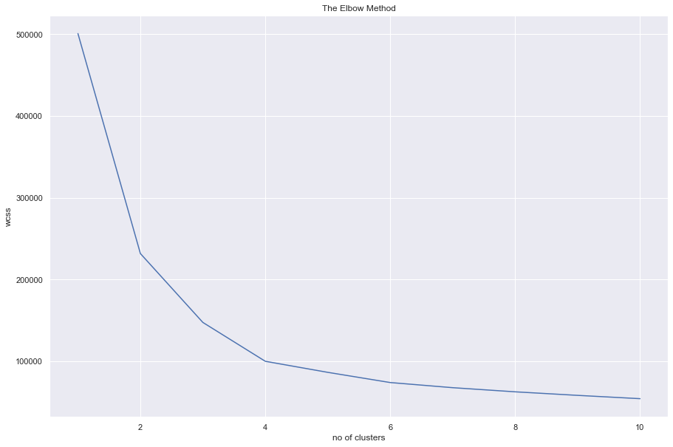
K-Means Clustering
We have used the elbow method to get the optimal value of K
We see the last elbow bend at n = 4
Therefore, we will tell python to create 4 clusters in the next phase.

Slide 17
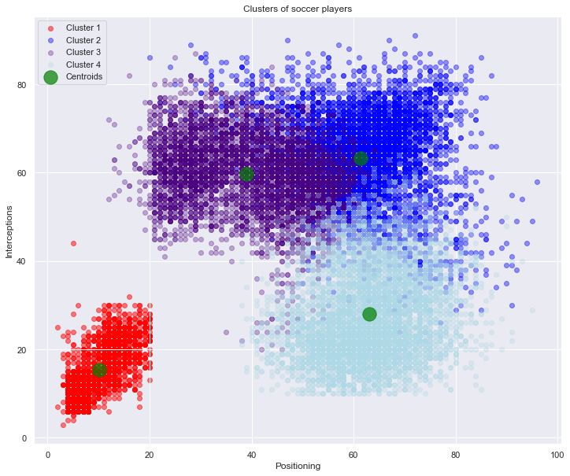
K-Means Clustering – Cont’d
We see the clusters properly distributed around their respective centroids. There are some overlaps between cluster 2,3 & 4.
We had dived deeper into each cluster in next section to have better insight.

Slide 18
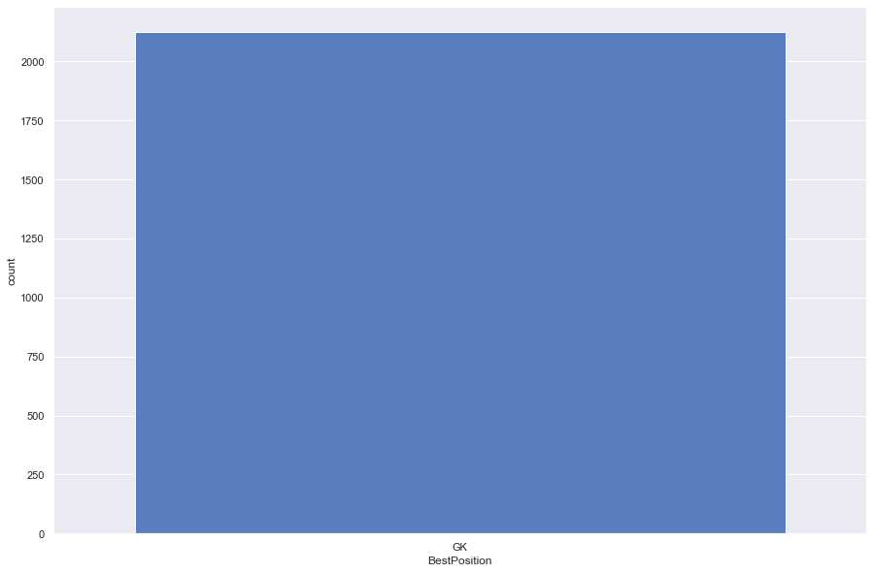
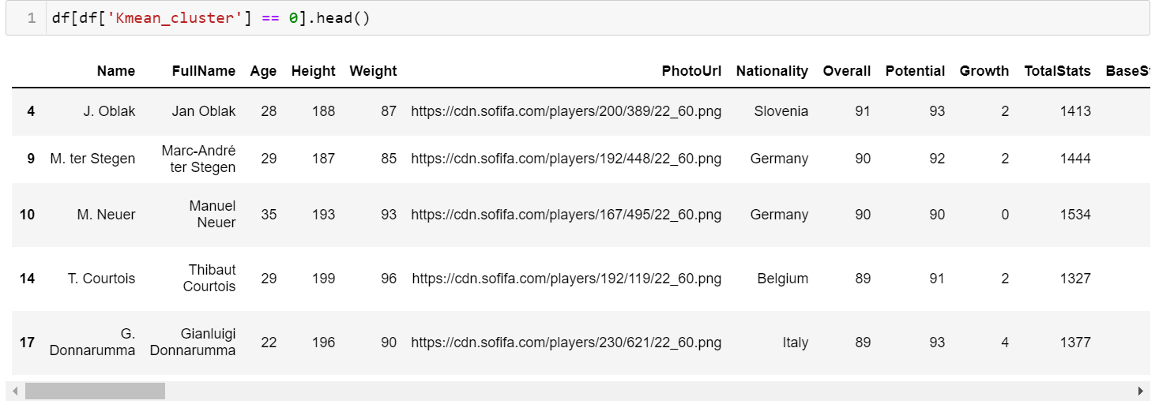
K-Means Clustering – Cluster 1
Only Goalkeepers were selected in this cluster.

Slide 19
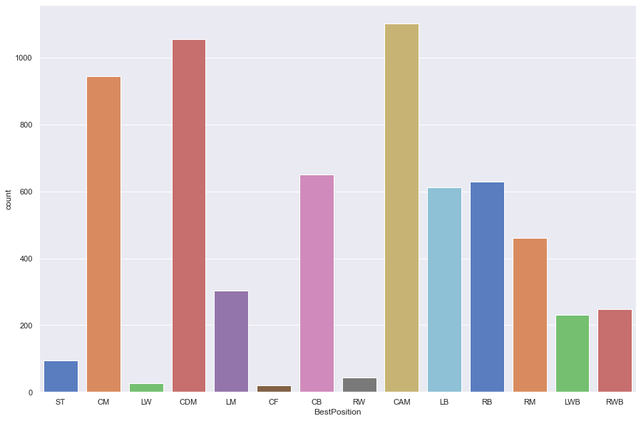
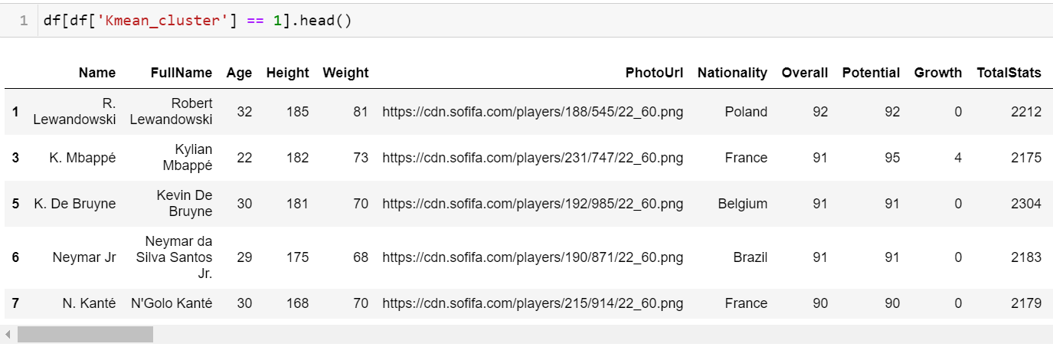
K-Means Clustering – Cluster 2
Players with good playmaking abilities were selected in this cluster.

Slide 20
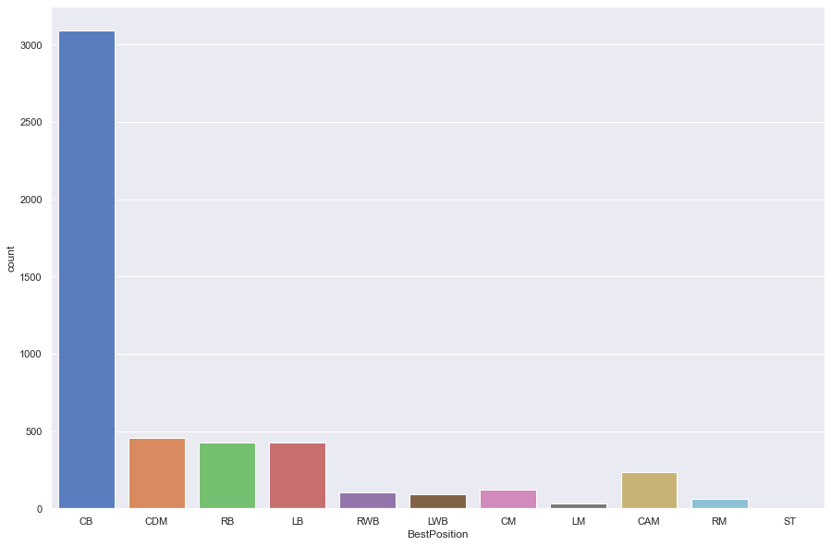
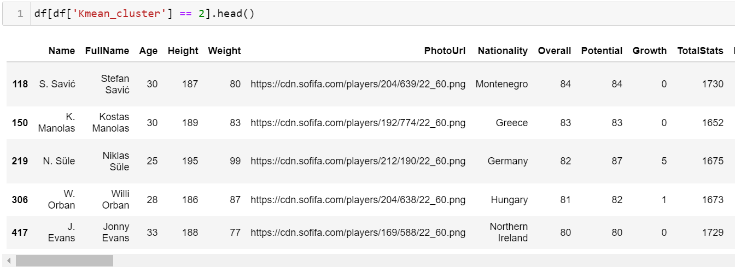
K-Means Clustering – Cluster 3
Players with good defending abilities were selected in this cluster.

Slide 21
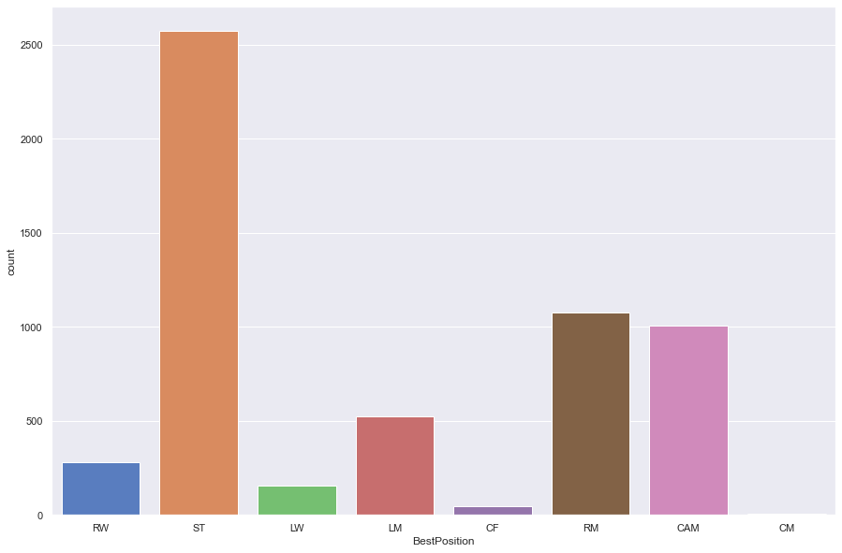
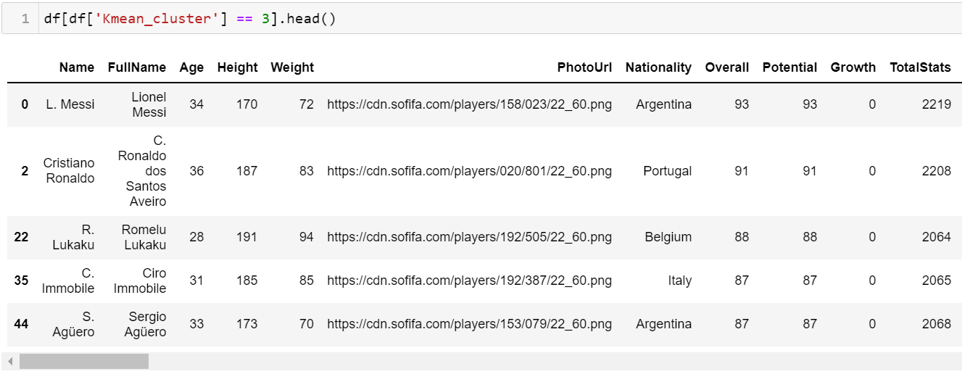
K-Means Clustering – Cluster 4
Players with finishing (better goal scoring abilities) were selected in this cluster.

Slide 22
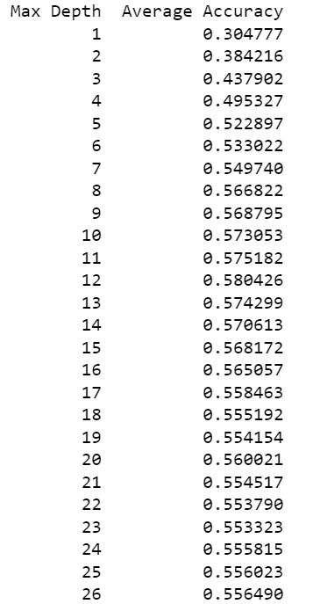
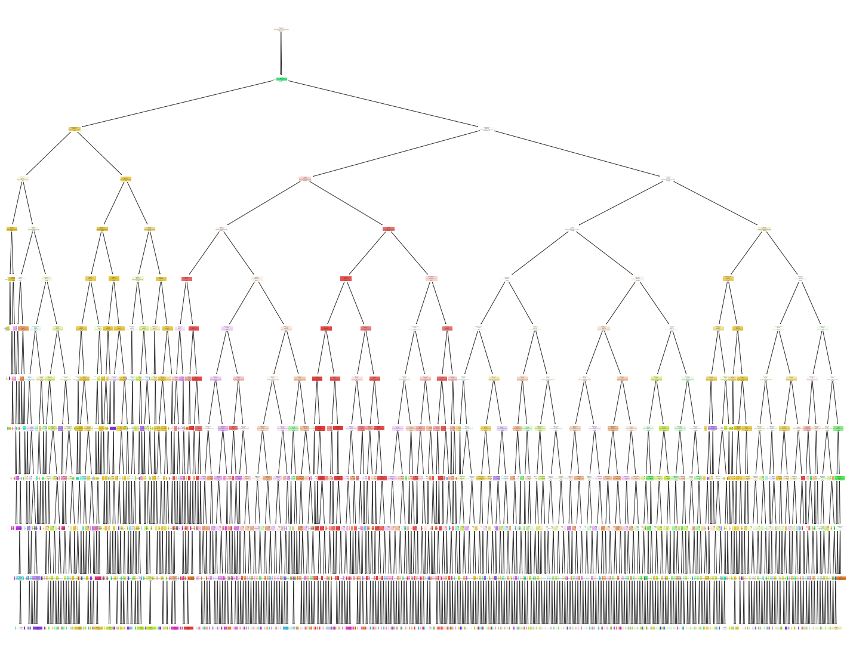
Decision Tree Classifier
So, we calculated accuracy for max depth from using just 1 feature to all the way to using all 26 features
We found that at max_depth = 12 we get the highest average accuracy.
Our decision tree model has ~62% accuracy.
Also, the tree diagram is huge and hard to decipher. So, we looked for alternative classification approaches.

Slide 23
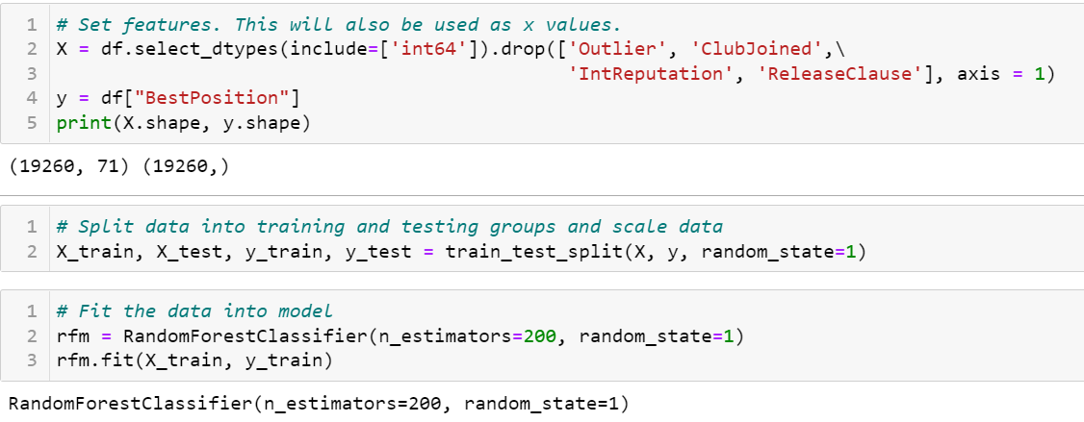
Random Forest Classifier
For this model, we used all the integer attributes from our dataset.
As random forest can predict string categories, we used the original position column as our response variable.

Slide 24
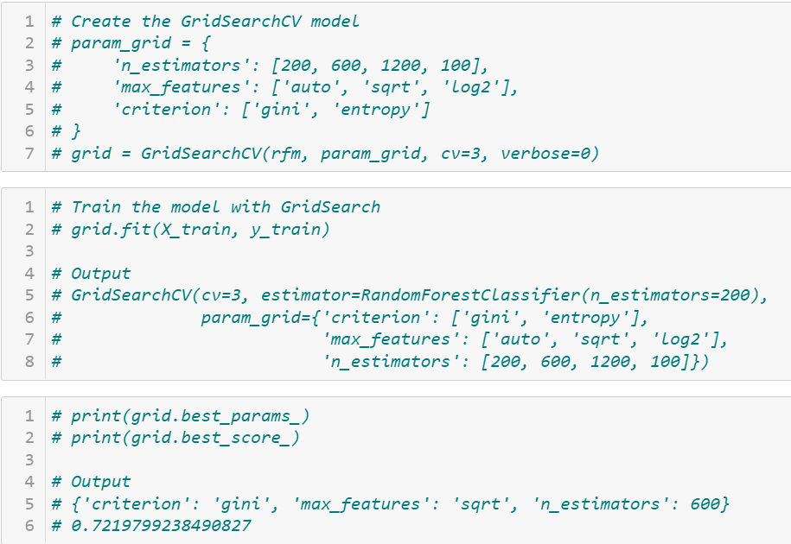
Random Forest Classifier – Cont’d
We used GridSearchCV to hyper tune or random forest classifier model
We can see the output of the GridSearchCV method on the screenshot to the right.

Slide 25
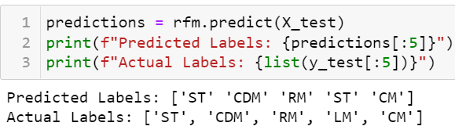
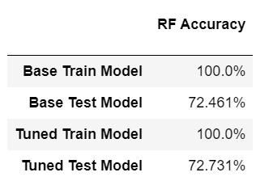
Random Forest Classifier – Cont’d
Using the GridSearchCV parameters we created our final random forest classifier model.
We can see that the hyper tuned model or the final model has a better accuracy than the base random forest classifier model.
The final model also has way better accuracy than decision tree classifier model.

Slide 26
Questions?

