Slide 1

DS – 600 DATA MINING
WEEK - 2
DS – 600 DATA MINING

Slide 2
AGENDA
EDA
Data Pre-Processing
Introduction to Clustering
Clustering Part 1
DS – 600 DATA MINING

Slide 3
AGENDA
EDA
Data Pre-Processing
Introduction to Clustering
Clustering Part 1
DS – 600 DATA MINING

Slide 4
What is Exploratory Data Analysis (EDA)?
Exploratory Data Analysis (EDA) is used on the one hand to answer questions, test business assumptions, generate hypotheses for further analysis. On the other hand, you can also use it to prepare the data for modeling. The thing that these two probably have in common is a good knowledge of your data to either get the answers that you need or to develop an intuition for interpreting the results of future modeling.
DS – 600 DATA MINING

Slide 5
How do we achieve (EDA)?
There are a lot of ways to reach these goals: you can get a basic description of the data, visualize it, identify patterns in it, identify challenges of using the data, etc.
One of the things that you’ll often see when you’re reading about EDA is Data profiling. Data profiling is concerned with summarizing your dataset through descriptive statistics. You want to use a variety of measurements to better understand your dataset. The goal of data profiling is to have a solid understanding of your data so you can afterwards start querying and visualizing your data in various ways. However, this doesn’t mean that you don’t have to iterate: exactly because data profiling is concerned with summarizing your dataset, it is frequently used to assess the data quality. Depending on the result of the data profiling, you might decide to correct, discard or handle your data differently.
DS – 600 DATA MINING

Slide 6
EDA and Data Mining
EDA distinguishes itself from data mining, even though the two are closely related, as many EDA techniques have been adopted into data mining. Also the goals of the two are very similar: EDA indeed makes sure that you explore the data in such a way that interesting features and relationships between features will become more clear. In EDA, you typically explore and compare many different variables with a variety of techniques to search and find systematic patterns. Data mining, on the other hand, is concerned with extracting patterns from the data. Those patterns provide insights into relationships between variables that can be used to improve business decisions. Also, in both cases, you have no a priori expectations or expectations that are not complete about the relations between the variables.
Data Mining accepts a “black box” approach to data exploration and doesn’t only use techniques that are also used in EDA but also techniques such as Neural Networks to generate valid predictions but don’t identify the specific nature of the relationships between the variables on which the predictions are based.
DS – 600 DATA MINING

Slide 7
Let’s do some fun practical exercise
https://www.kaggle.com/ekami66/detailed-exploratory-data-analysis-with-python
https://towardsdatascience.com/exploratory-data-analysis-tutorial-in-python-15602b417445
DS – 600 DATA MINING

Slide 8
AGENDA
EDA
Data Pre-Processing
Introduction to Clustering
Clustering Part 1
DS – 600 DATA MINING

Slide 9
Data Preprocessing
Data preprocessing is a data mining technique that involves transforming raw data into an understandable format. Real-world data is often incomplete, inconsistent, and/or lacking in certain behaviors or trends, and is likely to contain many errors. Data preprocessing is a proven method of resolving such issues. Data preprocessing prepares raw data for further processing.
DS – 600 DATA MINING

Slide 10
Why Data Preprocessing?
Real-world data are generally:
Incomplete: lacking attribute values, lacking certain attributes of interest, or containing only aggregate data
Noisy: containing errors or outliers
Inconsistent: containing discrepancies in codes or names
Tasks in data preprocessing:
Data cleaning: fill in missing values, smooth noisy data, identify or remove outliers, and resolve inconsistencies.
Data integration: using multiple databases, data cubes, or files.
Data transformation: normalization and aggregation.
Data reduction: reducing the volume but producing the same or similar analytical results.
Data discretization: part of data reduction, replacing numerical attributes with nominal ones.
DS – 600 DATA MINING

Slide 11
Let’s do some fun practical exercise
https://www.kaggle.com/ajay1216/practical-guide-on-data-preprocessing-in-python
DS – 600 DATA MINING

Slide 12
AGENDA
EDA
Data Pre-Processing
Introduction to Clustering
Clustering Part 1
DS – 600 DATA MINING

Slide 13
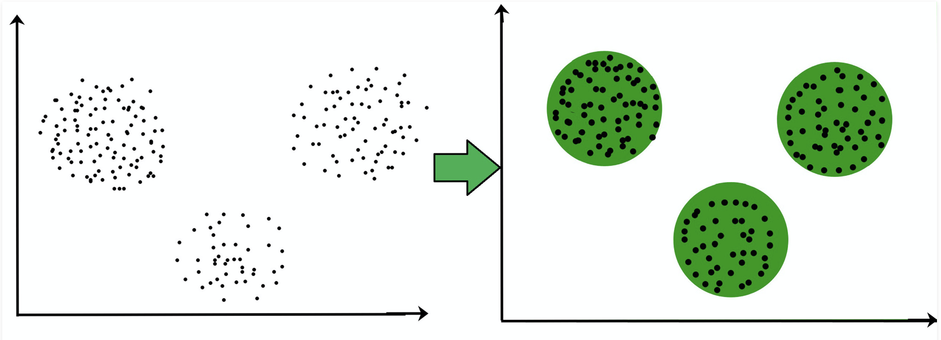
Clustering
Clustering is the task of dividing the population or data points into a number of groups such that data points in the same groups are more similar to other data points in the same group and dissimilar to the data points in other groups. It is basically a collection of objects on the basis of similarity and dissimilarity between them.
DS – 600 DATA MINING

Slide 14
Why Clustering
Clustering is very much important as it determines the intrinsic grouping among the unlabeled data present. There are no criteria for a good clustering. It depends on the user, what is the criteria they may use which satisfy their need. For instance, we could be interested in finding representatives for homogeneous groups (data reduction), in finding “natural clusters” and describe their unknown properties (“natural” data types), in finding useful and suitable groupings (“useful” data classes) or in finding unusual data objects (outlier detection). This algorithm must make some assumptions which constitute the similarity of points and each assumption make different and equally valid clusters.
DS – 600 DATA MINING

Slide 15
Clustering Methods
Density-Based Methods : These methods consider the clusters as the dense region having some similarity and different from the lower dense region of the space. These methods have good accuracy and ability to merge two clusters.Example DBSCAN (Density-Based Spatial Clustering of Applications with Noise) , OPTICS (Ordering Points to Identify Clustering Structure) etc.
Hierarchical Based Methods : The clusters formed in this method forms a tree-type structure based on the hierarchy. New clusters are formed using the previously formed one. It is divided into two category
Agglomerative (bottom up approach)
Divisive (top down approach)
examples CURE (Clustering Using Representatives), BIRCH (Balanced Iterative Reducing Clustering and using Hierarchies) etc.
Partitioning Methods : These methods partition the objects into k clusters and each partition forms one cluster. This method is used to optimize an objective criterion similarity function such as when the distance is a major parameter example K-means, CLARANS (Clustering Large Applications based upon Randomized Search) etc.
Grid-based Methods : In this method the data space is formulated into a finite number of cells that form a grid-like structure. All the clustering operation done on these grids are fast and independent of the number of data objects example STING (Statistical Information Grid), wave cluster, CLIQUE (CLustering In Quest) etc.
DS – 600 DATA MINING

Slide 16
Applications of Clustering
Applications of Clustering in different fields
Marketing : It can be used to characterize & discover customer segments for marketing purposes.
Biology : It can be used for classification among different species of plants and animals.
Libraries : It is used in clustering different books on the basis of topics and information.
Insurance : It is used to acknowledge the customers, their policies and identifying the frauds.
City Planning: It is used to make groups of houses and to study their values based on their geographical locations and other factors present. Earthquake studies: By learning the earthquake-affected areas we can determine the dangerous zones.
DS – 600 DATA MINING

Slide 17
AGENDA
EDA
Data Pre-Processing
Introduction to Clustering
Clustering Part 1
DS – 600 DATA MINING

Slide 18
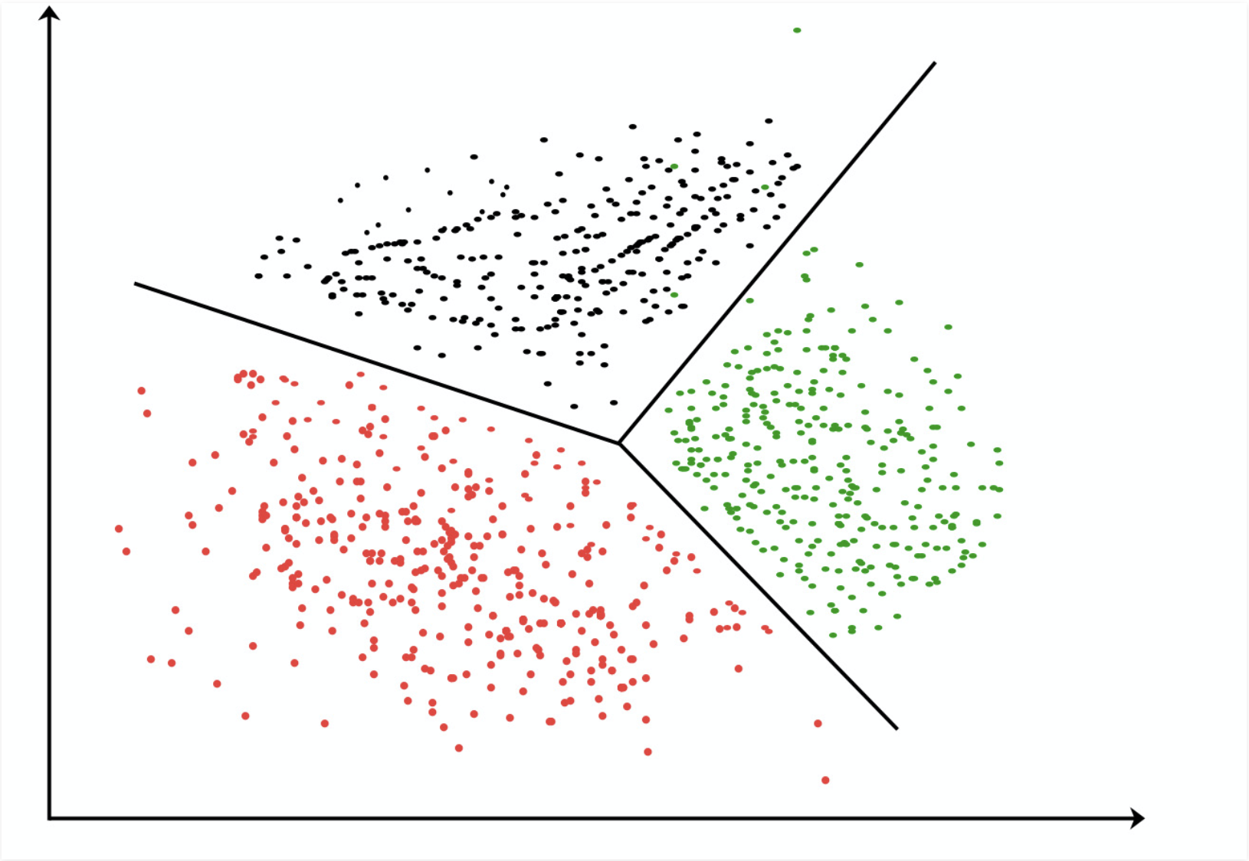
K-means Clustering
K-means clustering algorithm – It is the simplest unsupervised learning algorithm that solves clustering problem.K-means algorithm partition n observations into k clusters where each observation belongs to the cluster with the nearest mean serving as a prototype of the cluster
DS – 600 DATA MINING

Slide 19
Let’s do some fun practical exercise
https://www.kaggle.com/vjchoudhary7/kmeans-clustering-in-customer-segmentation
DS – 600 DATA MINING

