Slide 1

COVID-19: A Retrospective Analysis of Global Stringency Measures and the Impact on Incidence Rate
Created By: Mir Ahmed, Nina Anderson, Matthew Krenicki, Dan Zanoria & Tejas Iyer

Slide 2
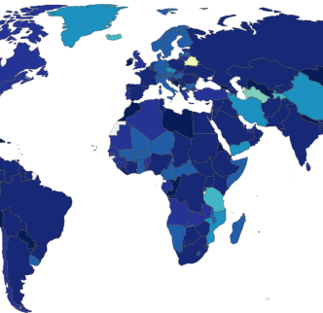
Introduction
In response to the COVID-19 pandemic, governments across the world have implemented various levels of stringency measures to prevent spread of disease
These measures vary amongst all countries with regards to the timing and scope (calculated index) of stringency
Our team’s question of interest was to determine if the various degrees of stringency measures implemented by all countries globally had an impact on the COVID-19 incidence rate based on the degree and timing of implementation
Notes:
Snapshot of heatmap from Oxford University showing “stringency indices” by country ~June 2020. Darker color signifies higher stringency.

Slide 3
HYPOTHESIS:
Countries that implemented stricter measures earlier have lower cases (per capita) than those that have looser restrictions and implemented measures later.
Notes:
Obvious question: How does one measure “strictness”?

Slide 4
Strategy & Approach
Gather data needs to test hypothesis (Cases, Population, Stringency)
Store all data needs in a common, merged dataframe
Visualize data through country by country plots and graphs
Explore statistical analysis (if viable given the data)
Arrive at and conclude on final set of insights in support of or not in support of hypothesis
Before coding our solution, we laid out a structured approach to working towards a solution supporting the hypothesis test we wanted to perform
The structured approach we followed allowed the team to work towards clear and achievable goals at each stage in the project, resulting in efficient and effective teamwork
Notes:
Snapshot of heatmap from Oxford University showing “stringency indices” by country ~June 2020. Darker color signifies higher stringency.

Slide 5

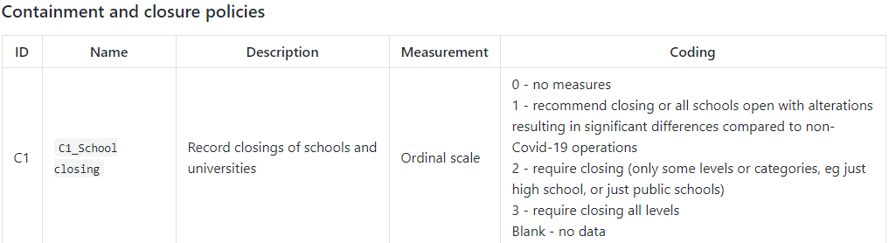
Government Response & Stringency Index Calculations
Country “Stringency Indices” were calculated according to 19 indicators which fall into 4 categorical policies:
“C” - Containment & Closure |“E” – Economic |“H” - Health System |“M” - Miscellaneous
Source: https://github.com/OxCGRT/covid-policy-tracker/blob/master/documentation/codebook.md#containment-and-closure-policies
Notes:
Click on link to demonstrate various indices and measurements of stringency calculations

Slide 6
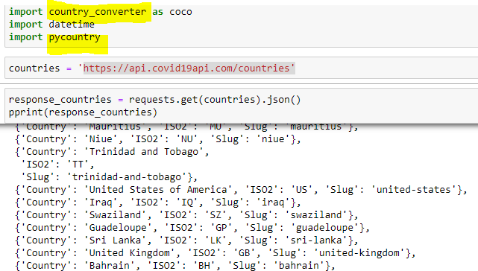
General Methods Part 1:
Identify & Obtain Current Country-specific COVID-19 Data
Source: https://api.covid19api.com/countries
Notes:
Because country name or identifications are not consistent amongst all data sets, our first goal was to create a standardized list of countries for which COVID data had been reported
API collecting the countries for which COVID data has been reported (includes country name, ISO code and “slug” required for standardizing country ID)

Slide 7
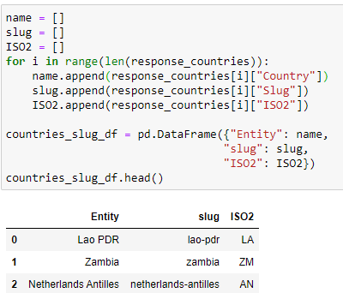
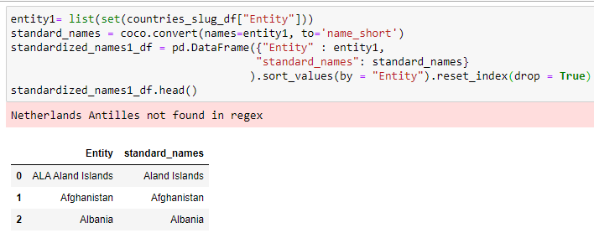
General Methods Part 1:
Identify & Obtain Current Country-specific COVID-19 Data (Continued)
Using API data, we created lists for each country name, “slug” and two-character ISO code
The lists created were then put into a pandas dataframe, then written to a .csv file
Pandas library “Country Converter” [aka “coco”] used to convert “Entity” to the common country name

Slide 8
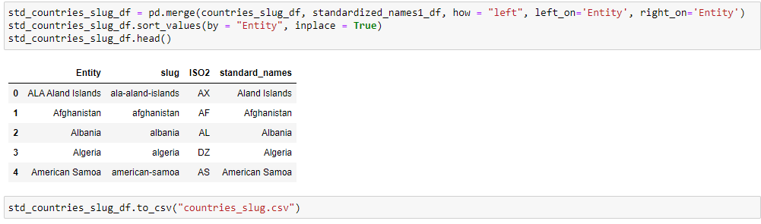

General Methods Part 1:
Identify & Obtain Current Country-specific COVID-19 Data (Continued)
The two separate CSV files containing country name and various identifiers were then merged into one standardized dataframe

Slide 9
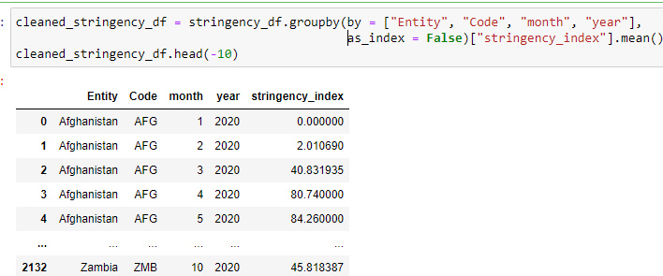
General Methods Part 1: Identify & Obtain Current Country-specific COVID-19 Data (Stringency Index Aggregation)
From the Oxford Government Response URL, we obtained a csv file of the daily “stringency index” for each country for which COVID data was reported (>62,000 records)
Notes:
The “Stringency Index” data were cleaned by dropping null or rows with empty data; monthly indices were averaged using “groupby” country and month

Slide 10

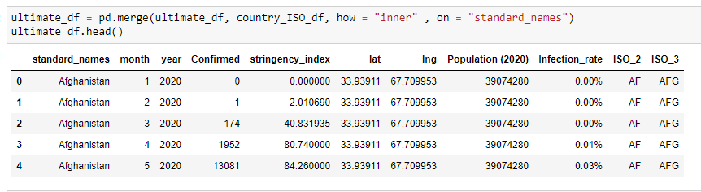
General Methods Part 1: Identify & Obtain Current Country-specific COVID-19 Data Master (“Ultimate”) Dataframe
Using similar methods, separate dataframes containing country population and geographic coordinates were created to generate the “Ultimate” dataframe containing all data needed to test hypothesis:
“Infection Rate” is a calculated field: (total population / #confirmed for month) *100

Slide 11
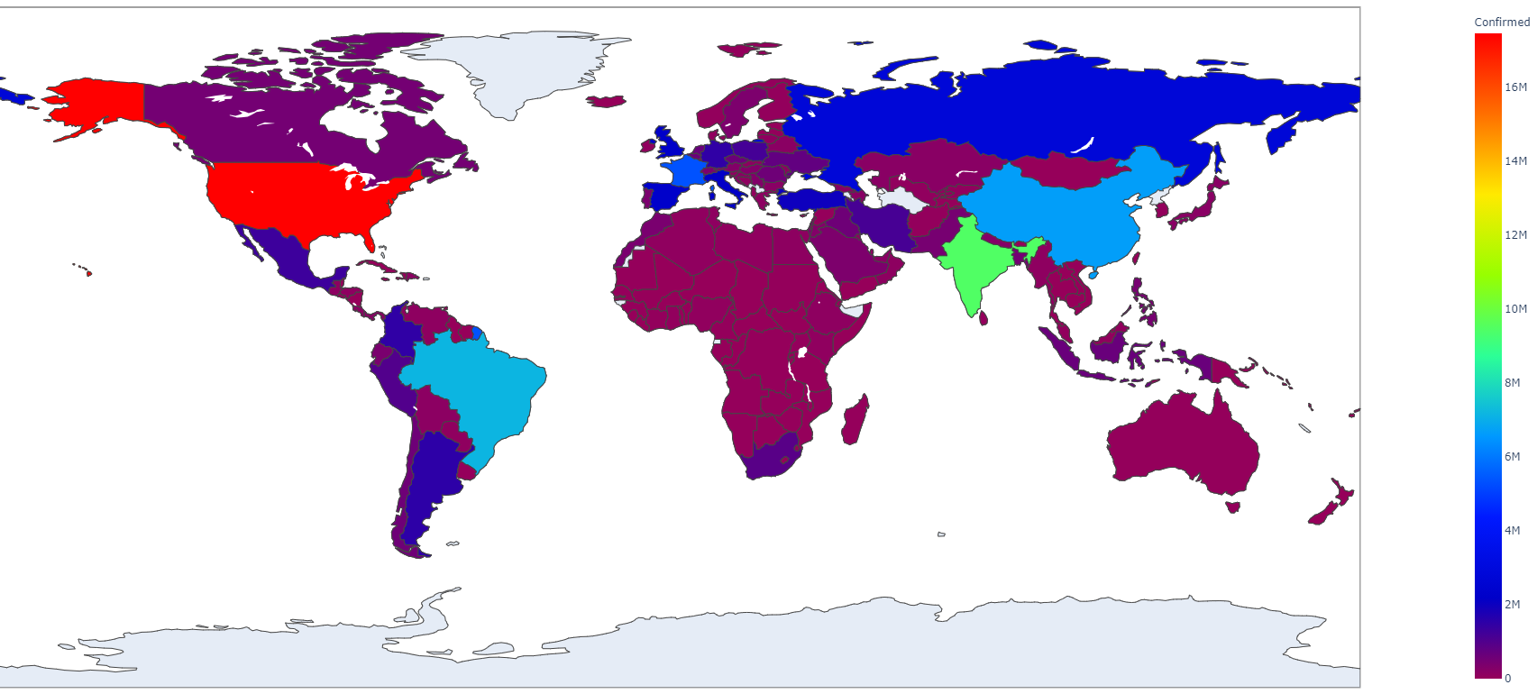
Part 2: Visualizing Data
Notes:
Heatmap courtesy of Mir Ahmed!

Slide 12
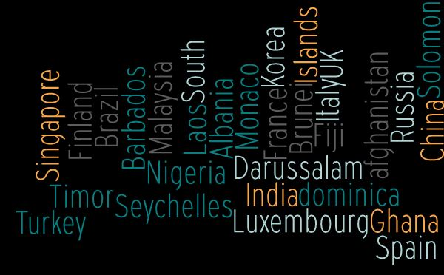
Country Sample Size (n = 30)
Countries were quasi-randomly selected for analysis. Several locations with known variables or potential confounders were intentionally chosen to illustrate geographic, political and social variables that may have had an impact on incidence rates.
Notes:
Examples include:
United Kingdon – Variant strain
Italy – known high rate of infection, one of earliest countries severely impacted
China – questionable data
Monaco – dense population
Seychelles – island region

Slide 13
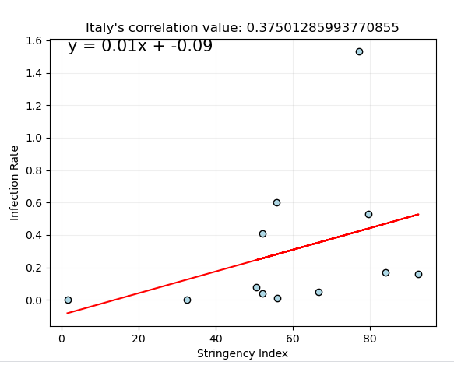
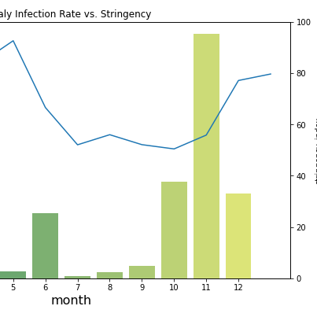
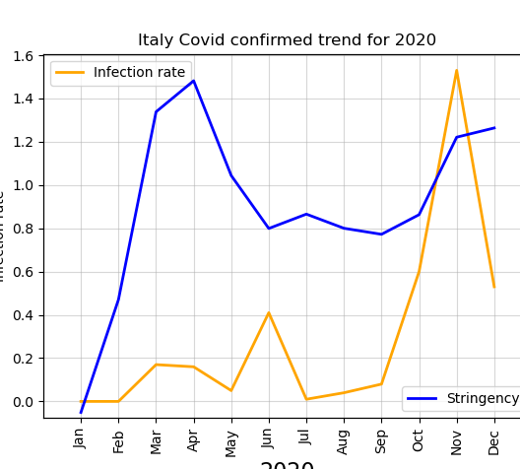
Various methods of data visualization were generated to determine if a quantitative correlation could be calculated (i.e. Pearson R value) or if trends in incidence versus stringency over time were identifiable qualitatively by visualizing histograms of incidence rate over time with the stringency index plotted as the trend line…
Notes:
Team members performed independent data visualization methods and found that output data was the same (YAY.)

Slide 14
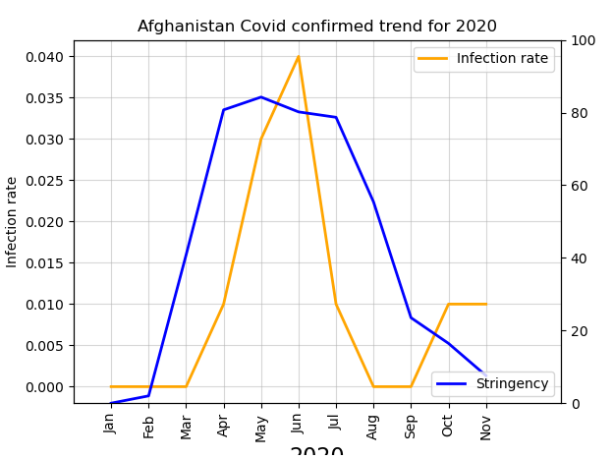
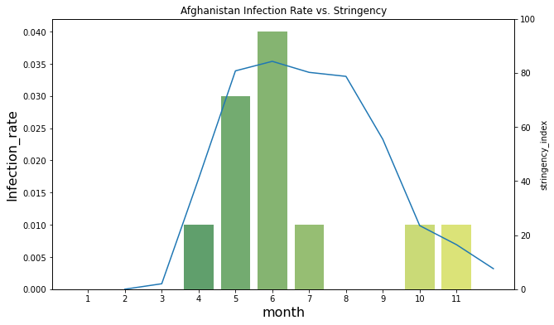
Comparison of Analyses
Notes:
Similar methods were used to visualize infection rate and stringency rate over time (by country).
Note that two separate y-axes (‘twinx’ function) as the ranges for “Infection Rate” and “Stringency Index” are separated by several orders in magnitude.
For purposes of demonstration, the double line graph images were selected for presentation.

Slide 15
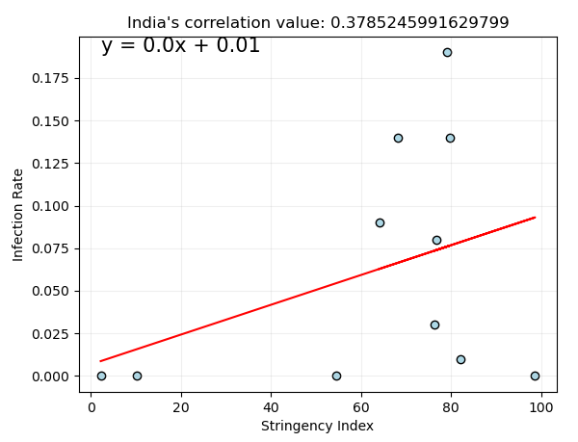
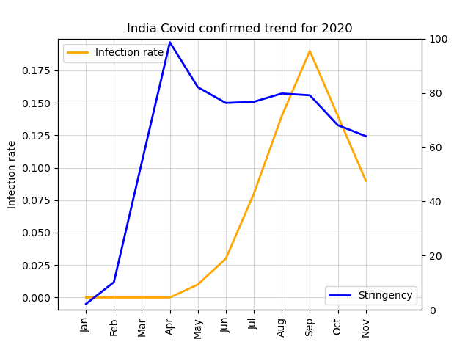
India

Slide 16
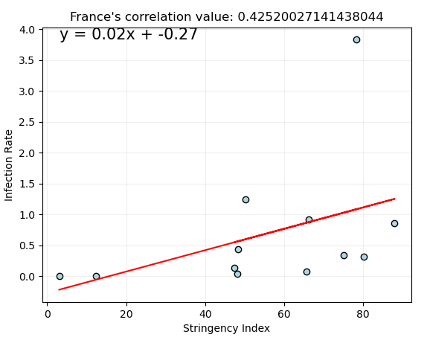
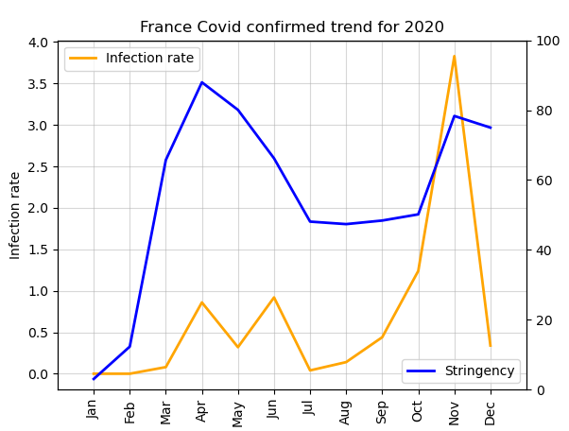
France

Slide 17
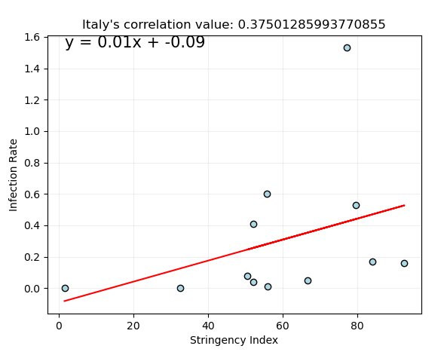
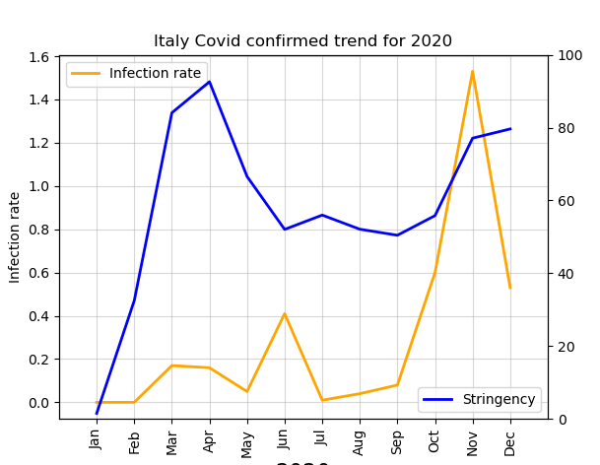
Italy

Slide 18
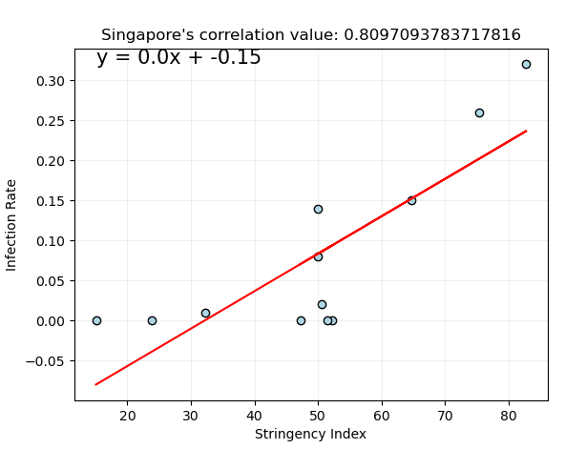
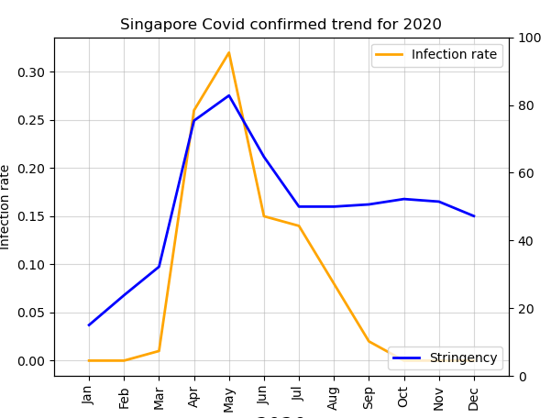
Singapore

Slide 19
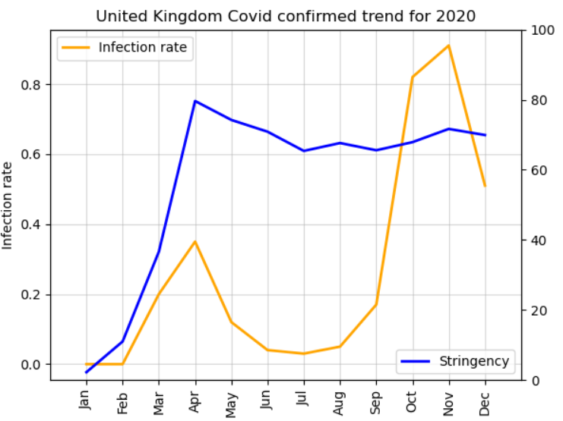
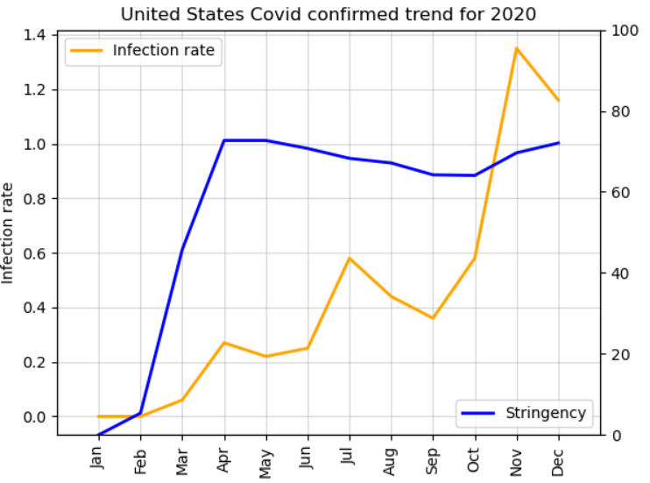
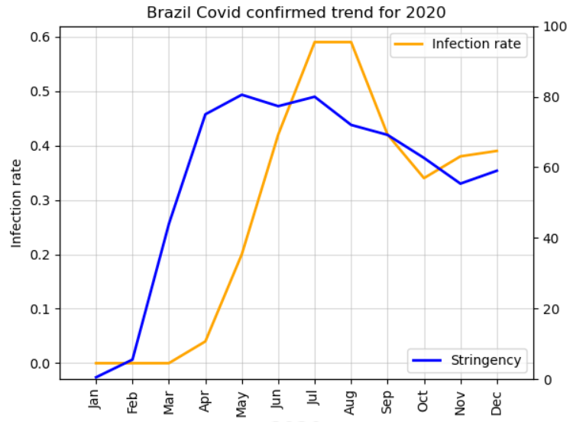
Observation #1 Impact Time-delay
Change in stringency needs at least one month to take effect as per the documentation of the stringency dataset. Also, the population might not follow the restrictions properly which leads to higher number of cases over time.
Yellow = Clear examples of trend observed

Slide 20
Observation #2
Stringency and infection rate are not contemporaneously negatively correlated (real-time) as we expected it to be.
This could imply that governments were not quick enough to implement measures to keep this spread of coronavirus under control
Not proactive
See reduction of infection rate ~1 month AFTER significant stringency measures were implemented (take countries as examples using bar / line graph plots)

Slide 21
Conclusions
Stringency and infection rate have weak to mild positive (real-time) correlation across most of the countries, which led us to analyze couple more variables like total population, density etc. With population, we found a mildly strong positive relation (.62) which means the bigger the population, the more infection.

Slide 22
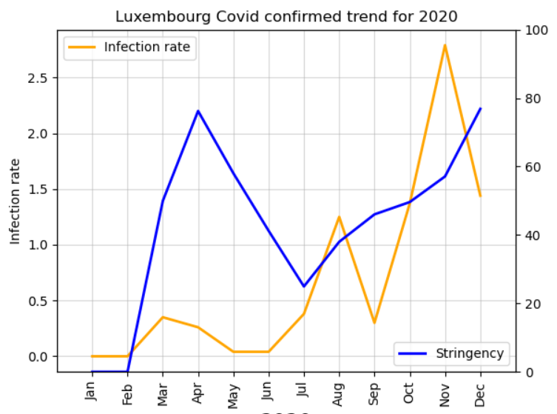
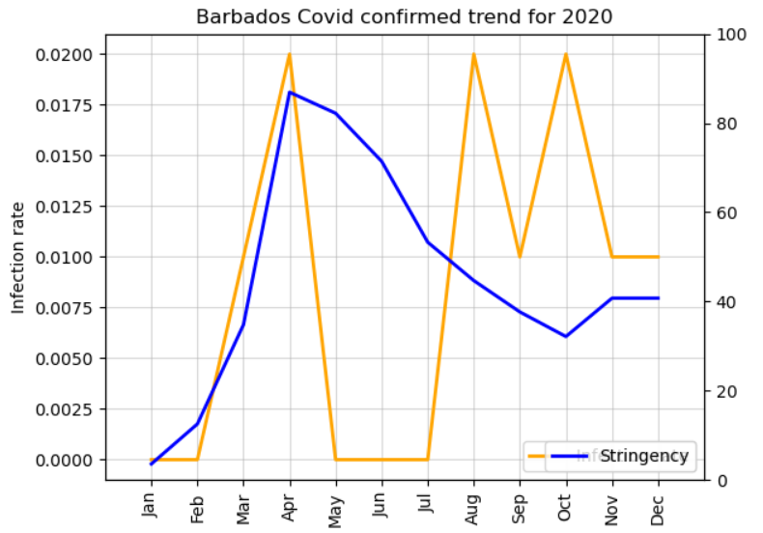
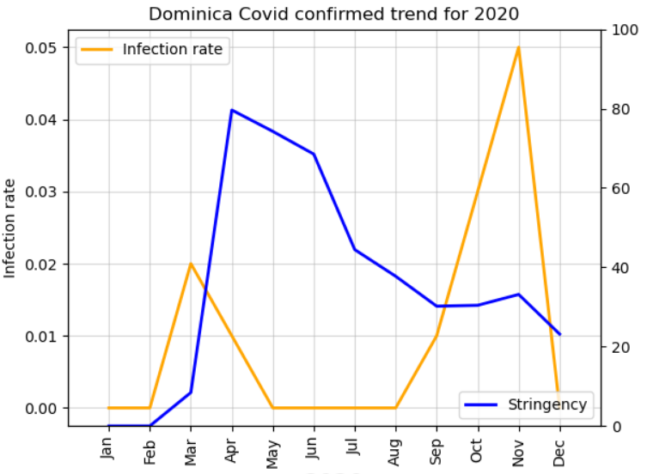
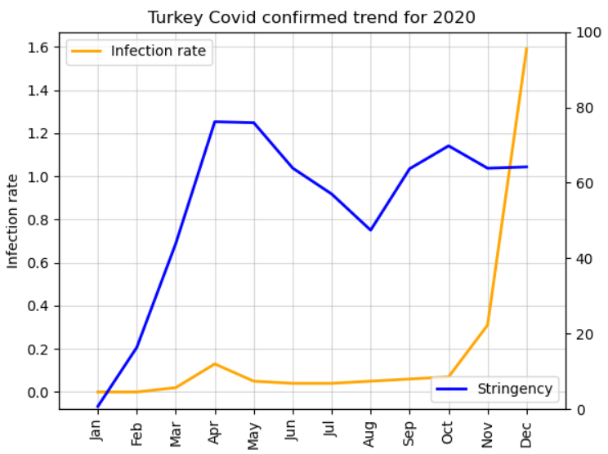
Observation #4
Less Isolated Nations
Highly Isolated Nations
Countries those could not ban cross-country road travel appear to be hit the hardest by Covid-19 as oppose to countries (mostly islands) those are surrounded by water/ocean
For isolated nations, short and sudden rises in stringency had large and (mostly) lasting impacts, but the same could not be said for less isolated nations
NOTE THE DIFFERENCES IN SCALE (Y-AXIS)

Slide 23
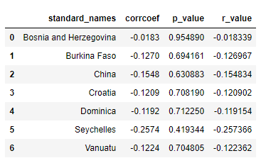
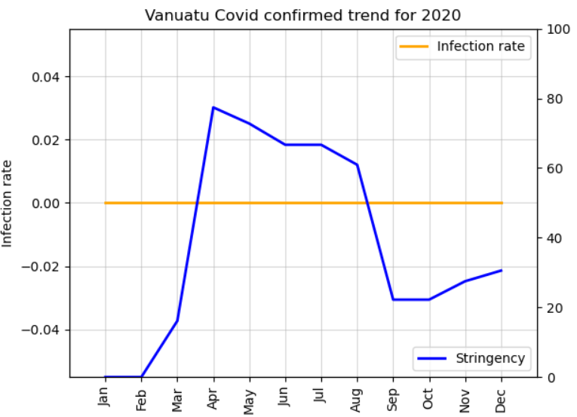
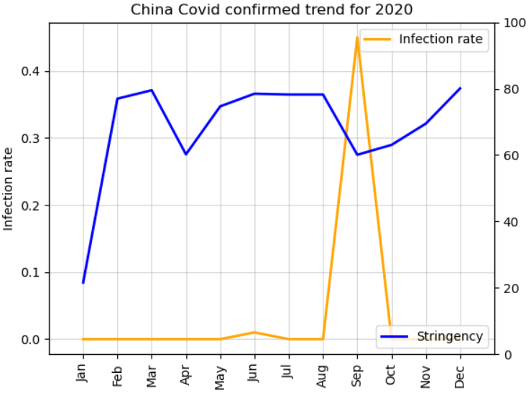
Observation #5 Outliers
There are a small handful of outliers to the previous trends showcased
These outliers (middle right table) have negative correlation coefficients, though small, meaning they appear to be more effective in using stringency measures to reduce cases in real-time
Outliers have some common characteristics among them
Data reporting may be limited and/or suspicious due to corruption, lack of testing, and other factors
Geographic isolation (Dominica, Seychelles, Vanuatu)
Analysis is only as good as data being reported (e.g. China); some countries don’t have any incidences reported for a given month(s)

Slide 24
Resources
Coronavirus COVID19 APIs:
https://documenter.getpostman.com/view/10808728/SzS8rjbc
https://api.covid19api.com/countries
University of Oxford, Blavatnik School of Government (2020):
https://www.bsg.ox.ac.uk/research/research-projects/coronavirus-government-response-tracker
Kaggle, “Population by Country 2020”:
https://www.kaggle.com/tanuprabhu/population-by-country-2020

