Slide 1

COVID-19: A Retrospective Analysis of Global Stringency Measures and the Impact on Incidence Rate
Created By: Mir Ahmed, Nina Anderson, Matthew Krenicki, & Dan Zanoria

Slide 2
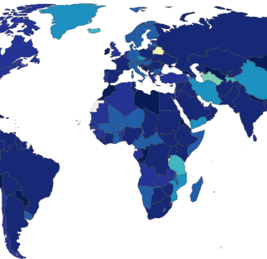
Introduction
In response to the COVID-19 pandemic, governments across the world have implemented various levels of stringency measures to prevent spread of disease.
These measures vary amongst all countries with regards to the timing and scope (calculated index) of stringency.
Our team’s question of interest was to determine if the various degrees of stringency measures implemented by all countries globally had an impact on the COVID-19 incidence rate based on the degree and timing of implementation
Notes:
Snapshot of heatmap from Oxford University showing “stringency indices” by country ~June 2020. Darker color signifies higher stringency.

Slide 3
HYPOTHESIS:
Countries that implemented stricter measures earlier have lower cases (per capita) than those that have looser restrictions and implemented measures later.
Notes:
Obvious question: How does one measure “strictness”?

Slide 4

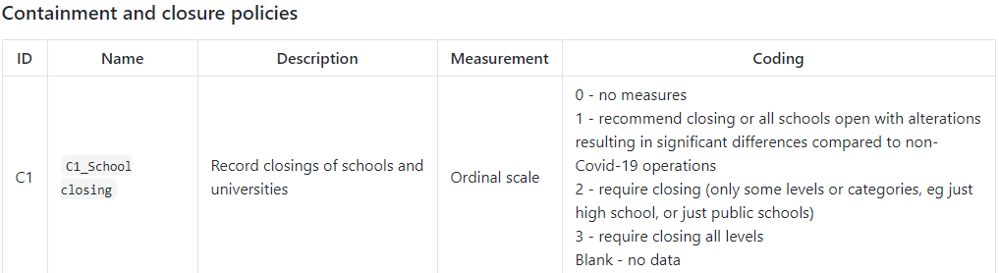
Government Response & Stringency Index Calculations
Country “Stringency Indices” were calculated according to 19 indicators which fall into 4 categorical policies:
“C” - Containment & Closure |“E” – Economic |“H” - Health System |“M” - Miscellaneous
Source: https://github.com/OxCGRT/covid-policy-tracker/blob/master/documentation/codebook.md#containment-and-closure-policies
Notes:
Click on link to demonstrate various indices and measurements of stringency calculations

Slide 5
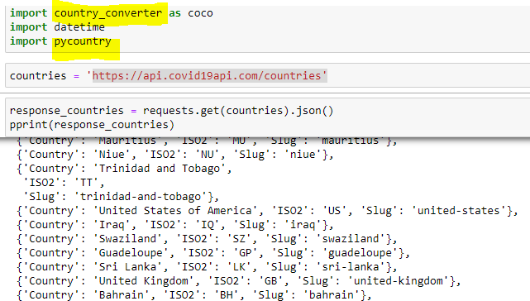
General Methods Part 1:Identify & Obtain Current Country-specific COVID-19 Data
Source: https://api.covid19api.com/countries
Notes:
Because country name or identifications are not consistent amongst all data sets, our first goal was to create a standardized list of countries for which COVID data had been reported
API collecting the countries for which COVID data has been reported (includes country name, ISO code and “slug” required for standardizing country ID)

Slide 6
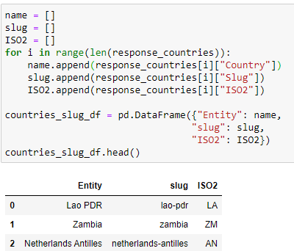
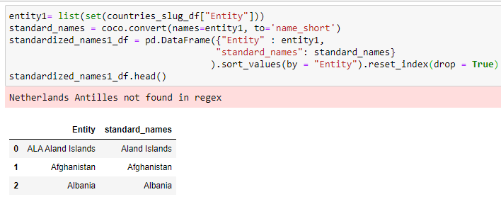
General Methods Part 1:Identify & Obtain Current Country-specific COVID-19 Data (Continued)
Using API data, we created lists for each country name, “slug” and two-character ISO code
The lists created were then put into a pandas dataframe, then written to a .csv file
Pandas library “Country Converter” [aka “coco”] used to convert “Entity” to the common country name

Slide 7
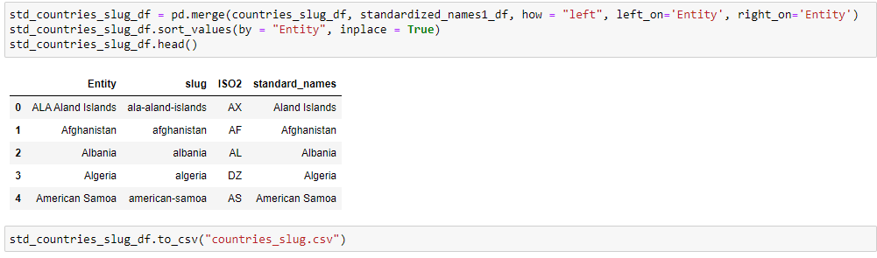

General Methods Part 1:Identify & Obtain Current Country-specific COVID-19 Data (Continued)
The two separate CSV files containing country name and various identifiers were then merged into one standardized dataframe

Slide 8
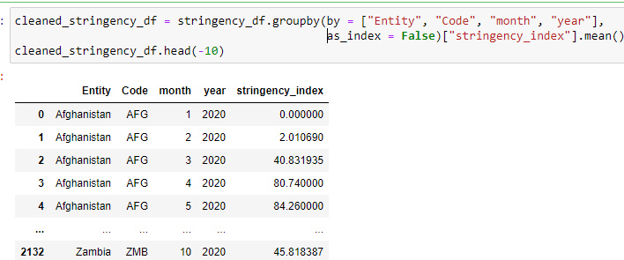
General Methods Part 1:Identify & Obtain Current Country-specific COVID-19 Data (Stringency Index Aggregation)
From the Oxford Government Response URL, we obtained a csv file of the daily “stringency index” for each country for which COVID data was reported (>62,000 records)
Notes:
The “Stringency Index” data were cleaned by dropping null or rows with empty data; monthly indices were averaged using “groupby” country and month

Slide 9

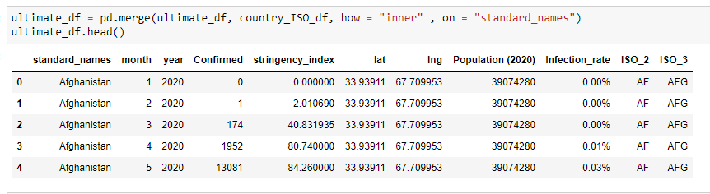
General Methods Part 1:Identify & Obtain Current Country-specific COVID-19 Data for the Master (“Ultimate”) Dataframe)
Using similar methods, separate dataframes containing country population and geographic coordinates were created to generate the “Ultimate” dataframe containing all data needed to test hypothesis:
“Infection Rate” is a calculated field: (total population / #confirmed for month) *100

Slide 10
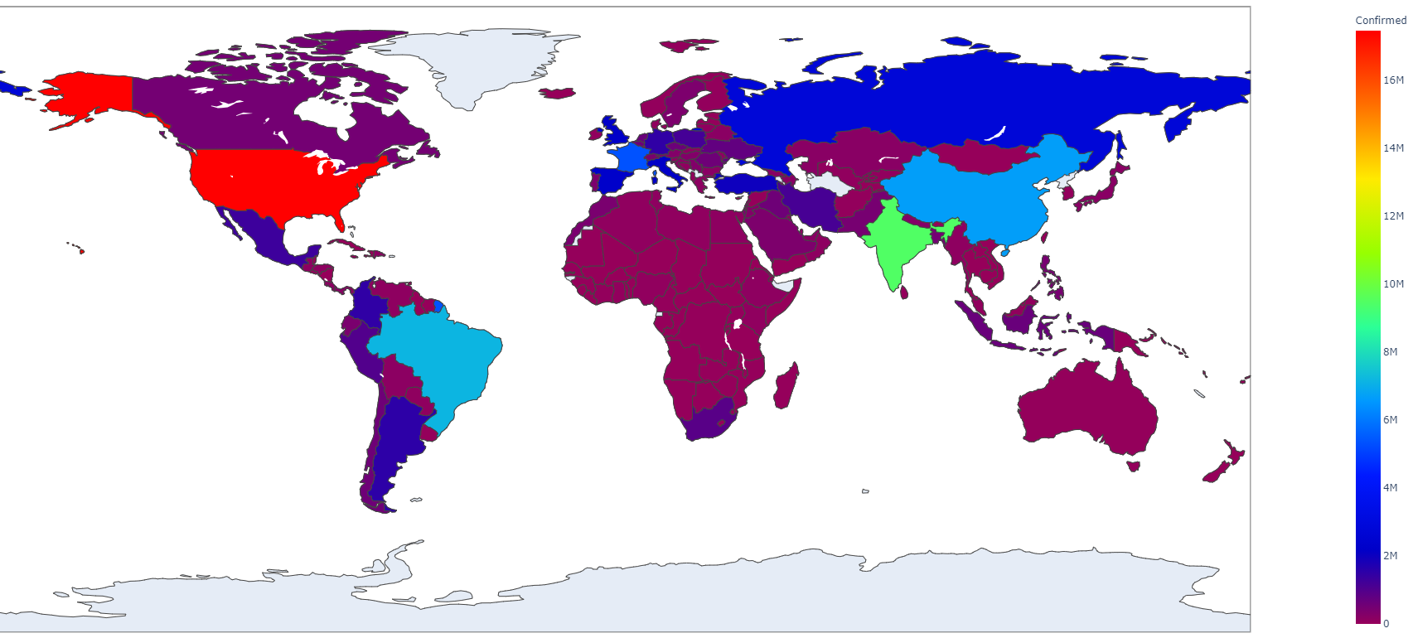
Part 2: Visualizing Data
Notes:
Heatmap courtesy of Mir Ahmed!

Slide 11
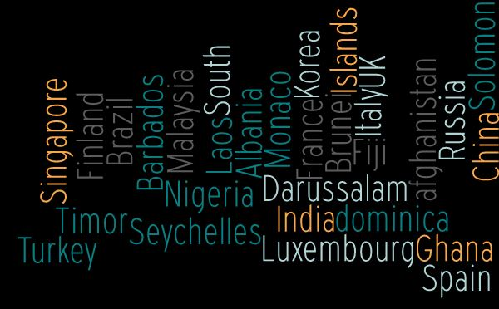
Country Sample Size (n = 30)
Countries were quasi-randomly selected for analysis. Several locations with known variables or potential confounders were intentionally chosen to illustrate geographic, political and social variables that may have had an impact on incidence rates.
Notes:
Examples include:
United Kingdon – Variant strain
Italy – known high rate of infection, one of earliest countries severely impacted
China – questionable data
Monaco – dense population
Seychelles – island region

Slide 12
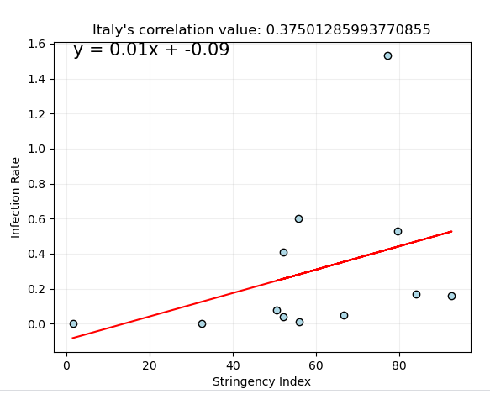
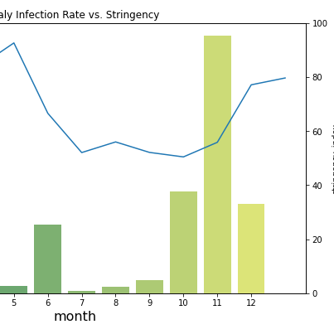
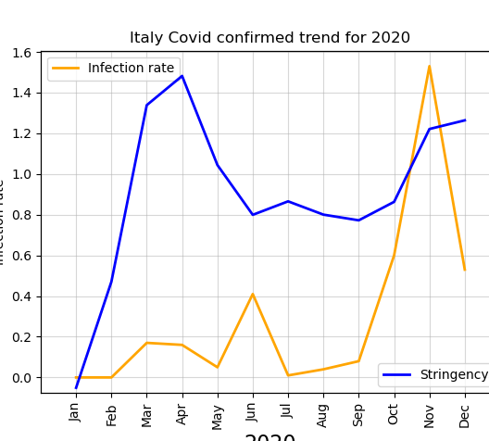
Various methods of data visualization were generated to determine if a quantitative correlation could be calculated (i.e. Pearson R value) or if trends in incidence versus stringency over time were identifiable qualitatively by visualizing histograms of incidence rate over time with the stringency index plotted as the trend line…
Notes:
Team members performed independent data visualization methods and found that output data was the same (YAY.)

Slide 13
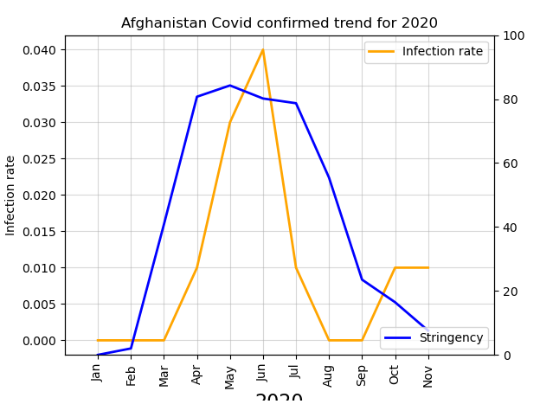
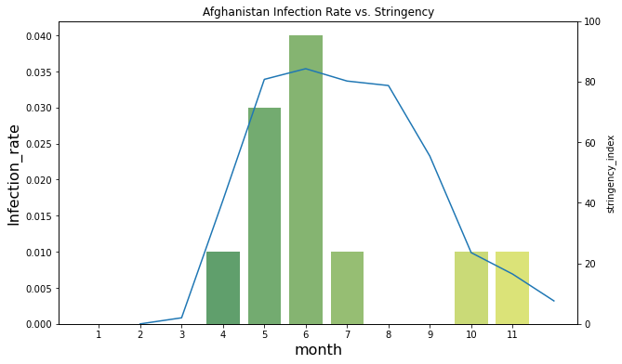
Comparison of Analyses
Notes:
Similar methods were used to visualize infection rate and stringency rate over time (by country).
Note that two separate y-axes (‘twinx’ function) as the ranges for “Infection Rate” and “Stringency Index” are separated by several orders in magnitude.
For purposes of demonstration, the double line graph images were selected for presentation.

Slide 14
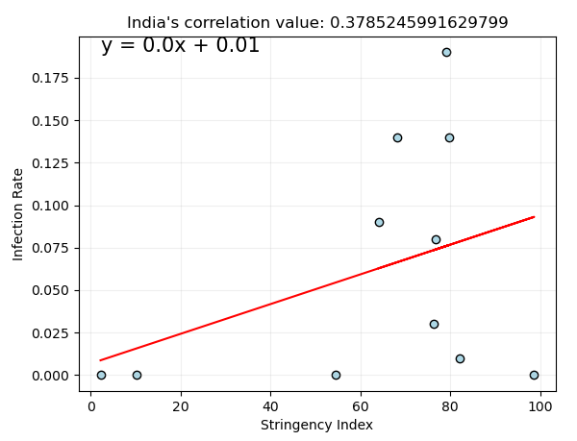
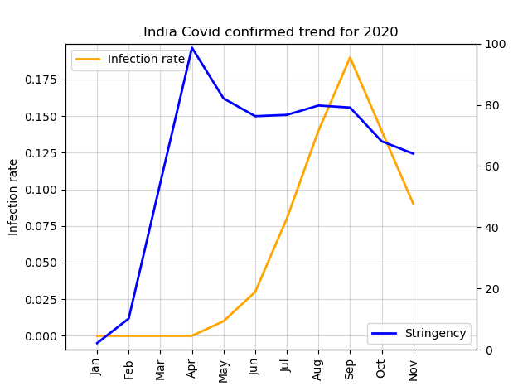
India

Slide 15
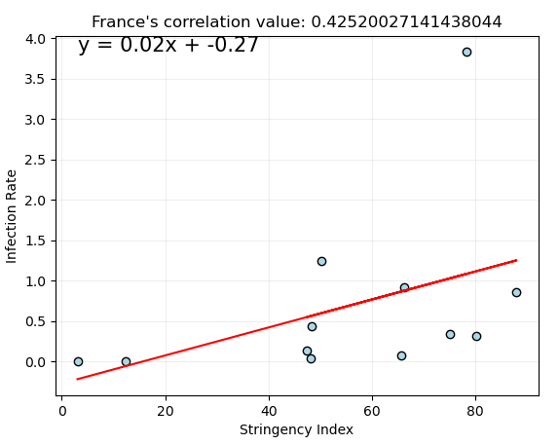
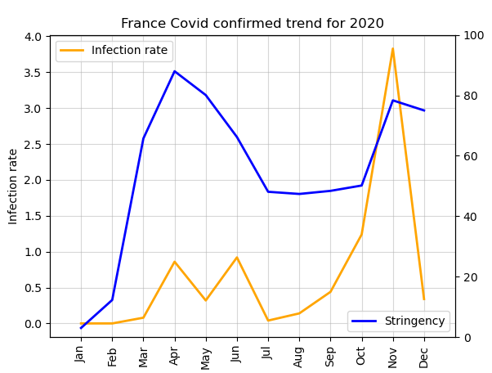
France

Slide 16
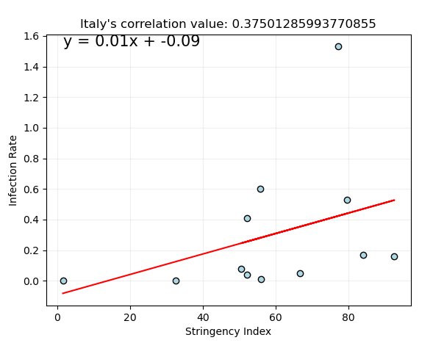
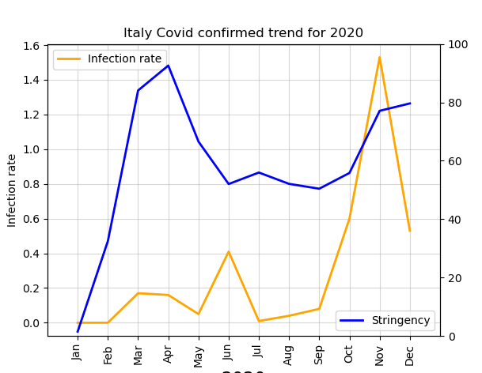
Italy

Slide 17
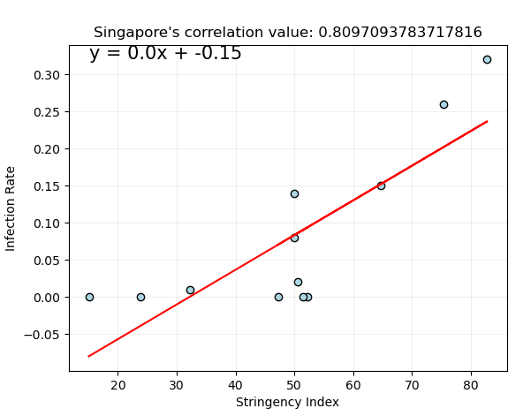
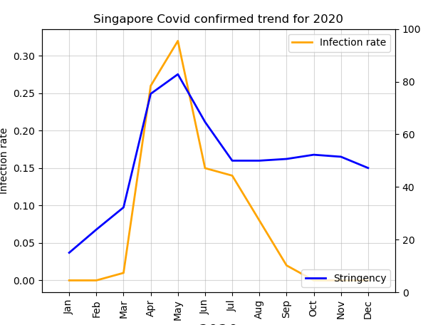
Singapore

Slide 18
Resources
Coronavirus COVID19 APIs:
https://documenter.getpostman.com/view/10808728/SzS8rjbc
https://api.covid19api.com/countries
University of Oxford, Blavatnik School of Government (2020):
https://www.bsg.ox.ac.uk/research/research-projects/coronavirus-government-response-tracker
Kaggle, “Population by Country 2020”:
https://www.kaggle.com/tanuprabhu/population-by-country-2020

