Slide 1

Hospital Management Dataset
By Zheng HaoFeng

Slide 2
About the dataset
- From Kaggle
Simple and clean
- Contains 5 CSV files:
appointments.csv
billing.csv
doctors.csv
patients.csv
treatments.csv

Slide 3
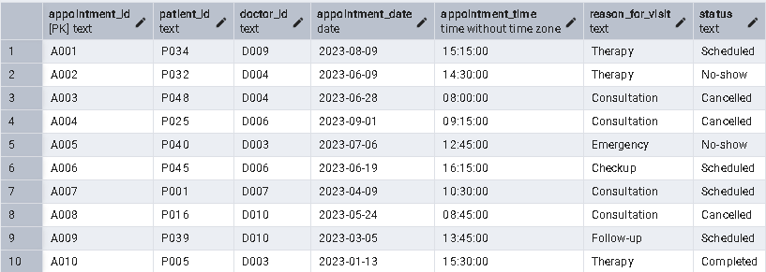
appointment.csv
Records of scheduled and completed patient appointments.
Primary key = appointment_id
200 rows
0 null values

Slide 4
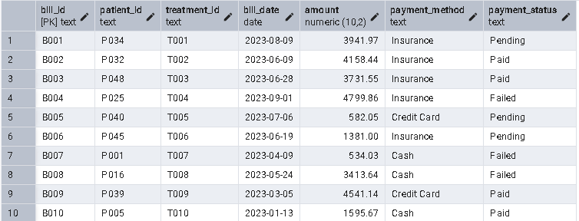
billing.csv
Billing and payment details for treatments.
Primary key = bill_id
200 rows
0 null values

Slide 5
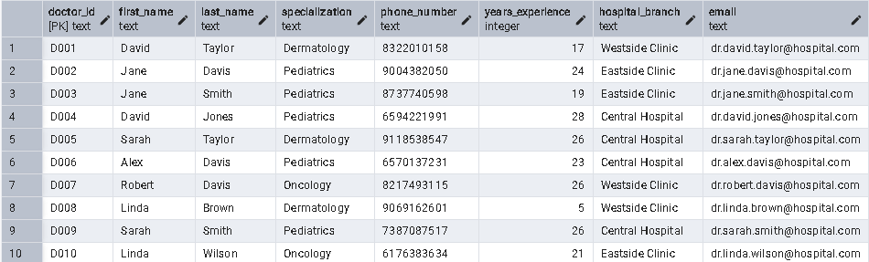
doctors.csv
Details about the doctors working in the hospital.
Primary key = doctor_id
10 rows
0 null values

Slide 6
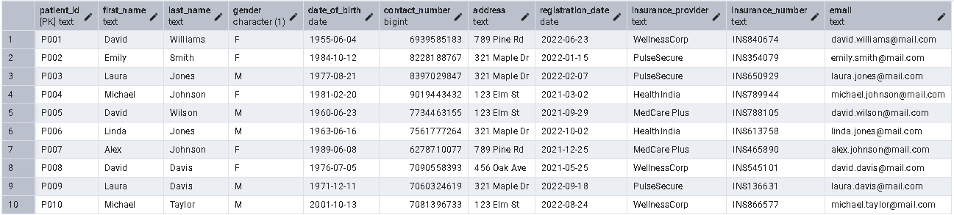
patients.csv
Contains patient demographic and registration details.
Primary key = patient_id
50 rows
0 null values

Slide 7
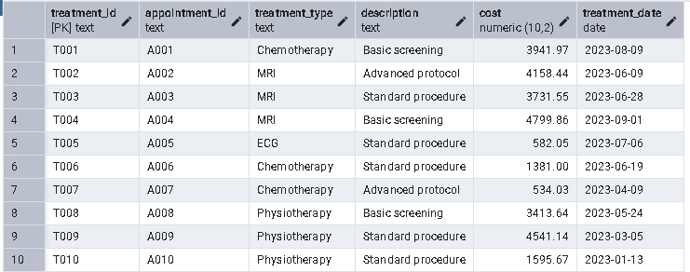
treatments.csv
Information about the treatments given during appointments.
Primary key = treatment_id
200 rows
0 null values

Slide 8
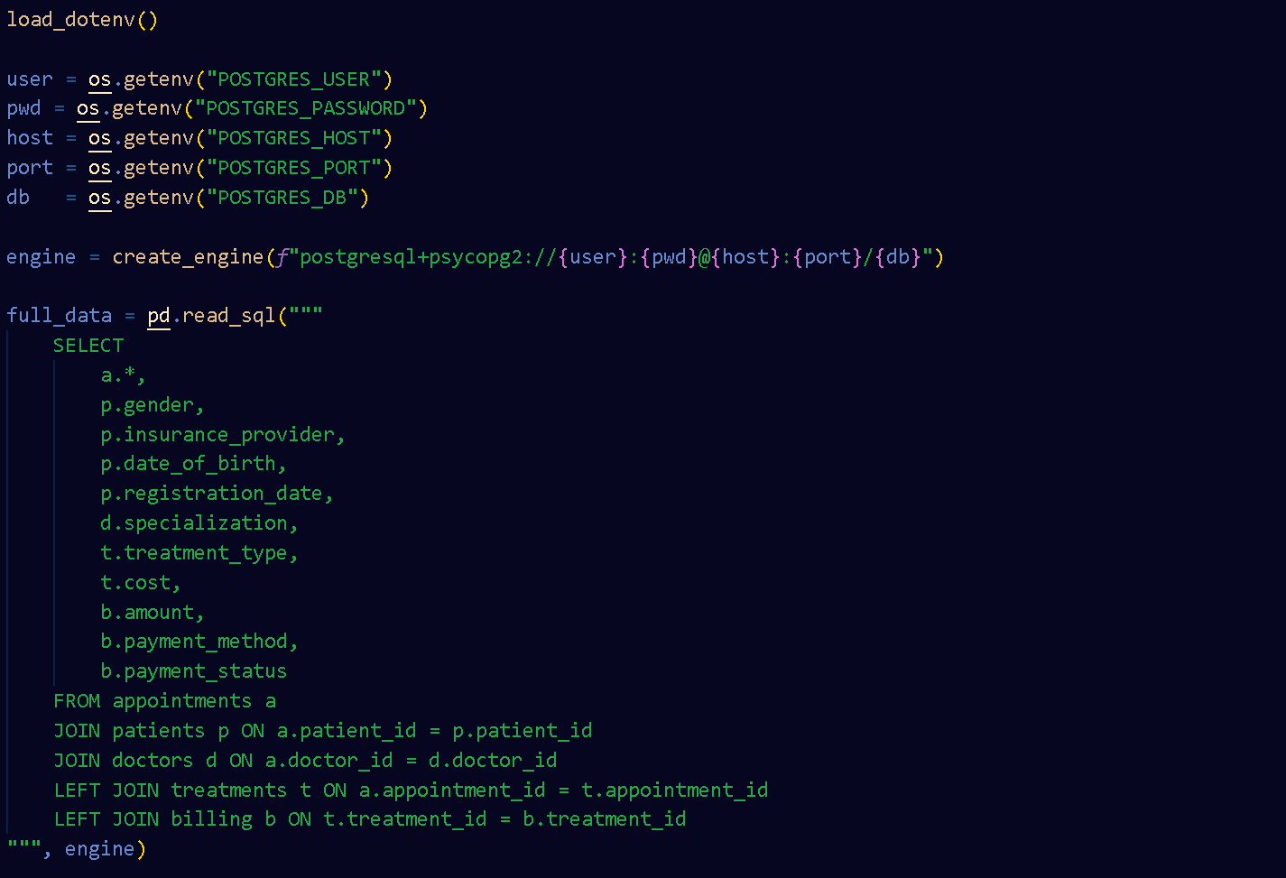

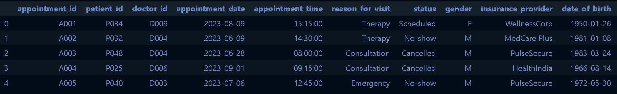
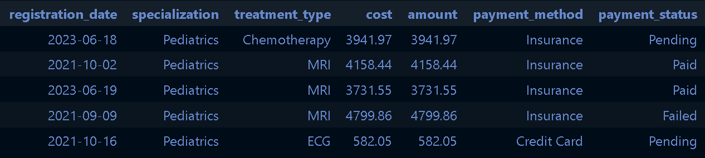
Preparing the data
Load them into PostgreSQL database with pgAdmin
Created a Relational Schema
Perform JOINS across tables to combine them into a single, flat table
Queried into a pandas dataframe with Python.

Slide 9
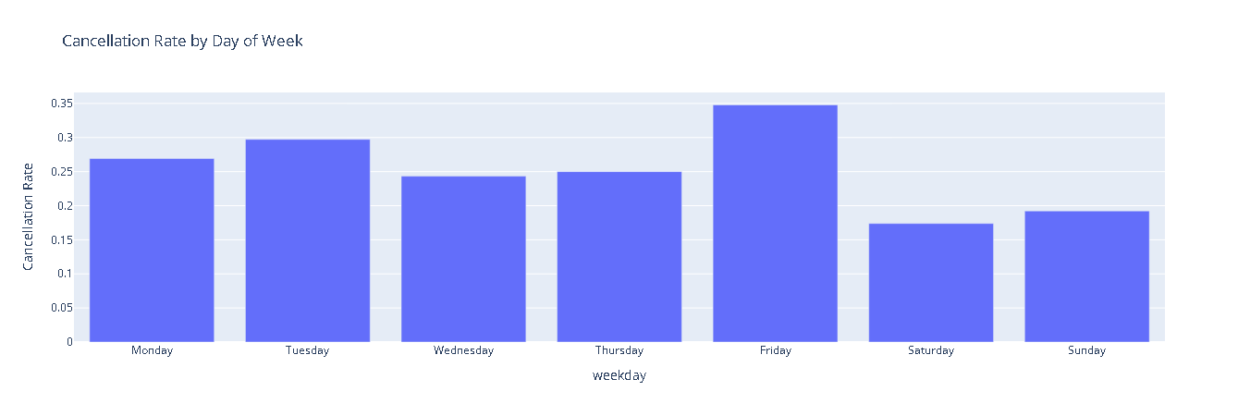
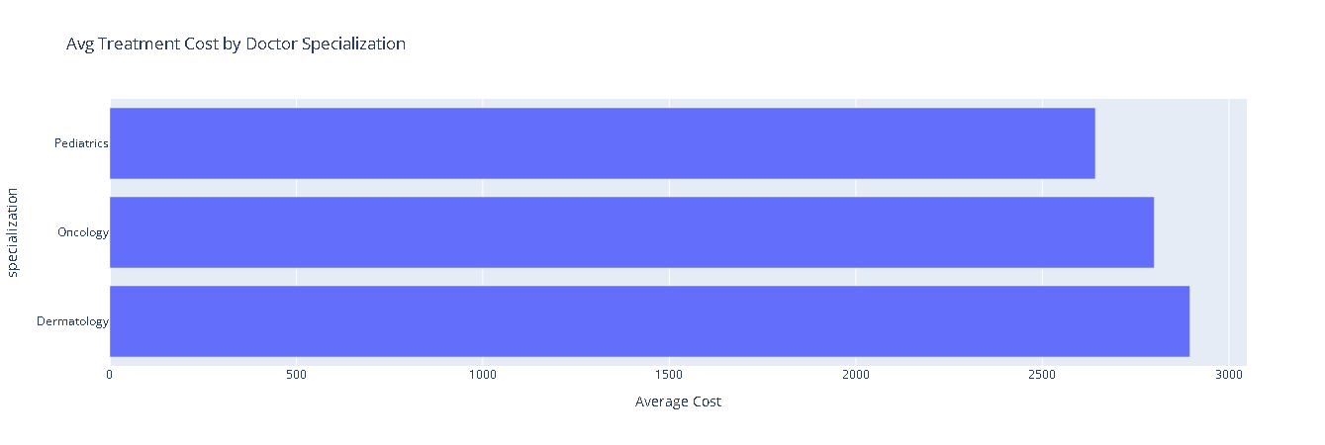
Exploratory Data Analysis
Friday has highest cancellation rate
Weekends have lower cancellation rate than weekday.
Dermatology treatments are the most expensive on average, followed by oncology and pediantrics

Slide 10
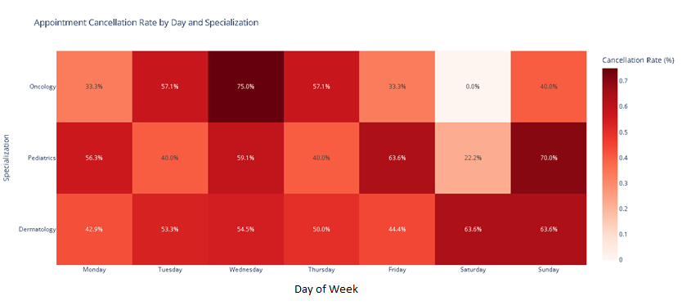
Exploratory Data Analysis
Heatmap to show appointment cancellation rate by Day and by Specialization

Slide 11
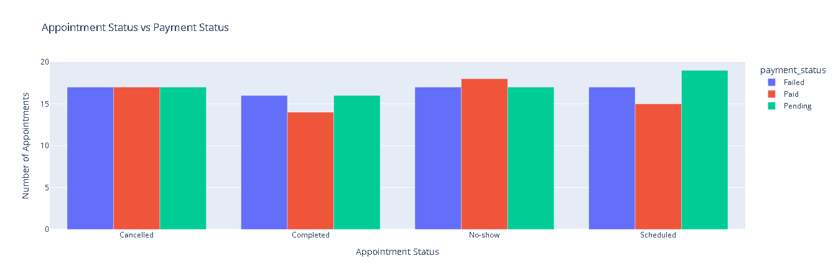
Exploratory Data Analysis
Number of each payment status per appointment status
Realised that there are patients who didn’t turn up or cancelled the appointment and already paid??

Slide 12
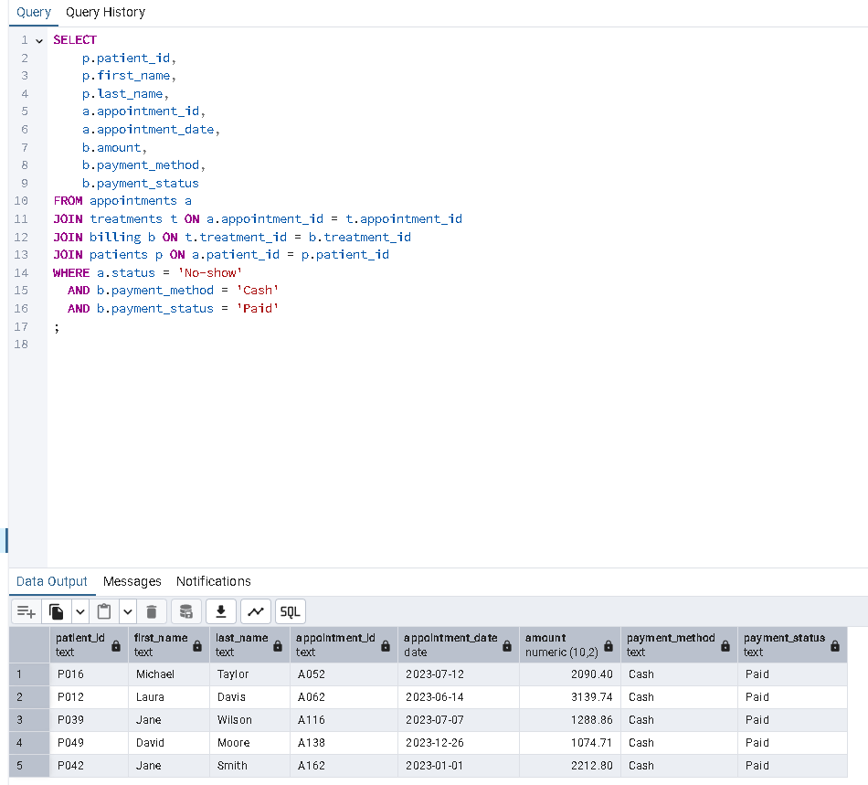
Exploratory Data Analysis
Did not turn up but paid by cash?

Slide 13
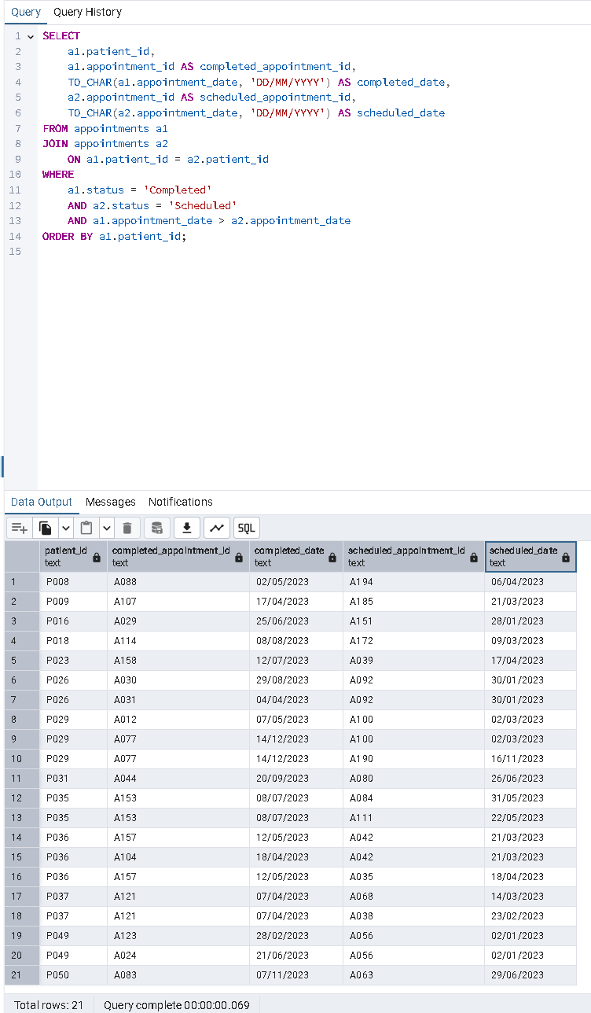
Exploratory Data Analysis
Ended up finding out that there are completed appointments with dates occurring after appointments that are still scheduled.
Some entries not updated?

Slide 14
Resolution
Assume payment needs to be made as long as appointment is scheduled, regardless patient receiving treatment
Drop rows where appointments are still scheduled as we cannot be sure if those appointments ended up getting completed/cancelled/patient did not show up.

Slide 15
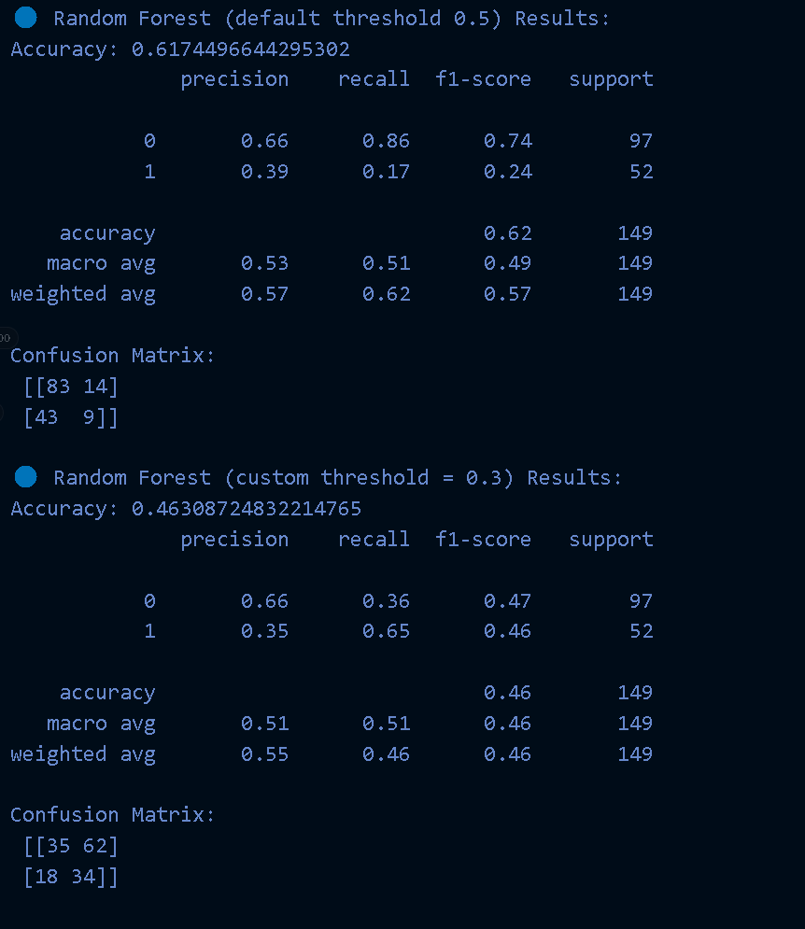
Random Forest
1) Prep data, drop rows with ‘Scheduled’ as their appointment_status
2) Feature engineering
- Calculate age of patients by using appointment date and date of birth - Made age categories e.g. Child/Young Adult/Senior
3) Select predictive features + apply one-hot encoding
4)Trained the random forest model using leave-one-out cross validation and balanced class weights.
5) Evaluated it under default classification threshold (0.5) and custom threshold(0.3) to improve sensitivity to no-shows.

Slide 16
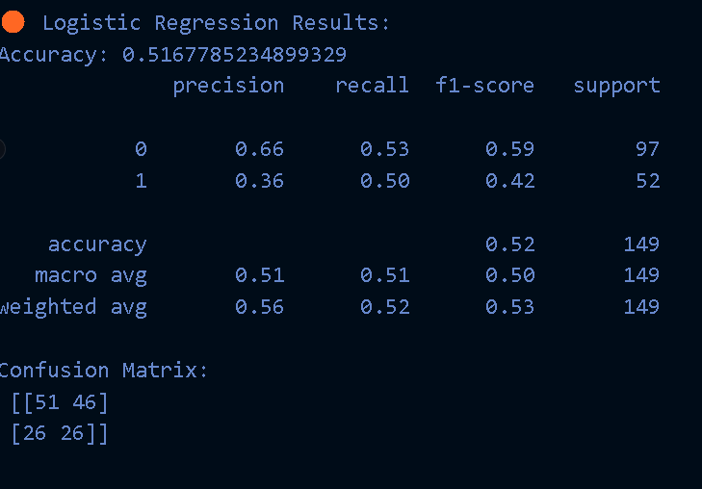
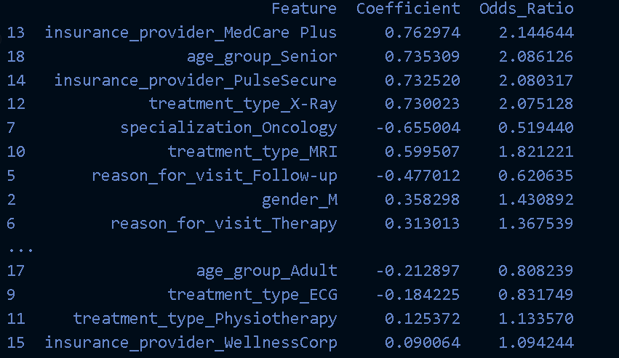
Logistic Regression
Used same x and y as random forest
Odds ratio to show feature coefficients to explain impact

Slide 17
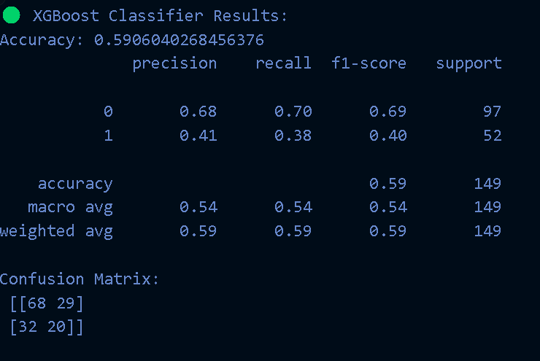
XGBoost
Used same x and y as random forest

Slide 18
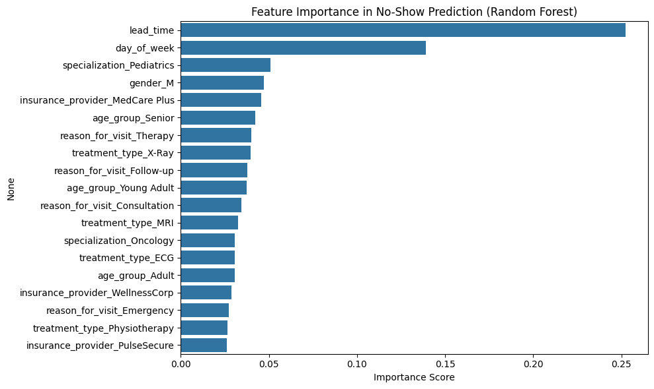
Feature Importance
Apparently, lead time and day of the week are the 2 most important features.

Slide 19
Conclusion
Random Forest at a 0.3 threshold gave the best recall for no-shows (65%), which supports operational interventions.
Logistic regression allows for more interpretability at the cost of performance

Slide 20
End

