Slide 1

615 Final Project: Video Game Sales
Xinyi Wang

Slide 2
Introduction
Has a long history as far back as the early 1950s
Mainstream popularity: 1970s and 1980s
In 2016, the video game market in the united states was valued at 17.68 billion U.S. Dollars
Main goal: Explore the development of the video game industry from 1983-2016

Slide 3
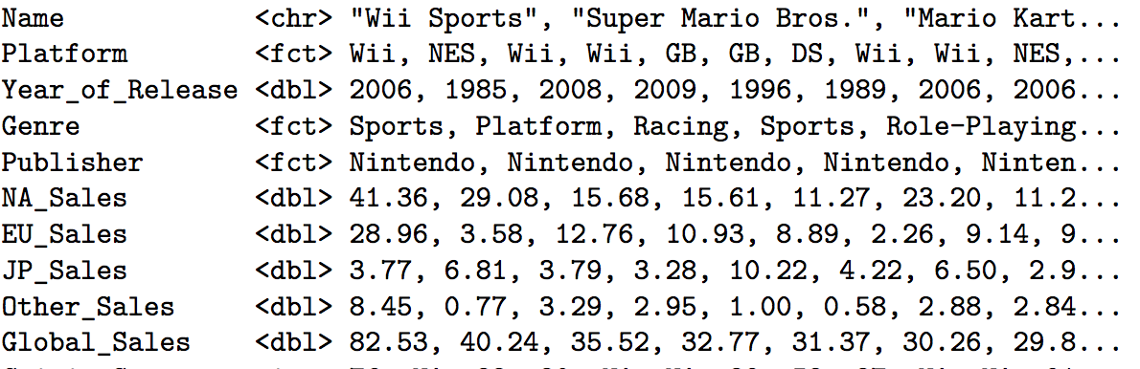
Data
Observations: 16,353
Important variables:

Slide 4

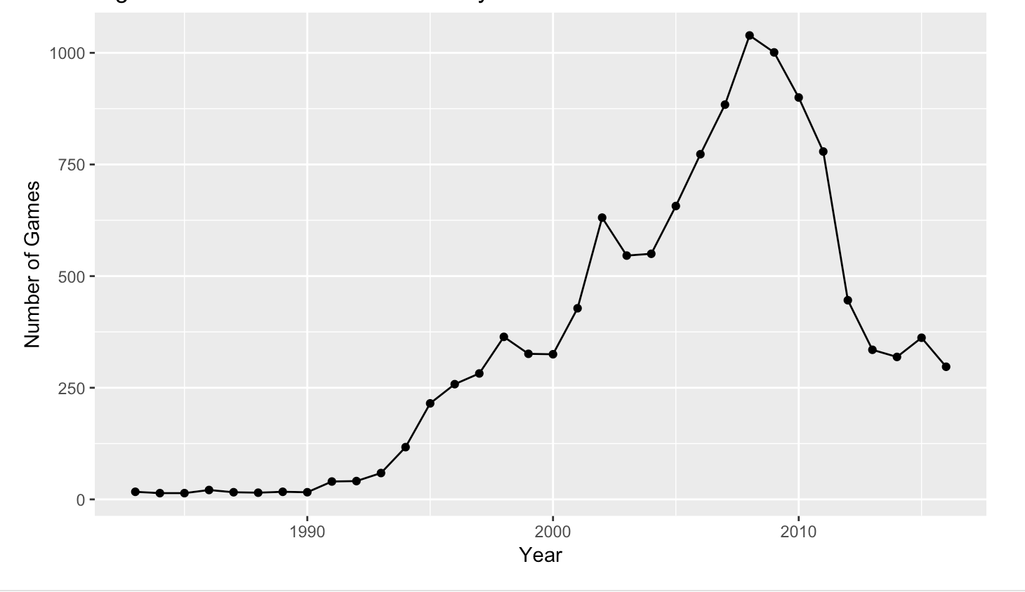
Games Released Each Year
A lot of video games released during 2005-2008
Competition became intense in the late 2000s

Slide 5
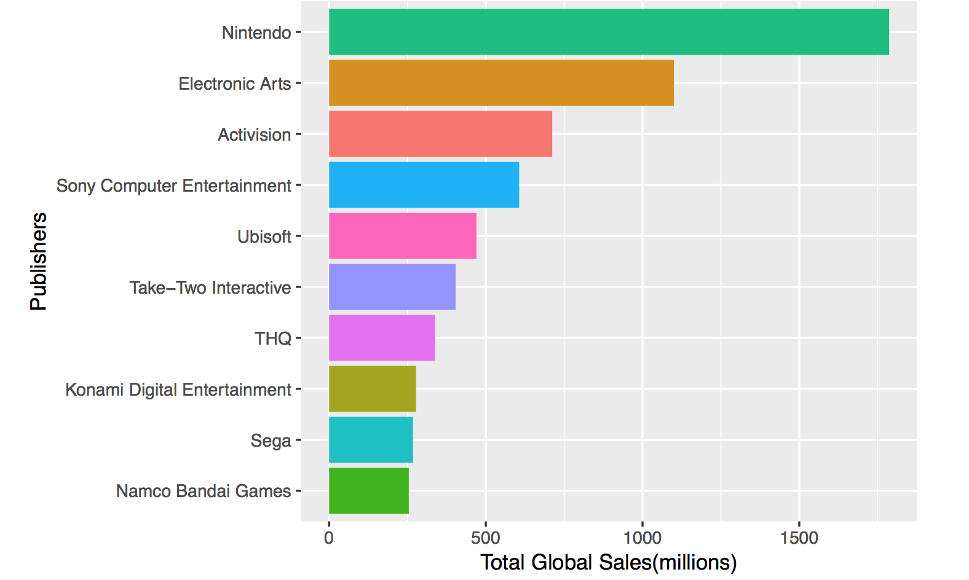
top 10 publishers
Sony computer entertainment not reached half of Nintendo’s total revenue
Potential reason:
“Sony online entertainment”,
“Sony music entertainment”,
Etc.

Slide 6
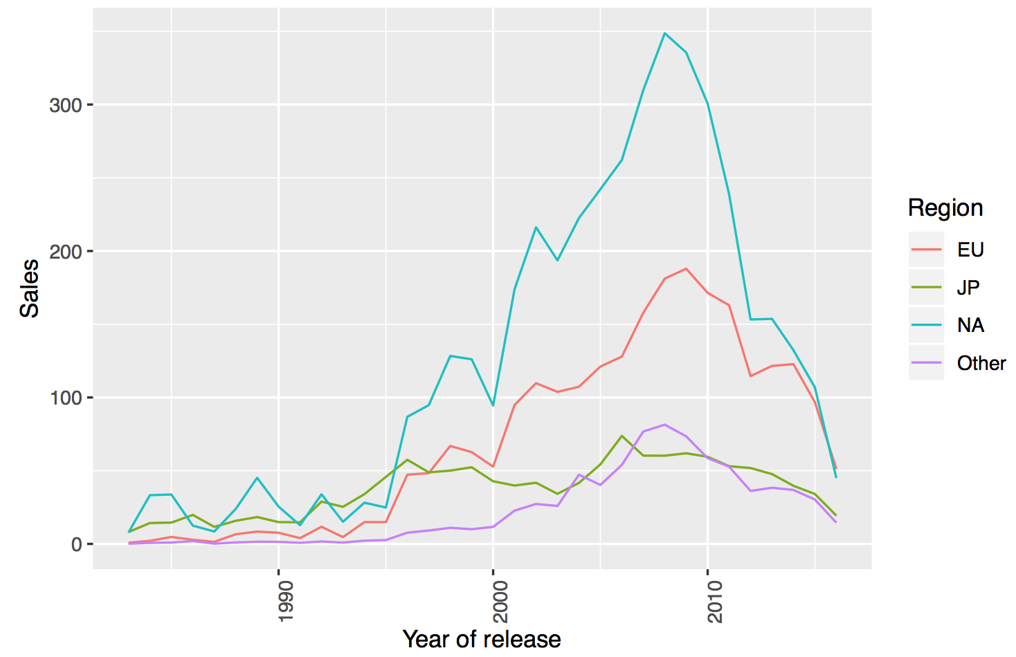
Sales per region
North America had the most drastic spike in the late 2000s.

Slide 7
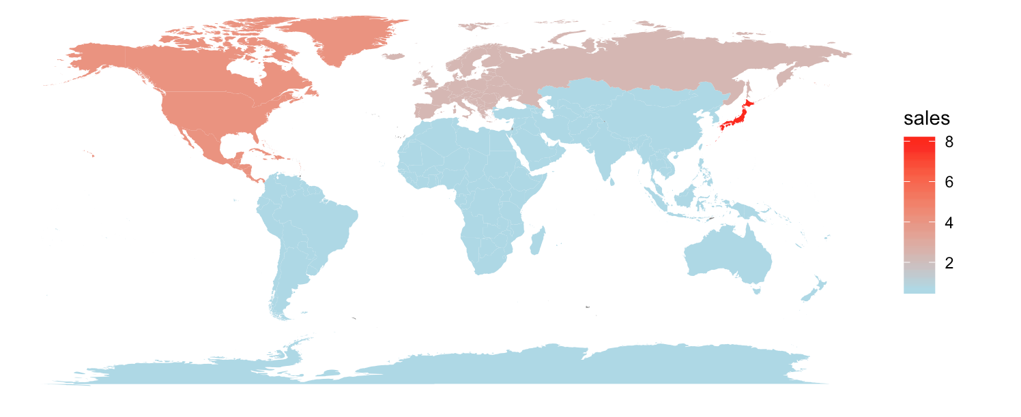
global sales map
Take platform=“3ds” and year_of_release=“2016” as example
Japan had highest sales revenue for 3DS video games in 2016
Adjust platform and year of release in shiny app

Slide 8

Word cloud
most frequently used keywords (2016):
Collection
Lego
Wars
Pro
Evil

Slide 9
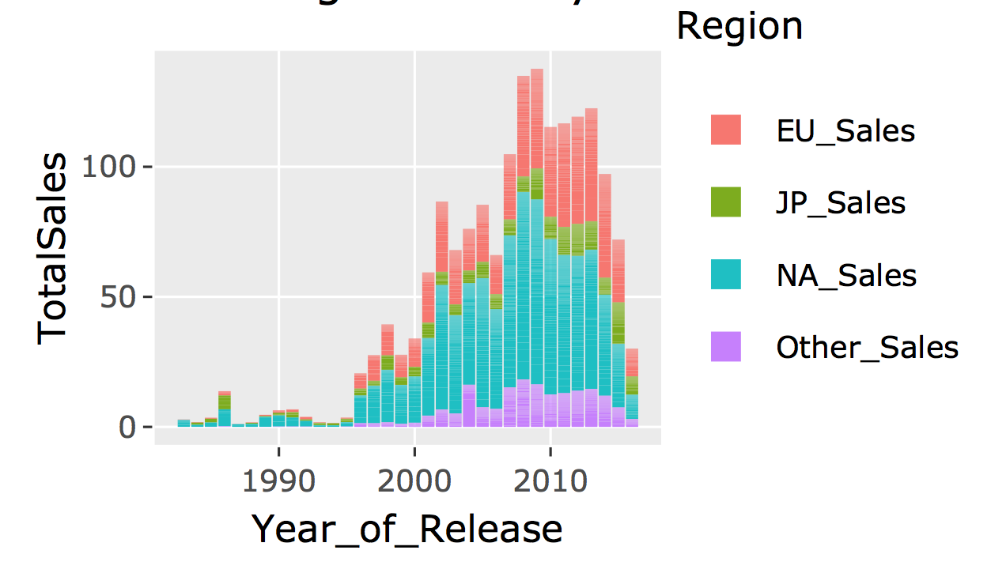
Sales by Genre
North America always contributes most of sales
in 2015 and 2016, it seems all four regions had equal sales amount

Slide 10
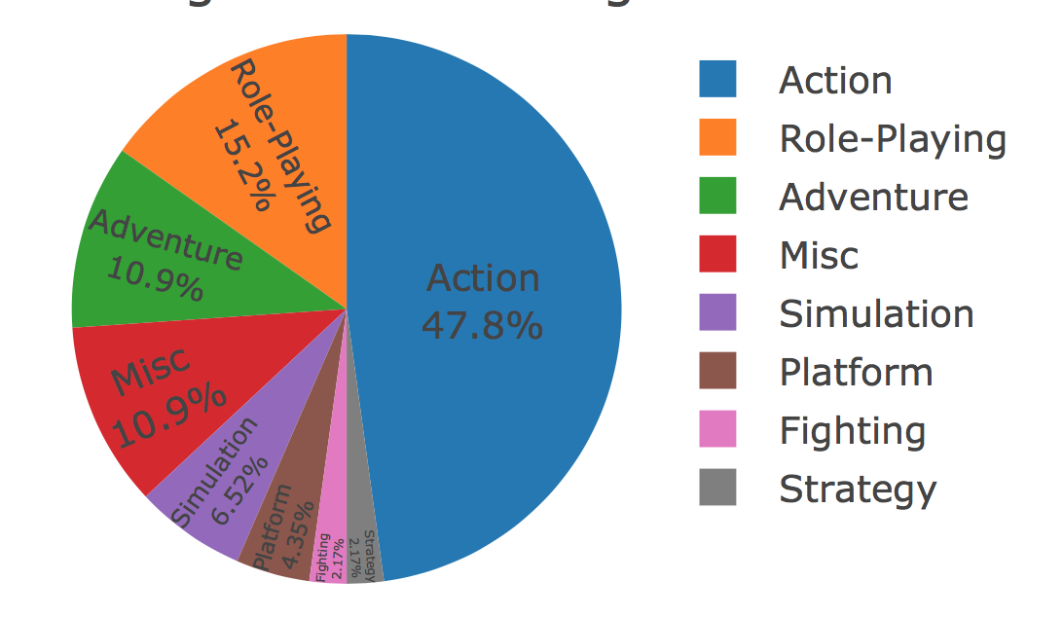
Pie chart of genres
Platform=“3DS” and Year_of_Release=“2016”
Action is the largest portion
Platform and Year of Release are also adjustable in Shiny App

Slide 11
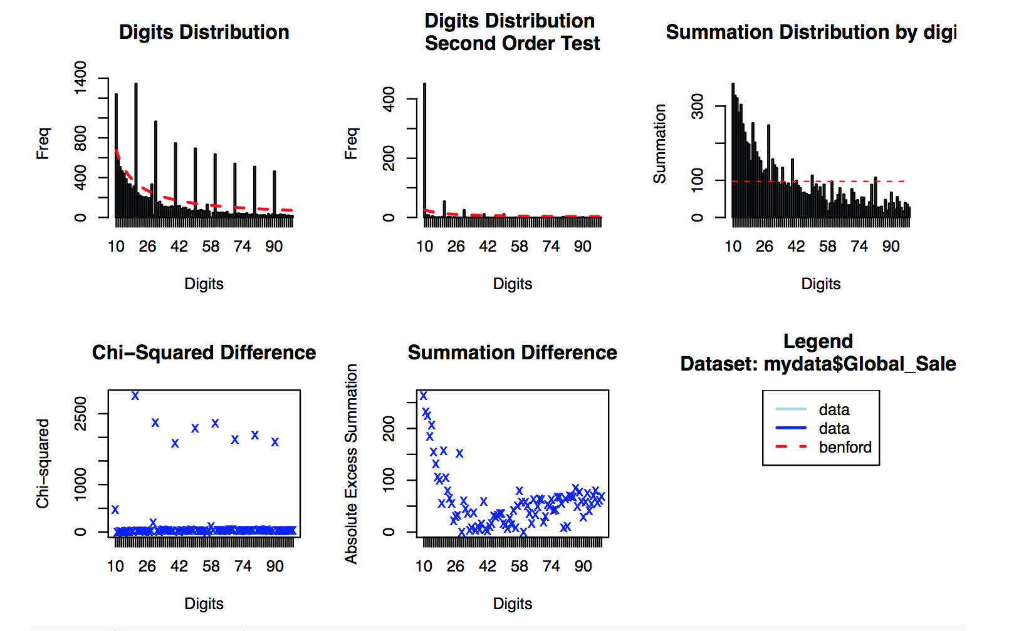
Benford Law
The p-value is smaller than 0.05 so that we reject the null hypothesis. Therefore, the goodness-of-fit test based on the Euclidean distance between the first digits’ distribution and Benford’s distribution shows the data does not conform to Benford’s law very well.

