Slide 1

Download the vscommunity
url: https://visualstudio.microsoft.com/vs/community
Double click this exe file:
Then install the vscommunity.

Slide 2
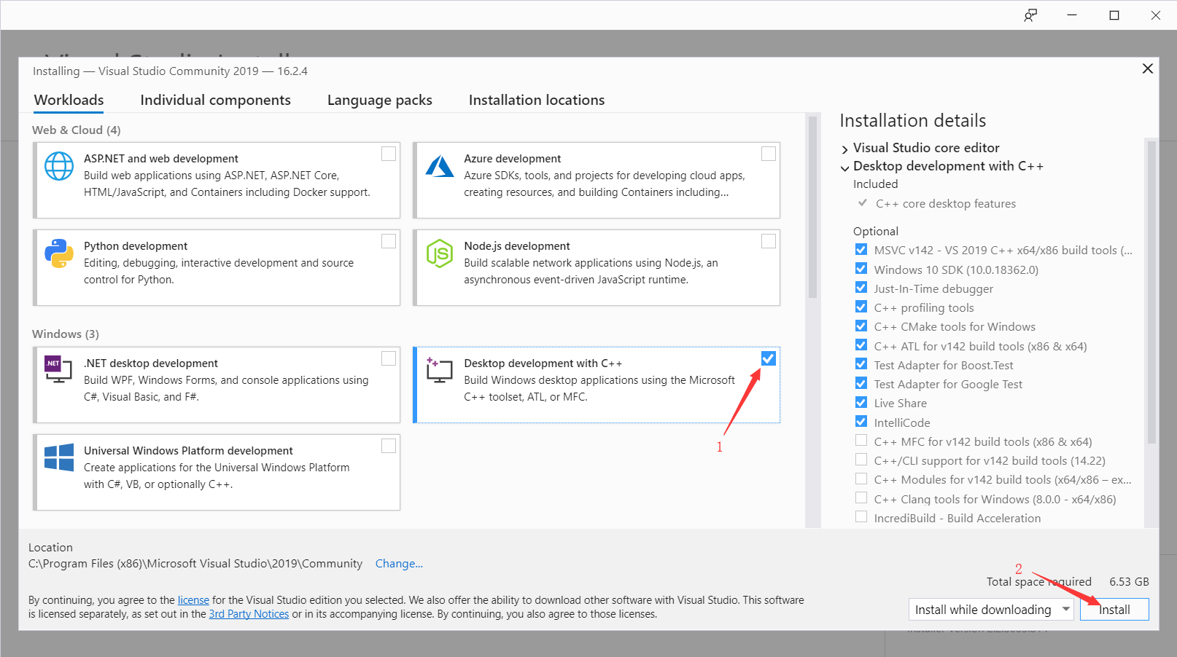
Install the C++ environment with vs2017(9)

Slide 3
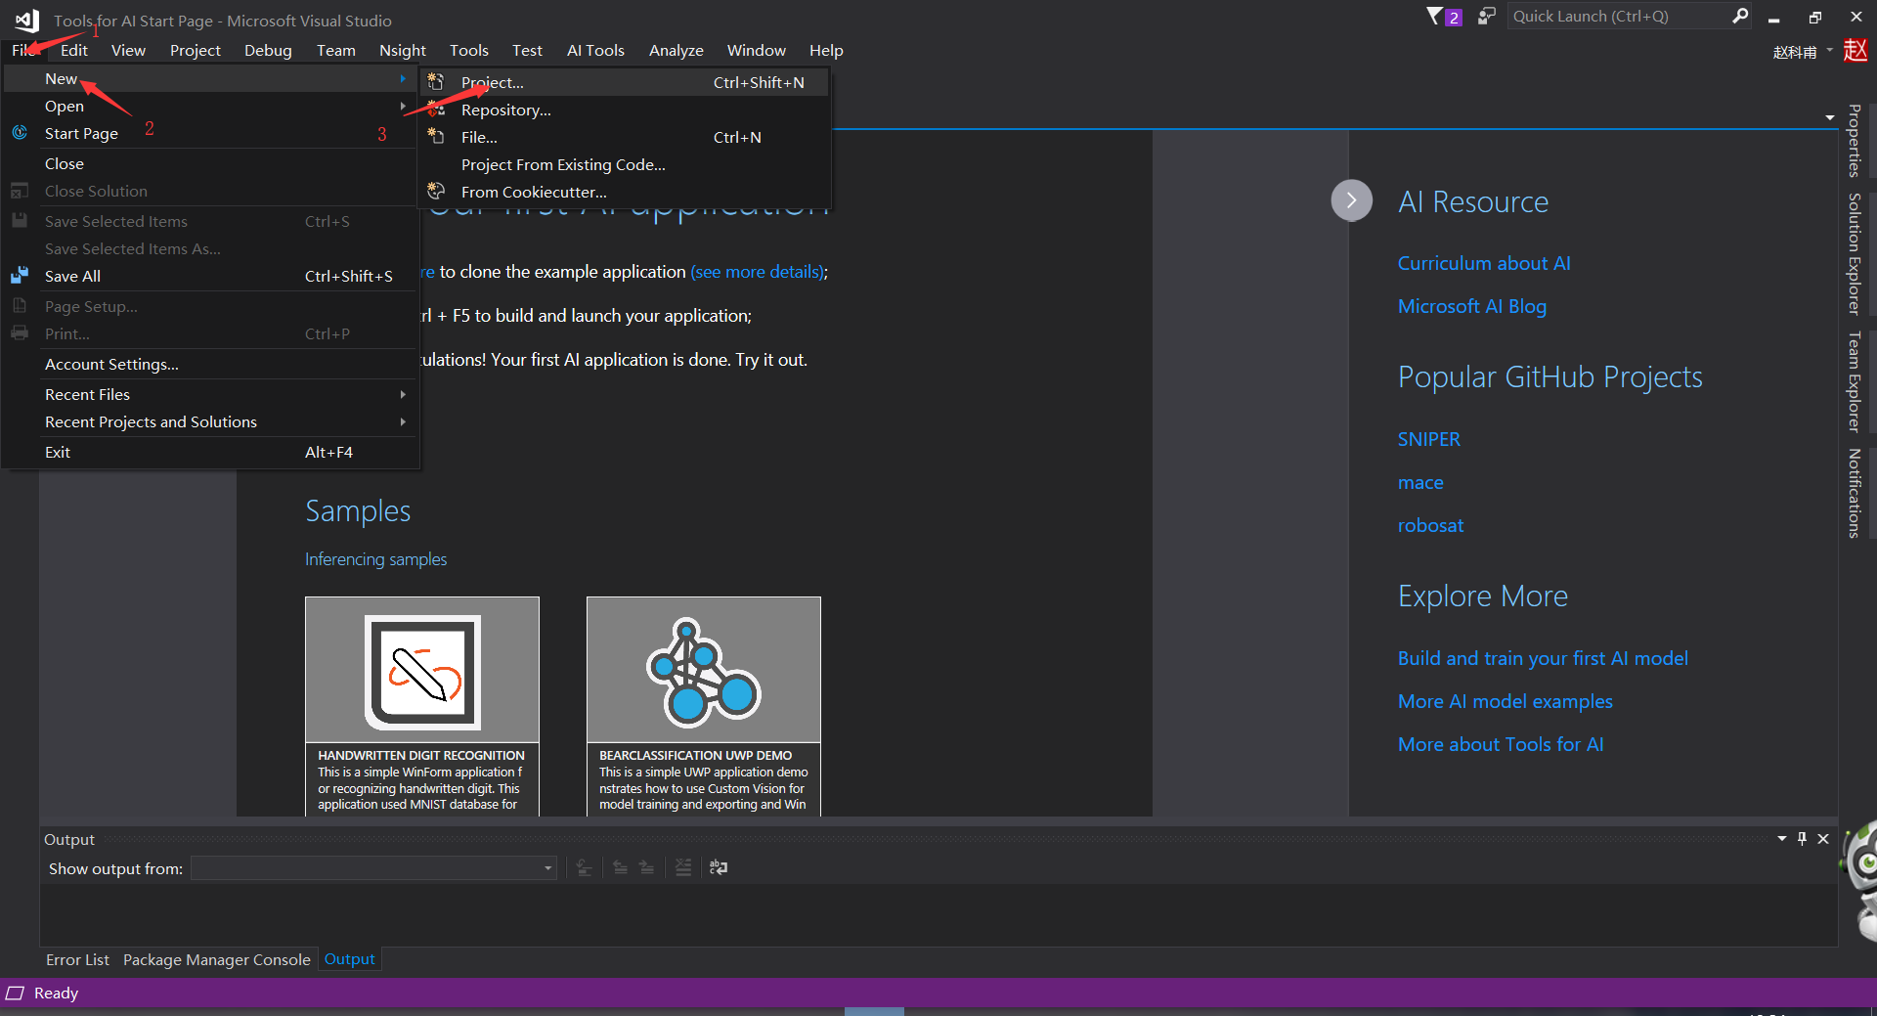
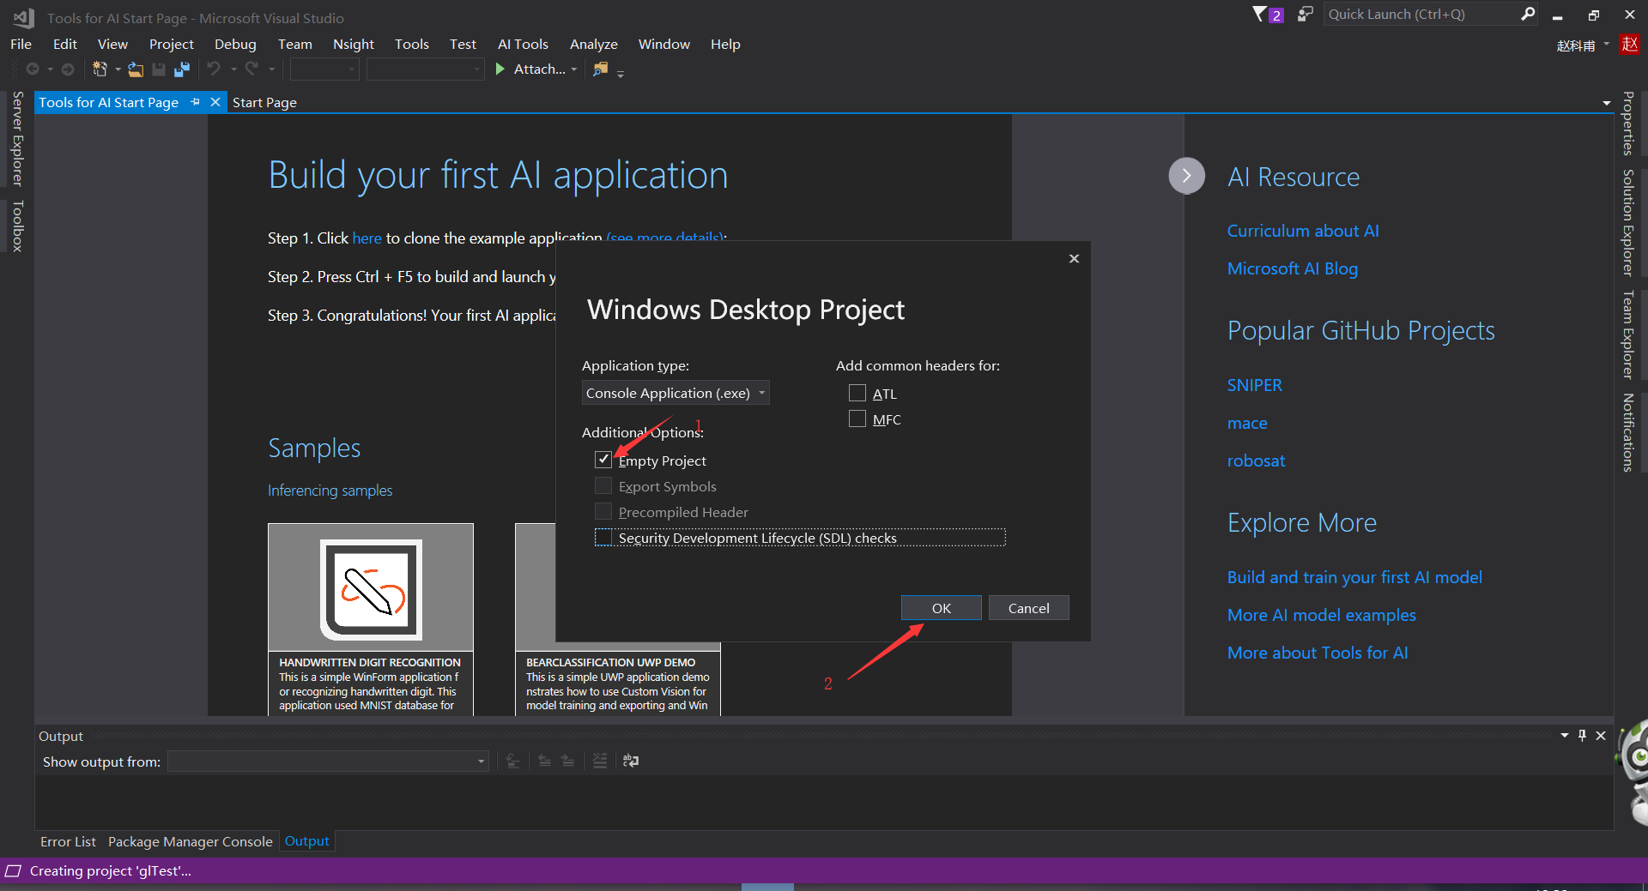
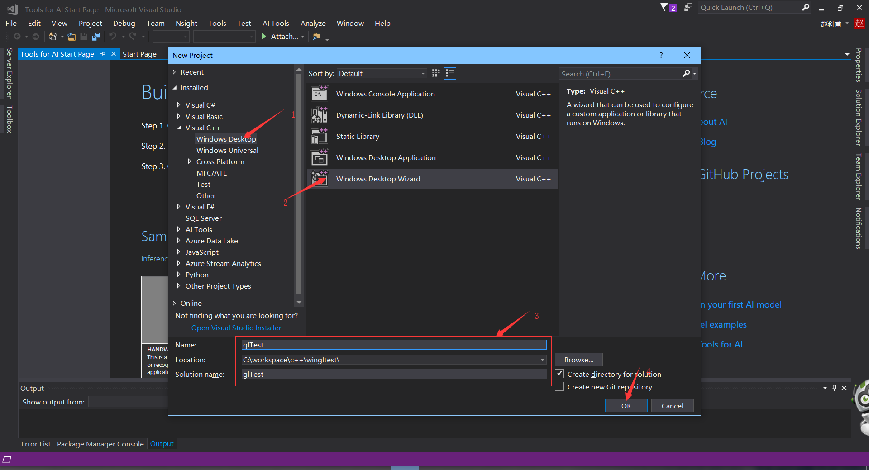
Create an empty project in vs2017
(There may be some changes in vs2019. But creating an empty project in vs2019 is also easy.)

Slide 4
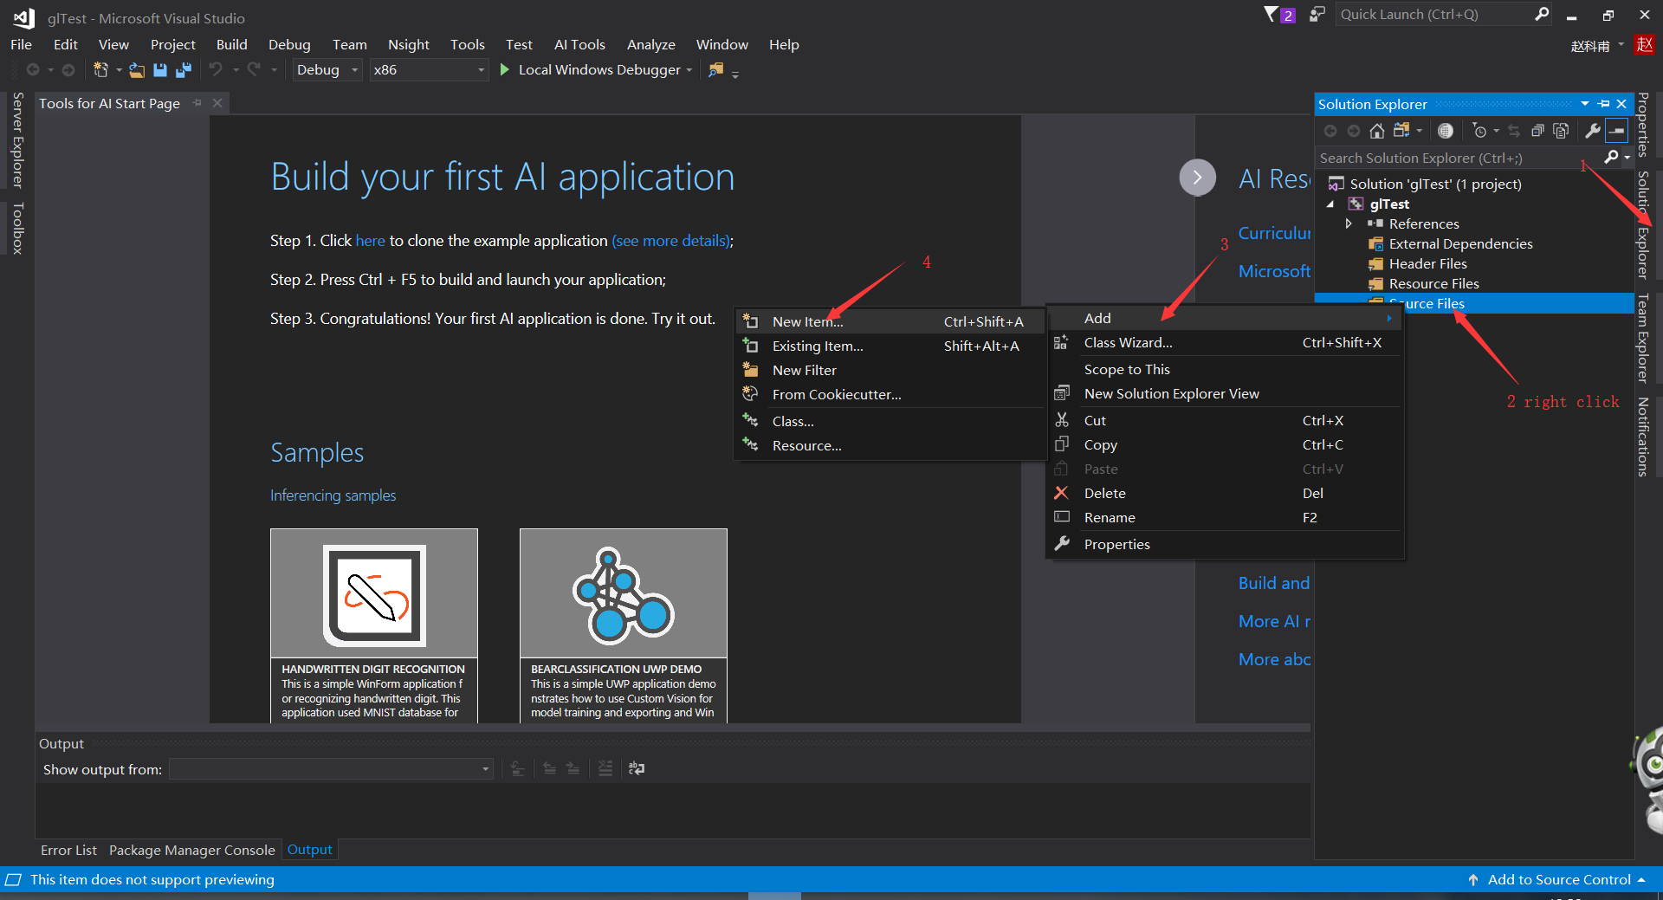
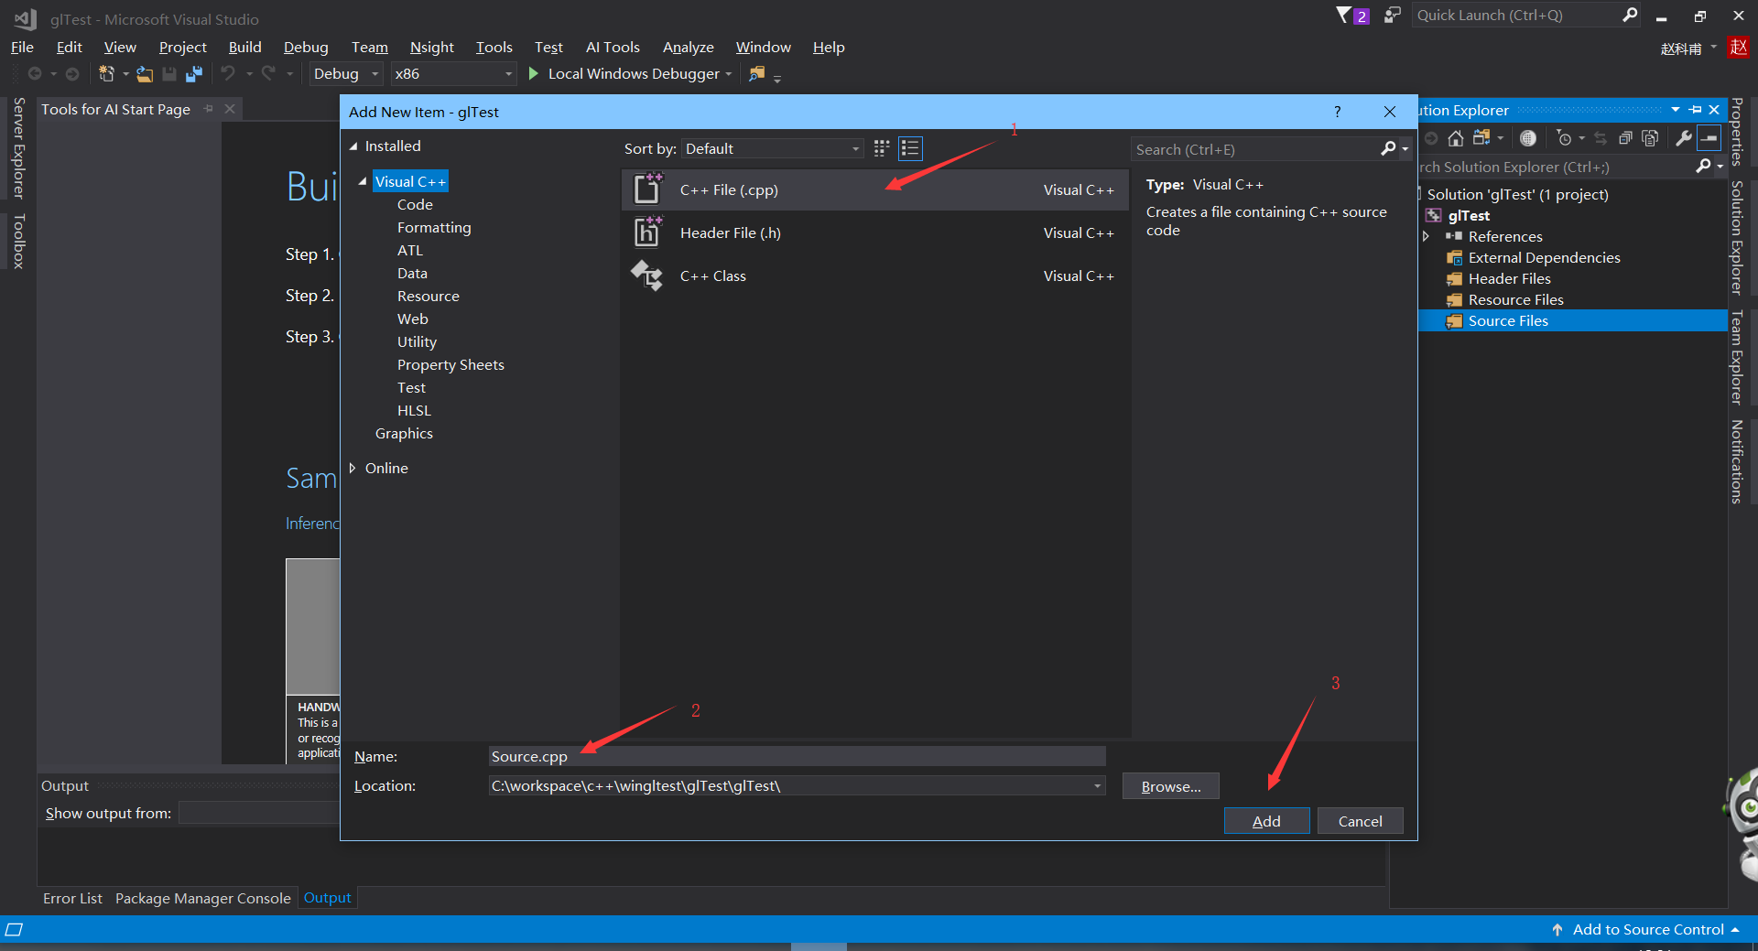
Add *.cpp file

Slide 5
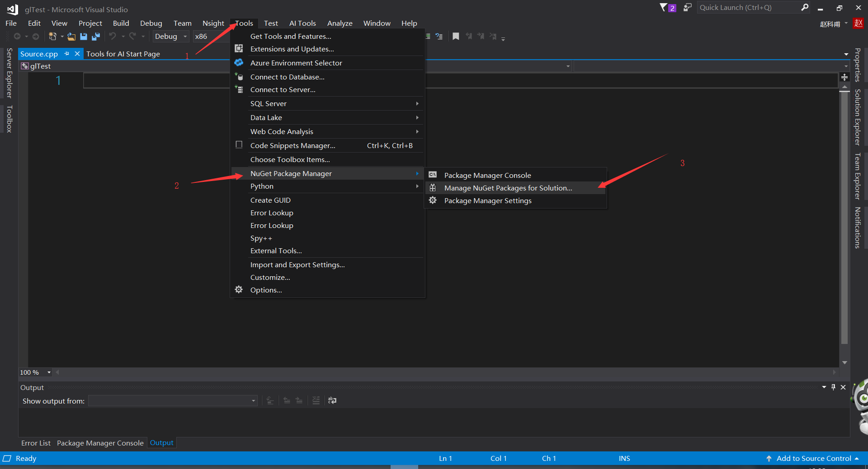
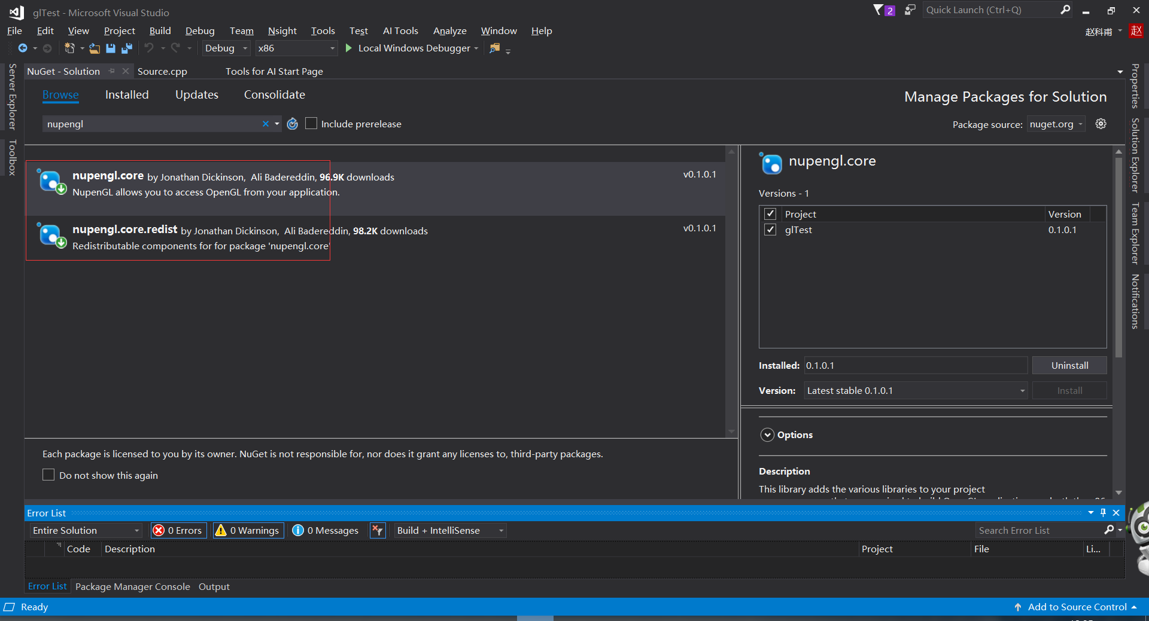
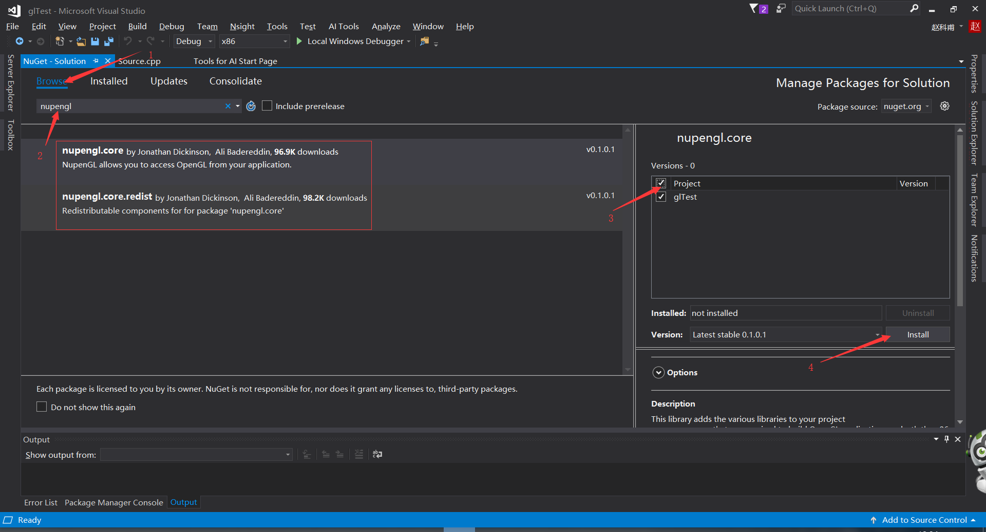
Add opengl package

Slide 6
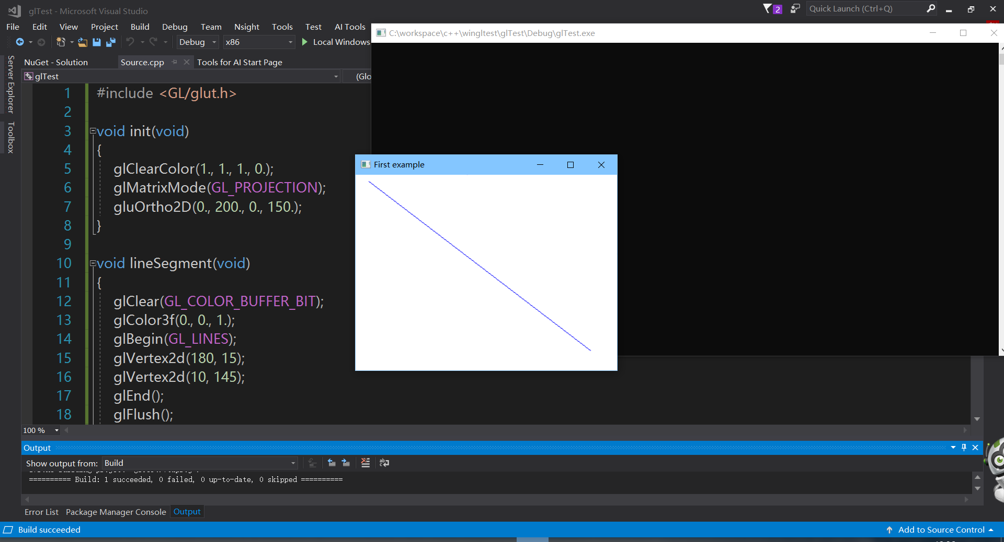
Run the codes

Slide 7
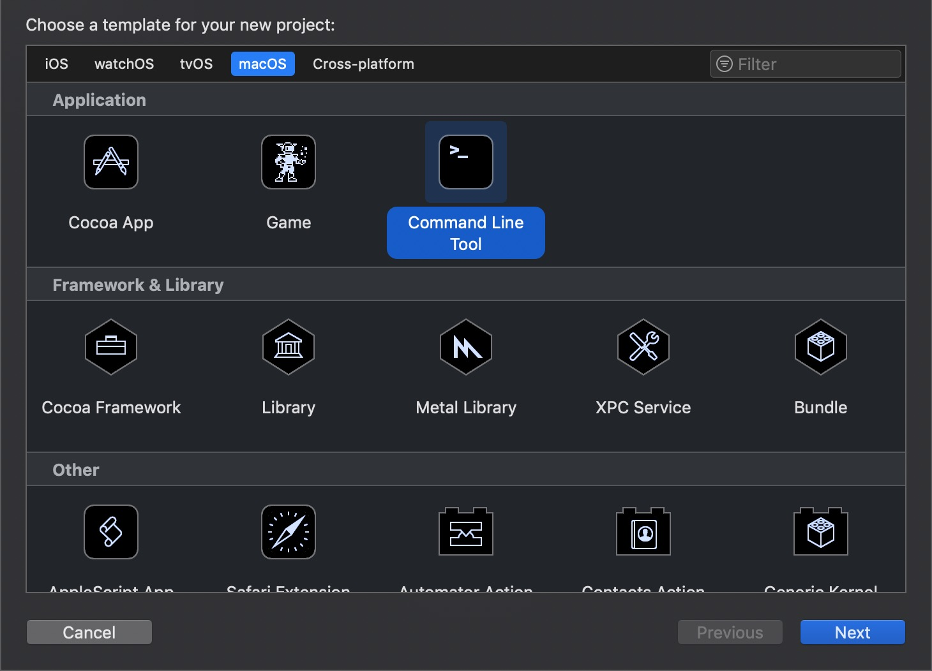
Using opengl in Mac with xcode
Create a command line project

Slide 8
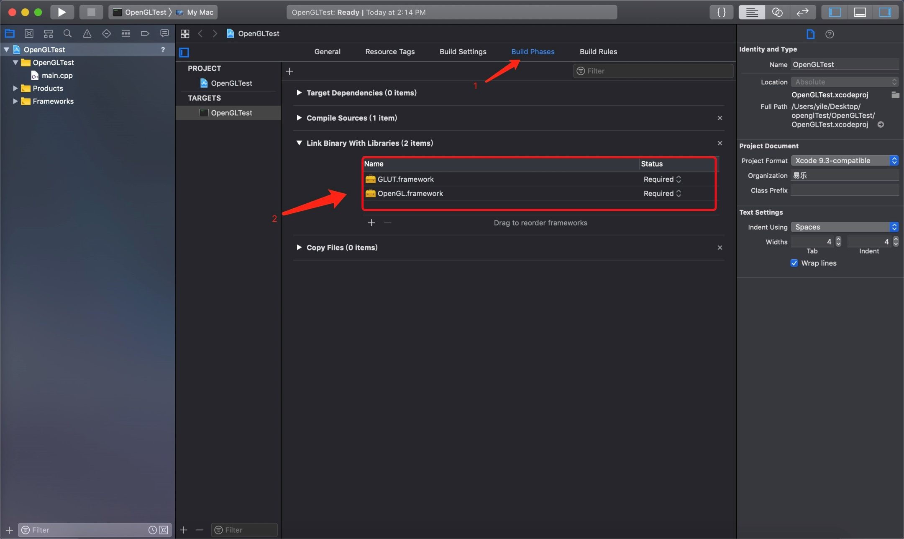
Add the opengl framework

Slide 9
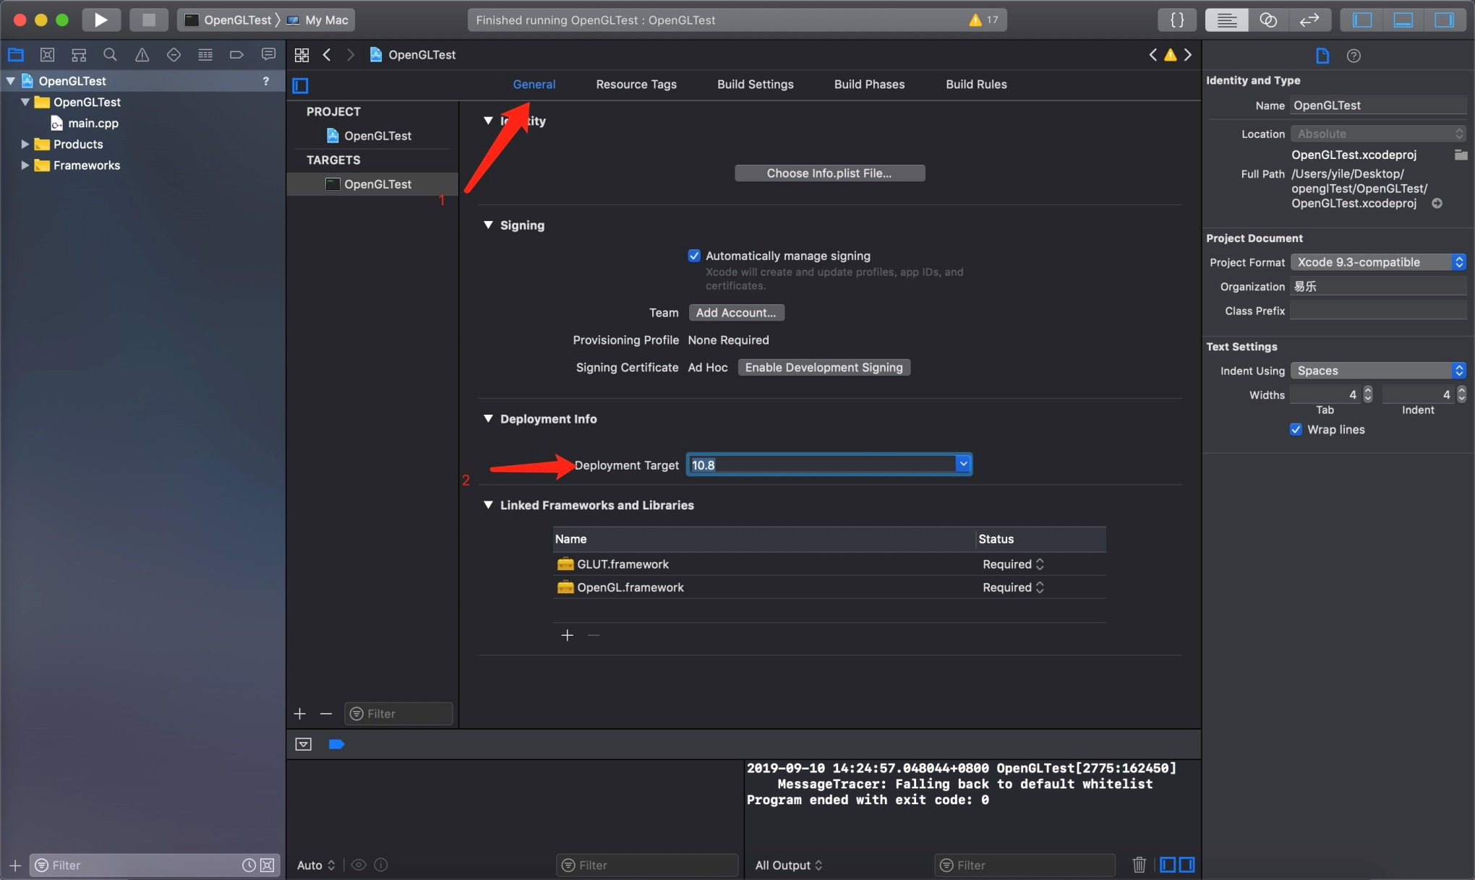
Change the deployment target to avoid deprecation warning

Slide 10
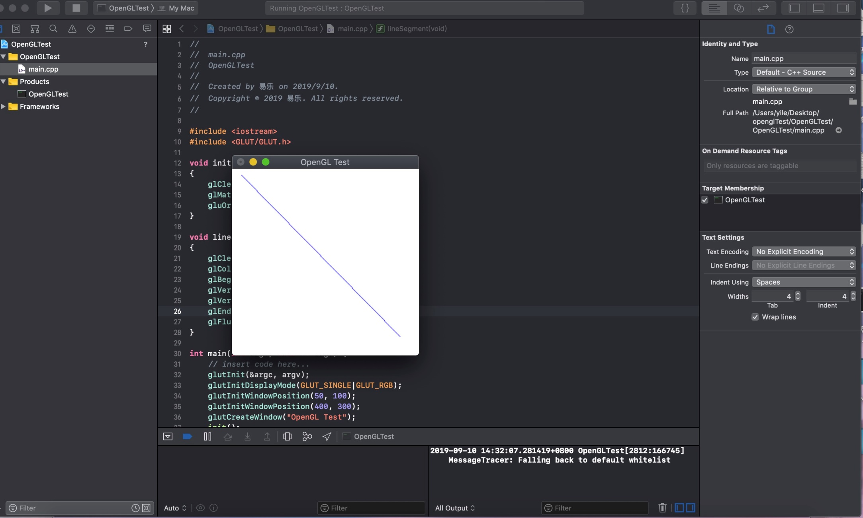
Run the code

