Slide 1
Human Computer Interaction
The computer part II
positioning, pointing & drawing
(Input devices)
CS 8th Semester

Slide 2
Positioning, Pointing And Drawing
Modern computing systems have the ability to point at something on the screen and thereby manipulate it, or perform some function.
There has been a long history of such devices, in particular in computer-aided design (CAD), where positioning and drawing are the major activities.
Pointing devices allow the user to point, position and select items, either directly or by manipulating a pointer on the screen.
Many pointing devices can also be used for free-hand drawing although the skill of drawing with a mouse is very different from using a pencil.
The mouse is still most common for desktop computers, but is facing challenges as laptop and handheld computing increase their market share.
Indeed, these words are being typed on a laptop with a touchpad and no mouse.

Slide 3
Positioning, Pointing And Drawing(Input)
Following are the most common pointing Devices.
Mouse
Touchpad
Trackball
Joystick
Keyboard Nipple
Touch screen
Tablet
Eye gaze
Cursors

Slide 4
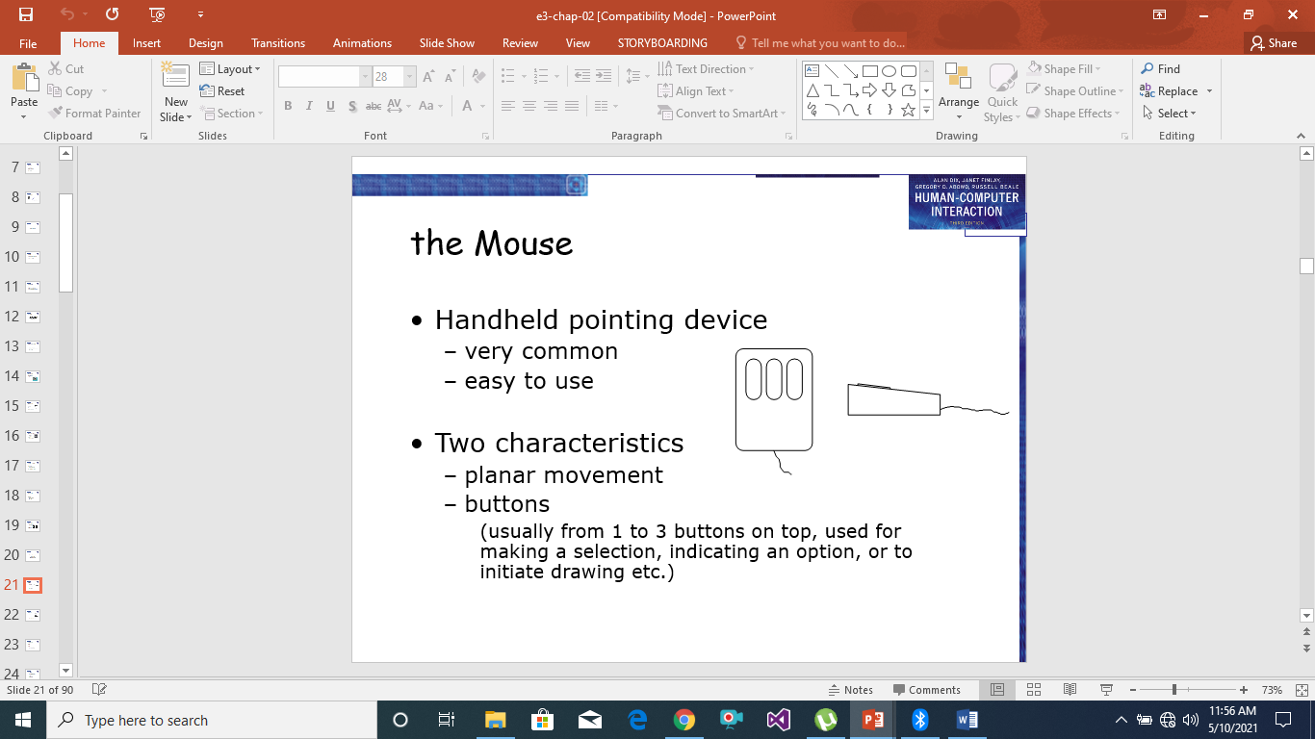
The Mouse

Slide 5
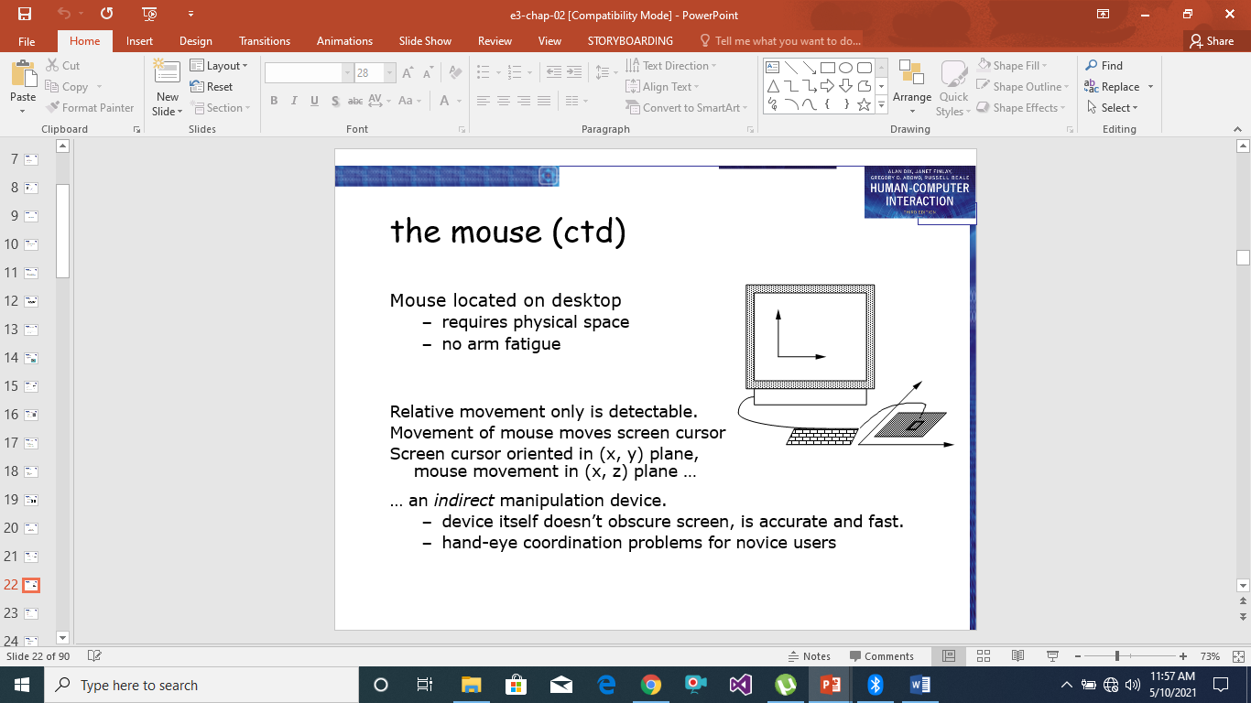
The Mouse

Slide 6
The Touch pad
Touchpads are touch-sensitive tablets usually around 2–3 inches (50–75 mm) square.
They were first used extensively in Apple PowerBook portable computers but are now used in many other notebook computers and it replaced the mouse on the desktop.
These are very common in Laptops.
They are operated by stroking a finger over their surface, rather like using a simulated trackball. The feel is very different from other input devices, but as with all devices users quickly get used to the action and become proficient.
Because they are small it may require several strokes to move the cursor across the screen. This can be improved by using acceleration settings in the software linking the track pad movement to the screen movement. Rather than having a fixed ratio of pad distance to screen distance, this varies with the speed of movement.

Slide 7
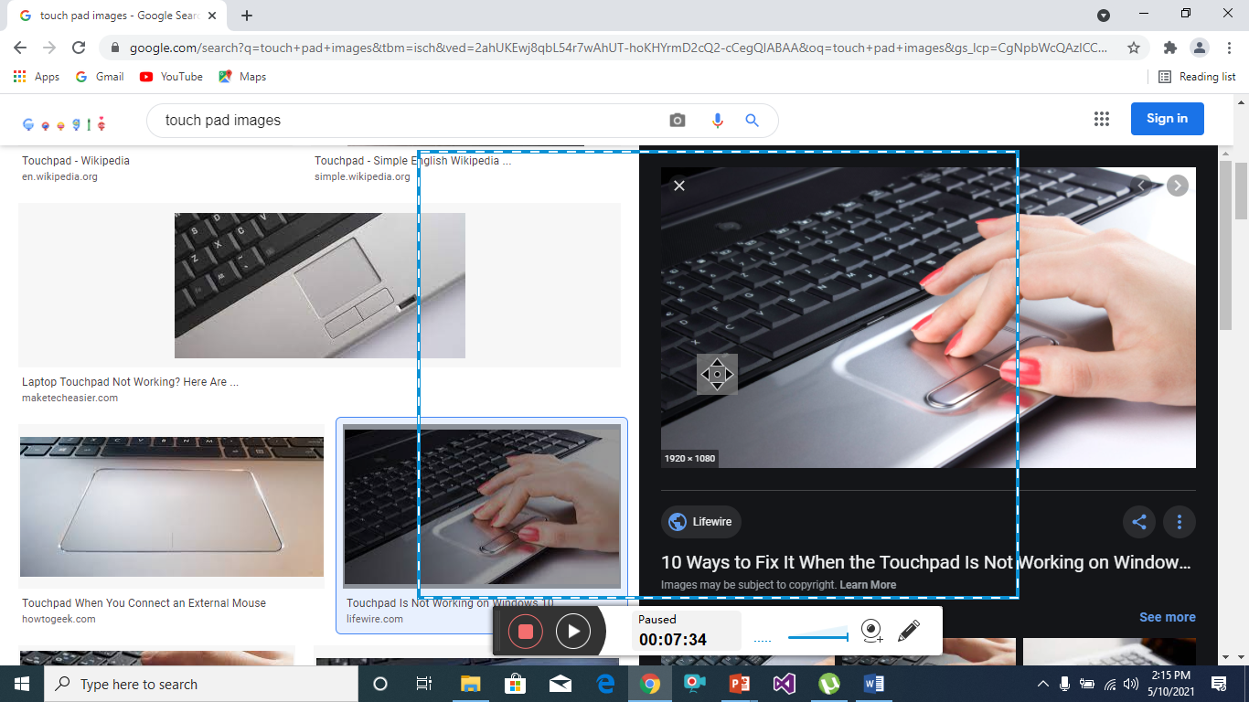
Touch pad

Slide 8
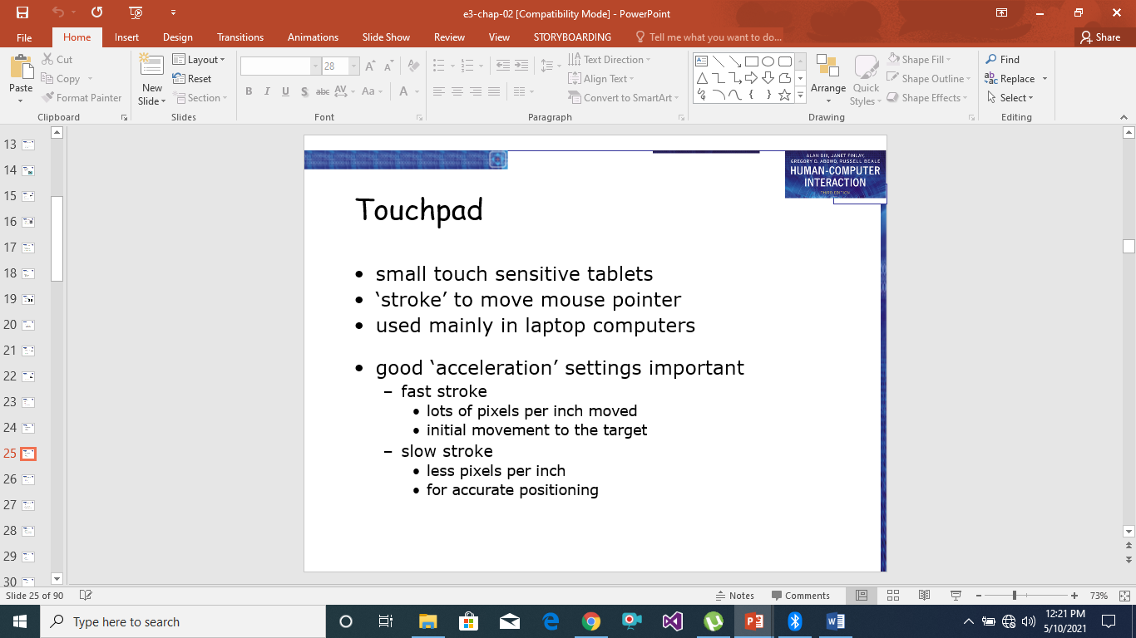
The Touch Pad

Slide 9
The Track Ball
The trackball is really just an upside-down mouse! A weighted ball faces upwards and is rotated inside a static housing, the motion being detected in the same way as fora mechanical mouse, and the relative motion of the ball moves the cursor. Because of this, the trackball requires no additional space in which to operate, and is therefore a very compact device.
It is an indirect device, and requires separate buttons for selection.
It is fairly accurate, but is hard to draw with, as long movements are difficult.
Trackballs now appear in a wide variety of sizes, the most usual being about the same as a golf ball, with a number of larger and smaller devices available.
The size and ‘feel’ of the trackball itself affords significant differences in the usability of the device: its weight, rolling resistance and texture all contribute to the overall effect.

Slide 10
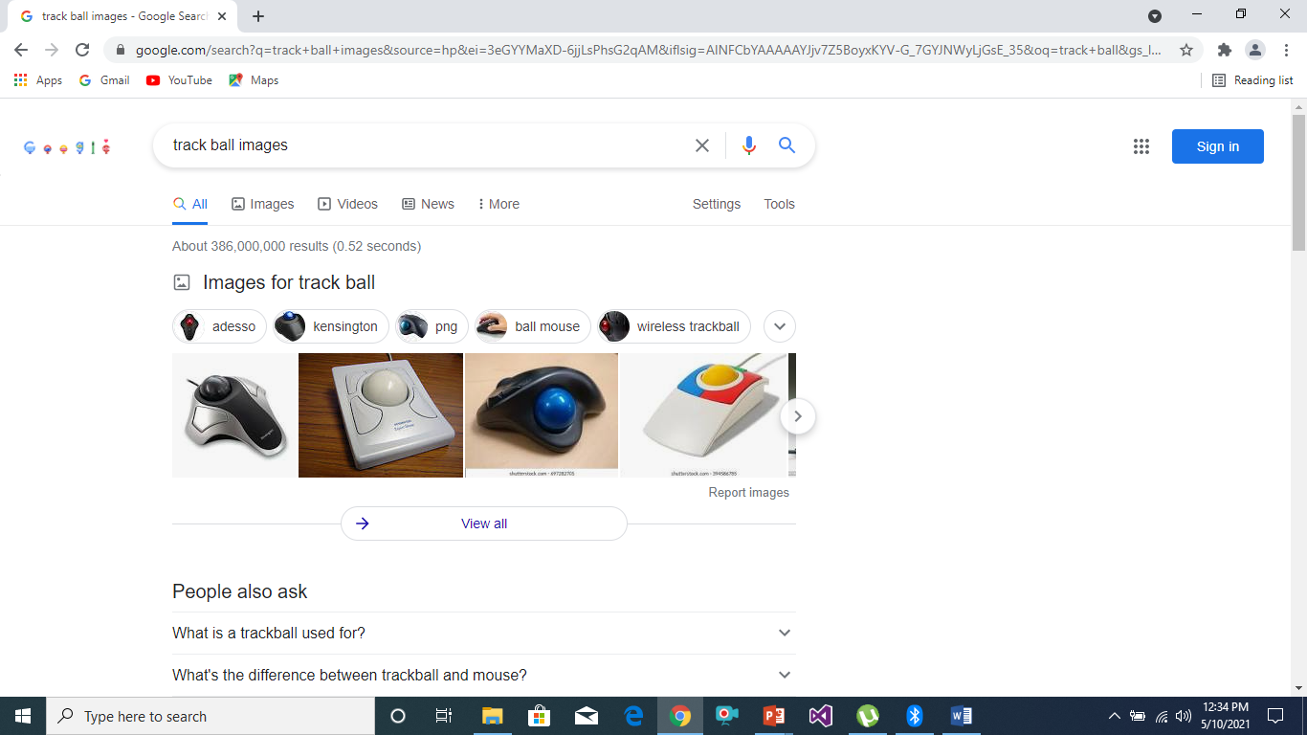
Track Ball

Slide 11
The Joystick and Keyboard Nipple
Joystick: The joystick is an indirect input device, taking up very little space. Consisting of a small palm-sized box with a stick or shaped grip sticking up from it, the joystick is a simple device with which movements of the stick cause a corresponding movement of the screen cursor. There are two types of joystick: the absolute and the isometric.
In the absolute joystick, movement is the important characteristic, since the position of the joystick in the base corresponds to the position of the cursor on the screen.
In the isometric joystick, the pressure on the stick corresponds to the velocity of the cursor, and when released, the stick returns to its usual upright centered position.
Keyboard Nipple: More commonly a small rubber nipple projects in the center of the keyboard and acts as a tiny isometric joystick. It is usually difficult for novices to use, but this seems to be related to fine adjustment of the speed settings.
Like the joystick the nipple controls the rate of movement across the screen and is thus less direct than a mouse or stylus.

Slide 12
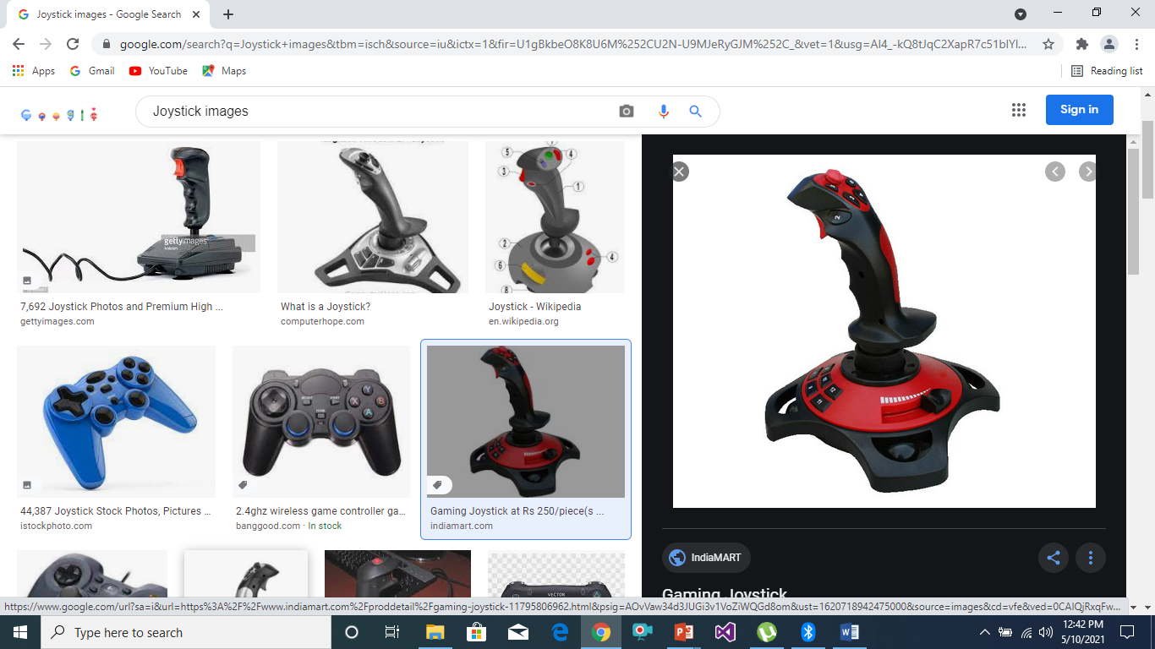
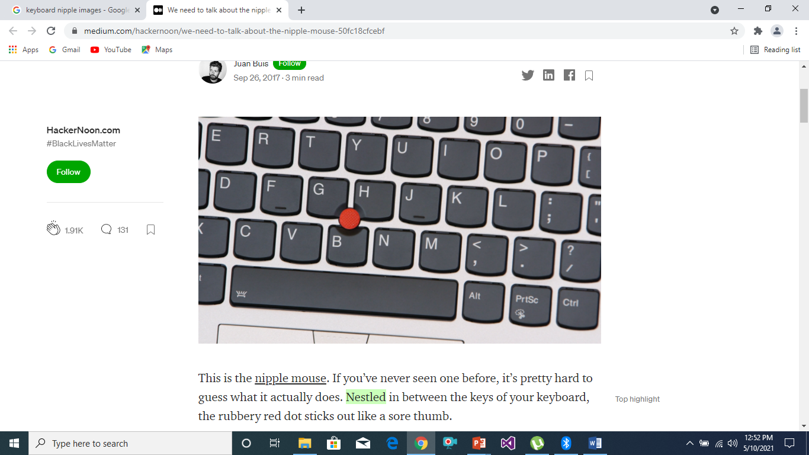
Images Of Joystick and Keyboard Nipple

