Slide 1
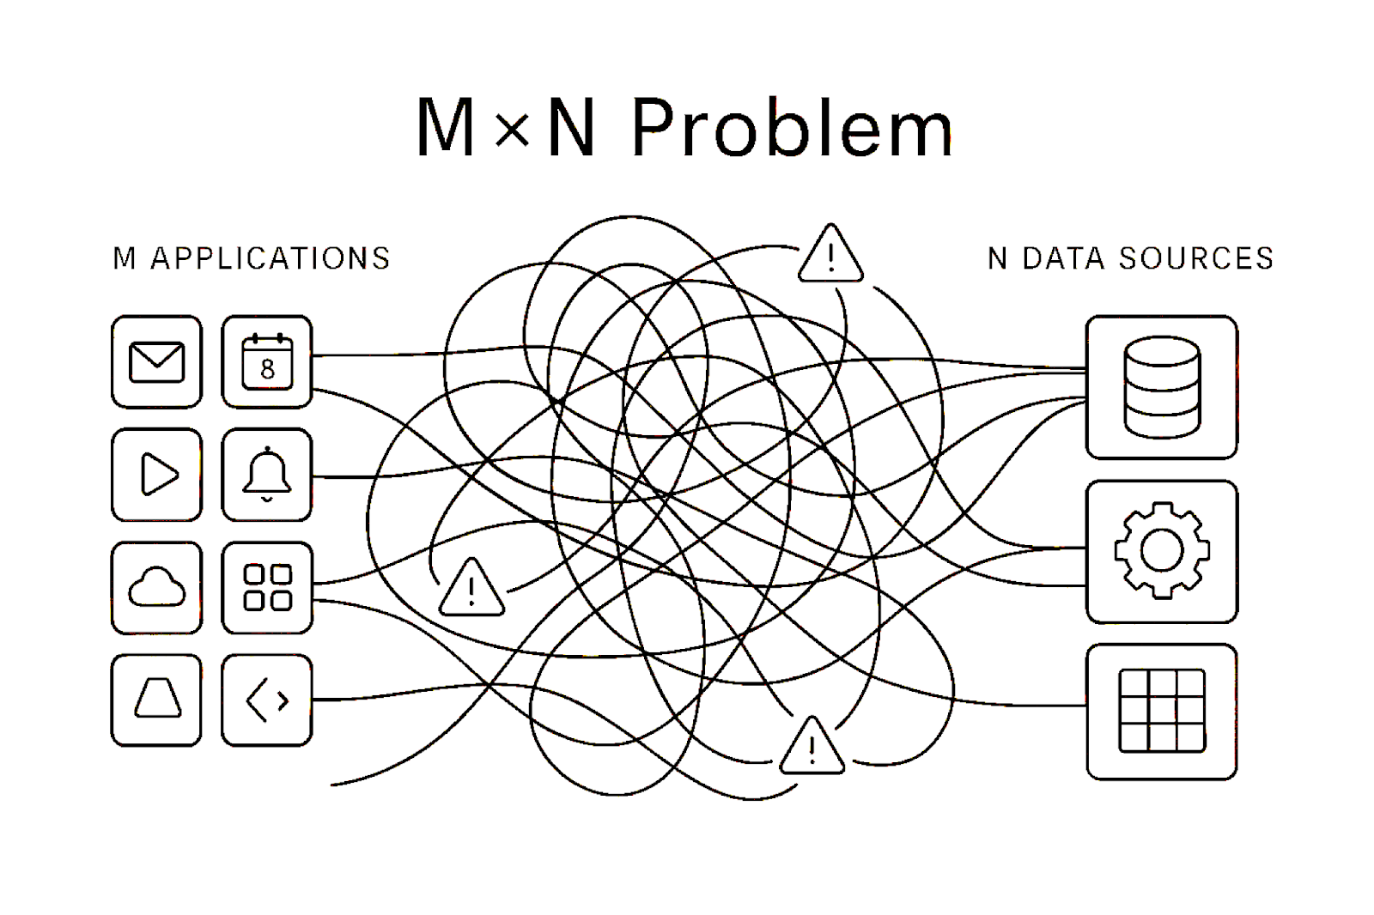
Understanding Model Context Protocol (MCP)
Notes:
Hello everyone, I am Miraj Bhandari. Today, in this session, we will understand the Model Context Protocol (MCP). So We will discuss its importance, architecture diagram, core components, and also do a hands-on session with the code. So let’s get started.

Slide 2
Topics to be Discussed in This Session :
Problem Scenario (for knowing the need of MCP)
MCP Introduction
Core Components of MCP
Understanding the Architecture of MCP
Discuss Benefits of Using MCP
Hands-on with Code
Notes:
In this session, we will go through the following topics: first, a problem scenario to understand the need for MCP, then its introduction;, next, we will discuss its core components and architecture diagram;,after that, we will cover its benefits; and finally, we will do a hands-on with MCP code.

Slide 3
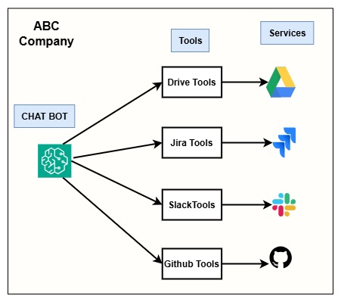
Problem Scenario :
Lets Say there is one company named ABC . It has built an internal AI Chatbot System that integrates with multiple services:
Google Drive – for file operations
Jira – for issue tracking
Slack – for communication
GitHub – for code-related queries
When a user asks a question:
File-related questions → Chatbot calls Drive Tools
Code-related questions → Chatbot calls GitHub Tools
Task/bug questions → Chatbot calls Jira Tools
Message-related questions → Chatbot calls Slack Tools
Notes:
Before diving into the MCP introduction, I want to share a scenario through which we can understand the need for MCP and how it solves real-world problems. So, let’s move on to the problem scenario.

Slide 4
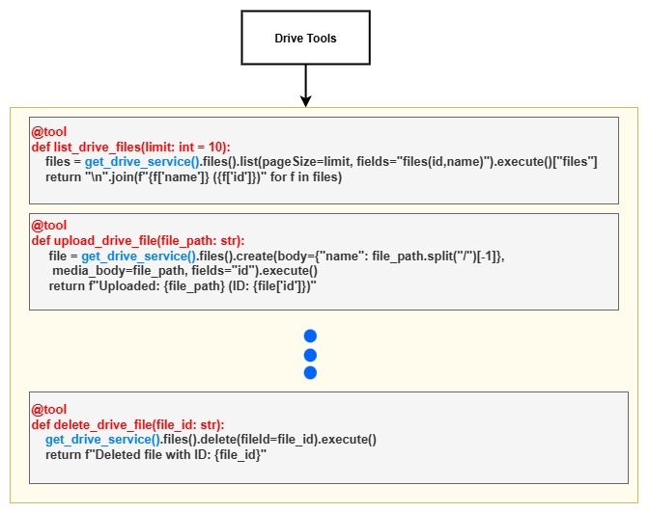
The Real Problem :
Let’s focus only on Drive Tools.
ABC Company has created N number of Drive tools, such as:
list_drive_files()
upload_drive_file()
delete_drive_file()
search_drive_files() ETC.
All these tools internally depend on a function like:
get_drive_service() → which connects to Google Drive APIs.
Now imagine this:
After a few years, Google updates their Drive API and changes the internal implementation of get_drive_service().

Slide 5
Continue . . .
Then Suddenly:
All relevant Drive tools stop working.
Developers must go tool-by-tool and update each one.
This takes time, effort, and increases chances of bugs.
Now lets assume ABC Company is not using just 4 services. They are using 20–30 services, and each service has 30–40 tools.
This means:
Hundreds of tools to maintain.
For Every API change = There is huge engineering effort.
Developers must constantly monitor all third-party service updates.
This creates a maintenance nightmare.

Slide 6
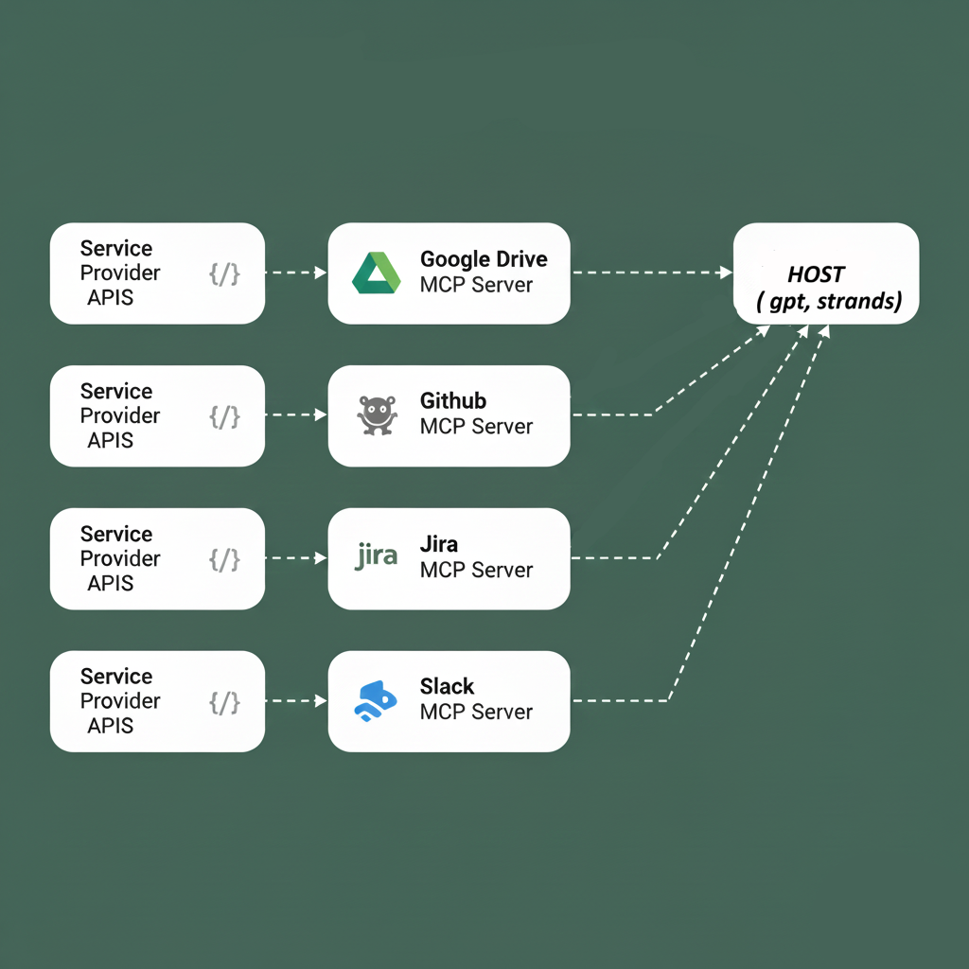
How MCP Solves This:
With MCP:
Each service (Drive, GitHub, Jira, Slack…etc) provides its own MCP Server.
The chatbot acts as an MCP Client.
All API updates are handled by service providers themselves inside the MCP Server.
The chatbot does not need to change its internal code when services update APIs.
So instead of updating hundreds of tools, ABC Company only needs to:
Update the MCP server for that specific service.
Keep the chatbot untouched.
Which really Save time, cost, and engineering effort.

Slide 7
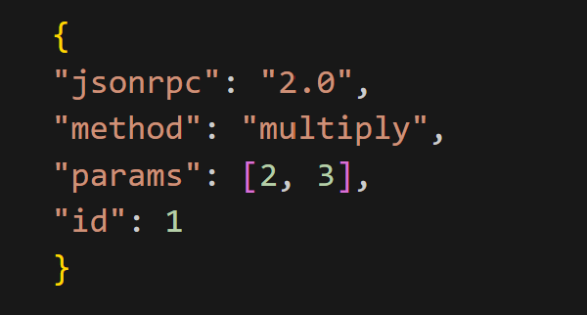
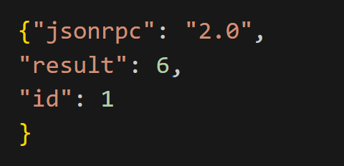
MCP (Model Context Protocol):
Model Context Protocol (MCP) is an open protocol that enables Large Language Models (LLMs) to interact with external tools using structured API calls over JSON-RPC 2.0. IT was introduced by Anthropic on November 25, 2024.
When the host (chatbot - gpt, claude, bedrock ) needs to use a tool, it asks the MCP client to communicate with the MCP server. The client can either ask server to retrieve the list of available tools or request the server to invoke a specific tool and return the result. All communication between the MCP client and the server happens using the JSON-RPC 2.0 format.
JSON-RPC 2.0 – JSON-RPC is the communication format between the MCP Client and MCP Server. IT supports multiple transport methods such as stdio, HTTP/SSE, and WebSockets.
Client Request Structure
using JSON-RPC 2.0 Format
Server Response Structure
using JSON-RPC 2.0 Format

Slide 8
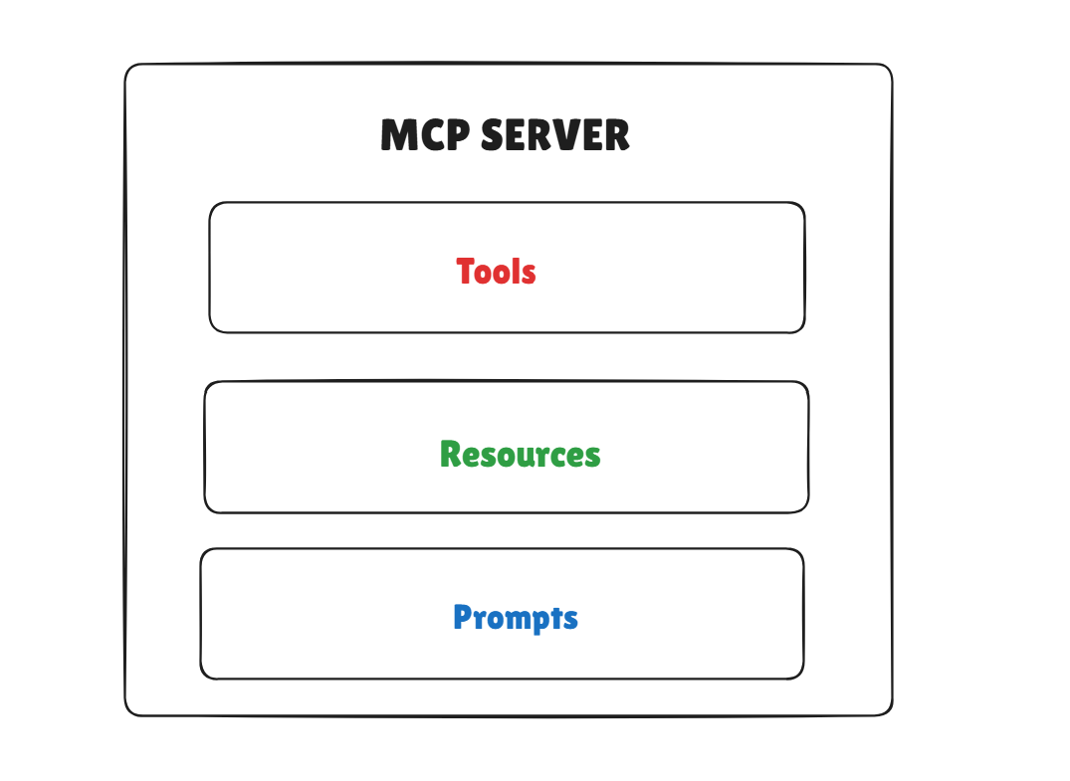
Continue . . .
Each MCP server can expose three things:
Tools – Actions the AI can perform, like searching files, creating tickets, or calling APIs.
Resources – Data the AI can read, such as documents, database records, or files.
Prompts – Predefined instructions or templates that guide how the AI should behave or respond

Slide 9
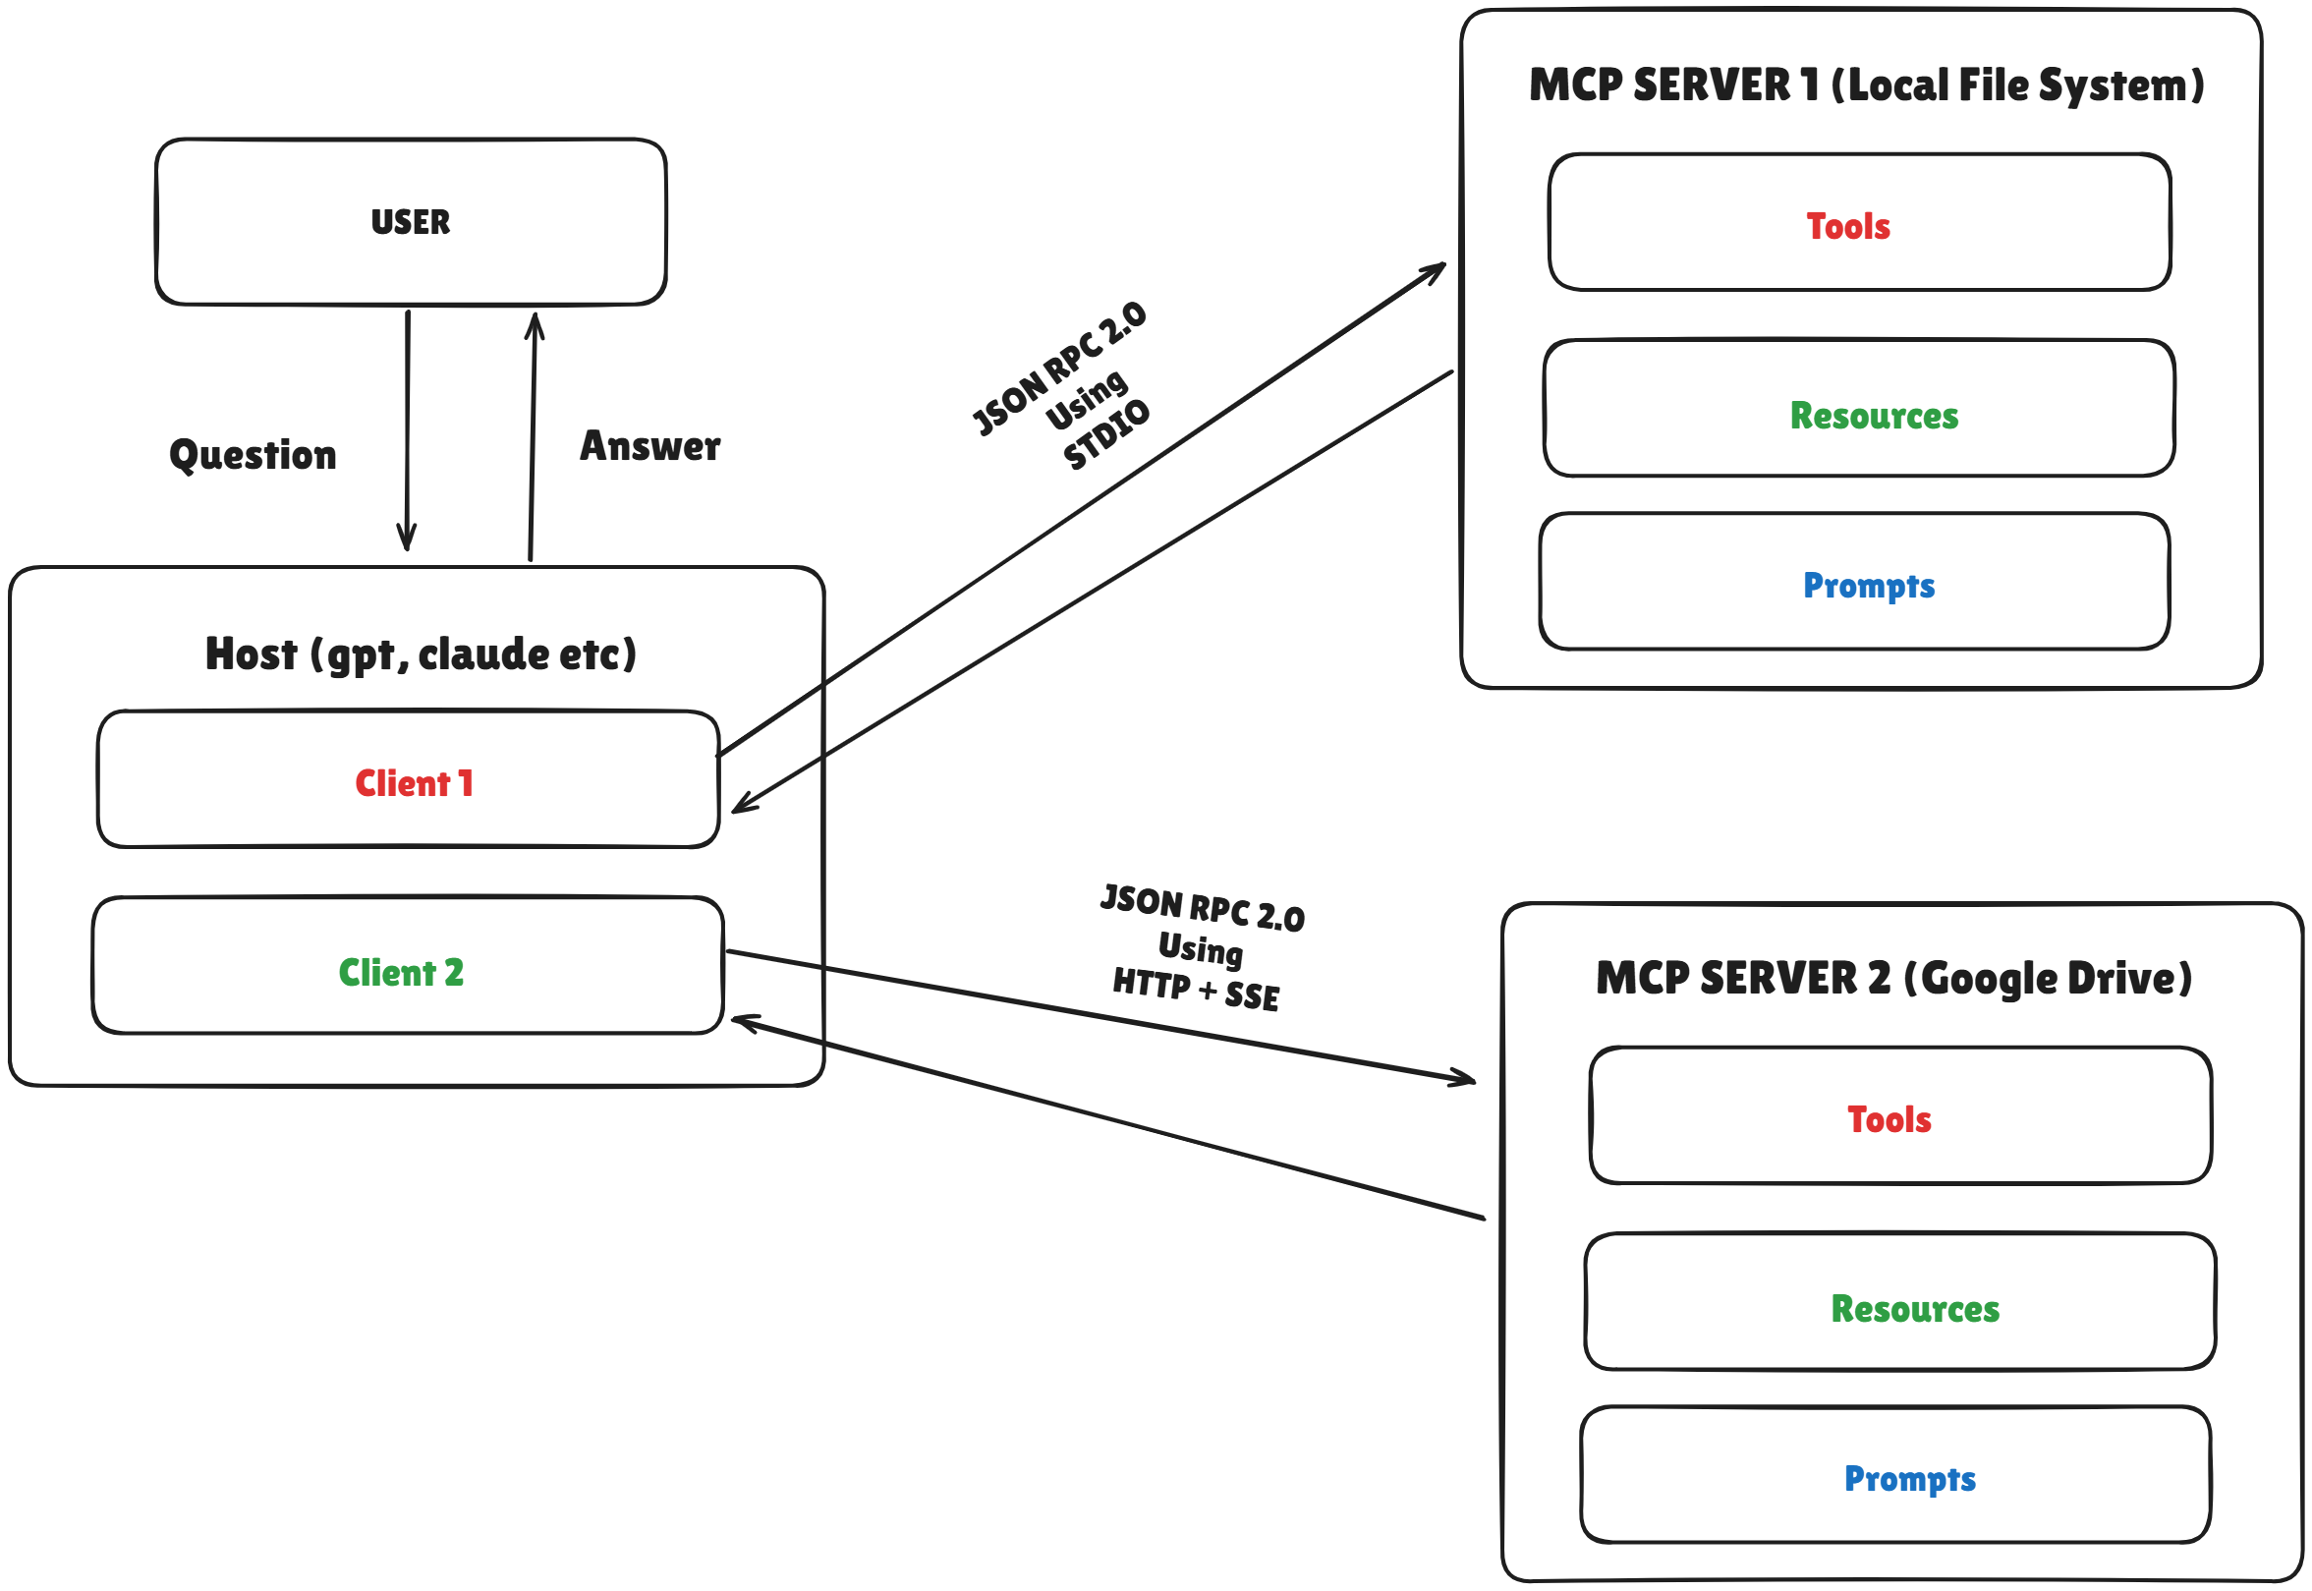
Understanding Model Context Protocol Architecture:
In this architecture, the User talks only to the Host (e.g., GPT, Claude, Gemini, Bedrock).
The Host AI does not access tools directly.
Instead, it uses MCP Clients to communicate with MCP Servers.
How the Flow Works
User asks a question Example: “List all my Google Drive files”
The Host AI understands the request.
Since it needs external data, it calls the correct MCP Client.
The Client communicates with the server using JSON-RPC 2.0 to request the invocation of the correct tool.
The server executes the tool and sends the result to the client, and the client forwards it to the Host.
The Host formats the response and sends it back to the User.

Slide 10
Advantages of Using MCP:
Reduce Maintenance Effort
There is no need to modify any tool logic, as service providers themselves update and maintain their tools on their own servers.
Scalability
Easily supports integration with 20–30+ services and thousands of tools.
Standardized Communication
Uses a common protocol (JSON-RPC 2.0) for all tool interactions.
Decoupled Architecture
The AI system(host) is completely separated from service logic, improving flexibility.
Faster Development
New tools and services can be added without modifying the core chatbot.
Lower Cost & Time
Less engineering effort = reduced operational and maintenance cost.

