Slide 1

CNN ESSENTIALS
ARCHITECTURE & OPERATIONS
BY- MIRAJ DEEP BHANDARI

Slide 2

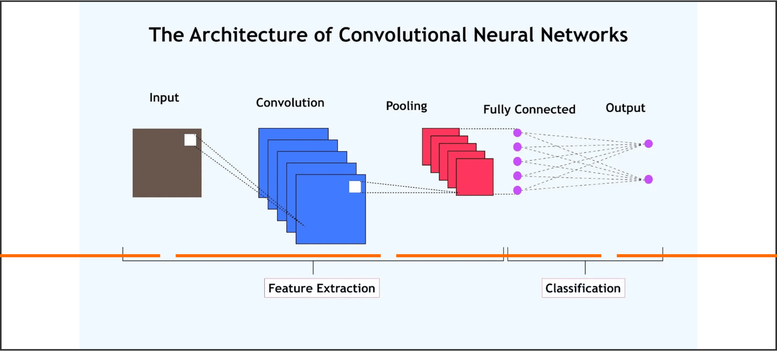
ARCHITECTURE
INPUT
CONV
POOL
FC
Raw pixel volume
Feature detection
Data compression
Final classification

Slide 3

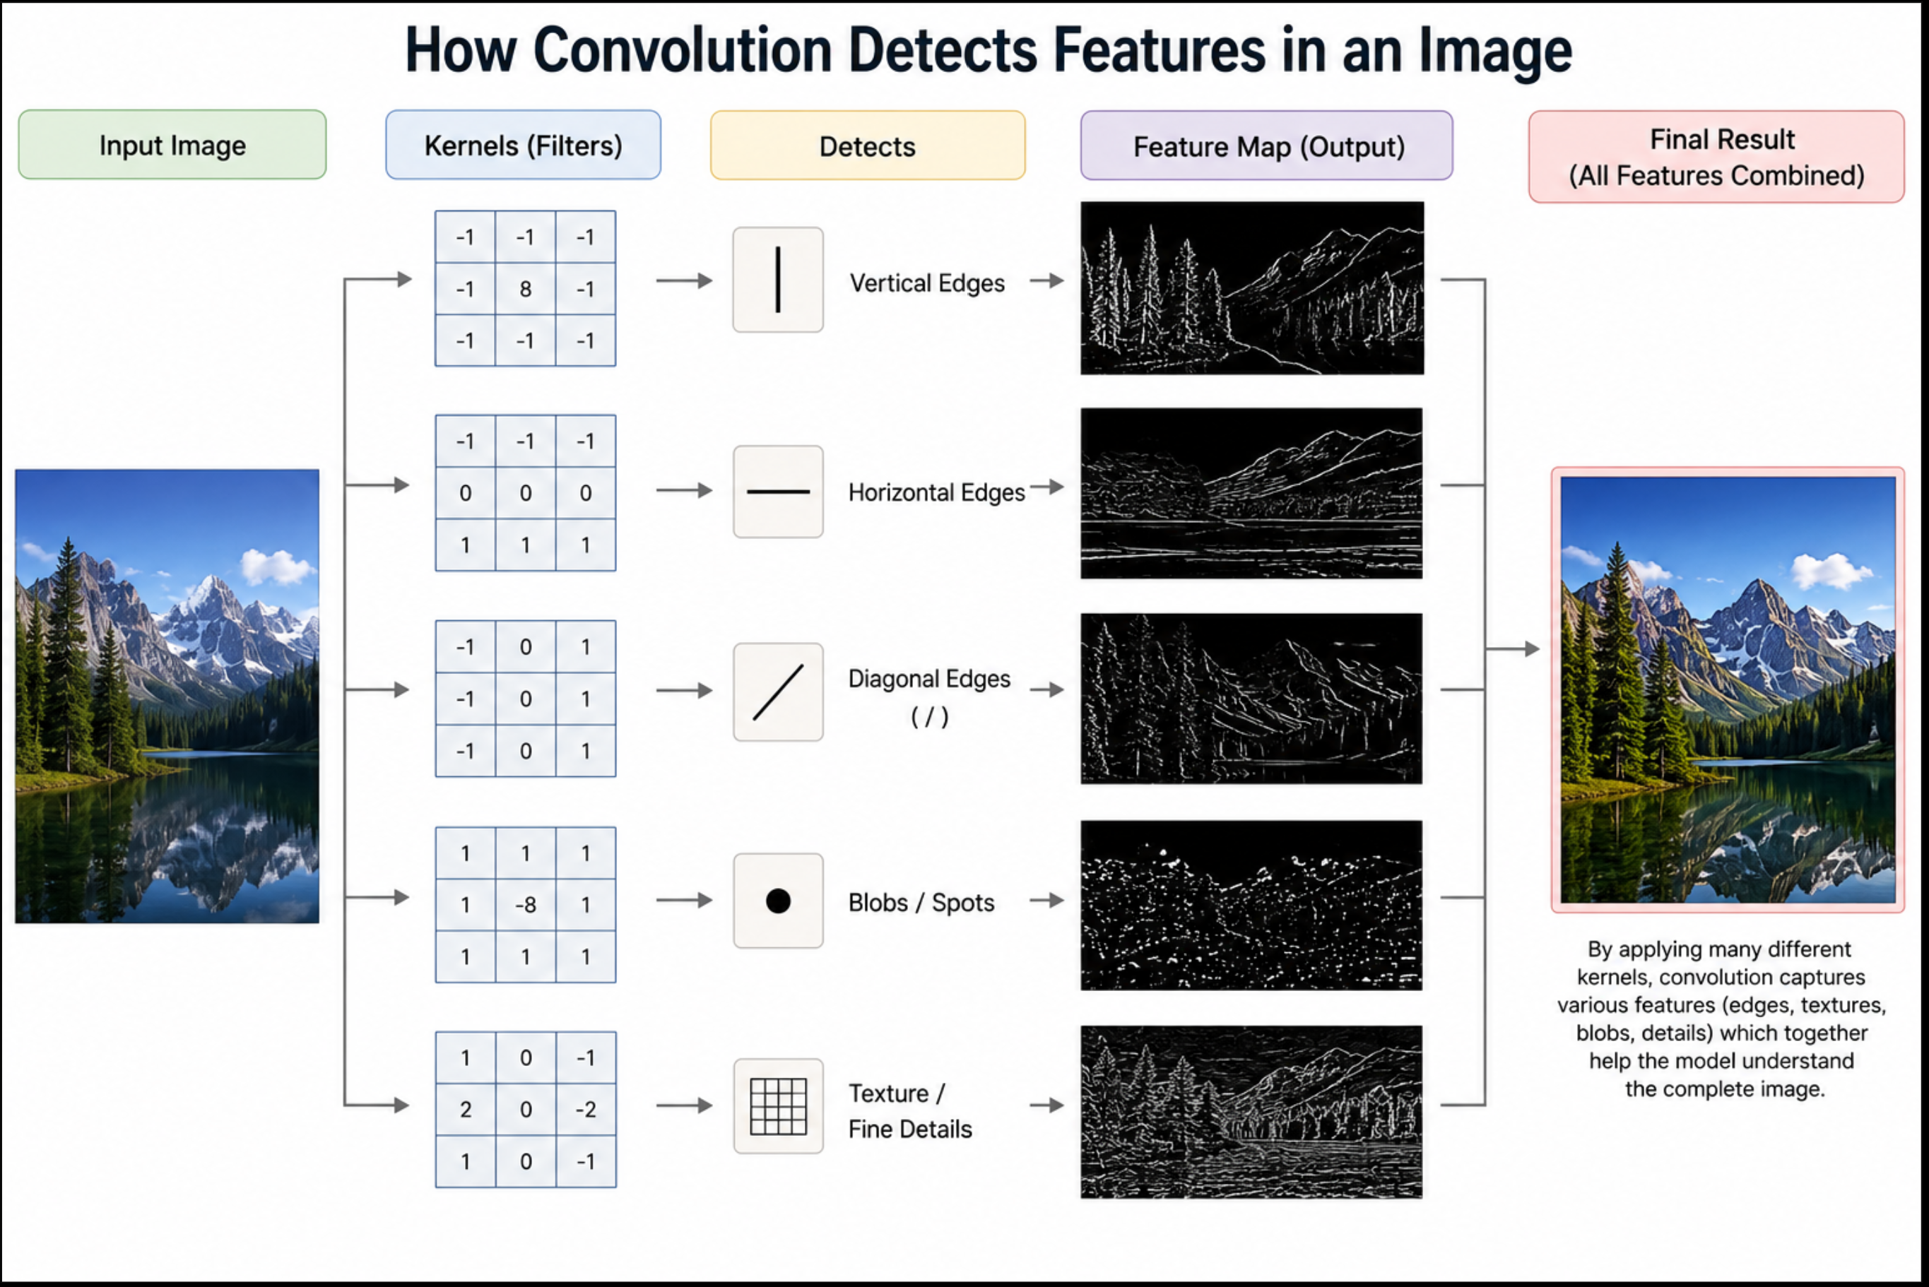
CONVOLUTION OPERATION
The convolution operation is the heart of a CNN.
It extracts important features from an input image by applying learnable filters that detect patterns such as edges, textures, and shapes.

Slide 4

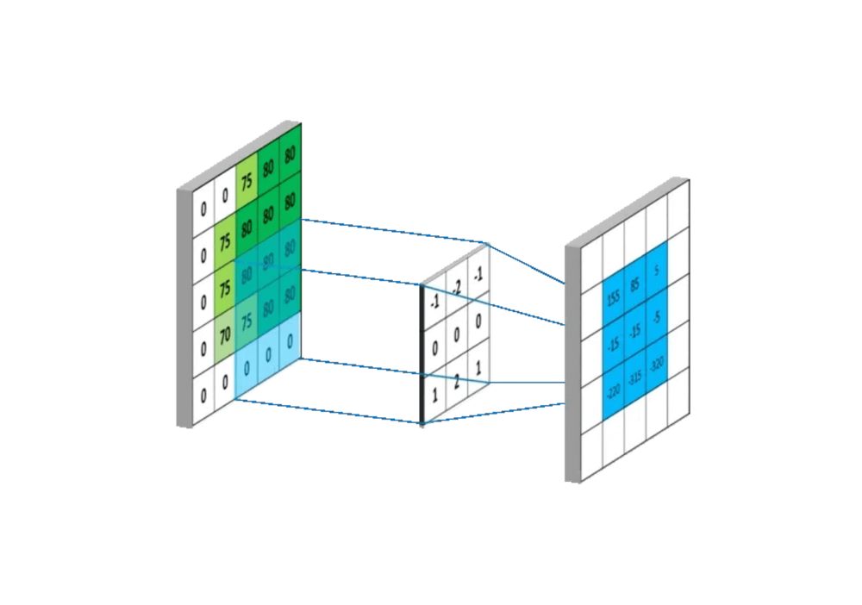
CONVOLUTION LOGIC
THE KERNEL
A small weight matrix that slides over the input to detect patterns.
DOT PRODUCT
Element-wise multiplication and summation at every step.
FEATURE MAP
The spatial grid representing detected features.

Slide 5
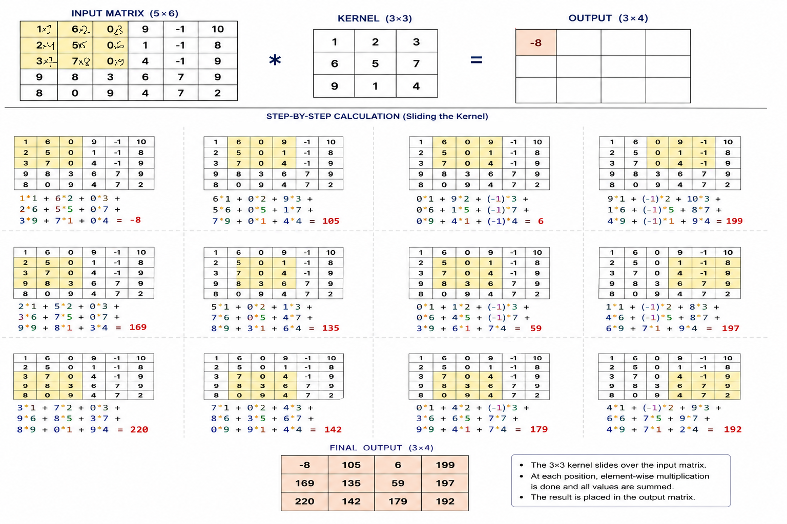
CONVOLUTION MATH

Slide 6
OUTPUT GEOMETRY
THE STEP SIZE
STRIDE
Determines how many pixels the filter shifts. Larger strides result in smaller feature maps.
BORDER CONTROL
PADDING
Adds zero-pixels around the input to preserve spatial dimensions and edge information.

Slide 7

Notes:
https://www.youtube.com/shorts/DwyhphGXBoE

Slide 8

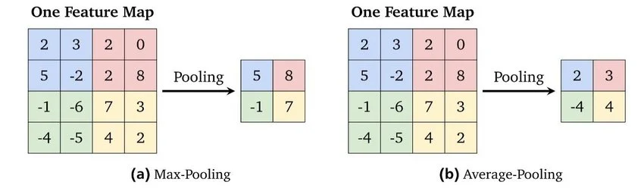
EFFICIENT DOWNSAMPLING
MAX POOLING
AVERAGE POOLING
Extracts the peak activation from each patch. Preserves the most prominent features while discarding noise.
Computes the mean activation. Smoothes the feature map, often used in global pooling layers.

Slide 9
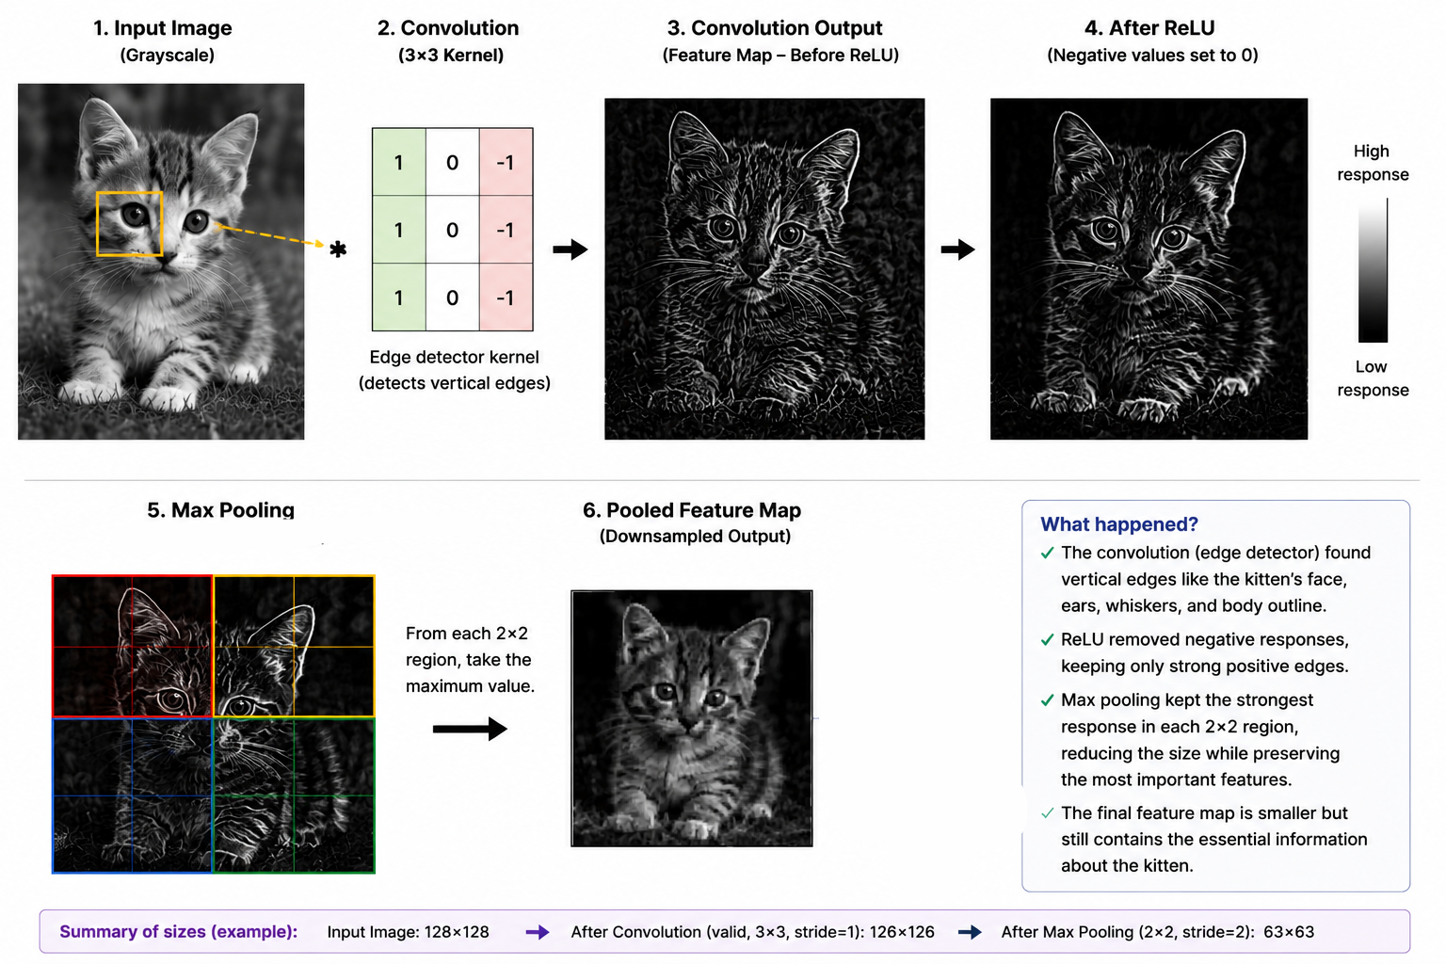
OVERALL

Slide 10


Slide 11




COMBATTING OVERFITTING
Data Augmentation creates synthetic variety from existing data, forcing the model to learn invariant features rather than memorizing noise.
GEOMETRIC
COLOR
Flip, Rotate, Crop, Zoom, Translate
Brightness, Contrast, Hue, Saturation
FILTERS
ERASING
Essential for small datasets to achieve high generalization.
Gaussian Blur, Sharpen, Noise Injection
Random Occlusion, Cutout, Mixup

Slide 12




THE CNN WORKFLOW
LEARN
COMPRESS
GENERALIZE
Convolution layers extract hierarchical features from raw pixels.
Pooling simplifies data volume while retaining key activations.
Augmentation expands datasets to prevent model overfitting.

