Slide 1


YOLO: The Speed King of Object Detection
Real-Time Detection Simplified
Look Once, Detect All
A High-Level Introduction to Computer Vision

Slide 2




How YOLO "Sees": The Bounding Box Vector
Object Presence
Spatial Location
Identity Label
Is there an object here? The model first predicts the probability of an object's existence.
Where is it exactly? Four numbers define the precise box surrounding the detected object.
What is the object? A classification label identifies the category from a predefined list.
pc
x, y, w, h
Class
0 = Empty, 1 = Object
Center & Dimensions
e.g., Car, Person, Dog

Slide 3
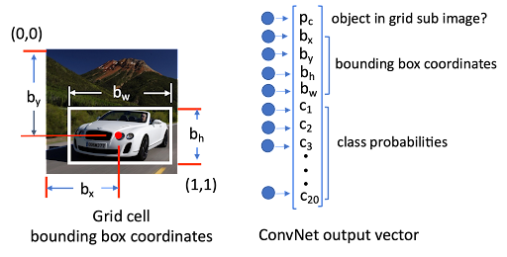

Slide 4




Roboflow: The Ultimate Toolkit
Annotate & Label
Training a YOLO model requires high-quality labeled data. Roboflow simplifies this entire process, allowing developers to focus on building rather than data management.
Easily draw bounding boxes around objects in your images with intuitive tools.
Augment Data
Multiply your dataset size by creating variations (flips, rotations, blurs) automatically.
One-Click Export
"The bridge between raw images and a trained model."
Export your dataset in the exact format YOLO needs to start learning immediately.

Slide 5



Precision Matters: IoU and Loss
IoU (Intersection over Union)
Loss Function
A metric that measures how well the predicted box overlaps with the real object. It tells us the accuracy of the box placement.
The "teacher" that tells the model how far off its guesses are. Training aims to minimize this value for better predictions.
Area of Overlap / Area of Union
Minimize Error = Maximize Accuracy

Slide 6
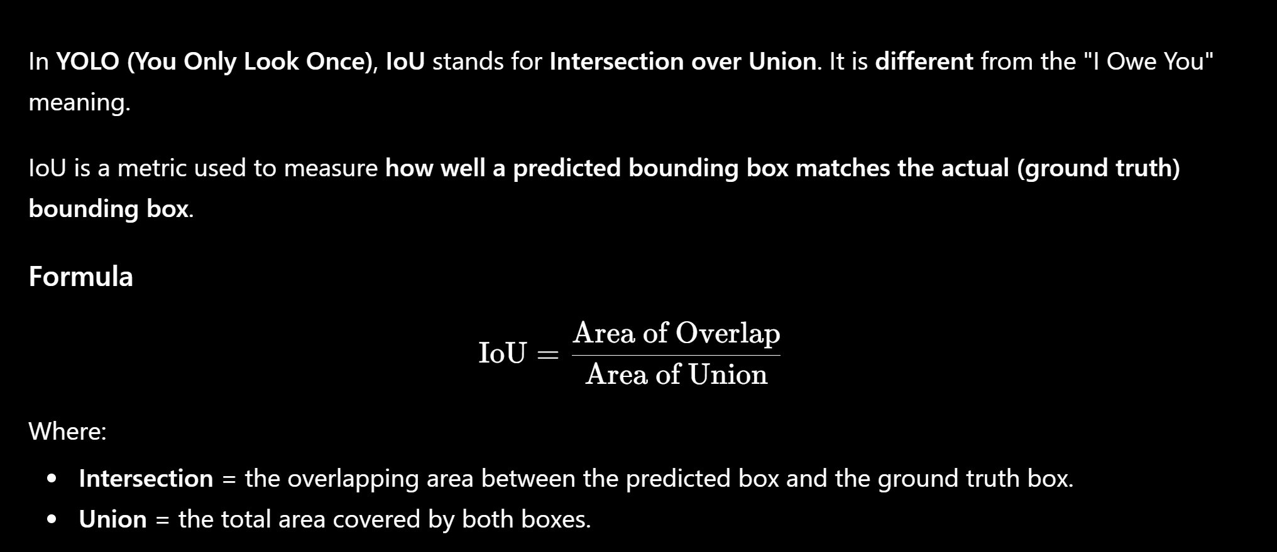

Slide 7




From Traffic to Medicine: YOLO in Action
Autonomous Vehicles
Healthcare
Security & Retail
Identifying pedestrians, signs, and other cars in milliseconds to ensure safe and smart driving.
Assisting doctors by detecting anomalies or specific structures in medical scans with high precision.
Monitoring foot traffic, detecting shoplifting, or managing smart checkout systems efficiently.
REAL-TIME SAFETY
SMART OPERATIONS
DIAGNOSTIC AID

Slide 8




YOLO is the Future
Unmatched Speed Real-time detection for dynamic environments.
High Accuracy Precision that rivals complex, slower models.
Accessible AI Simple architecture for developers at all levels.
Whether you're building a hobby project or a global application, YOLO is the most efficient way to give eyes to your code.
Start Detecting Today.

