Slide 1

BEGINNER FRIENDLY
Hugging Face
Introduction
Step-by-step study material for using models, datasets, Spaces, pipelines, tokenizers, and AutoClasses.
🤗 Start Here
01

Slide 2
Learning path for beginners
Follow this order while teaching or studying. Each step builds on the previous one.
🧭
1. Understand the Hub
⚙️
2. Run a pipeline
📦
3. Pick a checkpoint
🧩
4. Use AutoClasses
Models, datasets, demos, community
Use a model in one line of code
Choose model based on task and license
Load tokenizer, processor, and model
🗂️
5. Load datasets
🚀
6. Explore Spaces
🧪
7. Fine-tune basics
✅
8. Build projects
Use public datasets for practice
Try and deploy ML demos
Prepare data, train, evaluate
Apply the same recipe to tutorials
Study rule: do not memorize every class. First understand the pattern: task → checkpoint → tokenizer/processor → model → output.
02

Slide 3


What is Hugging Face?
Think of it as GitHub + app store + documentation hub for machine learning.
🤗
Community platform
Browse, share, and use AI models built by the community.
🧠
Model Hub
Find pretrained models for text, image, audio, and multimodal tasks.
🗂️
Datasets
Explore datasets with dataset cards and examples.
🚀
Spaces
Try machine learning demos in the browser.
Public homepage says: Browse 2M+ models
KGP Talkie • Hugging Face Introduction
youtube.com/kgptalkie
kgptalkie.com
linkedin.com/in/laxmimerit
03

Slide 4
The Hugging Face ecosystem
You will mostly use these four pieces in beginner tutorials.
🤗
🤗 Hub
⚙️
⚙️ Transformers
Model repos, dataset repos, Spaces repos, files, README, versions
Python library to load tokenizers, processors, models, and pipelines
🗂️
🗂️ Datasets
🚀
🚀 Spaces
Library and Hub pages to search, inspect, and load datasets
Deploy demos using Gradio, Streamlit, Docker, or static apps
04

Slide 5
Setup before running tutorials
Keep installation simple first. Do advanced GPU setup later.
1
Create environment
Use conda or venv so your project stays clean.
# Option 1: create a clean Python environment
python -m venv hf
# Windows: hf\Scripts\activate
# macOS/Linux: source hf/bin/activate
pip install -U transformers datasets accelerate torch
# Optional login for gated models / uploads
huggingface-cli login
2
Install libraries
Start with transformers, datasets, accelerate, and torch.
3
Run a pipeline
Verify the setup before writing advanced code.
4
Login only when needed
Use a token for gated models or pushing files to Hub.
Beginner advice: first run everything on CPU. Once the logic is clear, then move to GPU or Colab.
05

Slide 6
Transformers library: the practical idea
Transformers gives you reusable building blocks for pretrained models.
Why beginners love it
Use it with
• One common API for many model types
• Works with text, image, audio, and multimodal tasks
• Gives ready-made pipelines for quick inference
• Lets you fine-tune models later using Trainer
🔥
🔶
⚡
PyTorch
TensorFlow
JAX
Pretrained model
Your task
Useful output
06

Slide 7
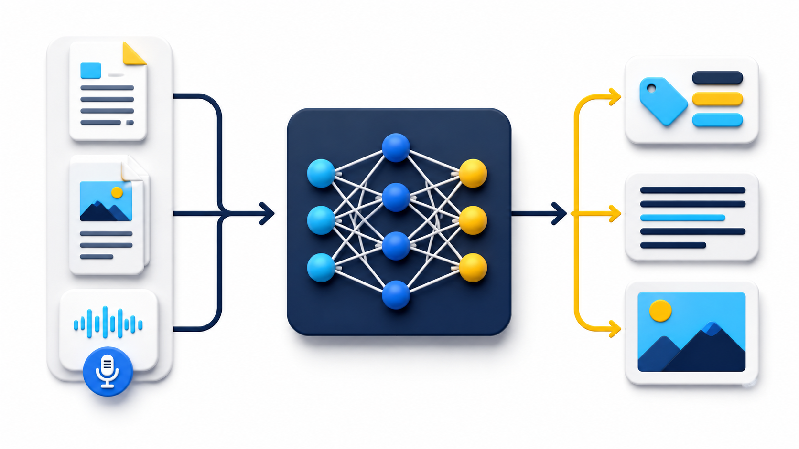
What is a pipeline?
A pipeline hides the boring steps and lets you focus on the task.
Input
Pre-processing
Model inference
Post-processing
Output
07

Slide 8
Hands-on 1: first inference pipeline
Goal: run a pretrained model without understanding every internal detail.
from transformers import pipeline
classifier = pipeline("sentiment-analysis")
result = classifier("I love learning Hugging Face!")
print(result)
# Example output:
# [{'label': 'POSITIVE', 'score': 0.99}]
🧪
What happened?
1. Pipeline downloaded a default sentiment model.
2. It converted text into tokens.
3. The model predicted a label.
4. Output became human readable.
Your first Hugging Face win: one task, one line
08

Slide 9
Behind the pipeline
The same idea appears again and again in Hugging Face tutorials.
✂️
1. Pre-process
🧠
2. Run model
🧾
3. Post-process
Tokenizer/processor converts raw input into tensors
Neural network predicts logits, scores, or hidden states
Convert raw model output into labels, text, or boxes
Beginner mental model
Whenever you see pipeline(), remember: input → conversion → model → readable output.
09

Slide 10
Common pipeline tasks
Start with simple text tasks, then move to image and audio tasks.
💬
Text Classification
❓
Question Answering
🧩
Fill-Mask
📝
Summarization
Sentiment, spam, topic
Context + question → answer
Predict missing word/token
Long text → short summary
🌍
Translation
🎙️
Speech Recognition
🖼️
Image Classification
📦
Object Detection
One language → another
Audio → text
Image → class label
Image → boxes + labels
When confused, search by task first. Then select a checkpoint trained for that task.
KGP Talkie • Hugging Face Introduction
youtube.com/kgptalkie
kgptalkie.com
linkedin.com/in/laxmimerit
10

Slide 11
Model checkpoints: what are you downloading?
A checkpoint is a saved model state: architecture + learned weights + config files.
Model family
Dataset / Task
Checkpoint name
📦
Checkpoint = saved model package
BERT
Wikipedia + Books
bert-base-uncased
It usually contains:
• config.json
• model weights
• tokenizer files
• model card README
• license and usage notes
DistilBERT
SQuAD QA
distilbert-base-cased-distilled-squad
ViT
ImageNet
google/vit-base-patch16-224
Tip: checkpoint name usually tells you model + size + training data/task
11

Slide 12
Read the model card before using a model
A model card is the README of a model repo. It protects you from wrong choices.
🎯
Task
📜
License
Is it trained for your use case?
Can you use it in your project or course?
📊
Evaluation
⚠️
Limitations
What metrics and benchmark data are shown?
What should you not use it for?
🧪
Example code
🧰
Framework
Can you reproduce the sample quickly?
Does it support Transformers / PyTorch / etc.?
Beginner habit: never copy a checkpoint name blindly. Read the card first.
12

Slide 13
Tokenizer: text becomes numbers
Models do not understand raw text directly. They work with token IDs.
from transformers import AutoTokenizer
tokenizer = AutoTokenizer.from_pretrained("bert-base-uncased")
text = "In a hole in the ground there lived a hobbit."
print(tokenizer(text))
# output contains input_ids, token_type_ids, attention_mask
Raw text
Token IDs
"Hello world"
[101, 7592, 2088]
AutoTokenizer loads the correct tokenizer for the checkpoint
13

Slide 14
AutoClasses: beginner-safe loading pattern
AutoClasses infer the correct architecture from the checkpoint.
AutoTokenizer
Text tokenization
from transformers import AutoTokenizer, AutoModelForSequenceClassification
checkpoint = "distilbert-base-uncased"
tokenizer = AutoTokenizer.from_pretrained(checkpoint)
model = AutoModelForSequenceClassification.from_pretrained(checkpoint)
# Same pattern works for many checkpoints.
AutoImageProcessor
Image preprocessing
AutoProcessor
Multimodal / layout inputs
AutoModelForSequenceClassification
Text classification model
AutoModelForTokenClassification
NER / token tagging
Beginner rule: pipeline() is fastest for inference. AutoClasses are better when you want control.
14

Slide 15
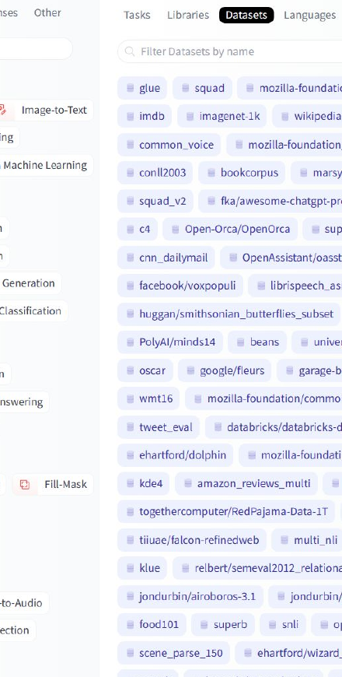
Datasets: discover, inspect, load
Datasets are training and evaluation data. Always read the dataset card.
Beginner workflow:
🔍
Search a dataset by task or domain
📄
Open dataset card and inspect columns
🧪
Load small split first
✅
Check license and data quality
from datasets import load_dataset
dataset = load_dataset("imdb", split="train[:100]")
print(dataset[0])
15

Slide 16
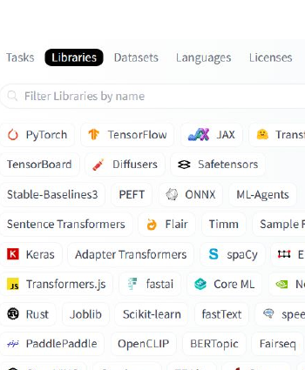
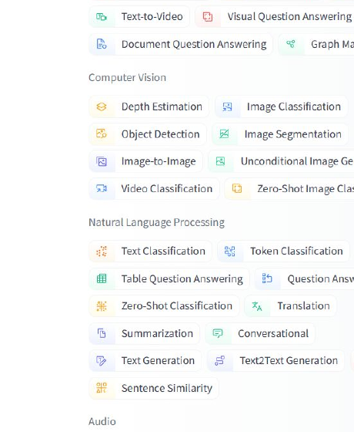
Hub filters: tasks, libraries, datasets
The Hub search page is a navigation tool. It helps you avoid random guessing.
Libraries
Tasks
Datasets
16

Slide 17

Spaces: try ML apps in the browser
Spaces are useful for demos, prototypes, and course projects.
🚀
Deploy demos in minutes
Gradio, Streamlit, Docker, and static apps are common options.
🧪
Test models interactively
Students can try inputs without writing backend code first.
🔗
Share project links
Perfect for portfolio demos and tutorials.
Use Spaces when you want students to see the model working visually.
17

Slide 18
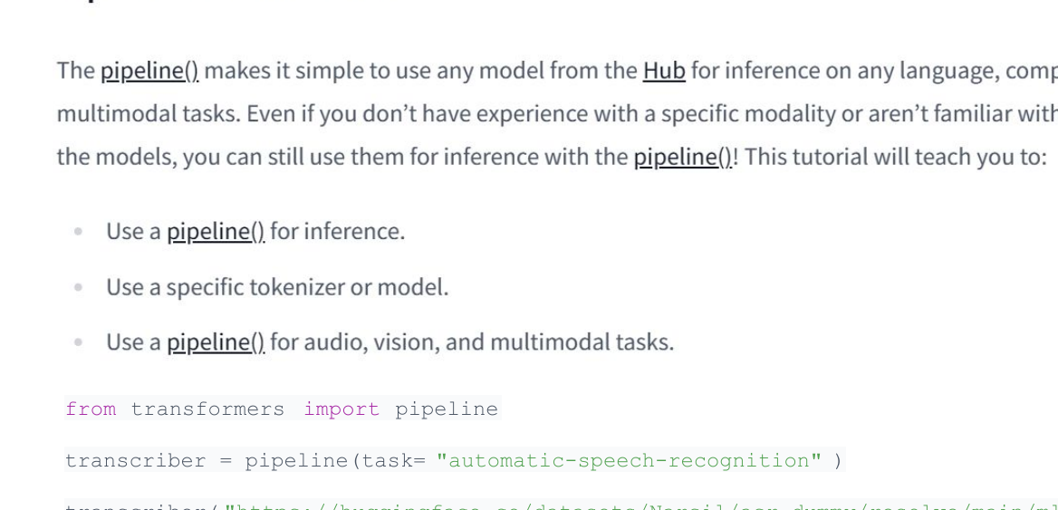
Hands-on 2: speech recognition pipeline
This example turns an audio file into text using a pretrained ASR model.
from transformers import pipeline
transcriber = pipeline(
task="automatic-speech-recognition"
)
url = "https://huggingface.co/datasets/Narsil/asr_dummy/resolve/main/mlk.flac"
print(transcriber(url))
Same pattern: task name + input → readable output.
18

Slide 19
Fine-tuning: when pretrained is not enough
Fine-tuning adapts a pretrained model to your own dataset and task.
🗂️
Dataset
✂️
Tokenizer
🏋️
Trainer
📊
Evaluate
Clean examples
Convert inputs
Train model
Check metrics
Do not start with fine-tuning. First learn inference, checkpoint selection, and datasets. Fine-tuning is step two.
19

Slide 20
How to choose the right model
Use this checklist before using any checkpoint in a tutorial or project.
Question
What to check
Is it for my task?
Task tag, model card examples, pipeline support
Can I use it legally?
License, commercial restrictions, gated access
Will it run on my machine?
Model size, RAM/VRAM, quantized versions
Is it reliable enough?
Evaluation metrics, known limitations, recent updates
Can students reproduce it?
Simple code, downloads, stable dependencies
Best beginner default: use a small, popular, well-documented model first. Upgrade only after the workflow works.
KGP Talkie • Hugging Face Introduction
youtube.com/kgptalkie
kgptalkie.com
linkedin.com/in/laxmimerit
20

Slide 21
Common beginner errors
Most issues are setup or checkpoint-choice problems, not Hugging Face itself.
❌
ModuleNotFoundError
🔐
401 / gated model
Install the missing library in the active environment.
Login with token or choose an open model.
💾
Out of memory
🌐
Slow download
Use smaller model, CPU, quantization, or Colab/GPU.
Model files are large; cache is reused after first download.
🧩
Wrong task
📜
License confusion
Choose checkpoint trained for the exact task.
Read the model card before public/commercial use.
21

Slide 22
Recap
The simplest Hugging Face learning formula.
🎯
Task
📦
Checkpoint
⚙️
Pipeline / AutoClass
✅
Output
What do you want to do?
Which model fits the task?
How will you load it?
How will you evaluate it?
Start with pipeline(). Grow into AutoClasses, Datasets, Spaces, and fine-tuning after the basic workflow is clear.
23

Slide 23
References used
Sources for facts, structure, and beginner examples.
Uploaded source PDF
Hugging Face Introduction.pdf
Hugging Face homepage
https://huggingface.co/
Hugging Face Hub documentation
https://huggingface.co/docs/hub/en/index
Transformers pipeline tutorial
https://huggingface.co/docs/transformers/en/pipeline_tutorial
Transformers pipelines reference
https://huggingface.co/docs/transformers/en/main_classes/pipelines
Model cards documentation
https://huggingface.co/docs/hub/en/model-cards
Spaces overview
https://huggingface.co/docs/hub/en/spaces-overview
Note: model/dataset counts change frequently. Treat public Hub numbers as current-context examples, not fixed course facts.
24

