Slide 1

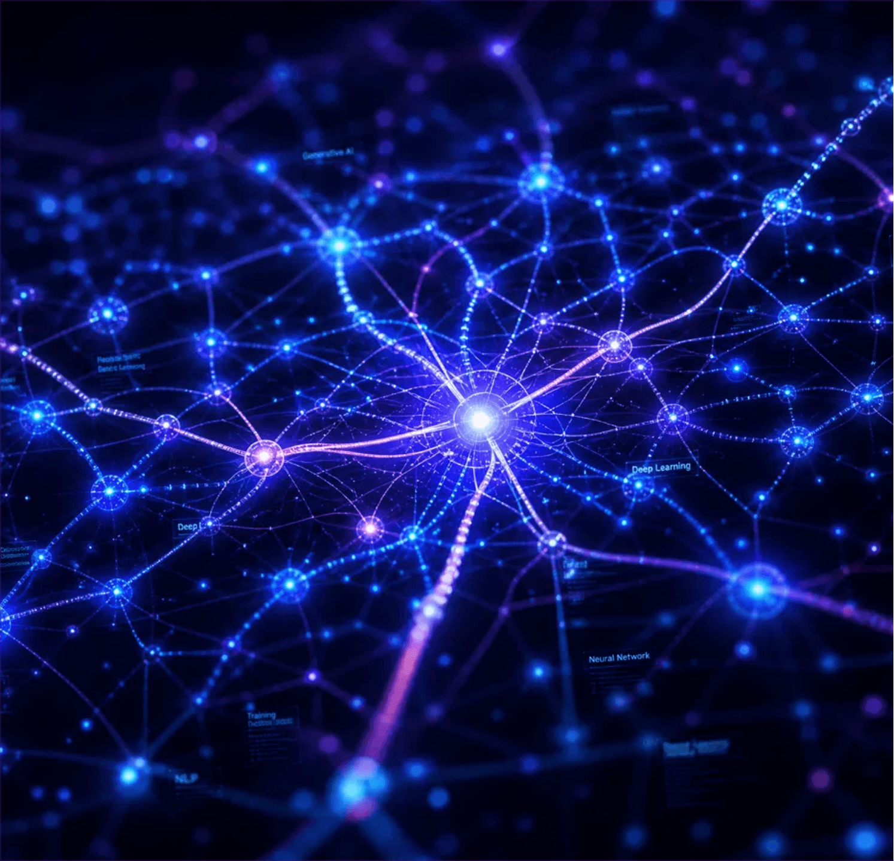
LLM FOUNDATIONS
Unpacking the Intelligence Behind AI: GPT, BERT, T5, LLaMA, and the Transformer Revolution

Slide 2

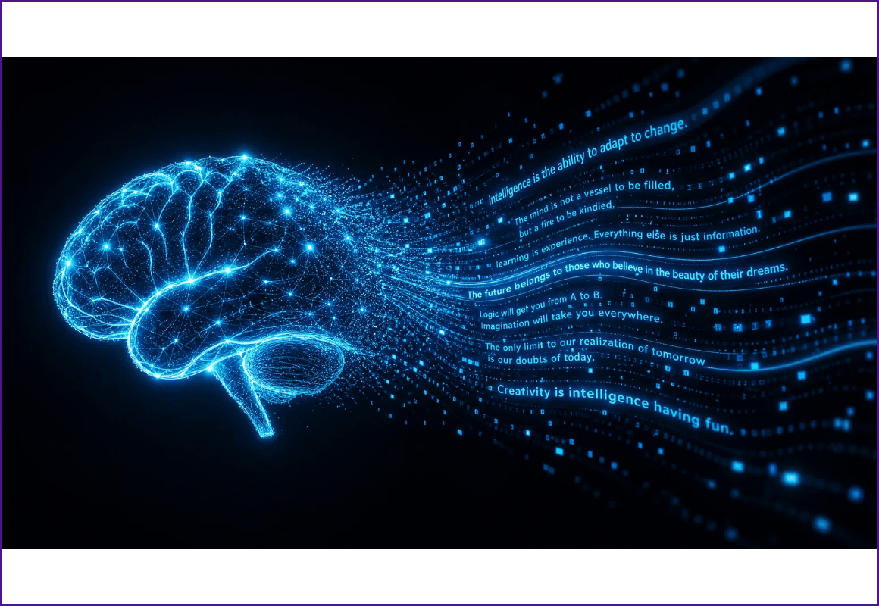
WHAT ARE LLMS?
Large Language Models (LLMs) are advanced AI systems trained on vast datasets to understand, generate, and interact with human language. They serve as the foundation for modern conversational AI and intelligent automation.
FOUNDATION OF GENERATIVE AI

Slide 3


KEY ARCHITECTURES
MODEL
DEVELOPER
TYPE
PRIMARY FOCUS
BERT
Google
Encoder-Only
Understanding Context
GPT
OpenAI
Decoder-Only
Text Generation
T5
Google
Encoder-Decoder
Task Transformation
LLaMA
Meta
Decoder-Only
Efficient Generation

Slide 4
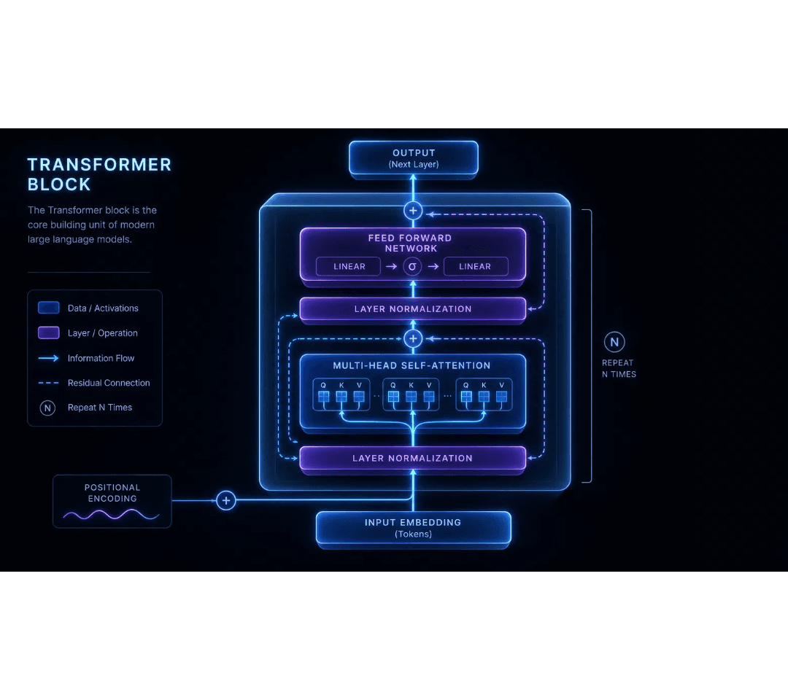
THE TRANSFORMER REVOLUTION
EST. 2017
The Transformer architecture replaced recurrent layers with self-attention, enabling massive parallelization and efficiency.
Eliminated sequential processing bottlenecks
Enabled training on internet-scale datasets
Foundation for GPT, BERT, and all modern LLMs

Slide 5

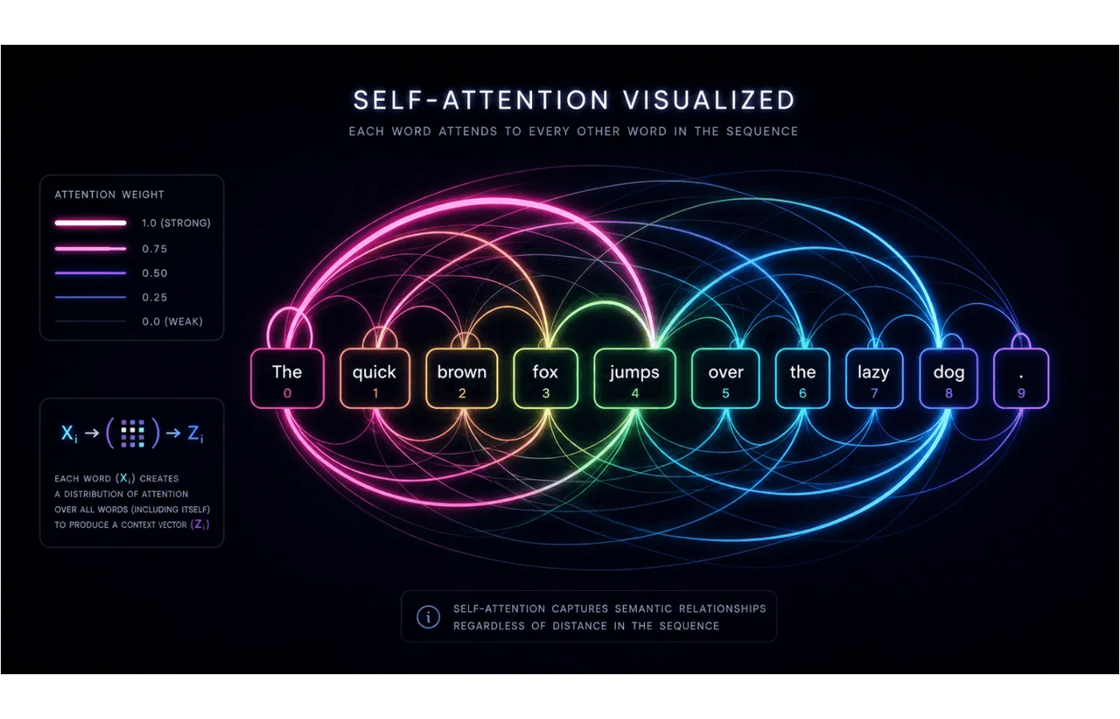
SELF-ATTENTION MECHANISM
Self-attention allows a model to weigh the importance of different words in a sequence when processing each token. It captures long-range dependencies and complex contextual relationships effortlessly by calculating relevance scores between all pairs of tokens.
CAPTURES CONTEXT REGARDLESS OF DISTANCE

Slide 6

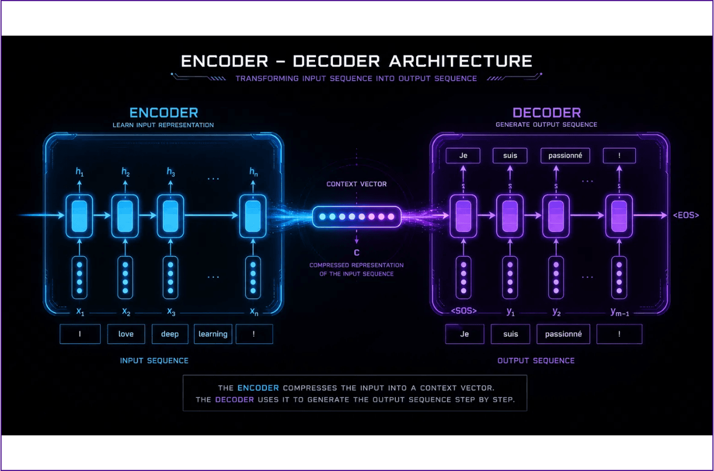
ENCODER-DECODER MODELS
Encoder-decoder architectures, like T5, are designed for sequence-to-sequence tasks. The encoder processes the input into a context vector, which the decoder then uses to generate the output sequence.
PRIMARY USE CASES
> Machine Translation
> Text Summarization
> Question Answering

Slide 7
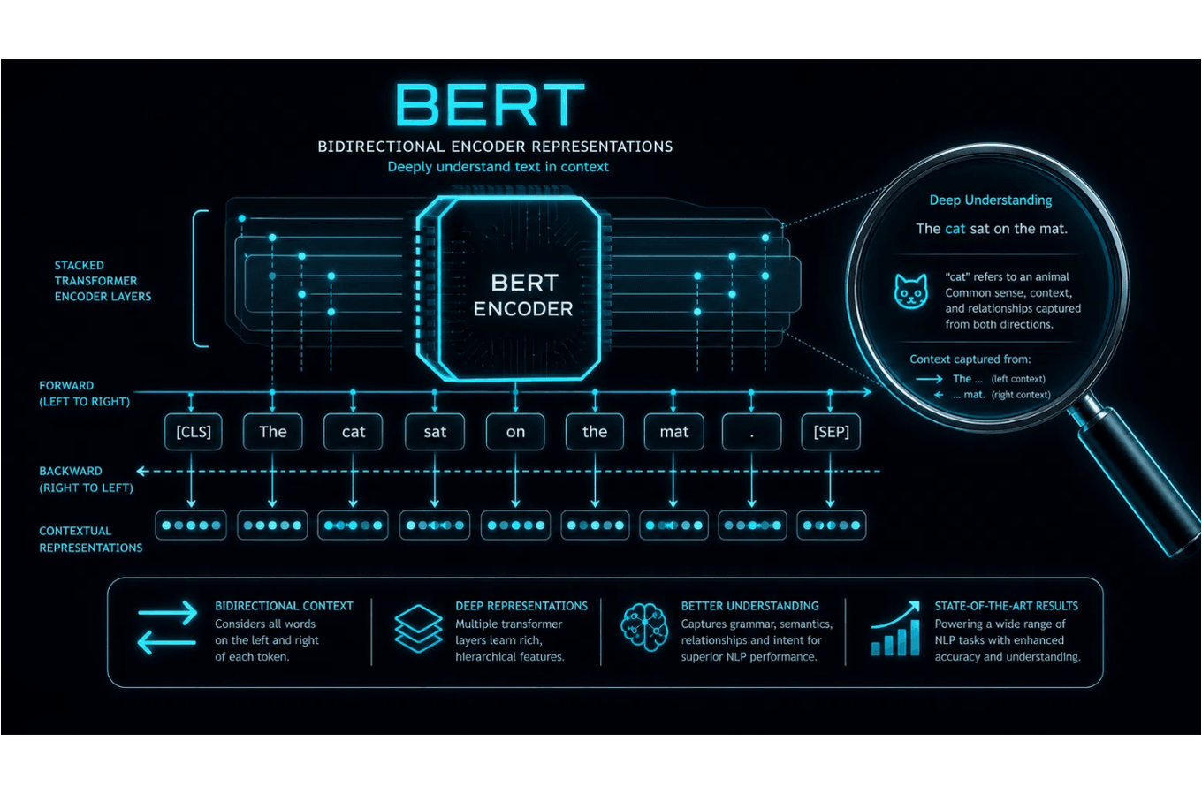
ENCODER-ONLY MODELS
Encoder-only models like BERT are designed to understand the deep context of language by processing text bidirectionally.
Bidirectional Contextualization
>
Masked Language Modeling (MLM)
>
Next Sentence Prediction (NSP)
>
Ideal for NLU (Understanding)
>
BEST FOR: CLASSIFICATION & NER

Slide 8
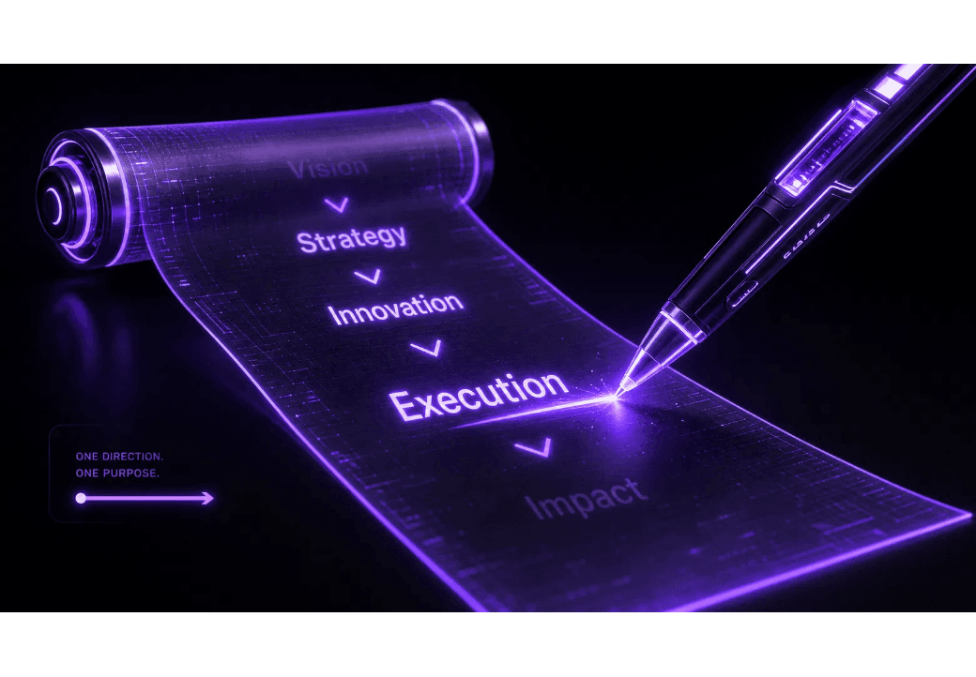
DECODER-ONLY MODELS
Primarily used for generative tasks, decoder-only models predict the next token in a sequence based on preceding context. This "writer" approach is the engine behind modern chatbots and creative AI.
CAUSAL ATTENTION
Tokens only attend to previous positions in the sequence.
KEY EXAMPLES
GPT-4, LLaMA 3, Mistral, Claude.
PRIMARY USE
Text generation, coding, and creative writing.

Slide 9

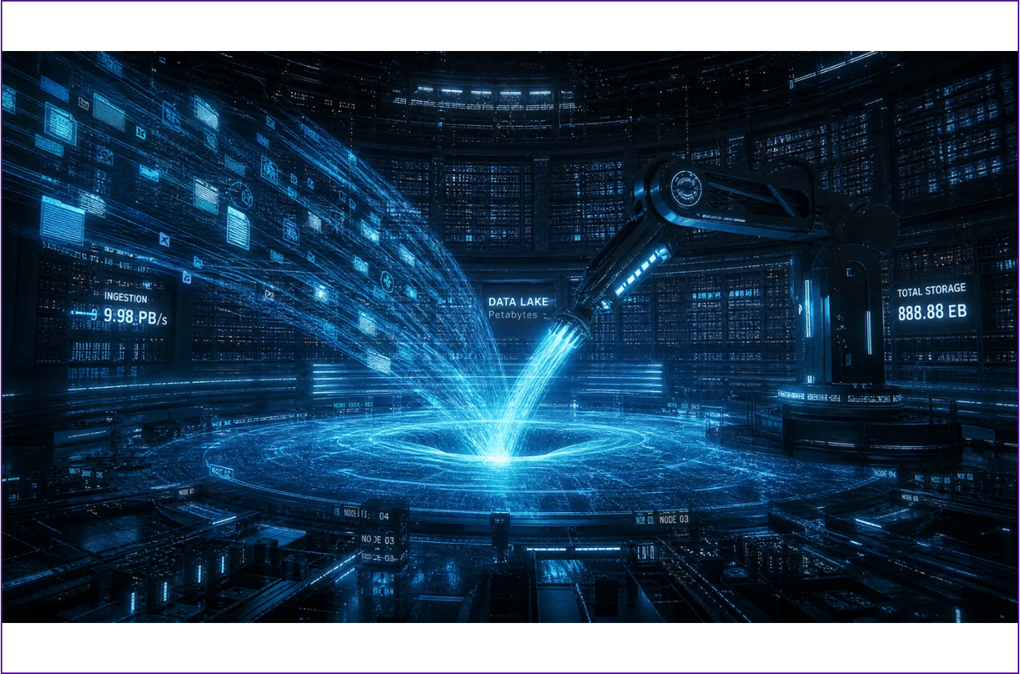
PRETRAINING: THE FOUNDATION
Pretraining involves training LLMs on massive, diverse datasets using self-supervised learning. This phase provides the model with a broad understanding of language, logic, and world knowledge.
LEARNING FROM PETABYTES OF DATA
> Self-Supervised Learning
> Next Token Prediction
> Foundational Knowledge

Slide 10
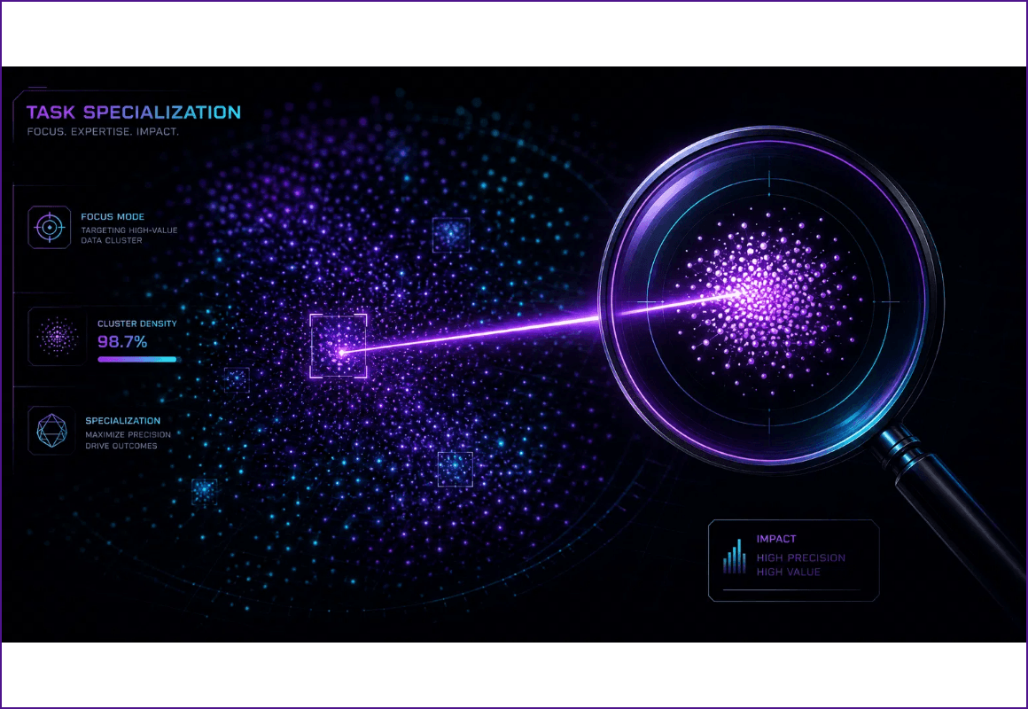
FINE-TUNING: TASK SPECIALIZATION
After pretraining, models are fine-tuned on smaller, task-specific datasets with labeled examples. This process adapts the general language understanding to perform specific downstream tasks with high precision.
ADAPTING GENERAL KNOWLEDGE TO SPECIFIC NEEDS
> Supervised Learning
> Domain Adaptation
> High Precision Output

Slide 11
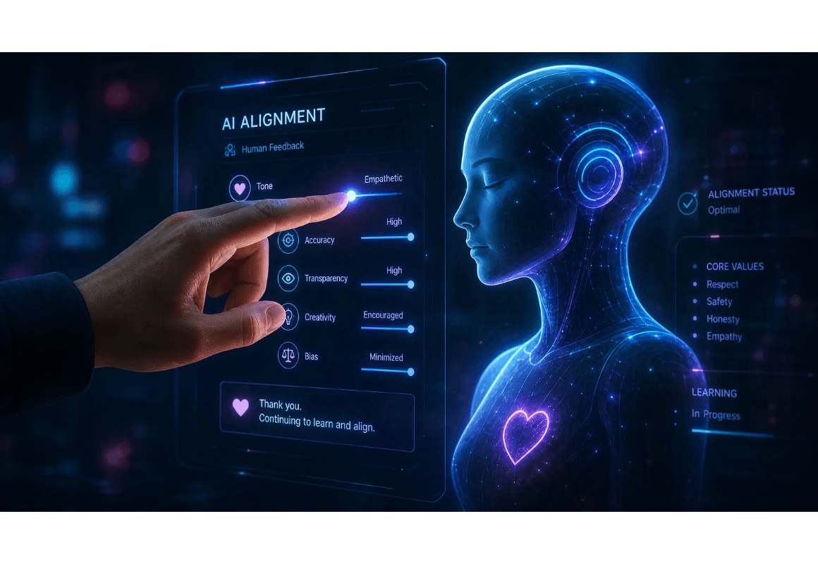
INSTRUCTION TUNING
Instruction tuning refines LLMs to follow human commands and behave as helpful assistants. This phase bridges the gap between raw knowledge and practical utility.
Supervised Fine-Tuning (SFT)
Reinforcement Learning from Human Feedback (RLHF)
Direct Preference Optimization (DPO)
GOAL: HELPFUL, HARMLESS, & HONEST

Slide 12

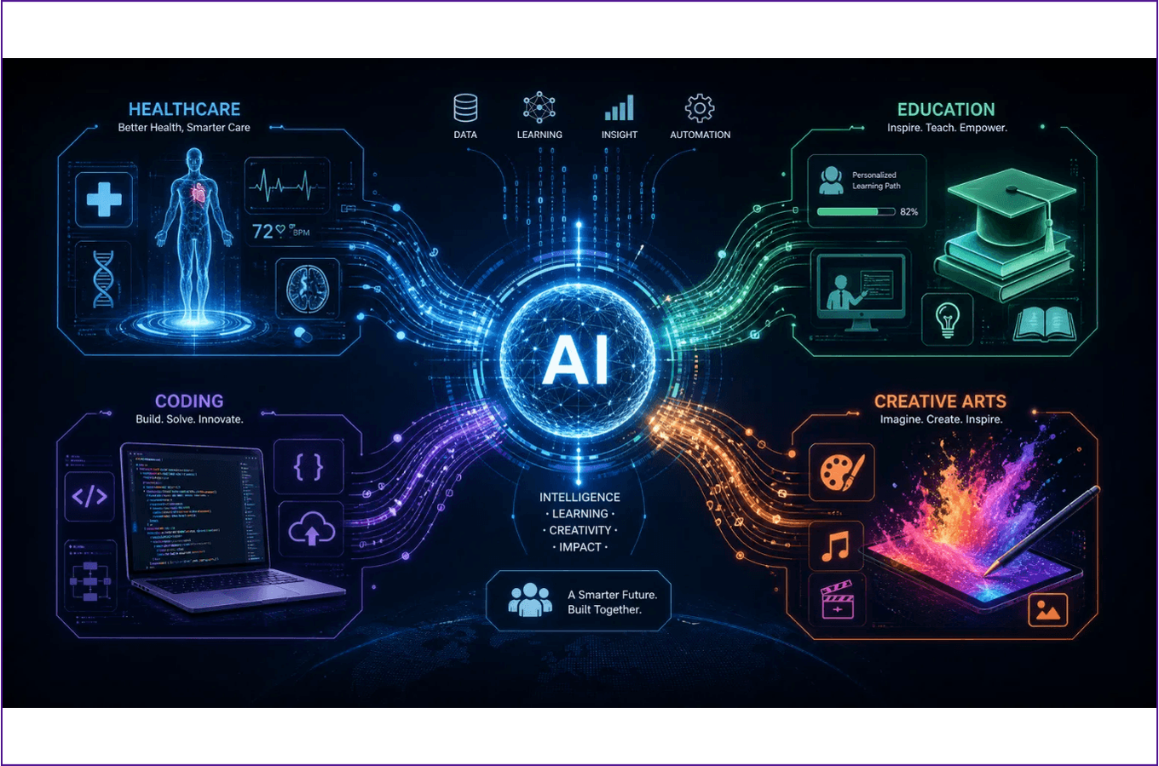
REAL-WORLD USE CASES
LLMs are transforming industries by automating complex tasks and enhancing human creativity across various domains.
HEALTHCARE
Medical research & diagnostics.
EDUCATION
Personalized learning & tutoring.
SOFTWARE DEV
Code generation & debugging.
CREATIVE ARTS
Content creation & design.

Slide 13

THE FUTURE OF AI
LLMs represent a paradigm shift in human-computer interaction. As research progresses, we move toward a future where AI collaboration is seamless, intuitive, and universally integrated into our daily lives.
THE FUTURE IS COLLABORATIVE

