Slide 1
KIVA Loans
Business Intelligence
Members:
2021170677 كريم كليموه
2022170664 زينب صالحي عبدالله
2022170671 نفيسة بشير دانغوغوا
2022170096 بسنت احمد محمد احمد
2018170128 تالا محمد سامر عطايا

Slide 2
Agenda
Project Overview
Objectives
Dataset Description
Data Cleaning & Transformation
Exploratory Data Analysis (EDA)
Machine Learning Model
Power BI Reports
Time Series Forecasting
Key Insights & Conclusion ,

Slide 3
Project Overview
This project analyzes Kiva’s loan data to uncover funding trends, build a predictive model for funded amounts, and visualize key insights using Power BI. A Random Forest model achieved high accuracy, and time series forecasting was initiated to predict future trends.

Slide 4
Objectives
Identify sectors and countries receiving the most funding
Analyze the relationship between lender count and funded amount
Predict funded loan amounts using machine learning
Visualize trends and key metrics using Power BI
Forecast future loan trends using ARIMA time series model

Slide 5
Dataset Description
Source: Kiva loan data (CSV file)
Total Records: ~33,561
Key columns:
No. | Name
1. | loan_amount
2. | funded_amount
3. | sector
4. | country
5. | term_in_months
6. | lender_count
7. | borrower_genders
8. | date

Slide 6
Data Loading & Initial Exploration
Loaded data using Python (pandas)
Checked structure: data types, null values
Explored distributions of loan size, funding, and duration
Identified early issues (missing values, inconsistent types)

Slide 7
Missing Values and Data Cleaning
partner_id: Filled missing values with -1
borrower_genders: Filled with 'unknown’
Removed any problematic records when needed
Standardized column types (e.g., converted date)

Slide 8
Data Transformation
Extracted year and month from date for time analysis
Split borrower_genders into female, male, unknown counts
Prepared clean data for Power BI and ML use
Saved cleaned data to .csv for visualization and modeling

Slide 9
EDA - Exploratory Data Analysis.
Exploring and visualizing data to understand its patterns, trends, relationships, and potential issues before building any models.
Tool used: Power BI

Slide 10
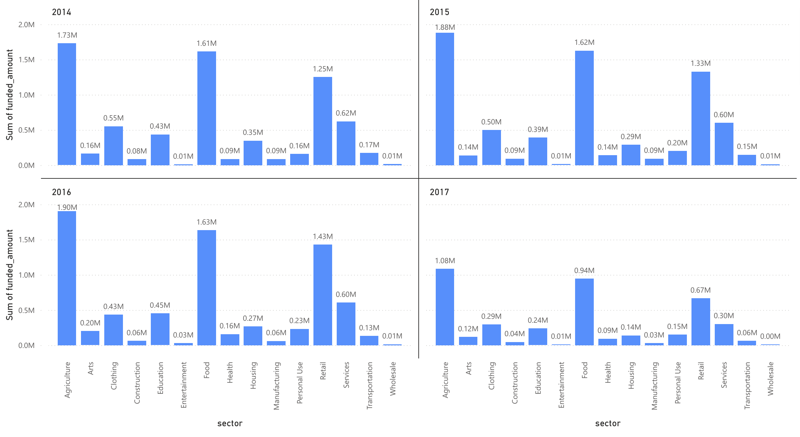
EDA: Funding by Sector
Visualization: Bar chart
Insights:
  Dominant sectors (e.g., Agriculture, Food) have the highest funding.
  Smaller sectors (e.g., Entertainment, Health) show minimal funding.

Slide 11
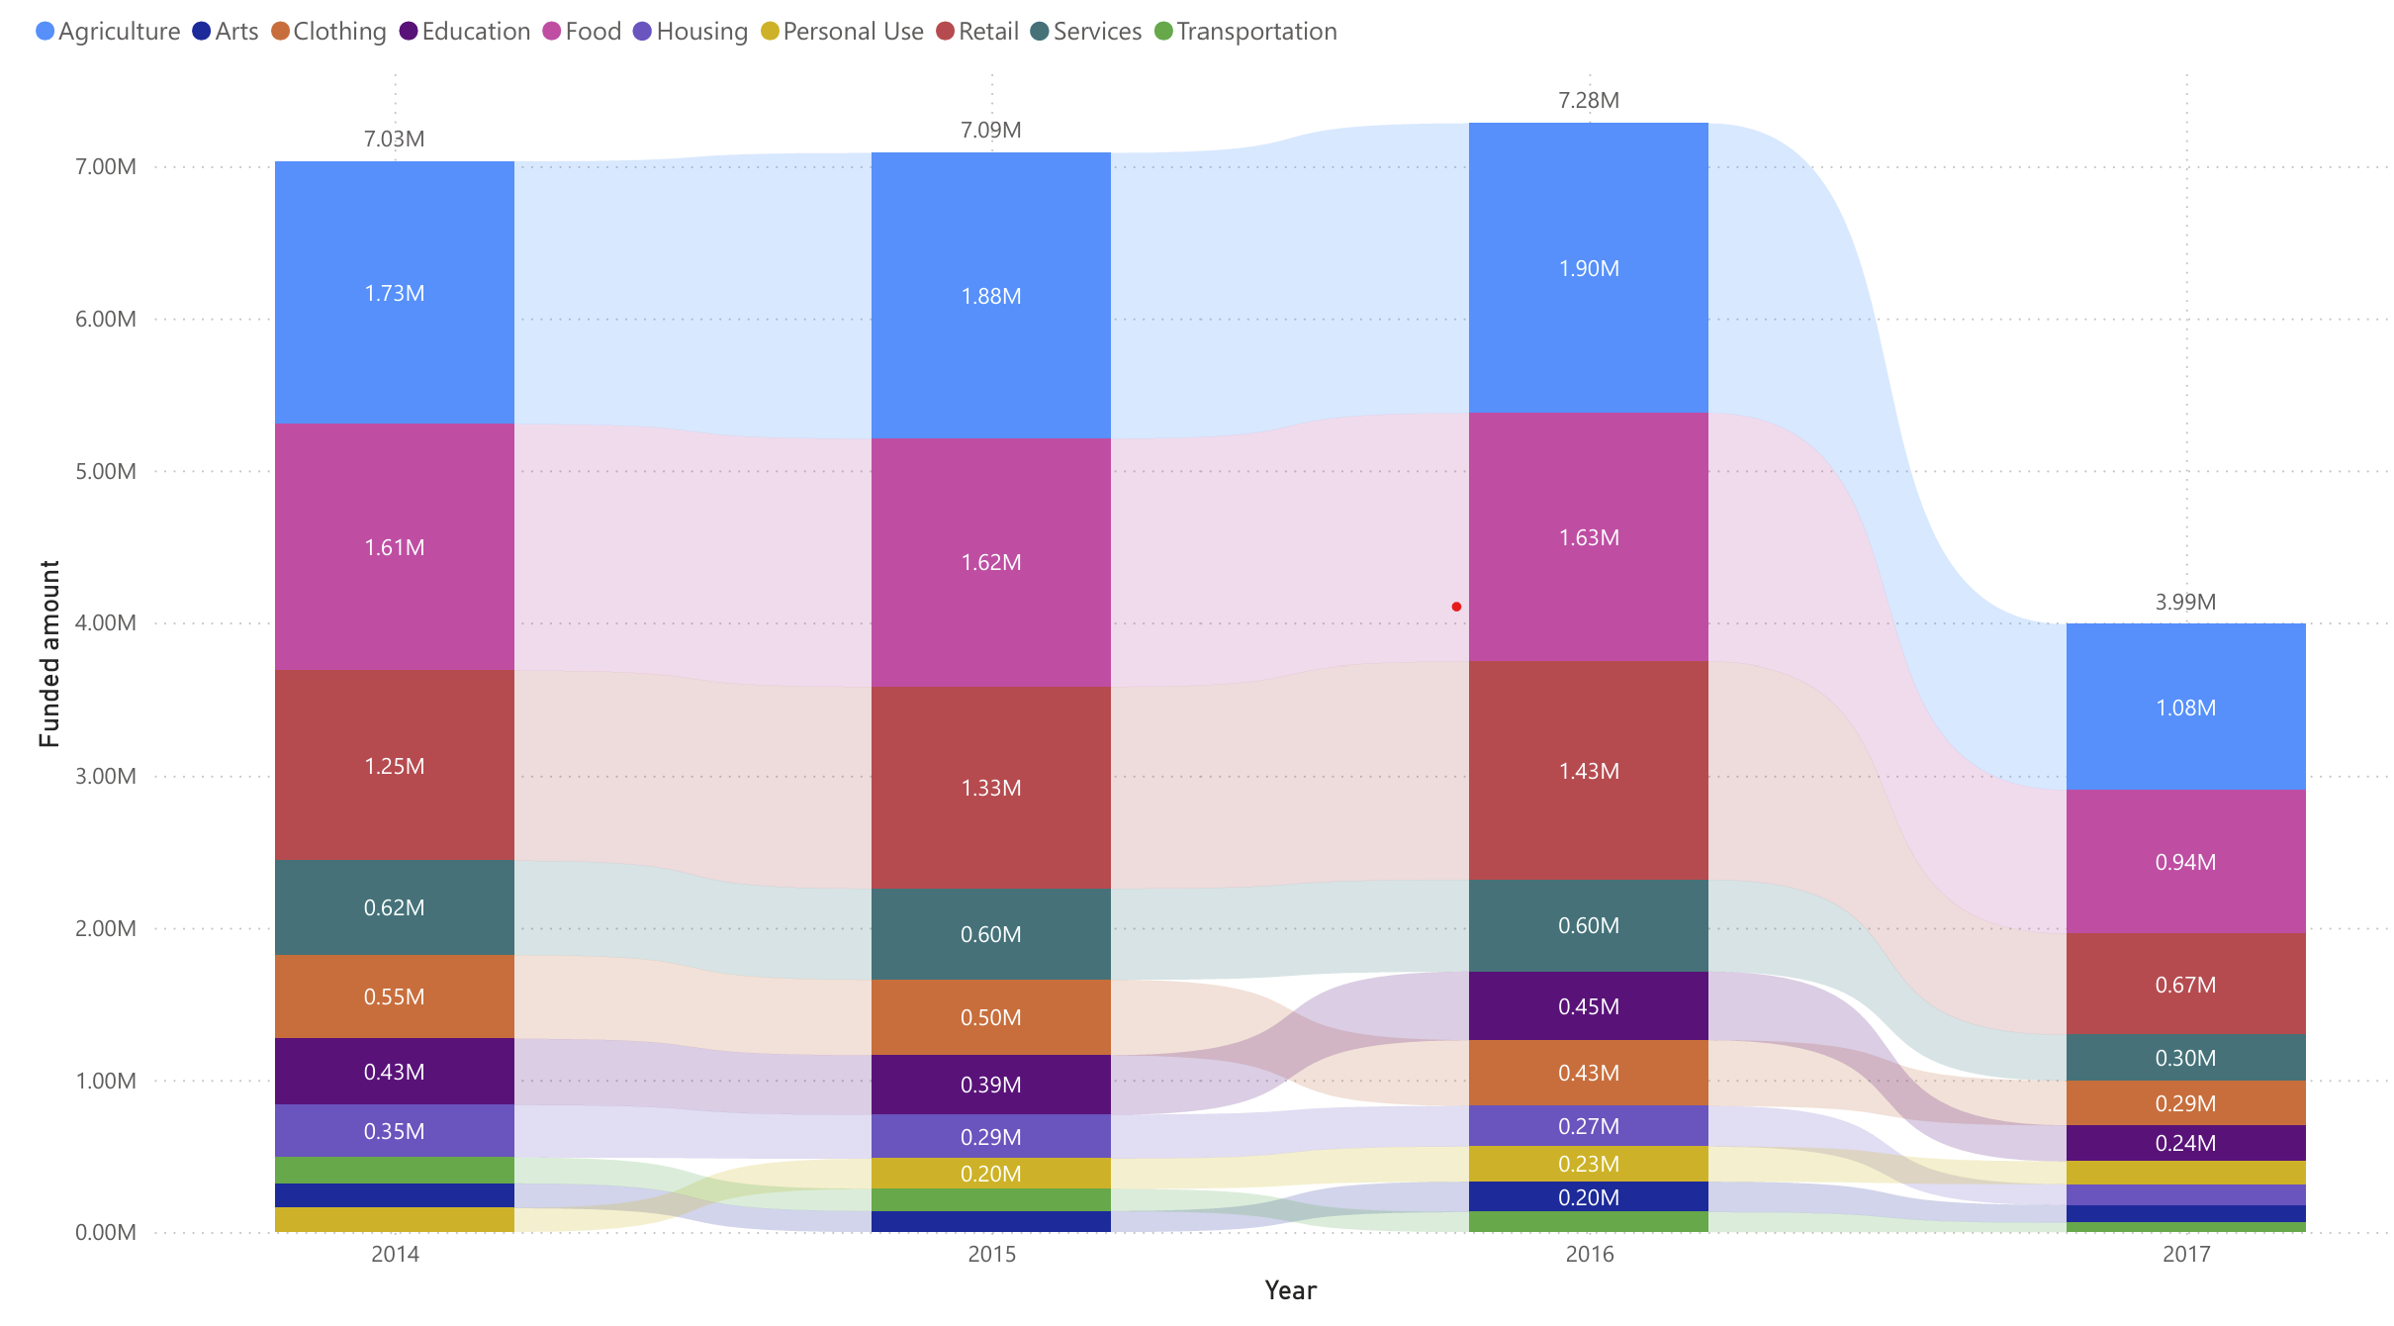
EDA: Top 10 sectors years comparison
Visualization: Stacked Column Chart
Insights:
  Agriculture dominates yearly funding.
  Trends (e.g., growth in "Food" or decline in "Arts").

Slide 12
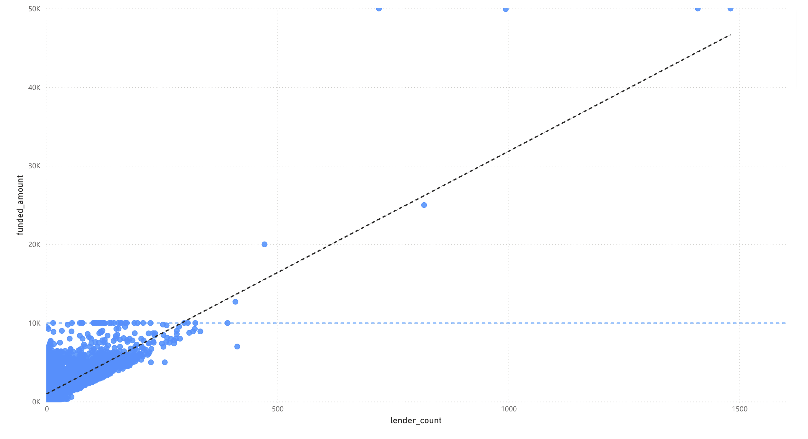
EDA: Correlation between funded amount and lender count
Visualization: Scatter Plot
Insights:
Positive correlation: More lenders may associate with higher funding.
Outliers: Loans with high funding but few lenders (or vice versa) may indicate unique cases.

Slide 13
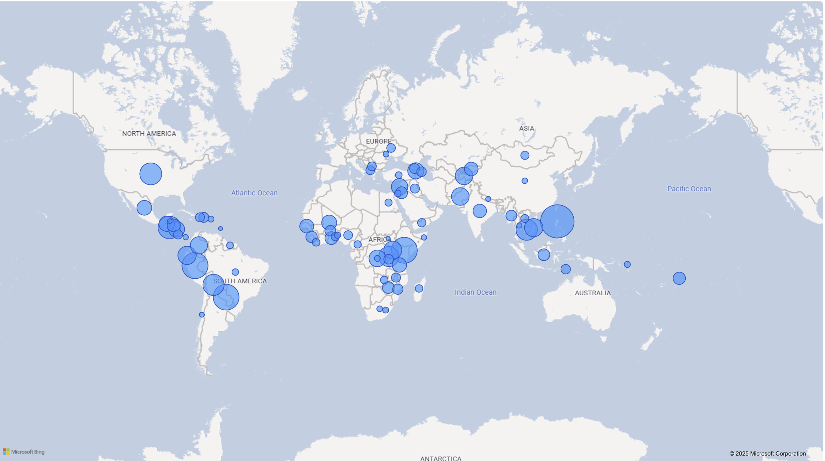
EDA: Funded amount per country

Slide 14
Machine Learning Objective
Goal: Predict funded amount from historical data

Slide 15
Feature Selection & Preprocessing
Objective: Predict the 'funded_amount' using other variables
Approach: Supervised machine learning using regression model

Slide 16
Model Building
Chose Random Forest Regressor for its performance and robustness
Built a pipeline combining preprocessing and modeling steps
Used ColumnTransformer to one-hot encode categorical features (sector, country)
Included numerical and engineered features like: loan_amount, lender_count, term_in_monthsfemale_count, male_count, unknown_count
Split data into training (80%) and testing (20%) sets
Trained model using sklearn with default hyperparameters

Slide 17
Model Evaluation
Results:
Root Mean Squared Error (RMSE): ~$181.72
This means predictions are generally very close to actual values.
R²: 0.97.
97% of the variation in the actual funded amounts is explained by the model.
Model is highly accurate and generalizes well

Slide 18
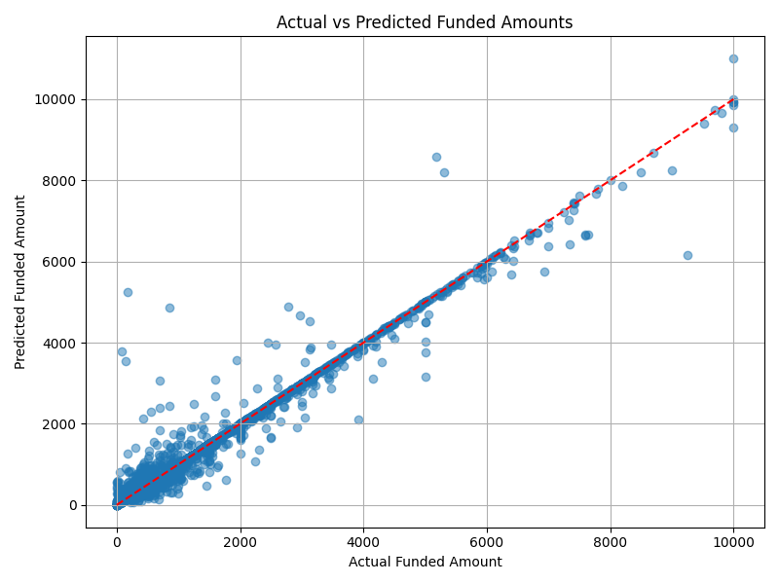
Prediction Results
Scatterplot of predicted vs actual funded amounts
The points clustered near a diagonal line.
The line represents perfect predictions.
The tighter the points hug that line, the better the model's predictions are.

Slide 19
Time Series Forecasting (ARIMA)
Transformed data into time series format based on date
Resampled data annually for ARIMA forecasting
Trained ARIMA(1,1,1) model to forecast loan amounts
Results suggest a flat future trend due to limited time points
Sector-based trends show Agriculture and Food leading consistently

Slide 20
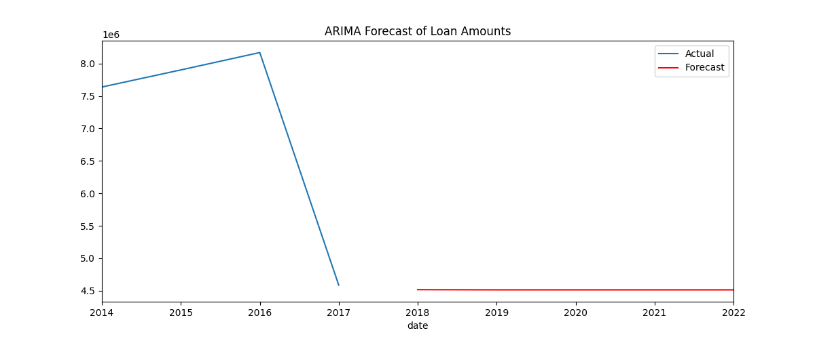
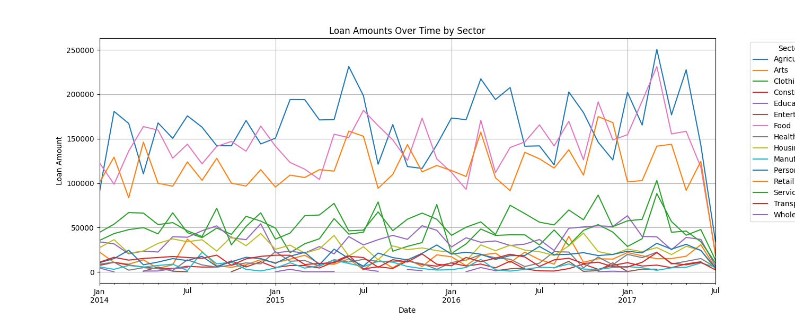

Slide 21
Conclusion & Insights
Funding Trends:
Sectors like Agriculture, Food, and Retail received the most funding.
Countries like Philippines and Kenya stood out in total loan support.
Lender Behavior:
A higher lender count is generally associated with higher funded amounts.
Most loans are short-term (under 14 months).
Machine Learning Model:
Achieved 97% accuracy (R²) in predicting funded amounts.
Random Forest Regressor performed well with low error (RMSE ≈ $181).
Time Series Forecasting:
Initial ARIMA model struggled due to limited yearly data.
Monthly resampling recommended for better forecasting results.
Business Impact:
BI tools and predictive models can support smarter funding strategies for Kiva.
Helps identify which sectors or countries need more visibility and resources.

