Slide 1


Slide 2
?
WHAT IS KAFKA
Apache Kafka is an open-source distributed event streaming platform used by thousands of companies for high-performance data pipelines, streaming analytics, data integration, and mission-critical applications.
Companies that are using Apache Kafka
LinkedIn, Uber, Netflix, Twitter, Spotify

Slide 3
HISTORY
Apache Kafka was created by Jay Kreps, Neha Narkhede, and Jun Rao (Confluent) while they were working at LinkedIn. They were looking for a way to process large volumes of data in real time, and Kafka was the solution they came up with.
Kafka was open sourced in 2011. It is managed by the Apache Software Foundation (ASF).

Slide 4
Apache Kafka is like a communication system that helps different parts of a computer system exchange data by publishing and subscribing to topics.
Subscribe
Kafka
Sender
Receiver

Slide 5
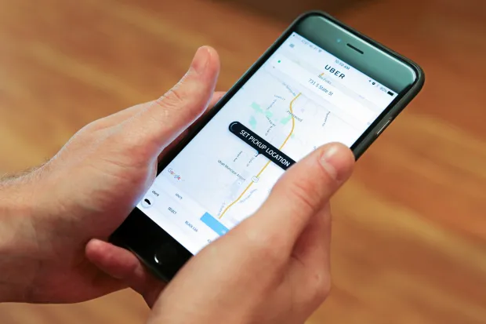


Rider
Driver
Location
Stream
Kafka
Server
EXAMPLE:
Database

Slide 6
CORE CONCEPTS OF KAFKA
Kafka cluster: A Kafka cluster is a group of interconnected Kafka brokers that work together to provide a scalable, fault-tolerant, and high-throughput data streaming and messaging platform. Kafka clusters are at the core of the Apache Kafka distributed architecture and are used to store, process, and transmit data in real-time.

Slide 7
Producers : In Apache Kafka, a sender is known as a producer who publishes messages
Consumers : Receiver is known as a consumer who consumes that message by subscribing it.
Topics : Kafka stores messages in a topic. Different topics are identified by their names and will store different kinds of events.
Partitions : Topics are split into partitions. For each topic, Kafka keeps a mini-mum of one partition. Each such partition contains messages in an immutable ordered sequence.

Slide 8
Offsets : Each partitioned message has a unique sequence id called as offset. The partitions are themselves numbered, starting at 0.
Replicas of partition : To protect against data loss if a broker fails. Replicas are nothing but backups of a partition. Replicas are never read or write data. They are used to prevent data loss.
Brokers : A single "server" running Kafka is called a broker. Brokers are simple system responsible for maintaining the published data. Each broker may have zero or more partitions per topic.
Zookeeper: Zookeeper is a separate Apache project. Currently, Kafka clusters are managed by Zookeeper. It is a service for managing and synchronizing distributed systems. Kafka uses Zookeeper to manage the brokers in a cluster. It kept track of the number of partitions and replicas.

Slide 9
Kafka Cluster
Kafka Ecosystem
Topic A
Broker 1
Topic B
Producer
Consumer
Topic A
Broker 2
Zookeeper

Slide 10
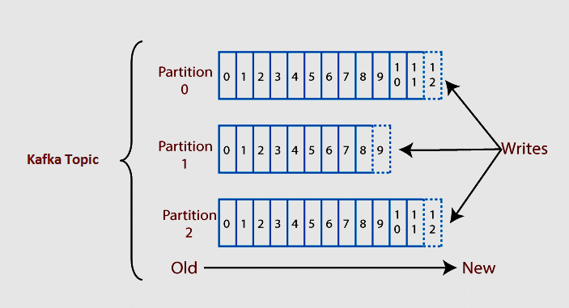
Offset

Slide 11
Let’s see Kafka in Console
Download Kafka from Official Website
Run the Zookeeper server
Run the Kafka Server
Create Kafka topic with the topic name
Create a producer connected to a specific topic
Create a consumer

Slide 12
References
https://kafka.apache.org/
https://www.javatpoint.com/apache-kafka
https://www.freecodecamp.org/news/apache-kafka-handbook
https://medium.com/@patelharshali136/apache-kafka-tutorial-kafka-for-beginners-a58140cef84f
https://www.tutorialspoint.com/apache_kafka/index.htm

