Slide 1


J.A.R.V.I.S
Just A Rather Very Intelligent System
AI-Based Desktop Virtual Assistant
BCA Semester-4 Web Development Application Using PHP Subject Final Examination | Academic Year 2025-26

Slide 2
Team Information
92400527161 – Miral Dhankecha
Internal Guide
Mr. Tejas Chauhan
Academic Year
2025 – 26

Slide 3
Problem Statement
Manual, repetitive computer operations reduce efficiency and productivity
Traditional systems need direct keyboard/mouse interaction for every task
Basic desktop assistants lack voice interaction, memory & real-time automation
No centralized platform for automation, weather updates, file handling & history

Slide 4
Proposed Solution: Overview
An intelligent, AI-based desktop virtual assistant built using PHP, Javascript, HTML, CSS3 and Python
Supports both voice-based and text-based command interaction
Integrates desktop automation, browser control, file management & weather reporting
Uses SQLite database for command history and personalized memory storage
Provides a single, centralized, interactive assistant platform for the user

Slide 5
Objectives
Voice Interaction – speech recognition based commands
Text Command Support – interaction using typing mode
Application Automation – open & close desktop apps
Browser Automation – search internet & play songs online
Weather Information – live weather updates via API
File Management – create, open & delete files/folders
Memory System – stores user-related information
Command History – saves past commands & responses
GUI Interface – interactive interface using CustomTkinter
Analytics System – usage statistics displayed via charts

Slide 6
System Requirements
Software: Python 3.x, SQLite, Visual Studio Code
Core Libraries: CustomTkinter, SpeechRecognition, pyttsx3
Supporting Libraries: Matplotlib, psutil, Geocoder
External Service: OpenWeather API for live weather data
Platform: Windows Desktop Application

Slide 7
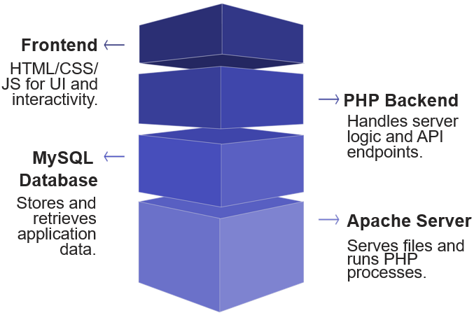
Technology Stack
HTML: Structure of webpages
CSS3: user interface design & styling
Javascript: Clint-side interactivity
PHP: Backend development & server logic
Apache Server: Web server environment
Laragon: Local development environment
GUI / Frontend: CustomTkinter (modern Python
GUI library)
Backend / Core Logic: Python
Database: SQLite (jarvis.db)
Voice: SpeechRecognition (input) & pyttsx3 (output)
Tools: VS Code, OpenWeather API, Matplotlib, psutil

Slide 8
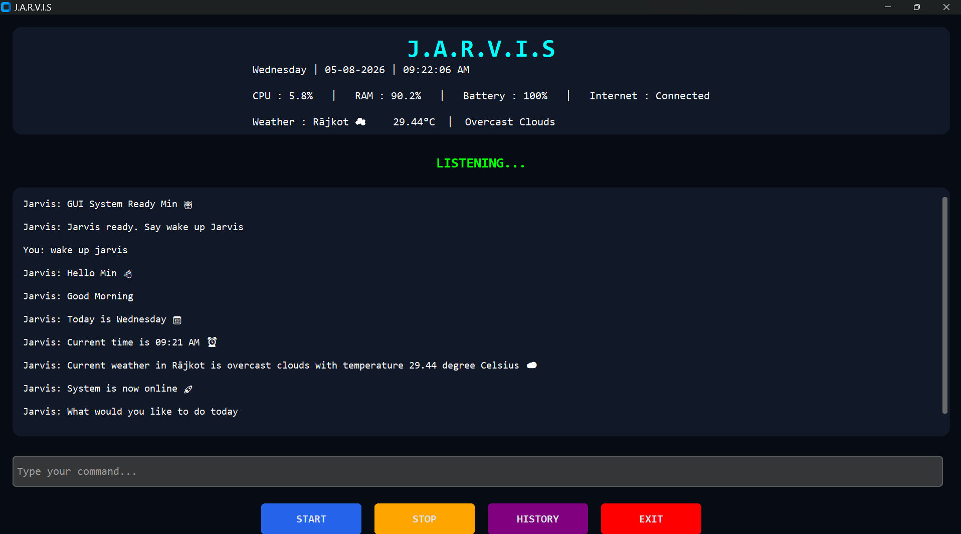
End User Interface
Chat-style conversation window for text & voice interaction
Command input box to type commands directly
Live system info bar: date, time, CPU, RAM, battery, internet, weather
Status indicators: LISTENING / PROCESSING / SYSTEM OFFLINE
Sample Screenshots :-
Screenshot

Slide 9
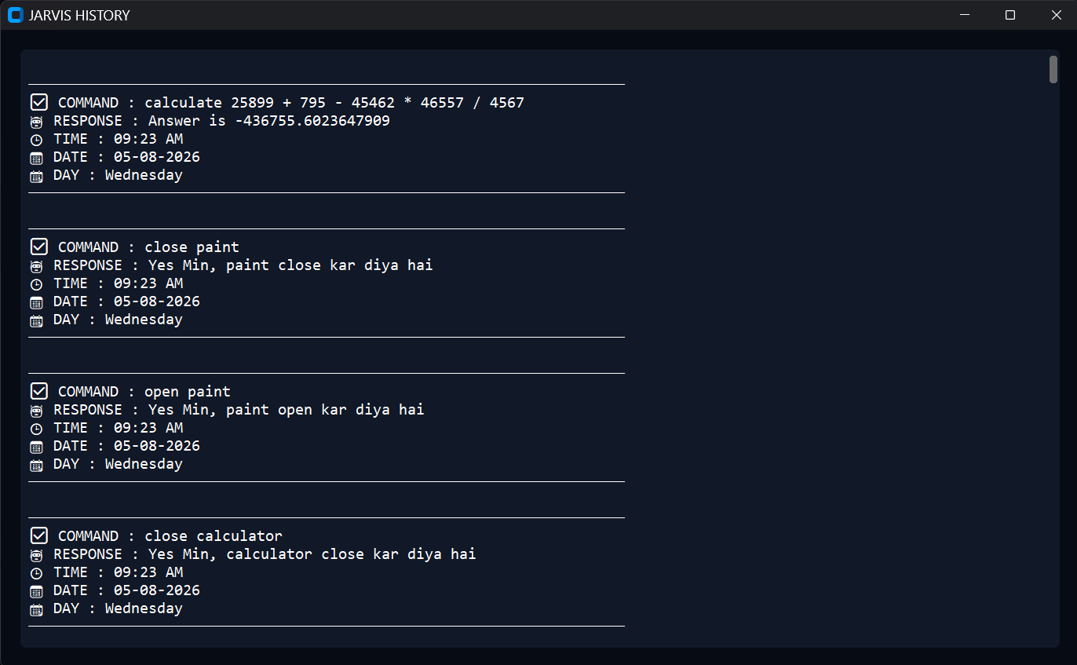
Command History & Analytics
History window lists past commands, responses, time, date & day
All records stored persistently in the SQLite database (jarvis.db)
Analytics module generates usage charts using Matplotlib
Charts: Successful vs Failed commands, Most-used commands
Screenshot

Slide 10
Database Design
Database: jarvis.db (SQLite)
command_history
memory
Field | Description
ID | Primary key, auto increment
COMMAND | Stores the user's command
RESPONSE | Stores the assistant's response
TIME / DATE / DAY | Timestamp of command execution
STATUS | Execution status (success / failed)
Field | Description
Key | Memory identifier (e.g. name, birthday)
Value | Stored user information
Lightweight, serverless relational database — ideal for desktop apps
Accessed via Python's built-in sqlite3 library

Slide 11
System Architecture
USER
GUI / VOICE INPUT
NLP ENGINE
COMMAND ROUTER
AUTOMATION
Apps, files,
system control
WEATHER
Live weather
information
MEMORY
User info &
preferences
DATABASE
Command history
& user data
OUTPUT / RESPONSE (Text / Voice / GUI)

Slide 12
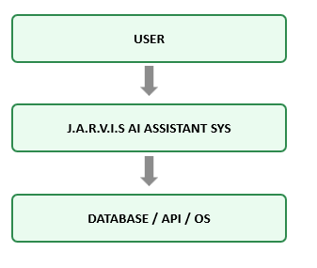
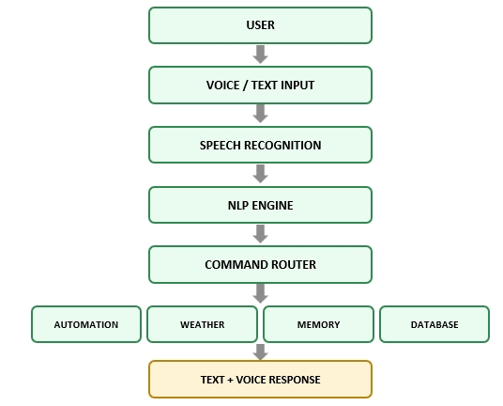
Data Flow Diagram (DFD)
Level 0 : DFD Structure
Level 1 : DFD Structure
USER
USER
VOICE / TEXT INPUT
J.A.R.V.I.S AI ASSISTANT SYS
SPEECH RECOGNITION
DATABASE / API / OS
NLP ENGINE
COMMAND ROUTER
AUTOMATION
WEATHER
MEMORY
DATABASE
TEXT + VOICE RESPONSE

Slide 13
Modules & Features
GUI Module – graphical interface & user interaction
Voice Processing Module – speech recognition & voice output
NLP Module – processes & understands user commands
Command Router Module – redirects commands to modules
Automation Module – controls apps, browser & files
Weather Module – live weather via OpenWeather API
Database Module – stores command history (SQLite)
Memory & Analytics Modules – user data and usage charts

Slide 14
Challenges & Learning
Implementing voice recognition & text-to-speech (SpeechRecognition, pyttsx3)
Understanding NLP concepts for processing user commands
Building a responsive GUI with CustomTkinter and real-time updates
Using multithreading to run voice listening & monitoring in background
Managing a SQLite database for history and memory storage
Integrating an external API (OpenWeather) for live data

Slide 15
References
Python Software Foundation – Python Documentation
CustomTkinter Documentation
SpeechRecognition & pyttsx3 Library Documentation
SQLite Documentation
OpenWeather API Documentation
Matplotlib & psutil Documentation

Slide 16

Thank You
Thank you for your valuable time and kind attention.
Miral Dhankecha
Department of Computer Applications, Marwadi University

