Slide 1


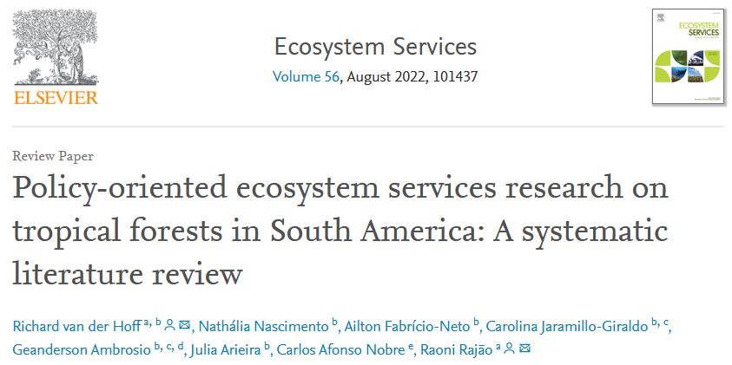

Slide 2
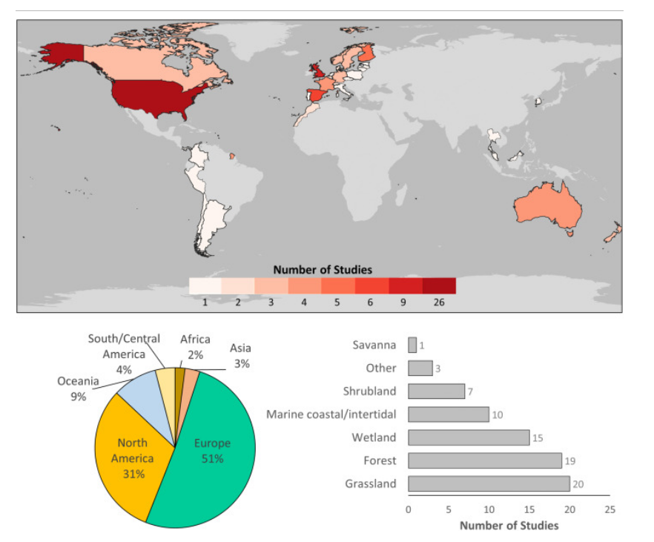

Slide 3
22/09/2022
N=301
Identification | # Query | ( TITLE-ABS-KEY ( logging AND "tropical forest*" ) OR TITLE-ABS-KEY ( "selective logging" AND "tropical forest*" ) OR TITLE-ABS-KEY ( "logging effects" AND "tropical forest*" ) OR TITLE-ABS-KEY ( "timber exploitation" AND "tropical forest*" ) ) AND PUBYEAR > 1969 | 1530
Screening & Eligibility | Approach | Unrelated to selective logging | -143
 |  | Publications that involve a general debate
 |  | Publications that do not present original research (e.g. comments, letters, editorials)
 |  | Gray literature
Included |  | Full scoping | 104 (+54?)

Slide 4
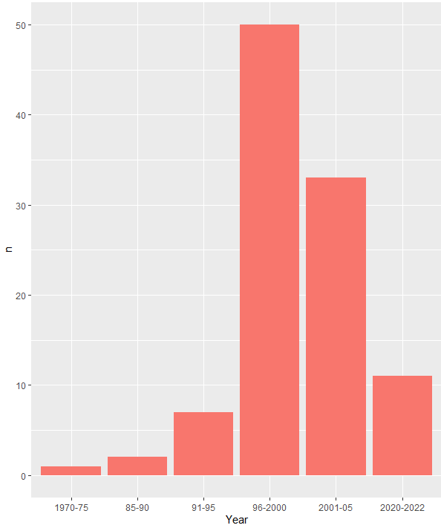
Hipotese – extracao seletiva eh fenomeno “recente” e esta em expansao recente, porem ciencia (geracao de conhecimento) em declinio
> Lacunas de conhecimento local (neotropico e africa), grupos taxonomicos e efeitos (recursos hidricos);
> common sense RIL eh sustentavel;
> […];

Slide 5
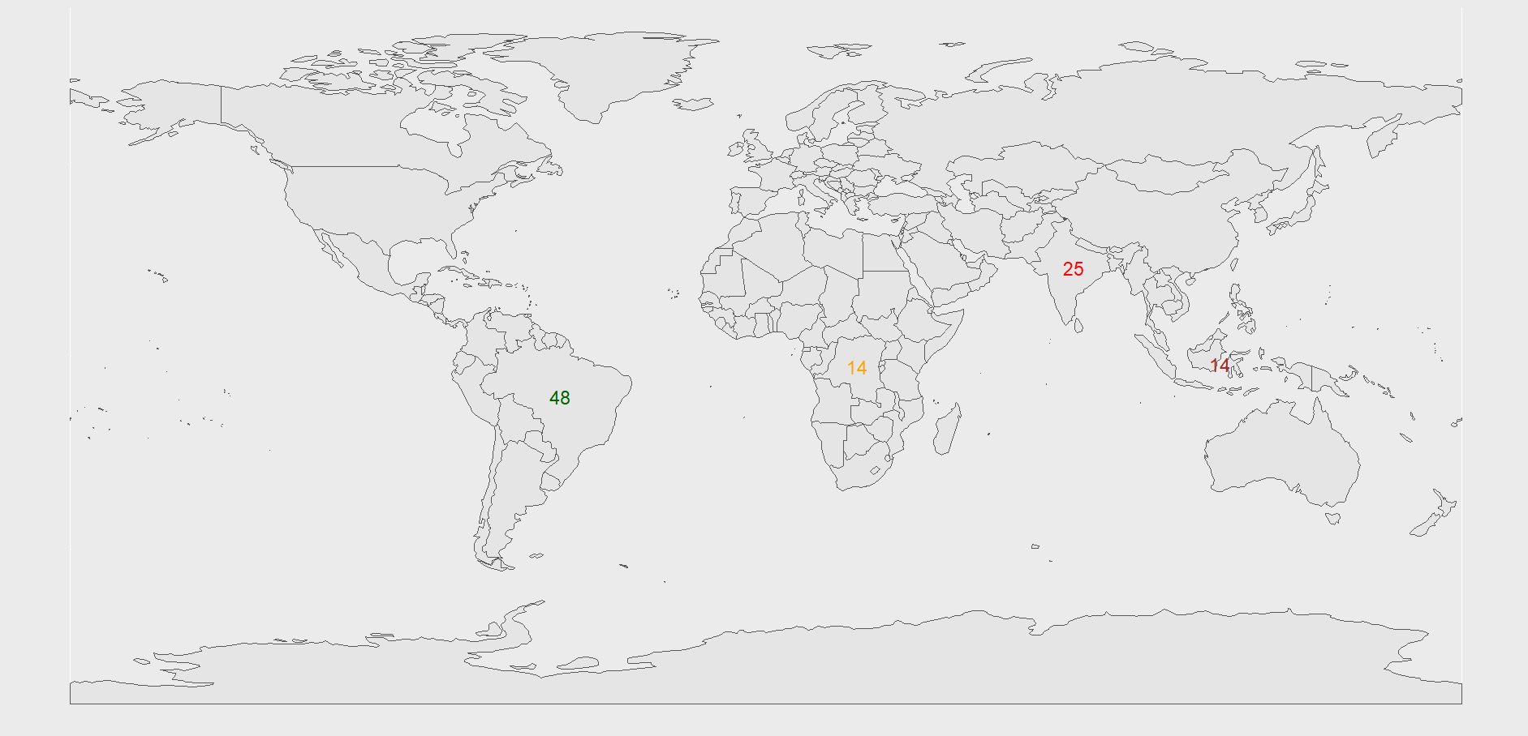

Slide 6
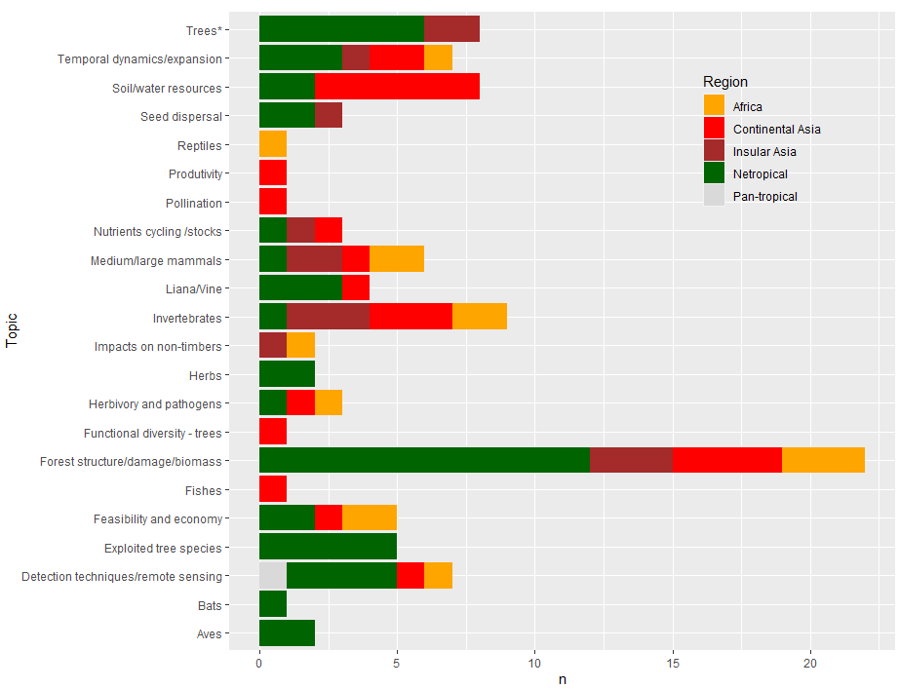

Slide 7
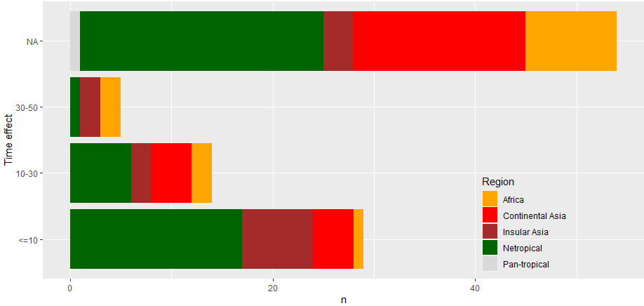

Slide 9
09/06/2022
N=175
Identification | # Query | ( TITLE-ABS-KEY ( logging AND "tropical forest*" ) OR TITLE-ABS-KEY ( "selective logging" AND "tropical forest*" ) OR TITLE-ABS-KEY ( "logging effects" AND "tropical forest*" ) OR TITLE-ABS-KEY ( "timber exploitation" AND "tropical forest*" ) ) AND PUBYEAR > 1969 | 1530
Screening & Eligibility | Approach | Unrelated to selective logging | -108
 |  | Publications that involve a general debate
 |  | Publications that do not present original research (e.g. comments, letters, editorials)
 |  | Gray literature
Included |  | Full scoping | 44 (+23?)

