Slide 1
Identification | # Query | ( TITLE-ABS-KEY ( logging AND "tropical forest*" ) OR TITLE-ABS-KEY ( "selective logging" AND "tropical forest*" ) OR TITLE-ABS-KEY ( "logging effects" AND "tropical forest*" ) OR TITLE-ABS-KEY ( "timber exploitation" AND "tropical forest*" ) ) AND PUBYEAR > 1969 | 1499
Screening & Eligibility | Approach | Unrelated to selective logging | -823
 |  | Publications that involve a general debate
 |  | Publications that do not present original research (e.g. comments, letters, editorials)
 |  | Gray literature
Included |  | Full scoping | 676

Slide 2
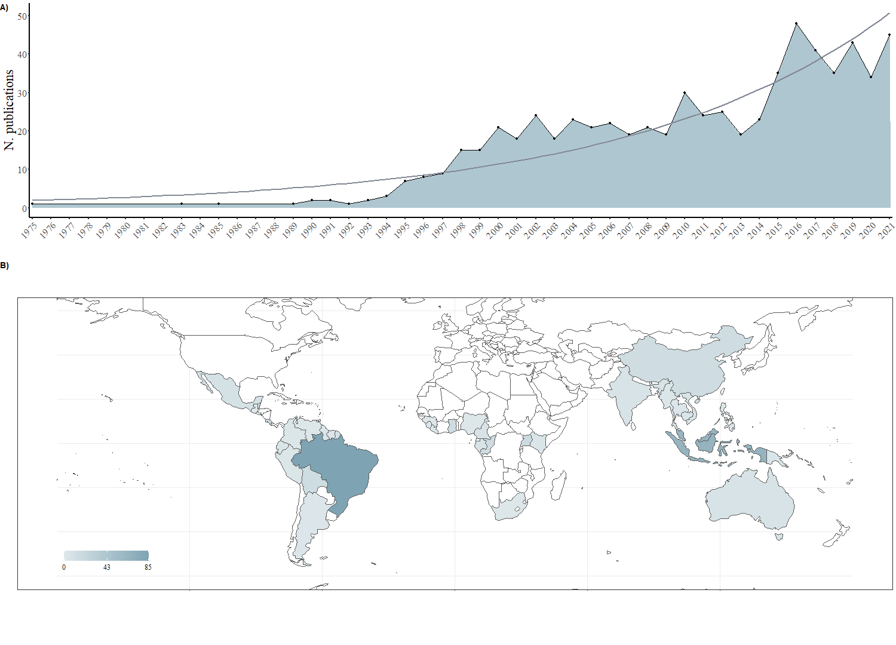

Slide 3
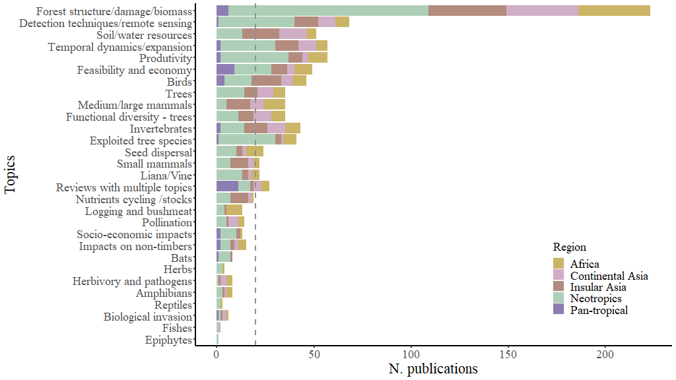

Slide 4
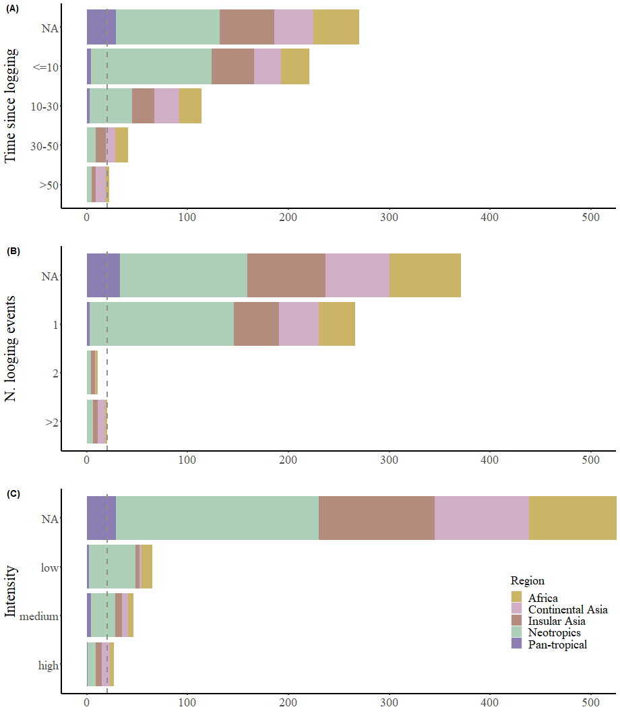

Slide 5
