Slide 1
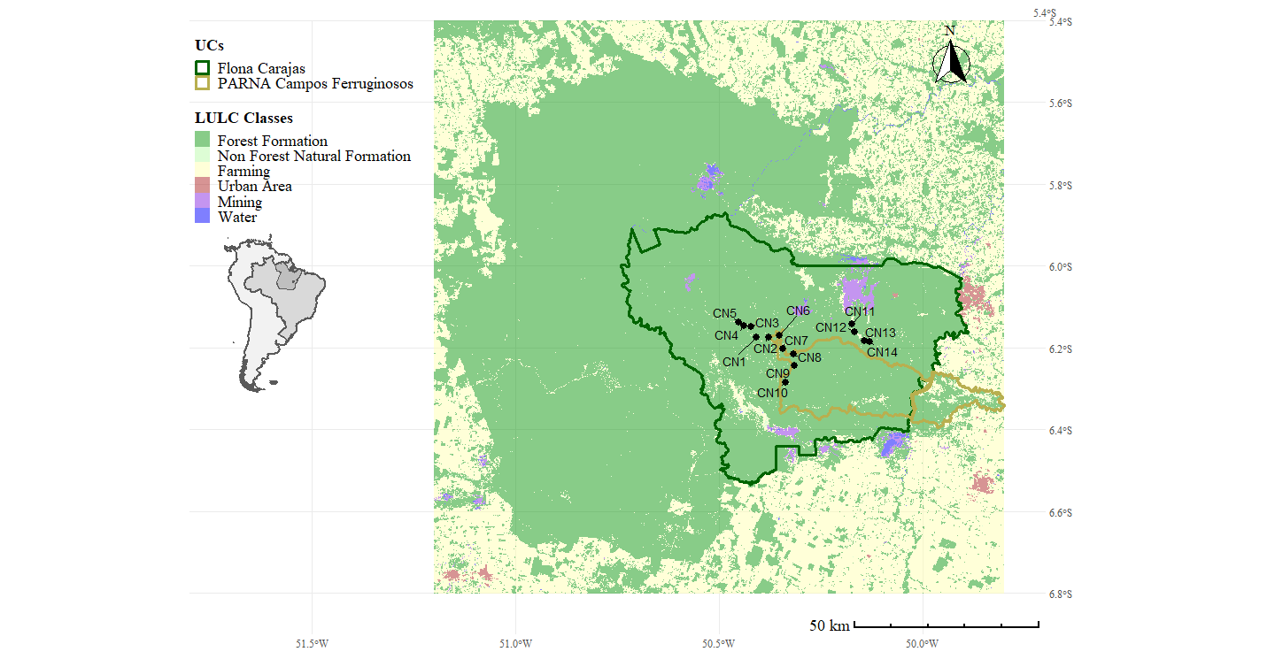
Study area

Slide 2
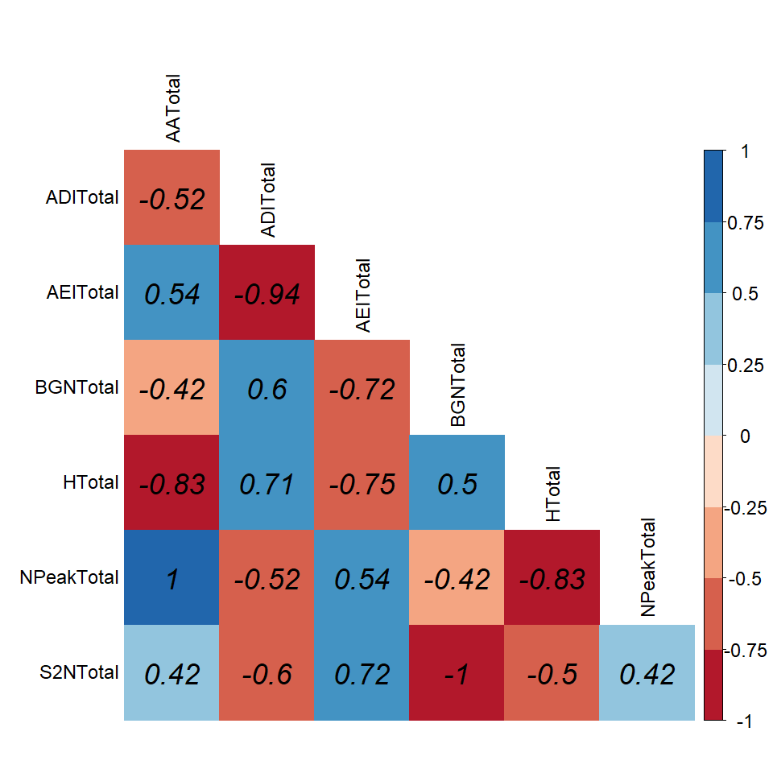
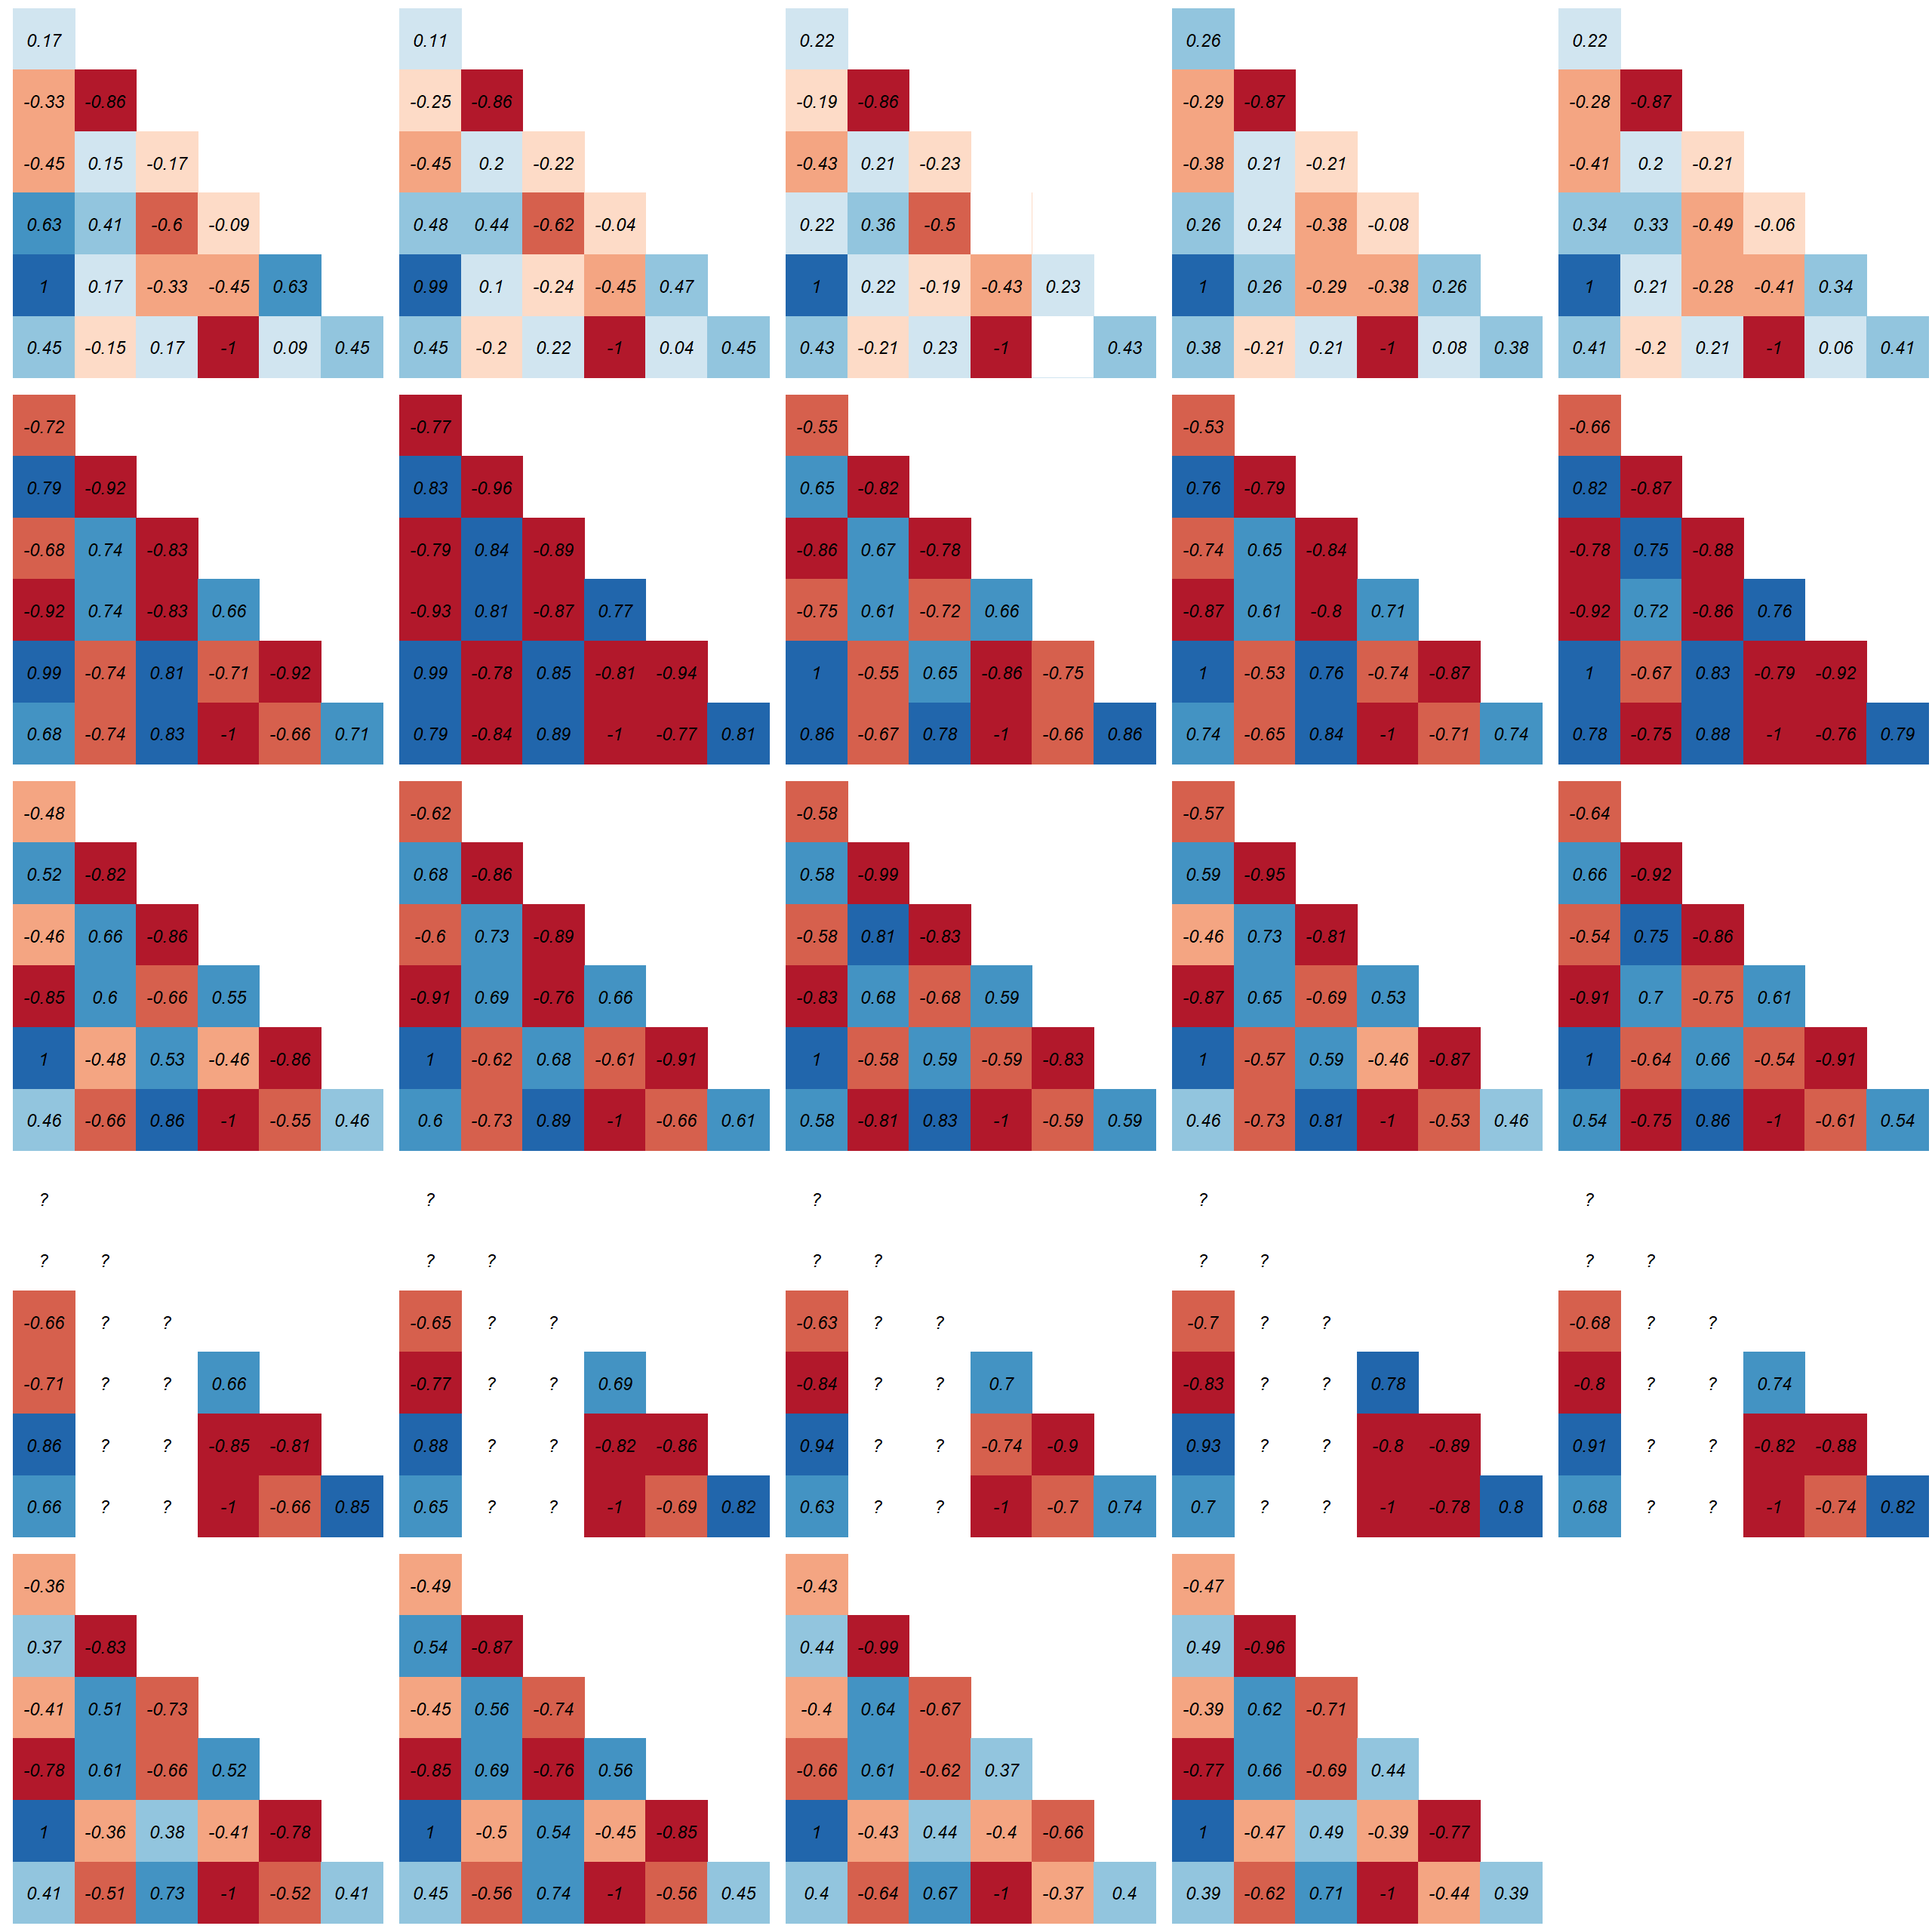
Are there correlations between indexes?
dawn
dawn
day
dusk
night
total
0.3-4
4-12
0.3-12
12-22.1
total

Slide 3
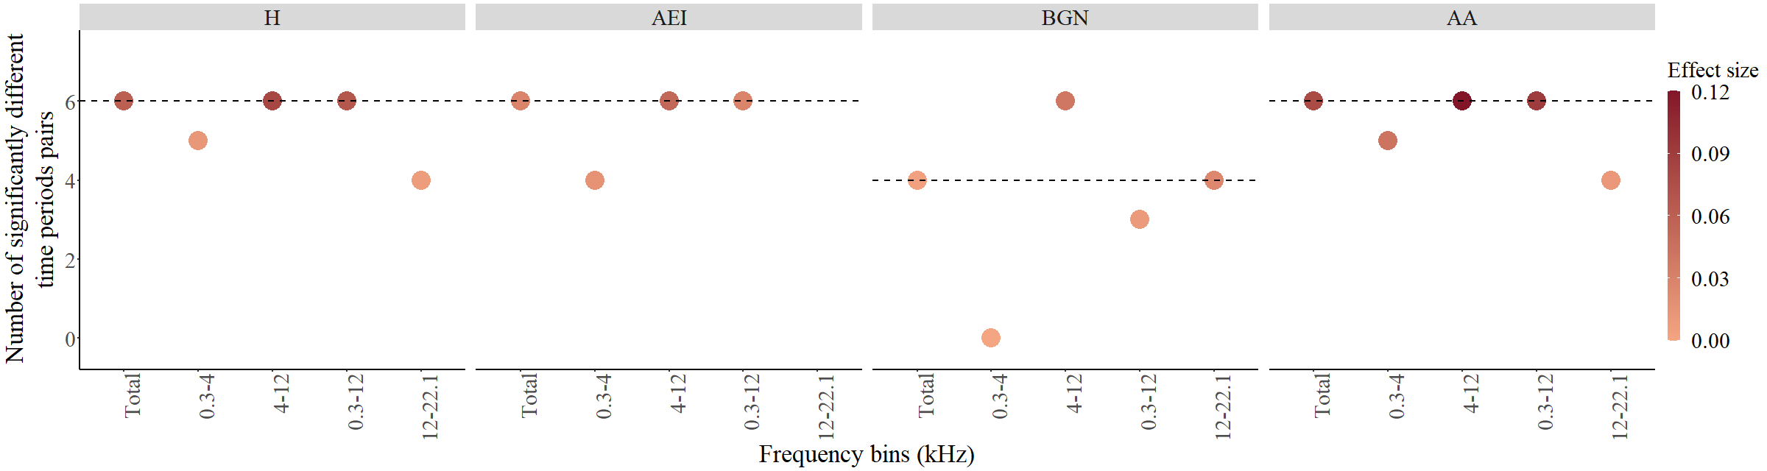
Are there differences between time of day?
Total

Slide 4
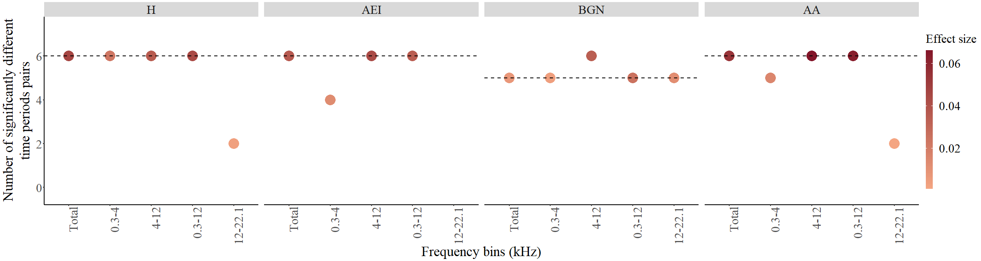
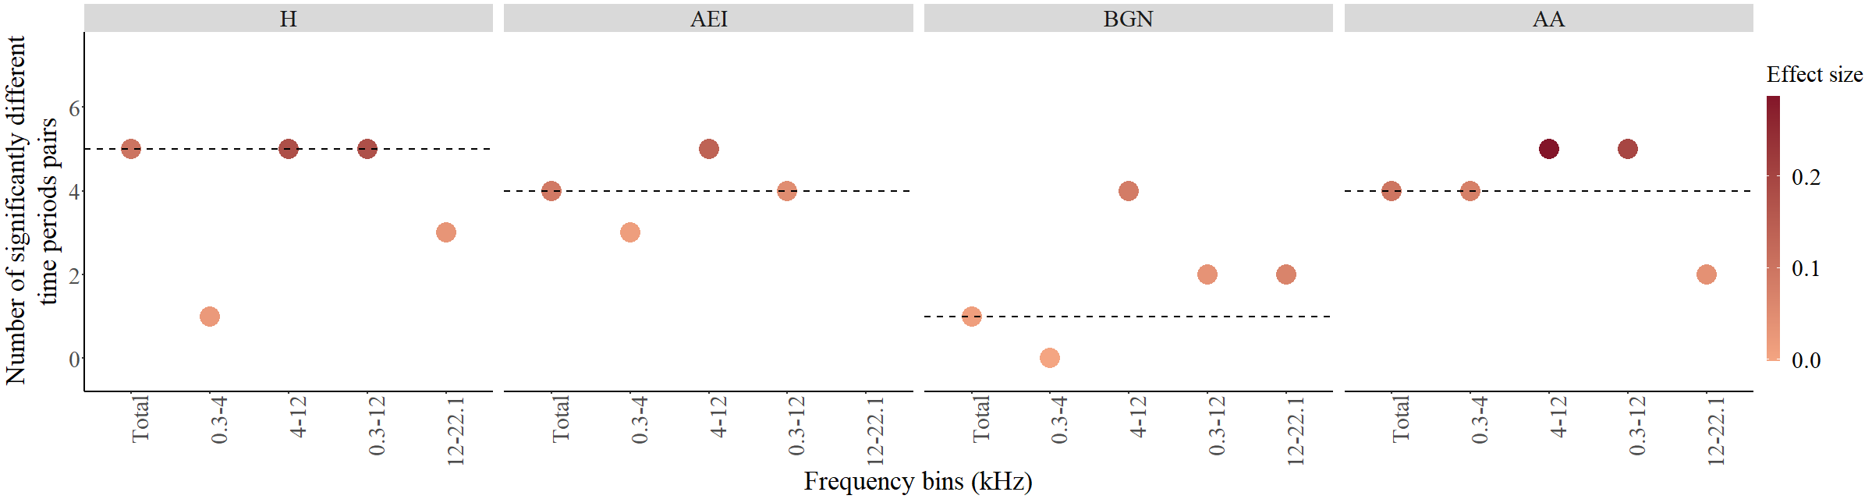
Are there differences between time of day?
2019
2022

Slide 5
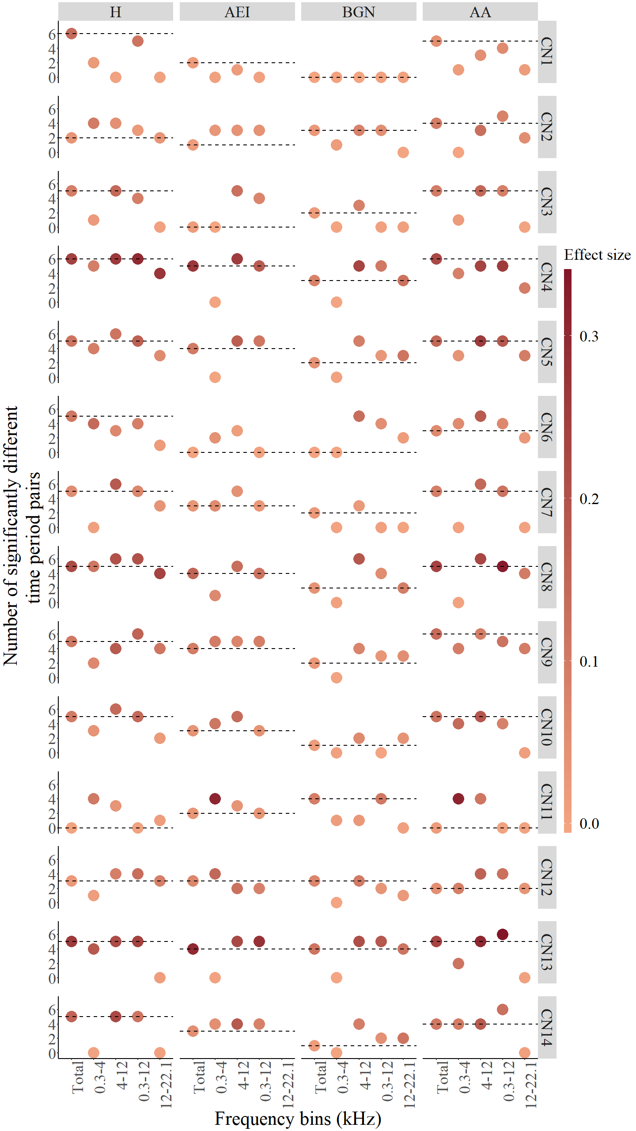
Are there differences between time of day?
Local

Slide 6
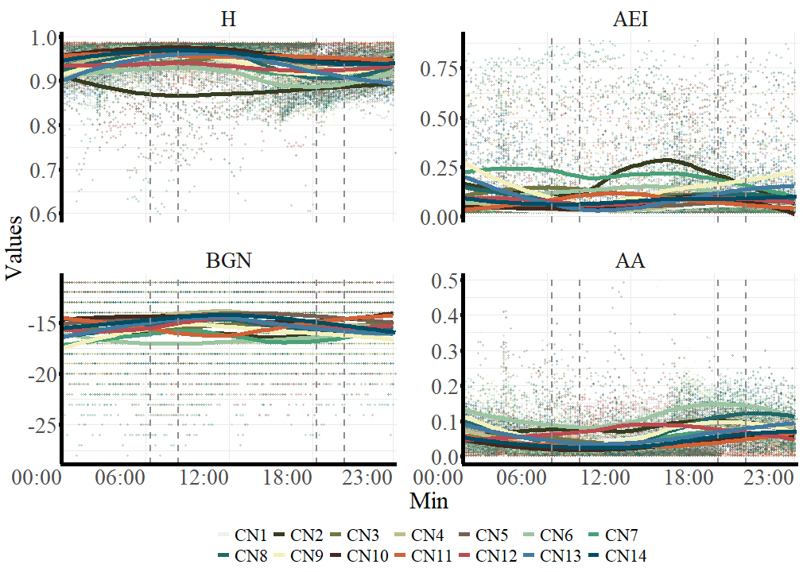

Slide 7
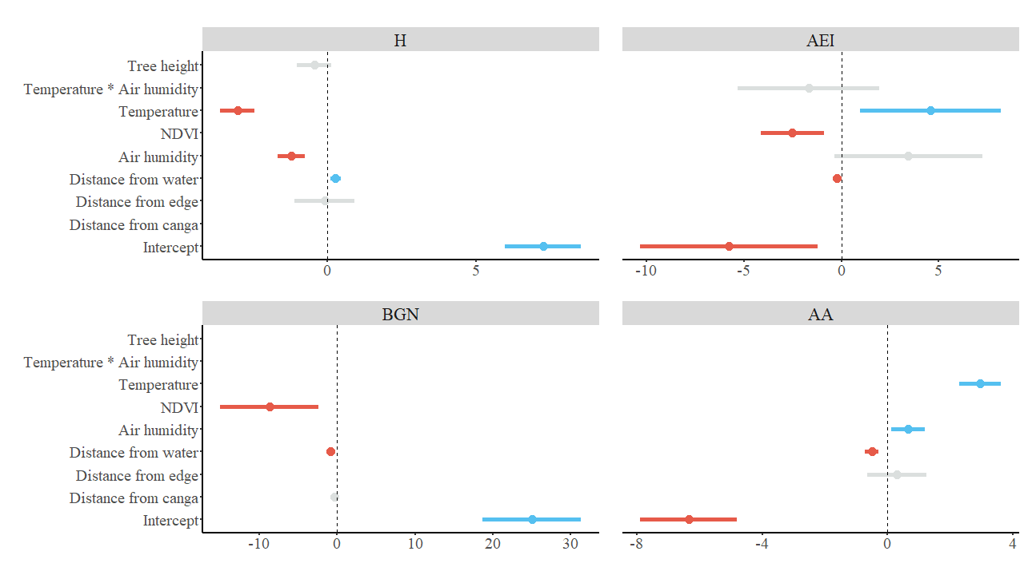
Which environmental trait has effects on soundscape? (regional)

Slide 8
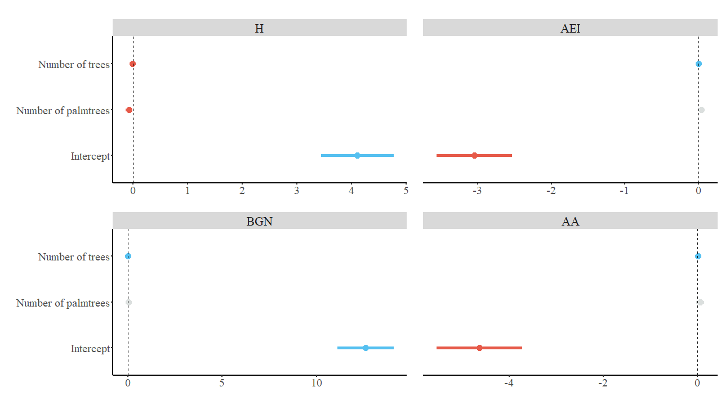
Which environmental trait has effects on soundscape? (local)

