Slide 1
Comparison of 3 different 2-step fit algorithms (+1 Bayesian)
2/2/2025
Code is available at:
https://github.com/miramliu/IVIM_Fitting_Methods

Slide 2
Summary of the algorithms tested
ALGORITHM 1
- Mira original code
- Fits f0 and D0 to b>250.
If poor goodness of fit, fits mono-exponential again using the first fit output f0 and D0 as starting points
- subtracts f0 and D mono-exponential from the total signal, and then fits f and D* to the remainder, at only b<200.
ALGORITHM 2
- Salman - old code
- fits D first, then holds D as a constant to fit to f and D* (in log space) the entire bi-exponential at all bvalues.
ALGORITHM 3
- Salman-Mira hybrid code
- get f0 and D from the high b-values, then fit for f and D* with given f0 and D, at all bvalues.
ALGORITHM 4
- Bayesian fit
- minimum mean square error estimator as the mean of the posterior distribution (see code for distributions)

Slide 3
Methods and Materials: Simulated Signal
Created 2000 voxels with simulated IVIM acquisition of 3 b-value directions and bvalues = [0, 50, 100, 150, 200, 250, 300, 500, 700, 900].
Generated data with f, D, D* from expected distributions (f: 0.09±0.04, D*=0.07±0.009, D = 0.001±0.0075).
Fractional anisotropy was 0.09±0.04 for perfusion and 0.18±0.1 for tissue diffusion.
Anisotropic ellipsoids were created from this data, rotated randomly in 3d space, and measured along the global axes to generated the measured D and D*.
Gamma was chosen for anomalous diffusion with gamma = 1.75±0.2 for ballistic perfusion and gamma = 0.85±0.05 for tissue diffusion.
With the values above, the data points were generated, and Rician noise was added with SNR=100, 50, and 30.

Slide 4
Materials and Methods: fits
Fit algorithms were run using matlab.engine to call on matlab files within python.
All algorithms were given the simulated data and returned:
D, Dstar, f, Sum-squared-error, rsquared, adjusted rsquared, fD*, and (1-f)D.
The output f, D, D*, fD*, and (1-f)D were compared to the true input by
Linear regression correlation
Median absolute percent difference (median(abs(input-output)/(input+output)/2)
Bland-Altman mean difference±95%CI
No voxels were excluded (e.g. no rsquared threhsolds or removal of non-physiologic values like D > 10)

Slide 5
Note:
Because this simulation is based off of a multi-component simulation, to keep the same code D = ‘slow diffusion’, D* = ‘fast diffusion, f = ‘fast fraction’, and (1-f) = ‘slow fraction’
f and 1-f are obviously inverses of one another…

Slide 6
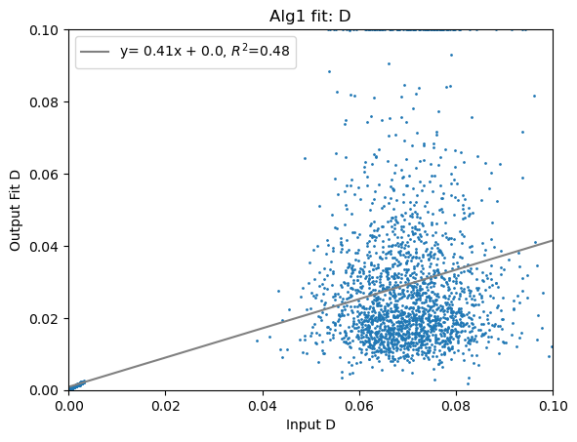
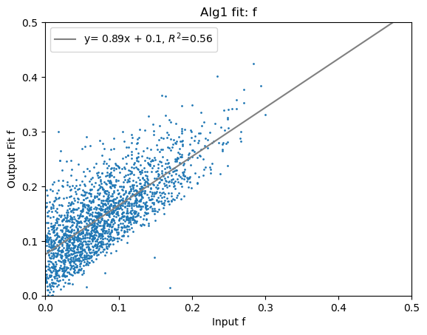
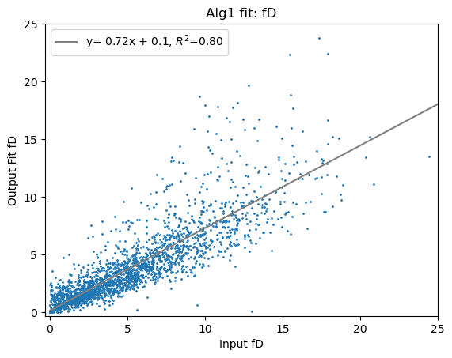
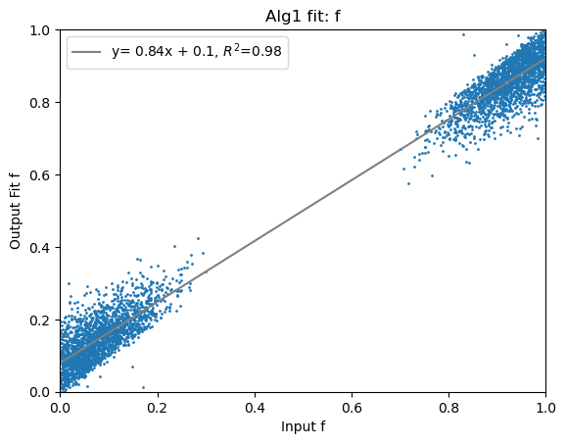
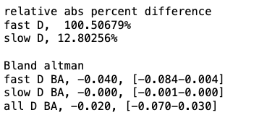
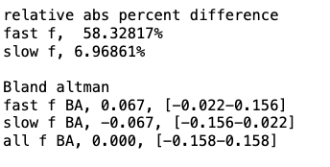
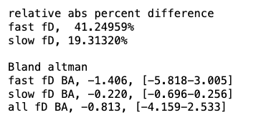
Algorithm 1: (without thresholding by r2)

Slide 7
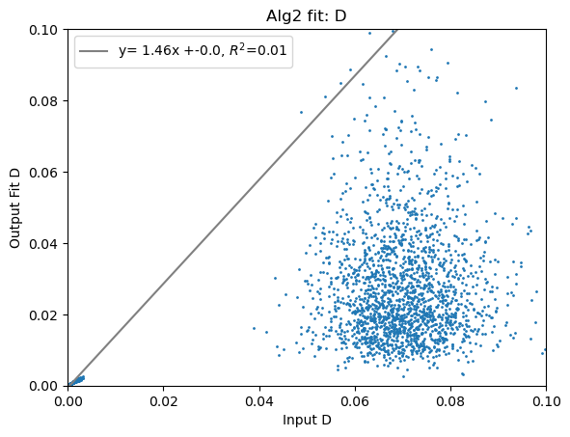
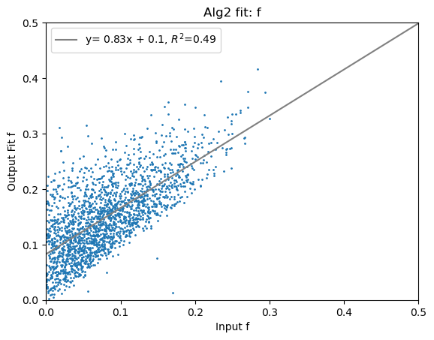
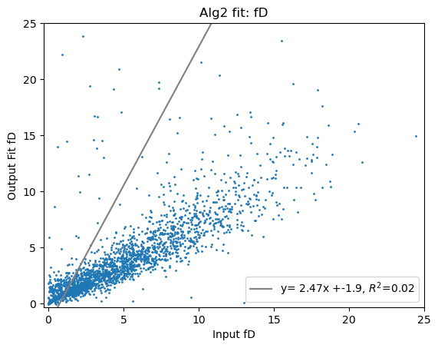
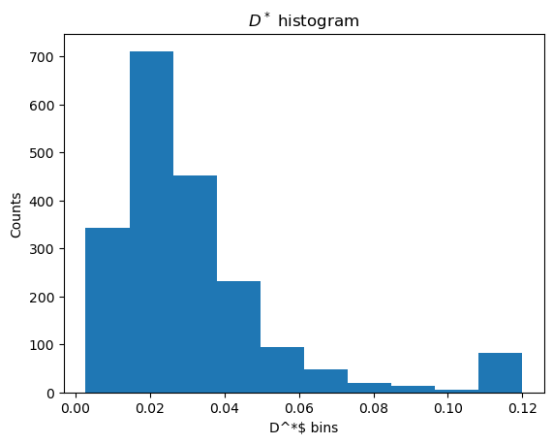
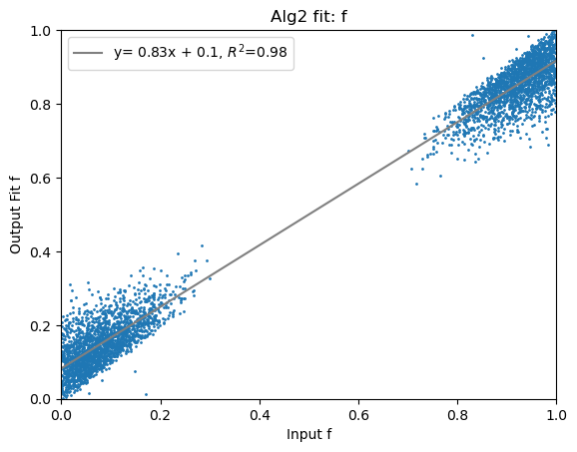
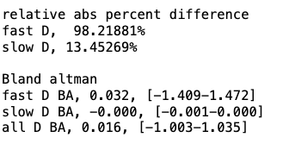
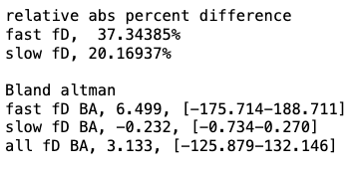
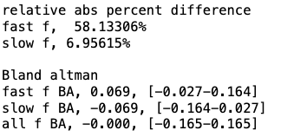
Algorithm 2:

Slide 8
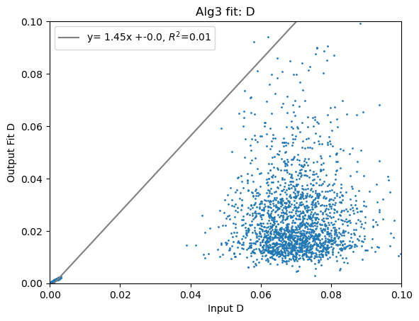
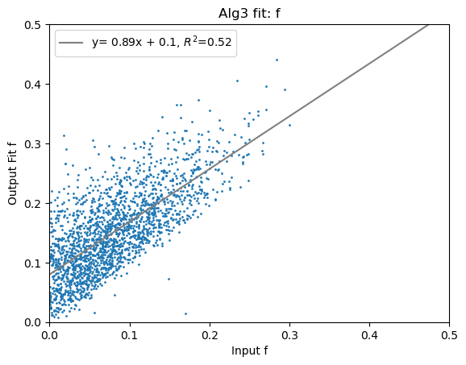
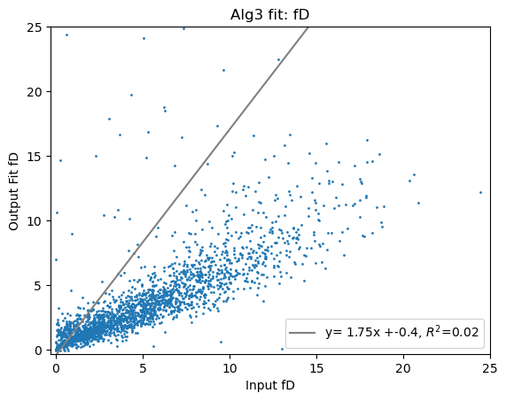
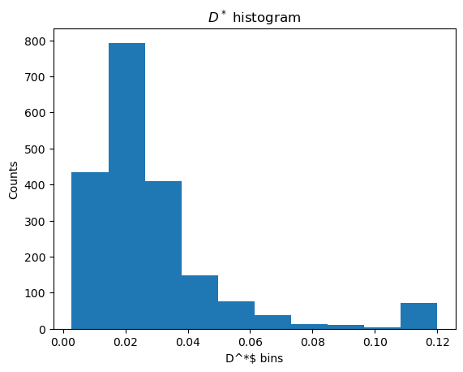

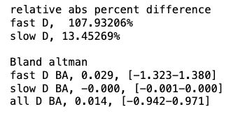
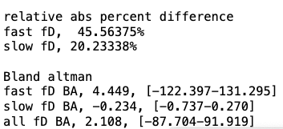
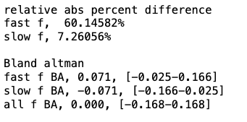
Algorithm 3

Slide 9
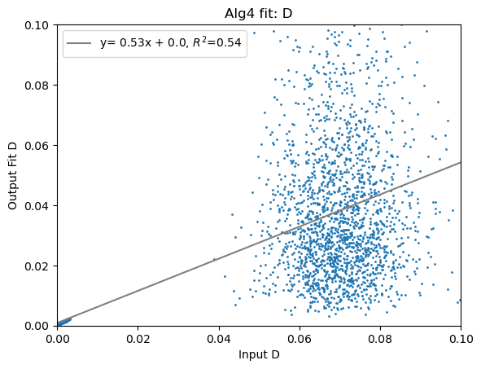
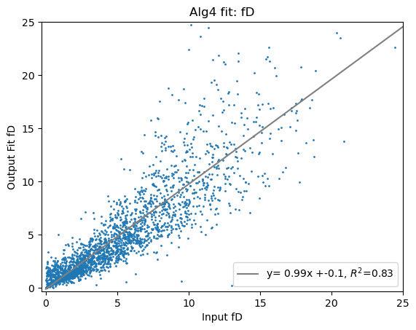
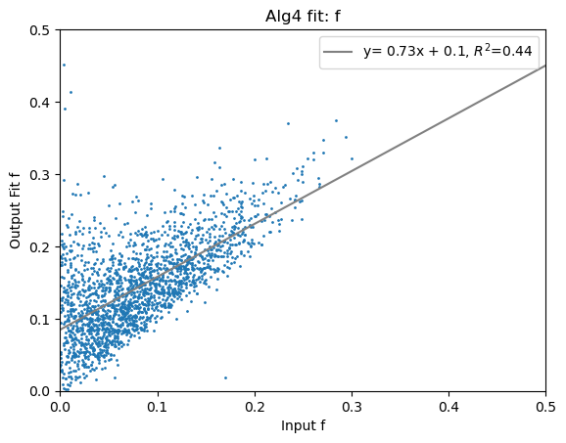
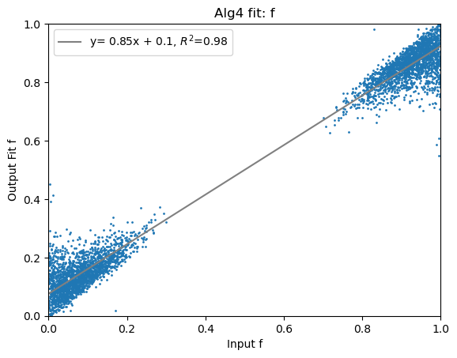
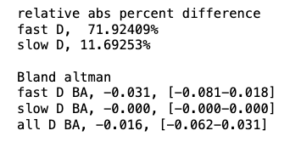
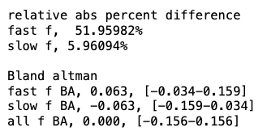
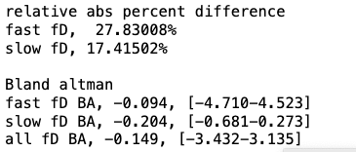
Algorithm 4

Slide 10
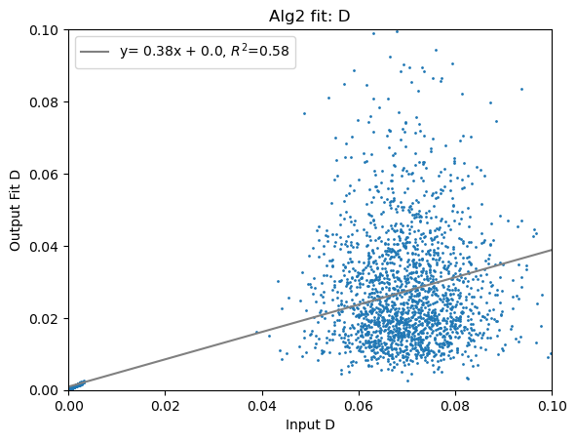
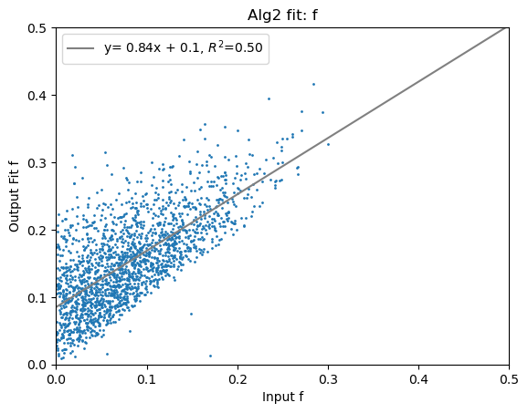
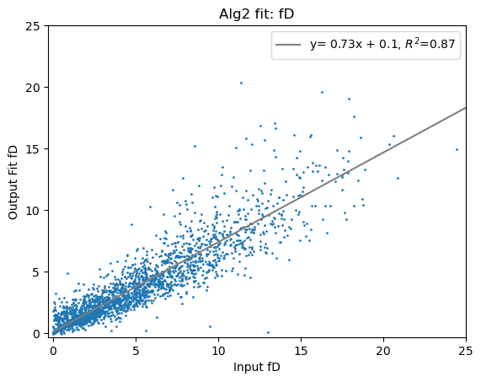

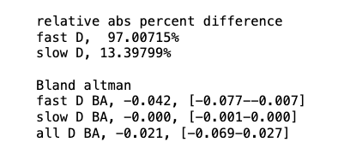
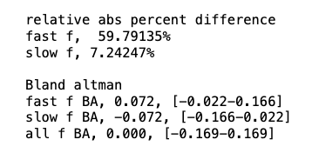
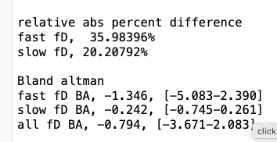
Algorithm 2 (with thresholding by D* <= 0.1)
With 85 (4.3%) voxels removed for having D*>0.10, correlation is strongly improved

Slide 11




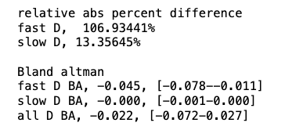
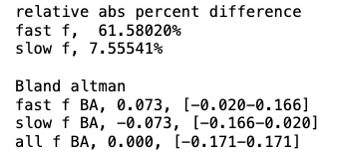
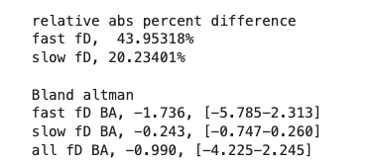
Algorithm 3 (with thresholding by D*<0.1)
With 75 (3.8%) voxels removed for having D*>0.10, correlation is strongly improved

Slide 12
Conclusions
Due to the anomalous diffusion effects, D is overestimated and D* is underestimated by all algorithms.
Correlation of fD is strong for all two-step algorithms (minimal difference in correlation or error)
Algorithm 2 with D* thresholding is highest (slope=0.73, R2=0.87)
Algorithm 1 is the highest without any thresholding (slope = 0.72, R2 = 0.80)
Percent error of fD* is lower for Algorithm 2 (35%) than algorithm 1 (41%)
Correlation of f alone is strongest for Algorithm 1 (slope = 0.89, R2 = 0.56).
Algorithm 2 is similar though (slope=0.89, R2=0.50)
Across all algorithms, correlation of fD is stronger than either f or D itself, likely because of correlative error in fits.
Correlation of fD with Algorithm 4 (Bayesian) returned slope closest to 1 (slope=0.98, R2=0.83)
Algorithm 4 returned the bland-altman mean difference closest to zero, but there is error bias.
Algorithm 2 returned some false fits with D* >> 0.10 despite no input being so, leading to poor correlation despite small error overall. A D* range limit in the fit may improve the fits, or voxels with high D* can be excluded from analysis and dismissed as not perfusion (fit error, noise, or CSF in the case of a real experiment
Overall conclusion: Would suggest using Algorithm 2 with D*>0.10 excluded if removal of ~4% of voxels is acceptable. If all voxels will be used, Algorithm 1 would be best.

