Slide 1
Comparison of 5 different IVIM fits
2/24/25

Slide 2
Results
Algorithm 1 and Algorithm 4 had the lower percent error for fD, both for fD* and (1-f)D
Algorithm 1 did max out the D* at the limit, with a forced D*=0.10 (it’s seen as 100 in the excel sheets as I multiply everything by 1000)
Algorithm4 may actually be best? (Salman, maybe try running the canine data with the Bayesian? I wonder how it looks)
- it had a low fD* error, and the best correlation R2=0.81, without needing any thresholding…
But there are some issues with biases.
Algorithm 2, 3, and 5 showed higher percent difference, even when thresholded by removing all D*<0.1
Algorithm 2 and 3 had 30% of the voxels with a non-physical value of D*>0.10
- this may be due to the lower SNR of this run (the prior one, which saw similarly high D* values but in <10% of simulated voxels, had an SNR=100 compared to this run with SNR=50)
Their correlations were better though, by eye, seeing less spread than Algorithm 1… But at the cost of 30% of them being unusable

Slide 3
Summary of algorithms tested
ALGORITHM 1
- Mira original code
- Fits f0 and D0 to b>250.
If poor goodness of fit, fits mono-exponential again using the first fit output f0 and D0 as starting points
- subtracts f0 and D mono-exponential from the total signal, and then fits f and D* to the remainder, at only b<200. Forces D* to be <=0.10
ALGORITHM 2
- Salman - old code
- fits D first, then holds D as a constant to fit to f and D* (in log space) the entire bi-exponential at all bvalues.
ALGORITHM 3
- Salman-Mira hybrid code
- get f0 and D from the high b-values, then fit for f and D* with given f0 and D, at all bvalues.
ALGORITHM 4
- Bayesian fit
- minimum mean square error estimator as the mean of the posterior distribution (see code for distributions)
ALGORITHM 4
- fit D and f in log space, then fit D* from all of the b-values

Slide 4
Methods & Materials
Created 3000 voxels with simulated IVIM acquisition of 3 b-value directions and bvalues = [0, 50, 100, 150, 200, 250, 300, 500, 700, 900].
With the values above, the data points were generated, and Rician noise was added with SNR=50, and 30.
Results presented here are of SNR=50
Anisotropy & non-Gaussian diffusion not included in this work

Slide 5
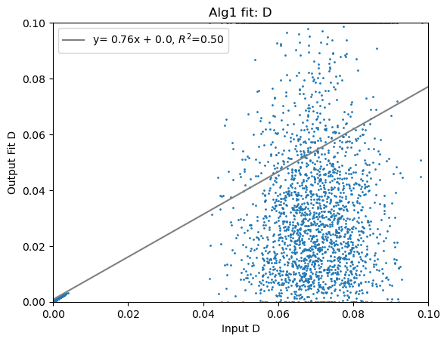
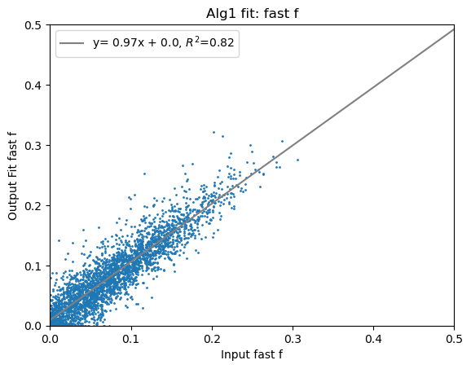
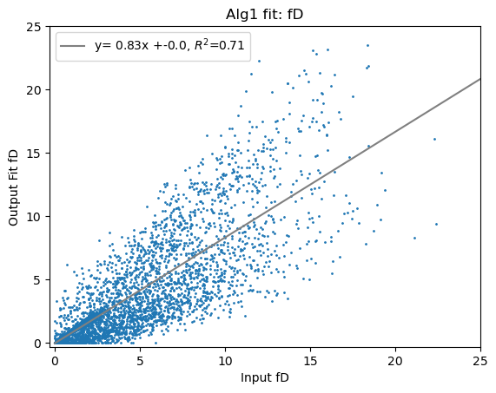
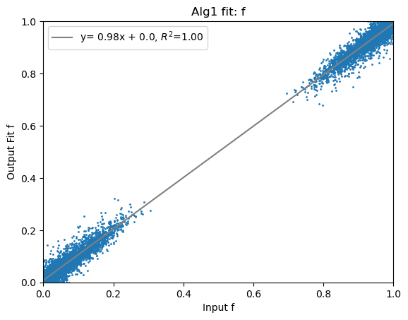
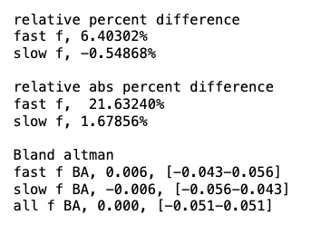
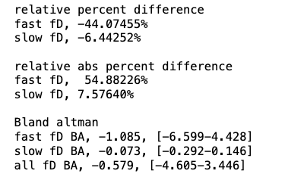
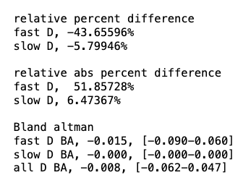
Algorithm 1

Slide 6
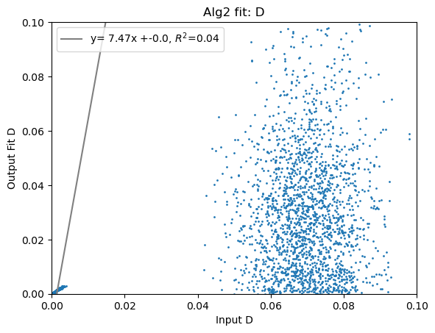
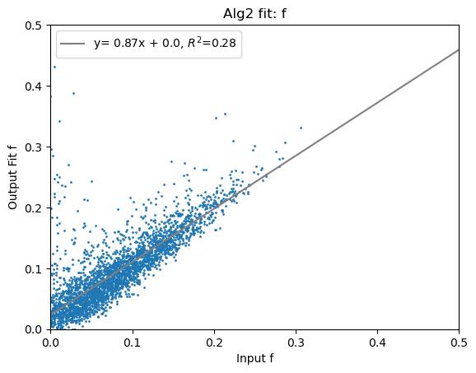
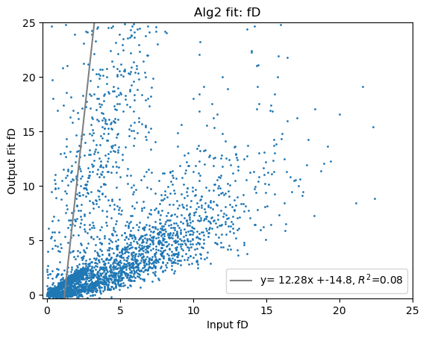
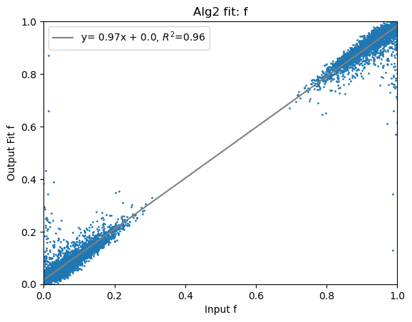
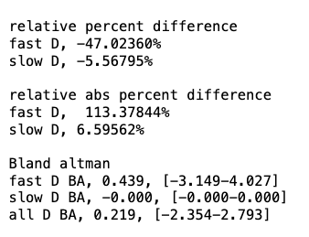
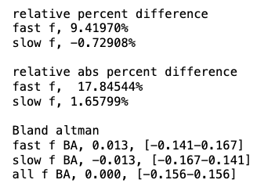
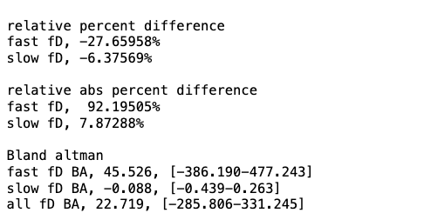
Algorithm 2

Slide 7
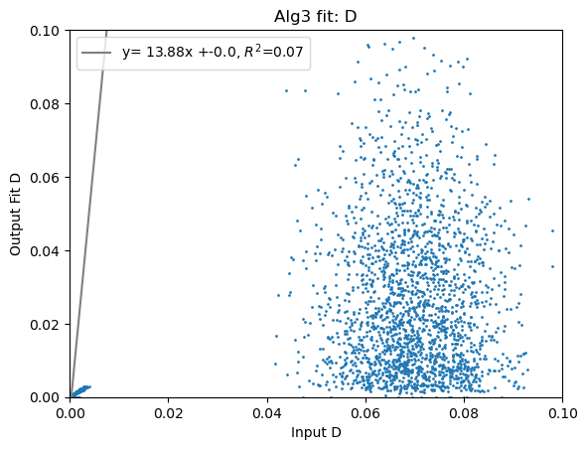

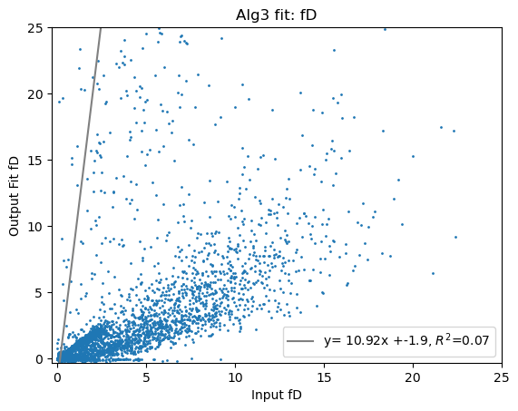

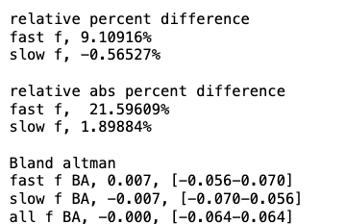
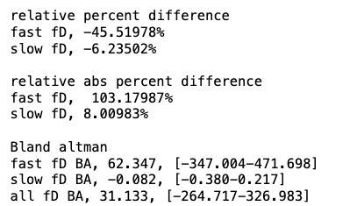
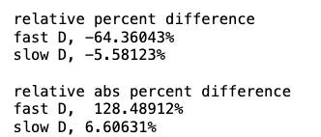
Algorithm3

Slide 8
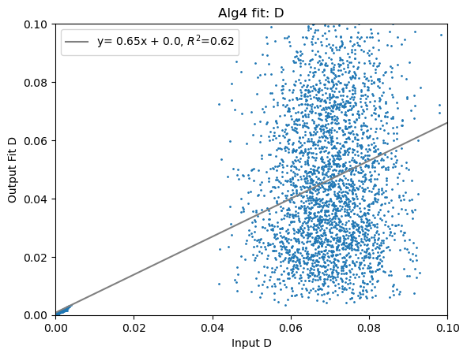
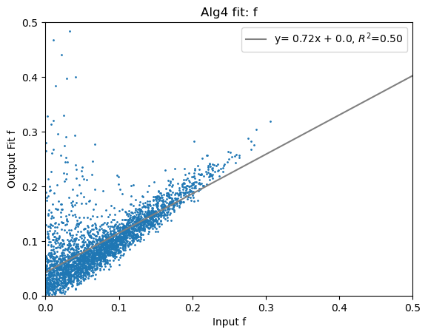
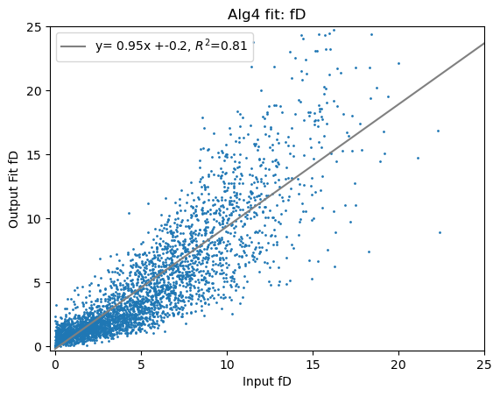
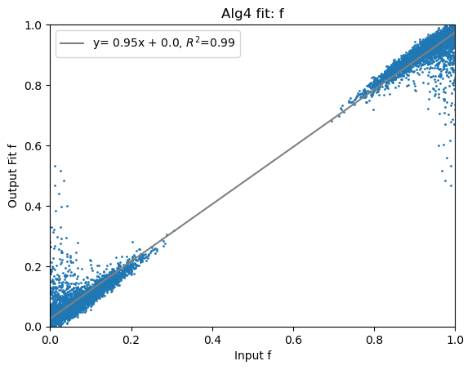
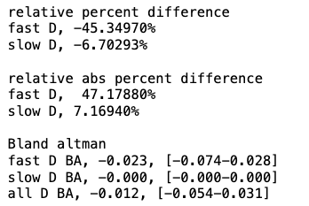
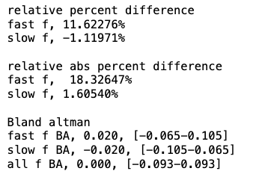
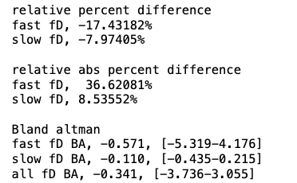
Algorithm4

Slide 9
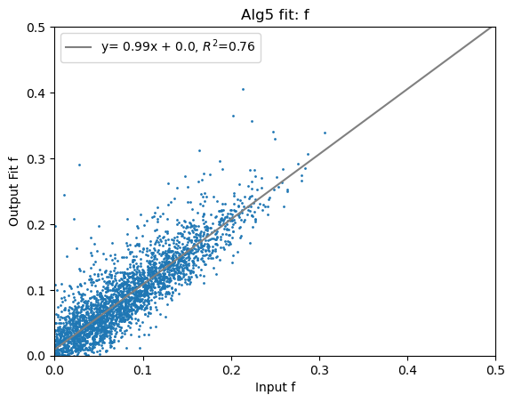
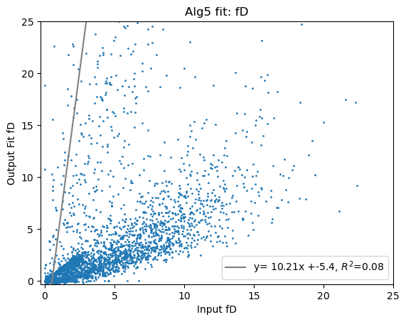
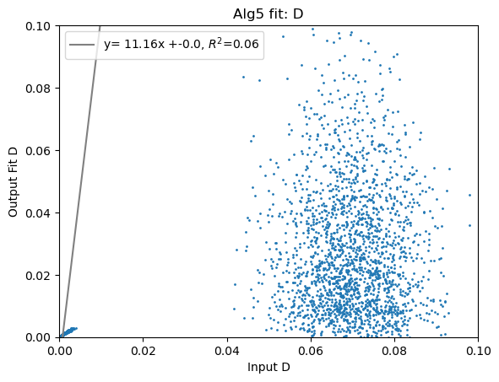

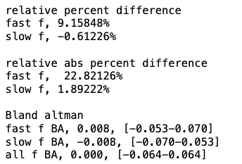
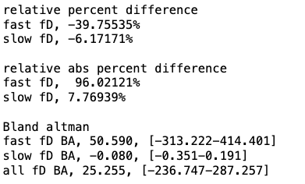
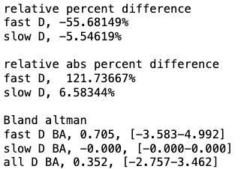
Algorithm5

Slide 10
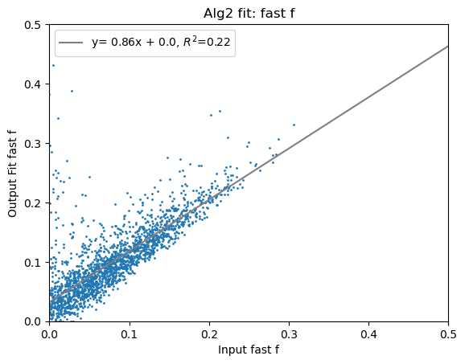
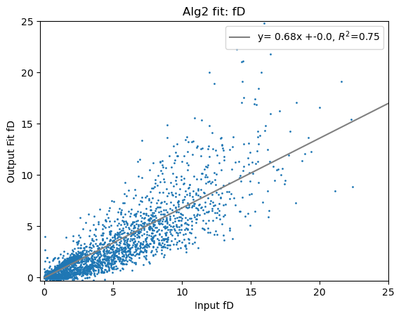
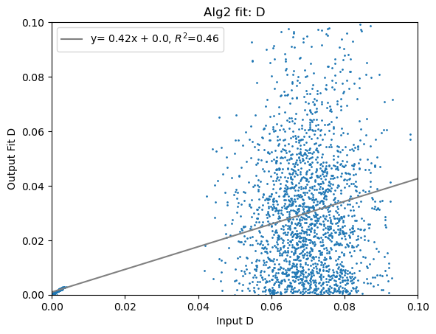
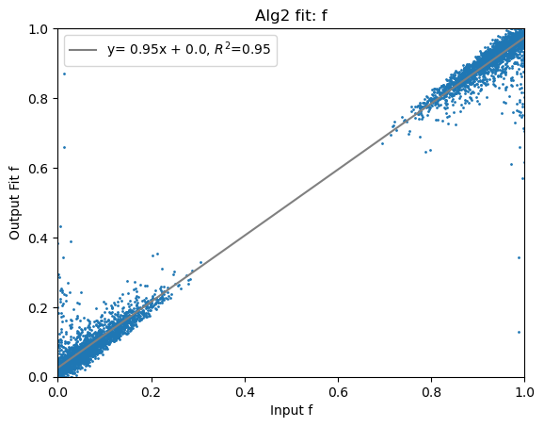
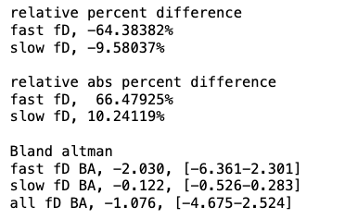
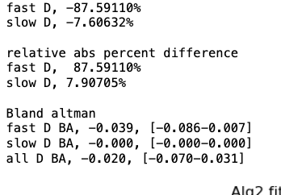
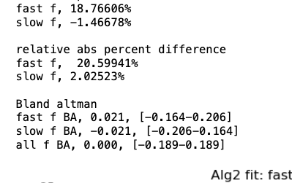
Algorithm 2 with D* threshold at 0.10 (but lost 976 voxels, or 33%! Perhaps because of SNR=30?)

Slide 11
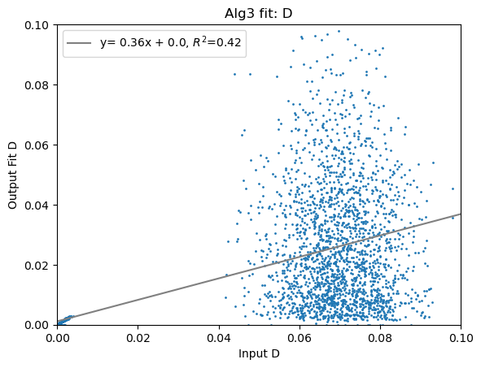
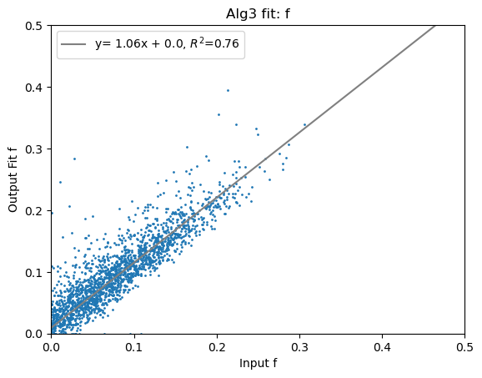
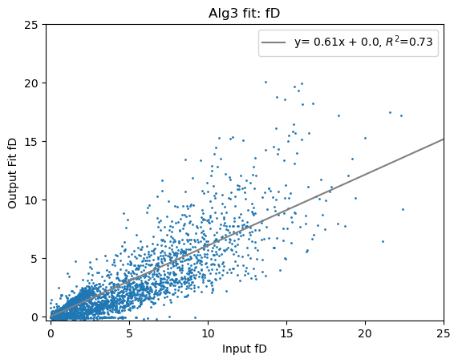

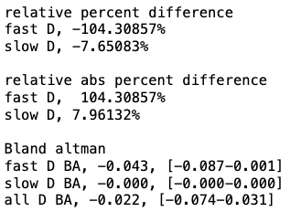
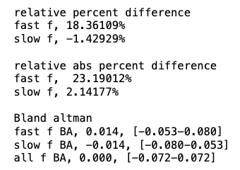
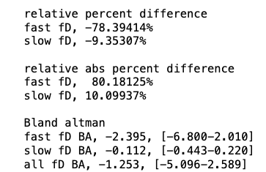
Algorithm 3 with D* threshold at 0.10 (but lost 874 voxels, or 29%! Perhaps because of SNR=30?)

Slide 12


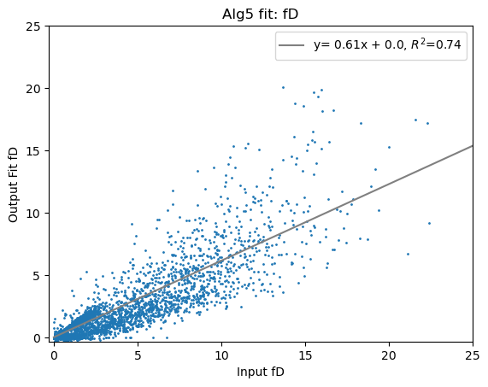
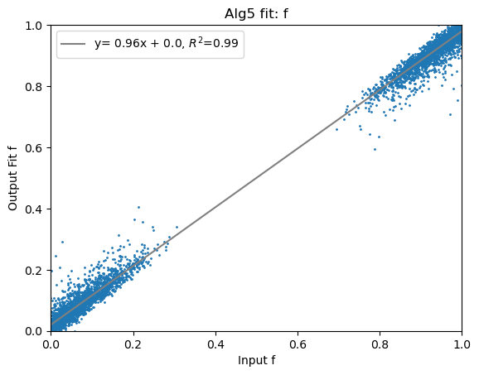
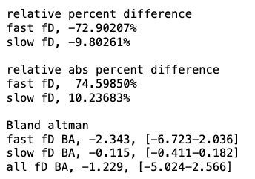
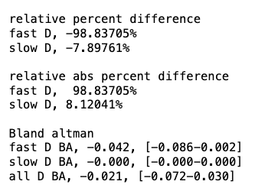
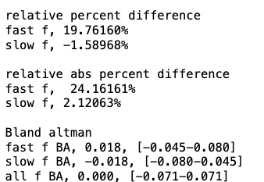
Algorithm 5 with D* threshold at 0.10 (but lost 43 voxels, or 2.15%!)

