Slide 1
Comparison of 3 different 2-step fit algorithms (+1 Bayesian)
2/2/2025
Used to see which (if any) algorithm might be best to run on experimental MRI data.

Slide 2
Conclusions
Would suggest using Algorithm 2 with D*>0.10 excluded if removal of ~4% of voxels is acceptable for the purpose of the work. If all voxels are of interest, or voxels with high D* may contain useful information, Algorithm 1 may be better.
Due to the anomalous diffusion effects included in the simulation, D is overestimated and D* is underestimated by all algorithms.
Correlation of fD is strong for all two-step algorithms (minimal difference in correlation or error)
Algorithm 2 with D* thresholding is highest (slope=0.73, R2=0.87)
Algorithm 1 is the highest without any thresholding (slope = 0.72, R2 = 0.80)
Percent error of fD* is lower for Algorithm 2 (35%) than algorithm 1 (41%)
Correlation of f alone is strongest for Algorithm 1 (slope = 0.89, R2 = 0.56).
Algorithm 2 is similar though (slope=0.89, R2=0.50)
Algorithm 1 has the lowest mean percent error for f
Across all algorithms, correlation of fD is stronger than either f or D itself, likely because of correlative error in fits.
Correlation of fD with Algorithm 4 (Bayesian) returned slope closest to 1 (slope=0.98, R2=0.83)
Algorithm 4 returned the fD bland-altman mean difference closest to zero, but there is error bias.
Algorithm 2 returned some false fits with D* >> 0.10 leading to poor correlation due to these outliers.
A D* range limit in the fit may improve the fits (i.e. not letting D* be higher than a certain value), or voxels with high D* can be excluded from analysis and dismissed as not perfusion (fit error, noise, or CSF in the case of a real experiment
Algorithm 2 is the fastest.

Slide 3
Summary of the algorithms tested
ALGORITHM 1
- Mira original code
- Fits f0 and D0 to b>250.
If poor goodness of fit, fits mono-exponential again using the first fit output f0 and D0 as starting points
- subtracts f0 and D mono-exponential from the total signal, and then fits f and D* to the remainder, at only b<200.
ALGORITHM 2
- Salman - old code
- fits D first, then holds D as a constant to fit to f and D* (in log space) the entire bi-exponential at all bvalues.
ALGORITHM 3
- Salman-Mira hybrid code
- get f0 and D from the high b-values, then fit for f and D* with given f0 and D, at all bvalues.
ALGORITHM 4
- Bayesian fit
- minimum mean square error estimator as the mean of the posterior distribution (see code for distributions)

Slide 4
Methods and Materials: Simulated Signal
Created 2000 voxels with simulated IVIM acquisition of 3 b-value directions and bvalues = [0, 50, 100, 150, 200, 250, 300, 500, 700, 900].
Generated data with f, D, D* from expected distributions (f: 0.09±0.04, D*=0.07±0.009, D = 0.001±0.0075).
Fractional anisotropy was 0.09±0.04 for perfusion and 0.18±0.1 for tissue diffusion.
Anisotropic ellipsoids were created from this data, rotated randomly in 3d space, and measured along the global axes to generated the measured D and D*.
Gamma was chosen for anomalous diffusion with gamma = 1.75±0.2 for ballistic perfusion and gamma = 0.85±0.05 for tissue diffusion.
With the values above, the data points were generated, and Rician noise was added with SNR=100, 50, and 30.
Results presented here are just of SNR=100 to match the measured SNR of the preclinical model data.

Slide 5
Materials and Methods: fits
Fit algorithm mat files were adjusted (not changing the algorithms themselves to the best of my ability) and run in python using matlab.engine
All algorithms were given the simulated data and returned:
D, Dstar, f, Sum-squared-error, rsquared, adjusted rsquared, fD*, and (1-f)D.
The output f, D, D*, fD*, and (1-f)D were compared to the true input by
Linear regression correlation
Median absolute percent difference (median(abs(input-output)/(input+output)/2)
Bland-Altman mean difference±95%CI
No voxels were excluded from output (no R2 thresholds etc)

Slide 6
Note:
Because this simulation is based off of a multi-component simulation, to not have to adjust the code much, the results on the following slides use this nomenclature:
D = ‘slow D’
D* = ‘fast D’
f = ‘fast fraction’
(1-f) = ‘slow fraction’

Slide 7
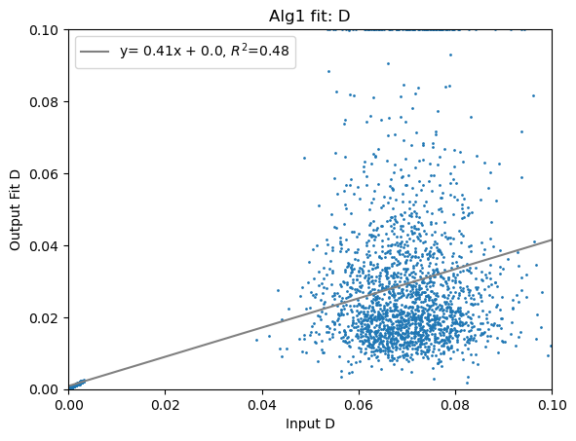
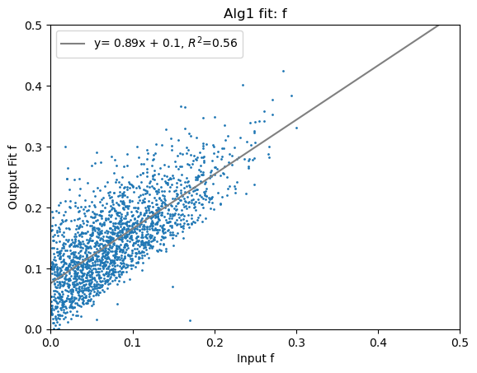
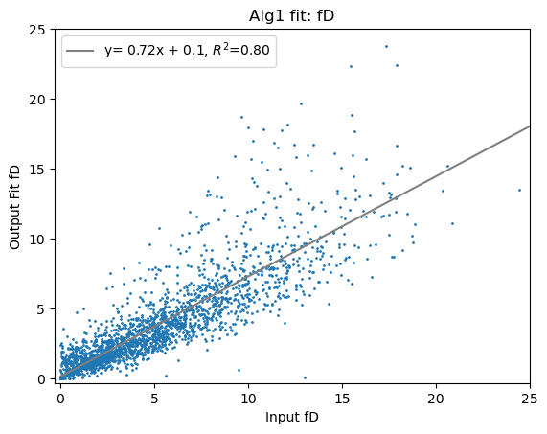
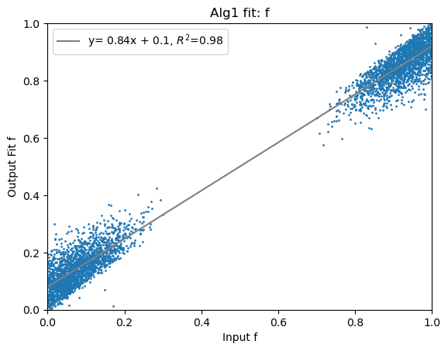
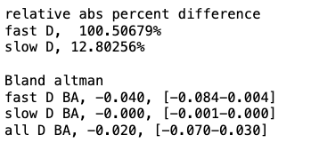
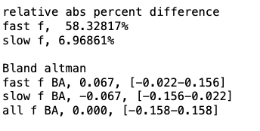
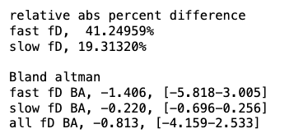
Algorithm 1

Slide 8
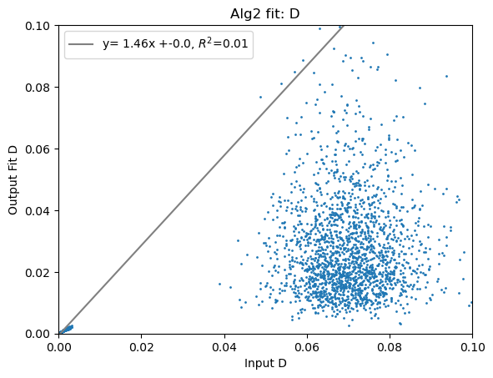
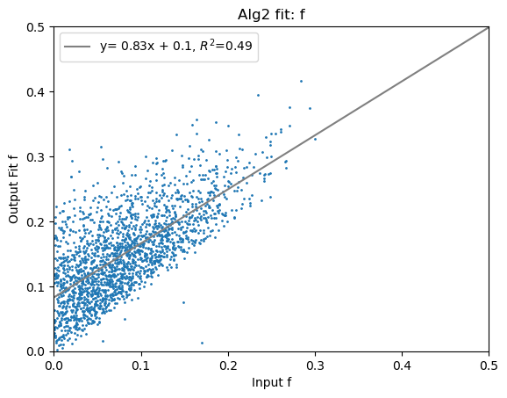
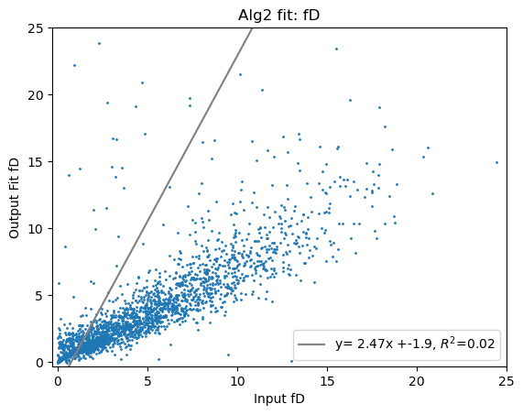
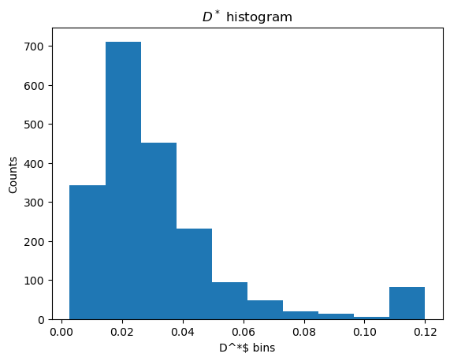
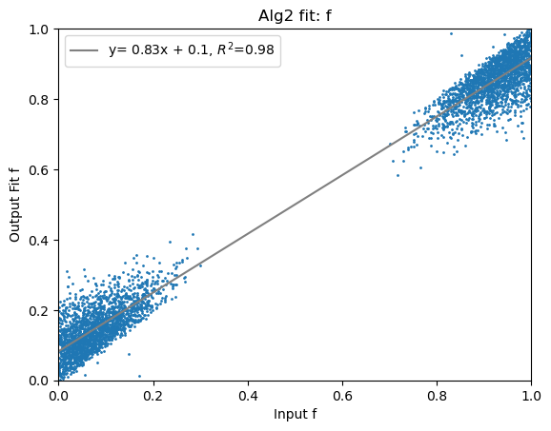
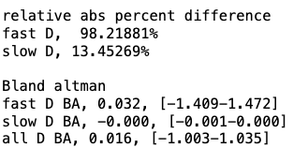
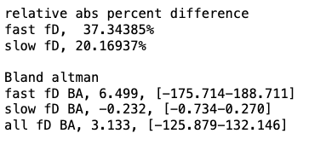
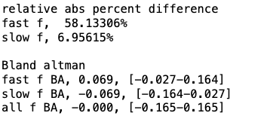
Algorithm 2

Slide 9
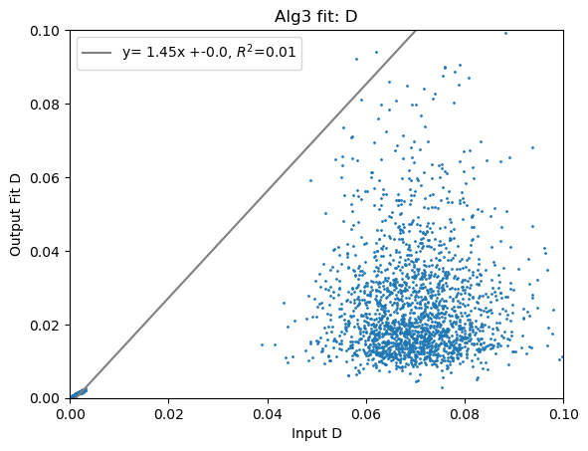
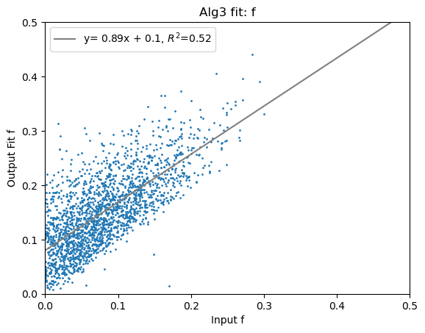
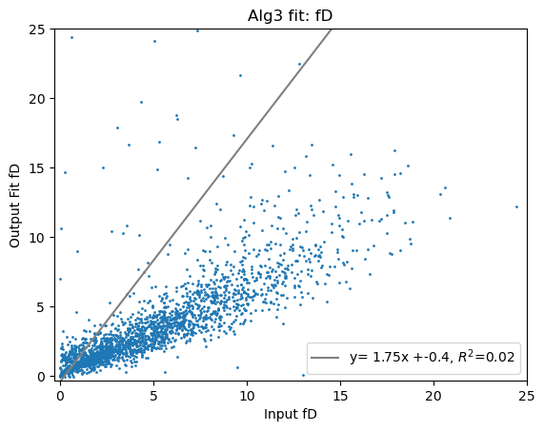
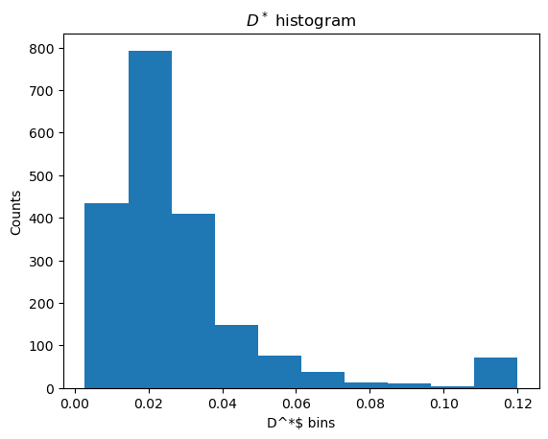

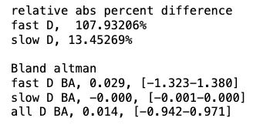
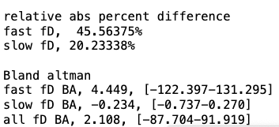
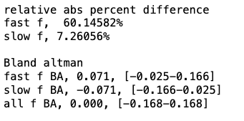
Algorithm 3

Slide 10
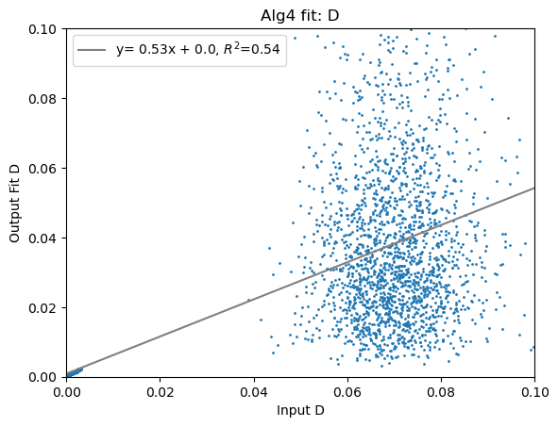
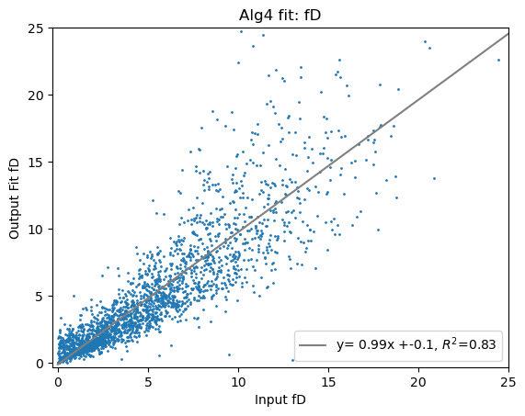
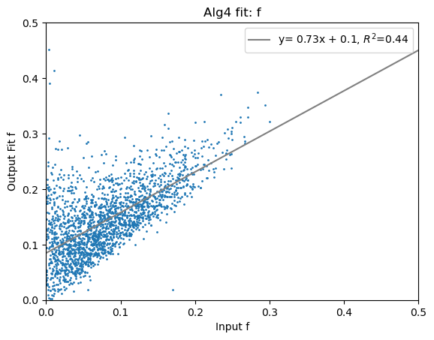
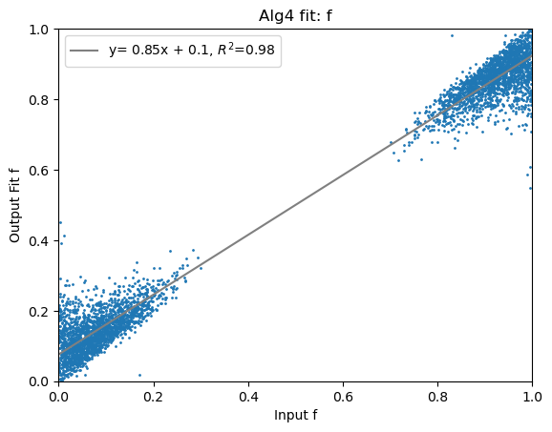
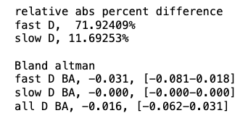
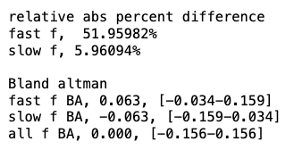
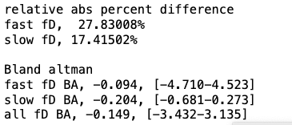
Algorithm 4

Slide 11
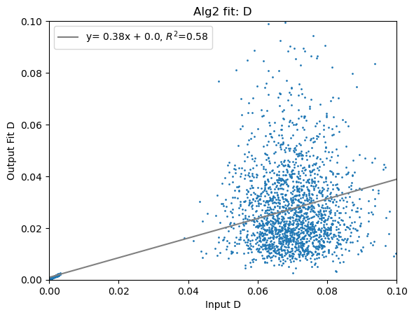
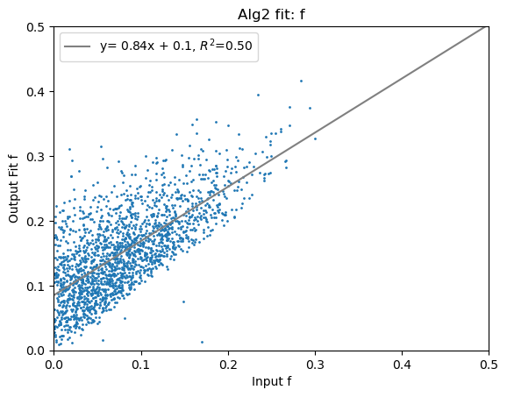
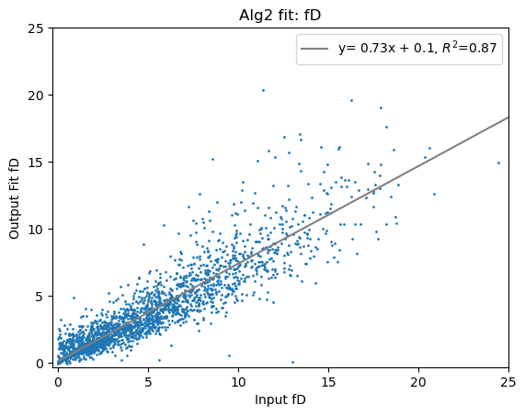

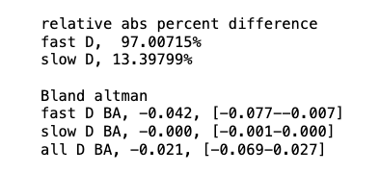
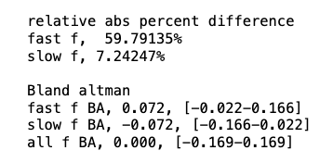
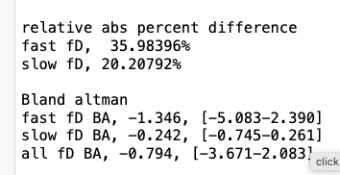
Algorithm 2 (with thresholding by D* <= 0.1)
With 85 (4.3%) voxels removed for having D*>0.10, correlation is strongly improved

Slide 12




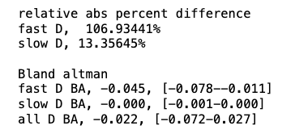
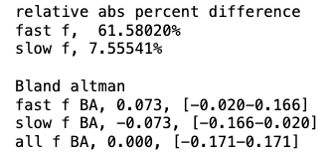
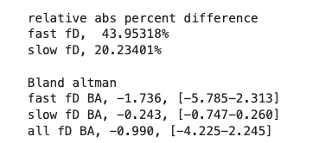
Algorithm 3 (with thresholding by D*<=0.1)
With 75 (3.8%) voxels removed for having D*>0.10, correlation is strongly improved

Slide 13
Further work
Performance of Algorithm 2 with D* ranges
Analysis of SSE, R2 and adj R2 between the different fits.
Surface plots of error based on different ranges of f, D, and D*
Comparison between different noise levels
Comparison between anomalous diffusion signal (as this simulation was) and if we just assume a standard bi-exponential.
The results here could be summarized in a quick paragraph in a larger paper that isn’t simulation-based. I think the algorithms didn’t return different enough results to really be of that much interest on their own… The differences do seem rather minor, at least in the results so far.

